Slide 1
Clock Synchronization between ISTA and RSTA
Date: 2018-07-09

Slide 2
Introduction
In 11az, the ToA/ToD is estimated based on ISTA’s UL NDP and RSTA’s DL NDP
The ISTA and RSTA use its own sampling clock to calculate ToA/ToD
ISTA’s or RSTA’s sampling clock error is translated to the range estimation error through ToA/ToD
It’s necessary to investigate the ISTA’s and RSTA’s sampling clock error’s impact on the range estimation

Slide 3
11ax Carrier Frequency Synchronization
Transmit center frequency and the symbol clock frequency for all transmit antennas and frequency segments shall be derived from the same reference oscillator (11ax spec)
The symbol clock frequency and transmit center frequency maximum tolerance shall be ±20 ppm in 5 GHz and ±25 ppm in 2.4 GHz
A STA that transmits an HE TB PPDU compensates for carrier frequency offset (CFO) error and symbol clock error.
After compensation, the residual CFO error (90%) with respect to the Trigger frame shall not exceed 350 Hz (AWGN, -60dBm)

Slide 4
Intuition for Clock Synchronization
ISTA, RSTA LO drift (10ppm, 10ppm), time drift between t2 and t3 is cancelled with drift between t1 and t4 (reduced RTT error)
ISTA, RSTA LO drift (10ppm,-10ppm), time drift between t2 and t3 is added with drift between t1 and t4 (increased RTT error)
t1 and t4 are measured using the RSTA’s clock (i.e., without applying any frequency offset correction to the time bases).
At ISTA the mechanism for tuning t1 and t4 is implementation dependent

Slide 5
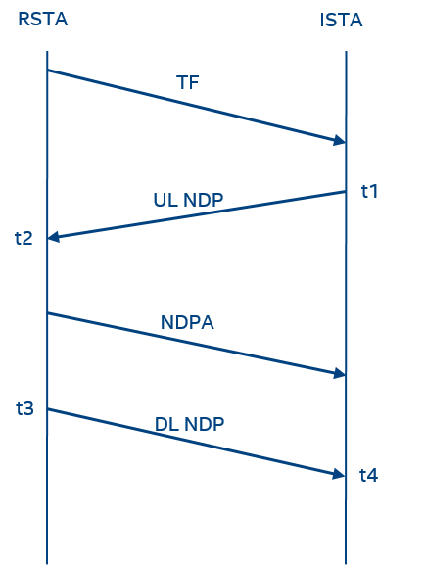
HEz Measurement Sequence
When ISTA transmits UL NDP, the carrier frequency and sampling clock frequency are compensated based on TF
The compensation can be easily done in digital domain (phase rotation, sample shift)
Or the ISTA can directly tune the local oscillator (LO)

Slide 6
Benefit of Clock Synchronization
Assume ISTA’s LO drift is $δi$ and RSTA’s LO drift is $δr$, and the real time stamp is t1’, t2’, t3’, and t4’, and real round trip time is RTT’
The estimated RTT is calculated as:
RTT = (t4 - t1) - (t3 - t2)
= (t4’ - t1’)(1 +$δi$) - (t3’ - t2’) (1 +$δr$)
= (t4’ - t1’) - (t3’ - t2’) + (t4’ - t1’)$δi$ - (t3’ - t2’)$δr$
= (t4’ - t1’) - (t3’ - t2’) + (t4’ - t1’)$(δr+∆$) - (t3’ - t2’)$δr$
= (t4’ - t1’) - (t3’ - t2’) + [(t4’ - t1’) - (t3’ - t2’)]$δr +$ (t4’ - t1’) $∆$
= RTT’(1 + $δr$) + (t4’ - t1’) $∆$
In the above derivation, we assume that $δi=δr+∆$
If ISTA’s clock and RSTA’s clock are synchronized, then $∆$ becomes 0, and the estimated RTT is
RTT = RTT’(1+$δr$)

Slide 7
Methods for Clock Synchronization
ISTA compensates the carrier frequency and sampling clock in digital domain
After receiving RSTA2ISTA LMR, the ISTA can use CFO estimation of TF to compensate t3 - t2
RSTA can estimate residual CFO based on pre-compensated UL NDP
Can’t reflect the absolute CFO between ISTA and RSTA
If RSTA solicits ISTA2RSTA LMR, the LMR can include CFO value
RSTA can combine the residual CFO and the CFO feedback from LMR
Based on the CFO, RSTA can tune t4 - t1
ISTA directly tunes the LO based on CFO
After tuning, the ISTA’s LO is synchronized with RSTA’s LO
The t1 and t4 are calculated using the ISTA’s synchronized LO
No need to include CFO in ISTA2RSTA LMR
Difficult for implementation

Slide 8
Design Consideration for VHTz
VHTz utilizes HE SU NDP for UL/DL channel sounding
Now there is no requirement regarding the carrier frequency and sampling clock frequency synchronization between UL/DL NDP
For implementation simplicity, RSTA doesn’t need to compensate the carrier frequency and sampling clock frequency of DL NDP
The ISTA and RSTA can estimate CFO using preamble of UL/DL NDPs
Whether or not to tune t4 - t1 or t3 - t2 is implementation dependent
Since in general RSTA is not required to record the ISTA’s CFO, the ISTA can include a CFO feedback in ISTA2RSTA LMR.
The ISTA or RSTA may exchange their LO quality information in negotiation
If ISTA or RSTA chooses to tune time stamps, the LO with higher accuracy should be used as reference

Slide 9
Straw Poll #1
In HEz and VHTz ISTA2RSTA LMR, do you support that
The ISTA2RSTA LMR shall include a CFO feedback,
Based on the CFO feedback, RSTA can tune t4, t1
Y: N: Abstain:

Slide 10
Motion #1
We agree that in HEz and VHTz ISTA2RSTA LMR
The ISTA2RSTA LMR shall include a CFO feedback,
Based on the CFO feedback, RSTA can tune t4, t1
Y: N: Abstain:

