Slide 1
802.11 NGV Target Use case frame sizes
Date: 2017-07-10
Authors:

Slide 2
Introduction
The basic V2V collision avoidance application (BSM/CAM/DENM) is supported by 802.11a/p.
802.11 NGV needs to target new applications.

Slide 3
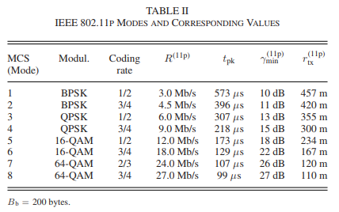
Existing Applications – Collision Avoidance
From: https://ieeexplore.ieee.org/stamp/stamp.jsp?arnumber=8031051
rate vs range vs frame size
Basic Safety Message (or CAM in Europe)
Frame size required = 200 bytes
Distance required = 300 m¹
These work with 802.11a/p today with 6 Mb/s typically used

Slide 4
Target “Next Generation” applications
Large download at close range:
Distance = 50m (or less)
Frame Size = 1500 bytes²
Rates: What rate can NGV provide?
Long Range Control Packet:
Frame Size = 8 to 16 bytes³ (CANbus style frame)
Rates: 250kb/s or 500kb/s³ (CANbus typical rates)
Distance = What range can NGV provide?
Sensor Sharing
Map Download
Remote Control

Slide 5
Wider Variety
NGV should target a wider variety of applications for the next generation of connected and autonomous vehicles.
To do this we need to support a wide variety of rates, ranges and frame sizes to meet the needs of “next generation” use cases.
This provides more benefit by complementing the 802.11a/p technology already deployed.

Slide 6
Next Steps
Does this affect the PAR/CSD?
Probably doesn’t need this much detail.
What should NGV do?
Evaluate performance of new PHY/MAC features for wide variety of frame sizes (not just 200 bytes)
Evaluate performance of new PHY/MAC features over a wide variety of distances (not just 300m)
This will create a better NGV protocol for “next generation” applications

Slide 7
Sources
1) 300 m: NHTSA NPRM
https://www.federalregister.gov/documents/2017/01/12/2016-31059/federal-motor-vehicle-safety-standards-v2v-communications
2) 2000 bytes MAP data size: NYC DSRC Pilot
https://rosap.ntl.bts.gov/view/dot/35363/dot_35363_DS1.pdf
3) 8-16 byte CAN control frame: CAN Specification 2.0
http://esd.cs.ucr.edu/webres/can20.pdf

