Slide 1
July 2018
doc.: IEEE 11-18-1239-00-00bb.
Project: IEEE 802.11bb Task Group
Submission Title: IEEE 802.11bb Reference Channel Models for Gas Pipelines
Date Submitted: July 06, 2018
Source: Murat Uysal (Ozyegin University), Farshad Miramirkhani (Ozyegin University), Tuncer Baykas (Istanbul Medipol University), Khalid Qaraqe (Texas A&M University at Qatar), and Mohamed Abdallah (Hamad Bin Khalifa University).
Address: Ozyegin University, Nisantepe Mh. Orman Sk. No:34-36 Çekmekoy 34794 Istanbul, Turkey
Voice: +90 (216) 5649329, Fax: +90 (216) 5649450, E-Mail: murat.uysal@ozyegin.edu.tr
Abstract: This contribution proposes LiFi reference channel models for gas pipelines.
Purpose: To introduce reference channel models for the evaluation of different PHY proposals.
Notice: This document has been prepared to assist the IEEE 802.11. It is offered as a basis for discussion and is not binding on the contributing individual(s) or organization(s). The material in this document is subject to change in form and content after further study. The contributor(s) reserve(s) the right to add, amend or withdraw material contained herein.
Release: The contributor acknowledges and accepts that this contribution becomes the property of IEEE and may be made publicly available by 802.11.
Submission
M. Uysal, F. Miramirkhani, T. Baykas, et al.

Slide 2
July 2018
doc.: IEEE 11-18-1239-00-00bb.
IEEE 802.11bb
Reference Channel Models for
Gas Pipelines
Submission
M. Uysal, F. Miramirkhani, T. Baykas, et al.

Slide 3
July 2018
doc.: IEEE 11-18-1239-00-00bb.
Outline
  Introduction
  Overview of Channel Modeling Methodology
  Modeling of the Pipeline
  Modeling of Gas Specifications
  Source Modeling
  Gas Pipeline under Consideration
  Channel Impulse Responses (CIRs)
  Effective Channel Responses
  Channel Characteristics
Conclusions
Submission
M. Uysal, F. Miramirkhani, T. Baykas, et al.

Slide 4
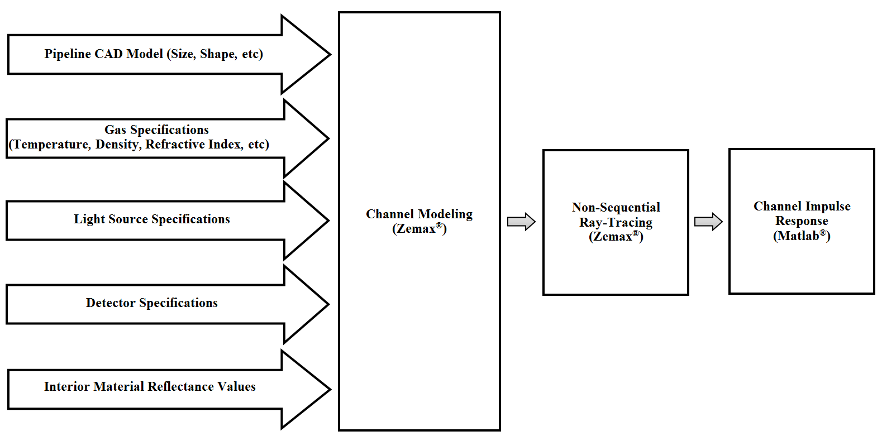
July 2018
doc.: IEEE 11-18-1239-00-00bb.
Overview of Channel Modeling Methodology^{[1]}
[1] F. Miramirkhani, M. Uysal, O. Narmanlioglu, M. Abdallah, and K. Qaraqe, “Visible light channel modeling for gas pipelines”, IEEE Photonics Journal, vol. 10, no. 2, pp. 1-10, 2018.
Submission
M. Uysal, F. Miramirkhani, T. Baykas, et al.

Slide 5
July 2018
doc.: IEEE 11-18-1239-00-00bb.
Modeling of the Pipeline
  Creation of 3D pipeline involves the selection of
    Dimension and shape of the pipeline
    Type and properties of materials
  The interior of pipeline is considered as carbon steel with spectral reflectance values shown in figure below.
Submission
M. Uysal, F. Miramirkhani, T. Baykas, et al.

Slide 6
July 2018
doc.: IEEE 11-18-1239-00-00bb.
Modeling of Gas Specifications
  Natural gas is composed primarily of methane, but may also contain ethane, propane and heavier hydrocarbons. Small quantities of nitrogen, oxygen, carbon dioxide, sulfur compounds, and water may also be found in natural gas.
  Methane is by far the major component over 95% by volume for LNG [2]. Therefore, in our study, we assume the presence of only methane gas in the pipeline. Density, wavelength-dependent refractive index and transmission values of methane gas at 111 K can be found in [3] and [4].
  Through “Table Glass Method” [5] in Zemax®, we also define the density, wavelength-dependent refractive index and transmission value of gas in the pipeline. This allows the characterization of interaction of rays with the medium.
[2] B. G. Liptak, and K. Venczel, Analysis and Analyzers: Vol. II, 5th ed., CRC Press, 2016.
[3] http://refractiveindex.info/?shelf=organic&book=methane&page=Martonchik-liquid-111K.
[4] J. V. Martonchik, and G. S. Orton, “Optical constants of liquid and solid methane,” Applied optics, vol. 33, no. 36, pp. 8306-8317, 1994.
[5] Zemax 13 Release 2, Radiant Zemax LLC. [Online]. Available:
http://www.zemax.com/os/resources/learn/knowledgebase/how-to-enter-glass-data-at-specific-wavelengths.
Submission
M. Uysal, F. Miramirkhani, T. Baykas, et al.

Slide 7
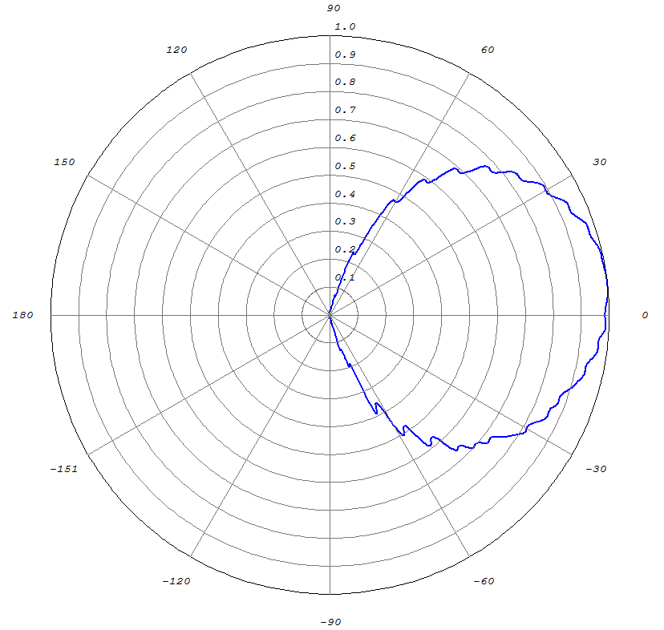
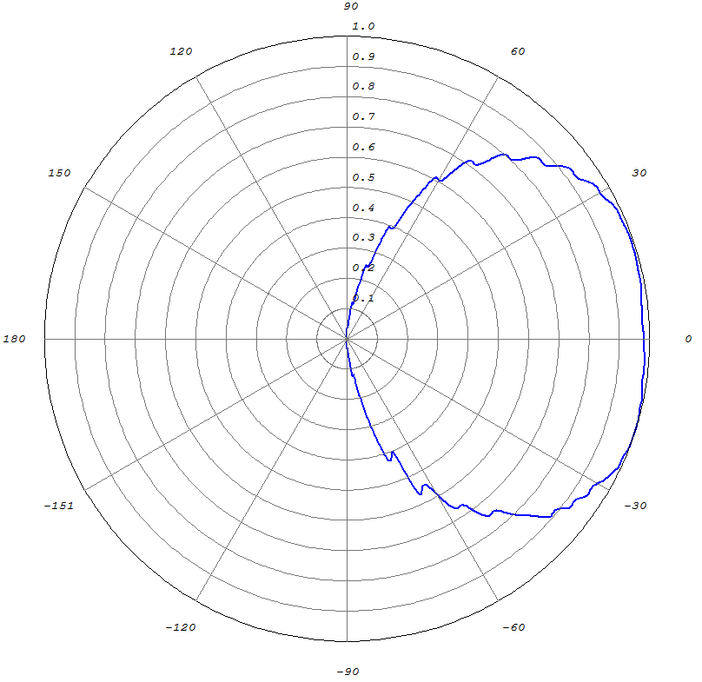
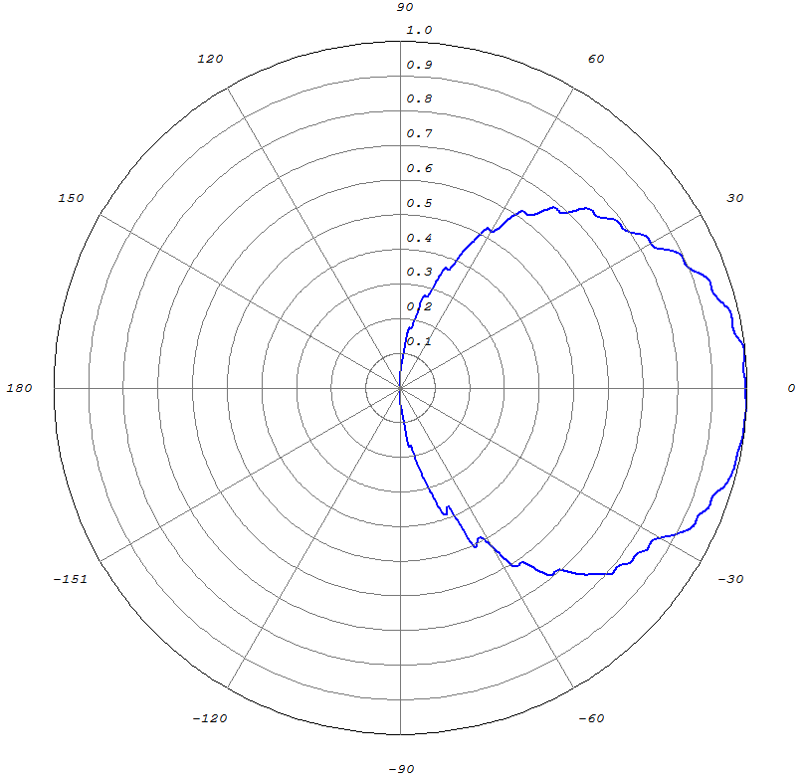
July 2018
doc.: IEEE 11-18-1239-00-00bb.
Source Modeling (1/2)
Emission pattern of
white Cree Xlamp MC-E
Emission pattern of
blue Cree Xlamp XP-C
Emission pattern of
red Cree Xlamp XP-C
Submission
M. Uysal, F. Miramirkhani, T. Baykas, et al.

Slide 8
July 2018
doc.: IEEE 11-18-1239-00-00bb.
Source Modeling (2/2)
Submission
M. Uysal, F. Miramirkhani, T. Baykas, et al.

Slide 9
July 2018
doc.: IEEE 11-18-1239-00-00bb.
Channel Impulse Response (CIR)
  Based on Monte Carlo Ray Tracing.
  Sobol sampling is used for speeding up ray tracing.
  The Zemax® non-sequential ray-tracing tool generates an output file, which includes all the data about rays such as the detected power and path lengths for each ray.
  The data from Zemax® output file is imported to MATLAB® and using these information, the multipath CIR is expressed as
P_{i} = the power of the i^{th} ray
τ_{i} = the propagation time of the i^{th} ray
δ(t) = the Dirac delta function
N_{r} = the number of rays received at the detector
Submission
M. Uysal, F. Miramirkhani, T. Baykas, et al.

Slide 10
July 2018
doc.: IEEE 11-18-1239-00-00bb.
Effect of LED Response
  In addition to the multipath propagation environment, the low-pass characteristics of the LED sources should be further taken into account in channel modelling.
  LED Model 1 [6]
  LED Model 2 [7]
  : 3 dB cut-off frequency of the LED
[6] L. Grobe, and K. D. Langer, “Block-based PAM with frequency domain equalization in visible light communications,” In IEEE Globecom Workshops (GC Wkshps), pp. 1070-1075, 2013.
[7] M. Wolf, S. A. Cheema, M. Haardt, and L. Grobe, “On the performance of block transmission schemes in optical channels with a Gaussian profile,” In 16th International Conference on Transparent Optical Networks (ICTON), pp. 1-8, 2014.
Submission
M. Uysal, F. Miramirkhani, T. Baykas, et al.

Slide 11
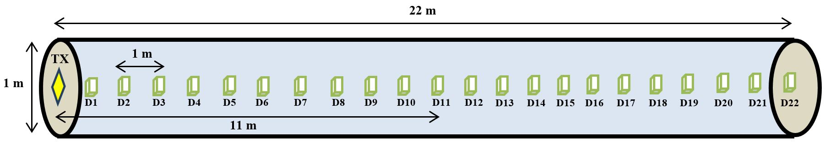
July 2018
doc.: IEEE 11-18-1239-00-00bb.
Simulation Scenario
The pipeline under consideration is used for transport of Liquefied Natural Gas (LNG) and has a cylindrical shape with a length of 22 meters and a diameter of 1 meter (see figure below).
As a wireless transmitter, an LED (i.e., denoted as TX) is located at the head of the pipeline.
Receiver test points with 1 meter apart from each other are assumed within the pipeline.
Submission
M. Uysal, F. Miramirkhani, T. Baykas, et al.

Slide 12
July 2018
doc.: IEEE 11-18-1239-00-00bb.
Simulation Parameters
Pipeline specifications | Length: 22 m Diameter: 1 m Internal material: Carbon steel
Fluid specifications | Methane gas
LED specifications | Cree MC-E Xlamp® White LED Cree XP-C Xlamp® Blue LED Cree XP-C Xlamp® Red LED Half viewing angle: 60º Input power: 1 W
Detector specifications | Area: 1 cm² FOV: 85º
Submission
M. Uysal, F. Miramirkhani, T. Baykas, et al.

Slide 13
July 2018
doc.: IEEE 11-18-1239-00-00bb.
CIR Results (1/3)
Submission
M. Uysal, F. Miramirkhani, T. Baykas, et al.

Slide 14
July 2018
doc.: IEEE 11-18-1239-00-00bb.
CIR Results (2/3)
LED | Configuration
 |  | D1 | D11 | D22
White LED | Empty Pipeline | 4.41×10⁻⁵ | 3.19×10⁻⁷ | 7.77×10⁻⁸
Red LED | Empty Pipeline | 3.78×10⁻⁵ | 2.06×10⁻⁷ | 8.51×10⁻⁸
Blue LED | Empty Pipeline | 3.84×10⁻⁵ | 2.57×10⁻⁷ | 4.97×10⁻⁸
White LED | Pipeline with Methane Gas | 3.99×10⁻⁵ | 1.94×10⁻⁷ | 2.41×10⁻⁸
Red LED | Pipeline with Methane Gas | 9.70×10⁻⁶ | 4.07×10⁻⁹ | 2.08×10⁻¹¹
Blue LED | Pipeline with Methane Gas | 3.80×10⁻⁵ | 2.28×10⁻⁷ | 3.80×10⁻⁸
It is observed that the channel gains obtained with red LED are smaller than those ones obtained with blue and white LEDs. This is as a result of the fact that the minimum transmittance of methane gas is in the red band i.e., 617 nm-631 nm (see p. 8).
It is also revealed that the channel gains obtained with white LED are more or less same as those obtained with the blue LED. Since the illumination purposes are not of concern in telemetry application under consideration, we choose blue LED with larger bandwidth as the transmitter in the rest of this study.
Submission
M. Uysal, F. Miramirkhani, T. Baykas, et al.

Slide 15
July 2018
doc.: IEEE 11-18-1239-00-00bb.
CIR Results (3/3)
Configuration
Blue LED with | 3.80×10⁻⁸
Blue LED with | 5.56×10⁻⁸
Blue LED with | 3.03×10⁻⁷
Blue LED with | 1.26×10⁻⁶
It is observed that as half viewing angle decreases, the number of reflected rays decreases and LOS channel gain increases. Particularly, channel DC gain is equal to 3.80 × 10⁻⁸ for 60º while it increases to 1.26 × 10⁻⁶ for 10º.
Submission
M. Uysal, F. Miramirkhani, T. Baykas, et al.

Slide 16
July 2018
doc.: IEEE 11-18-1239-00-00bb.
Effective Channel Responses
For the effective channel responses, the “LED Model 1” with cut-off frequency of 20 MHz is considered.
Submission
M. Uysal, F. Miramirkhani, T. Baykas, et al.

Slide 17
July 2018
doc.: IEEE 11-18-1239-00-00bb.
Channel Characteristics
Receivers | Blue LED with
 | Pipeline with Methane Gas |  | Empty Pipeline
 | (ns) |  | (ns)
D1 | 7.9535 | 2.90×10⁻³ | 7.9536 | 3.00×10⁻³
D2 | 7.9596 | 7.27×10⁻⁴ | 7.9595 | 7.47×10⁻⁴
D3 | 7.9671 | 3.27×10⁻⁴ | 7.9675 | 3.41×10⁻⁴
D4 | 7.9635 | 1.84×10⁻⁴ | 7.9646 | 1.93×10⁻⁴
D5 | 7.9650 | 1.13×10⁻⁴ | 7.9656 | 1.21×10⁻⁴
D6 | 7.9658 | 7.88×10⁻⁵ | 7.9670 | 8.52×10⁻⁵
D7 | 7.9613 | 5.70×10⁻⁵ | 7.9614 | 6.23×10⁻⁵
D8 | 7.9631 | 4.13×10⁻⁵ | 7.9623 | 4.62×10⁻⁵
D9 | 7.9630 | 3.36×10⁻⁵ | 7.9628 | 3.78×10⁻⁵
D10 | 7.9617 | 2.56×10⁻⁵ | 7.9593 | 2.91×10⁻⁵
D11 | 7.9617 | 2.14×10⁻⁵ | 7.9603 | 2.45×10⁻⁵
D12 | 7.9673 | 1.81×10⁻⁵ | 7.9614 | 2.08×10⁻⁵
D13 | 7.9593 | 1.41×10⁻⁵ | 7.9574 | 1.65×10⁻⁵
D14 | 7.9587 | 1.20×10⁻⁵ | 7.9586 | 1.41×10⁻⁵
D15 | 7.9604 | 1.00×10⁻⁵ | 7.9622 | 1.21×10⁻⁵
D16 | 7.9559 | 9.26×10⁻⁶ | 7.9575 | 1.12×10⁻⁵
D17 | 7.9586 | 7.93×10⁻⁶ | 7.9634 | 9.69×10⁻⁶
D18 | 7.9644 | 7.13×10⁻⁶ | 7.9643 | 8.91×10⁻⁶
D19 | 7.9581 | 6.28×10⁻⁶ | 7.9590 | 8.03×10⁻⁶
D20 | 7.9619 | 5.65×10⁻⁶ | 7.9718 | 7.29×10⁻⁶
D21 | 7.9703 | 4.93×10⁻⁶ | 7.9691 | 6.44×10⁻⁶
D22 | 7.9719 | 5.04×10⁻⁶ | 7.9715 | 6.59×10⁻⁶
Submission
M. Uysal, F. Miramirkhani, T. Baykas, et al.

Slide 18
July 2018
doc.: IEEE 11-18-1239-00-00bb.
Conclusions
  This contribution proposes LiFi reference channel models for gas pipelines to assist the IEEE 802.11bb.
Submission
M. Uysal, F. Miramirkhani, T. Baykas, et al.

Slide 19
July 2018
doc.: IEEE 11-18-1239-00-00bb.
Acknowledgement
This publication was made possible by the NPRP award [NPRP 8-648-2-273] from the Qatar National Research Fund (a member of the Qatar Foundation). The statements made herein are solely the responsibility of the authors.
Submission
M. Uysal, F. Miramirkhani, T. Baykas, et al.

