Slide 1
July 2018
doc.: IEEE 11-18-1237-00-00bb.
Project: IEEE 802.11bb Task Group
Submission Title: IEEE 802.11bb Reference Channel Models for Vehicular Communications
Date Submitted: July 06, 2018
Source: Murat Uysal (Ozyegin University), Farshad Miramirkhani (Ozyegin University), Tuncer Baykas (Istanbul Medipol University), Emrah Kinav (Ford Otosan), and Omer Rustu Ergen (Ford Otosan).
Address: Ozyegin University, Nisantepe Mh. Orman Sk. No:34-36 Çekmekoy 34794 Istanbul, Turkey
Voice: +90 (216) 5649329, Fax: +90 (216) 5649450, E-Mail: murat.uysal@ozyegin.edu.tr
Abstract: This contribution proposes LiFi reference channel models for vehicular communications.
Purpose: To introduce reference channel models for the evaluation of different PHY proposals.
Notice: This document has been prepared to assist the IEEE 802.11. It is offered as a basis for discussion and is not binding on the contributing individual(s) or organization(s). The material in this document is subject to change in form and content after further study. The contributor(s) reserve(s) the right to add, amend or withdraw material contained herein.
Release: The contributor acknowledges and accepts that this contribution becomes the property of IEEE and may be made publicly available by 802.11.
Submission
M. Uysal, F. Miramirkhani, T. Baykas, et al.

Slide 2
July 2018
doc.: IEEE 11-18-1237-00-00bb.
IEEE 802.11bb
Reference Channel Models for Vehicular Communications
Submission
M. Uysal, F. Miramirkhani, T. Baykas, et al.

Slide 3
July 2018
doc.: IEEE 11-18-1237-00-00bb.
Outline
  Introduction
  Overview of Channel Modeling Methodology
  Modeling of the Outdoor Environment
  Headlamp Modeling
  Modeling of Weather Conditions (Clear Weather, Rainy Weather and Foggy Weather)
  Vehicular Scenario under Consideration
  Channel Impulse Responses (CIRs)
  Effective Channel Responses
  Channel Characteristics
Conclusions
Submission
M. Uysal, F. Miramirkhani, T. Baykas, et al.

Slide 4
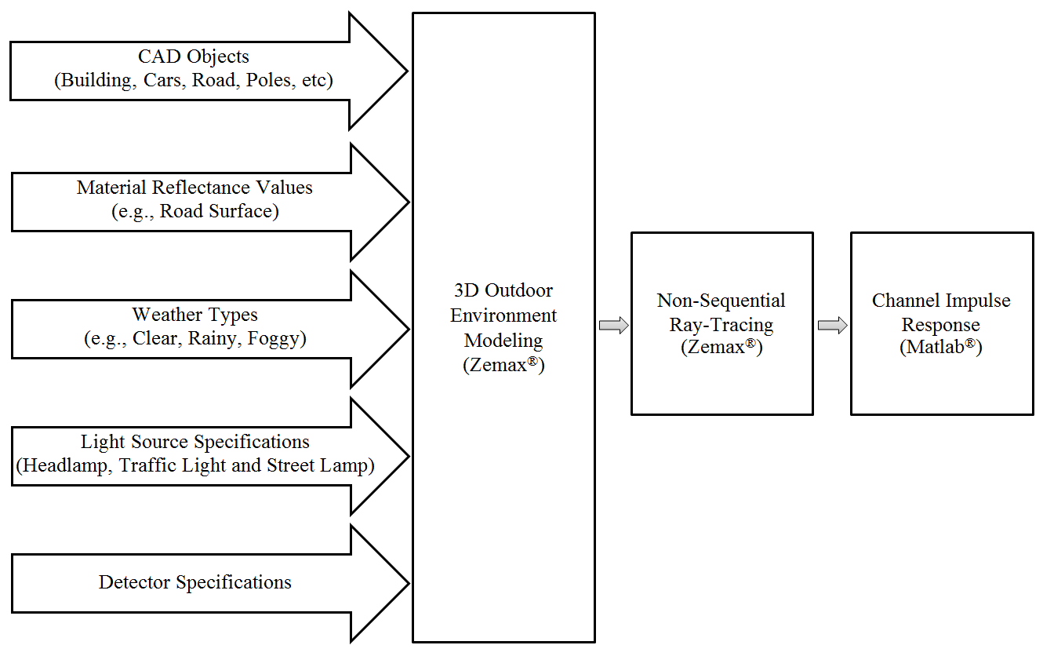
July 2018
doc.: IEEE 11-18-1237-00-00bb.
Overview of Channel Modeling Methodology^{[1]}
[1] M. Elamassie, M. Karbalayghareh, F. Miramirkhani, R. C. Kizilirmak, and M. Uysal, “Effect of fog and rain on the performance of vehicular visible light communications,” IEEE 87th Vehicular Technology Conference (VTC2018-Spring), Porto, Portugal, Jun. 2018.
Submission
M. Uysal, F. Miramirkhani, T. Baykas, et al.

Slide 5
July 2018
doc.: IEEE 11-18-1237-00-00bb.
Modeling of the Outdoor Environment
  Creation of 3D outdoor environment in Zemax® involves the selection of
    Dimension and shape of the outdoor environment
    CAD objects within the environment (buildings, cars, roads etc)
    Position and type of transmitters and receivers
    Type and properties of materials
Class | Road Surface Composition | Mode of Reflectance
R1 | Asphalt with aggregate including a minimum of 15% artificial brightener aggregate | Mostly diffuse
R2 | Asphalt with aggregate including a minimum of 60% gravel sized larger than 10 mm Asphalt with aggregate including a minimum of 10-15% artificial brightener aggregate | Mixed diffuse and specular
R3 | Asphalt with dark aggregate-the surface becomes rough after several months of use | Slightly specular
R4 | Very smooth asphalt | Mostly specular
Submission
M. Uysal, F. Miramirkhani, T. Baykas, et al.

Slide 6
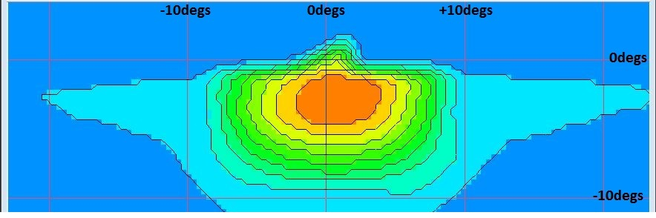
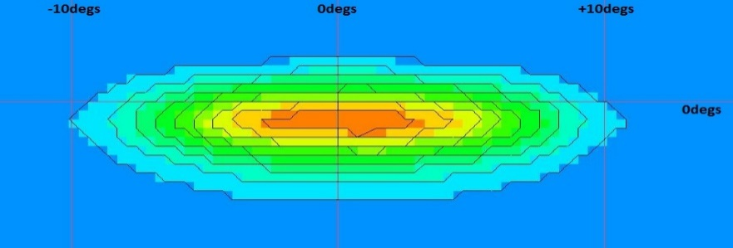
July 2018
doc.: IEEE 11-18-1237-00-00bb.
Headlamp Modeling
Spatial distribution of low-beam headlamp
Spatial distribution of high-beam headlamp
Relative intensity distributions of
low-beam headlamp
Relative spectral power distribution of
Philips LUXEON Rebel
Relative intensity distributions of
high-beam headlamp
Submission
M. Uysal, F. Miramirkhani, T. Baykas, et al.

Slide 7
July 2018
doc.: IEEE 11-18-1237-00-00bb.
Modeling of Weather Conditions
  To model the interaction of rays with the air, Mie scattering is used to model rainy and foggy weather conditions with different visibilities.
  “Bulk scatter” method in the Zemax software allows providing the input parameters
    “Particle index” (the refractive index of particles)
    “Size” (the radius of the spherical particles)
    “Density” (the density of particles). The characteristics of various weather types are listed in Table below.
 | Particle Index | Size (μm) | Density (cm⁻³)
Clear | 1.000277 | 10⁻⁴ | 10¹⁹
Rain | 1.33 | 100 | 0.1
Fog, | 1.33 | 10 | 124.6
Fog, | 1.33 | 10 | 622.6
Submission
M. Uysal, F. Miramirkhani, T. Baykas, et al.

Slide 8
July 2018
doc.: IEEE 11-18-1237-00-00bb.
Channel Impulse Response (CIR)
  Based on Monte Carlo Ray Tracing.
  Sobol sampling is used for speeding up ray tracing.
  The Zemax® non-sequential ray-tracing tool generates an output file, which includes all the data about rays such as the detected power and path lengths for each ray.
  The data from Zemax® output file is imported to MATLAB® and using these information, the multipath CIR is expressed as
P_{i} = the power of the i^{th} ray
τ_{i} = the propagation time of the i^{th} ray
δ(t) = the Dirac delta function
N_{r} = the number of rays received at the detector
Submission
M. Uysal, F. Miramirkhani, T. Baykas, et al.

Slide 9
July 2018
doc.: IEEE 11-18-1237-00-00bb.
Effect of LED Response
  In addition to the multipath propagation environment, the low-pass characteristics of the LED sources should be further taken into account in channel modelling.
  LED Model 1 [2]
  LED Model 2 [3]
  : 3 dB cut-off frequency of the LED
[2] L. Grobe, and K. D. Langer, “Block-based PAM with frequency domain equalization in visible light communications,” In IEEE Globecom Workshops (GC Wkshps), pp. 1070-1075, 2013.
[3] M. Wolf, S. A. Cheema, M. Haardt, and L. Grobe, “On the performance of block transmission schemes in optical channels with a Gaussian profile,” In 16th International Conference on Transparent Optical Networks (ICTON), pp. 1-8, 2014.
Submission
M. Uysal, F. Miramirkhani, T. Baykas, et al.

Slide 10
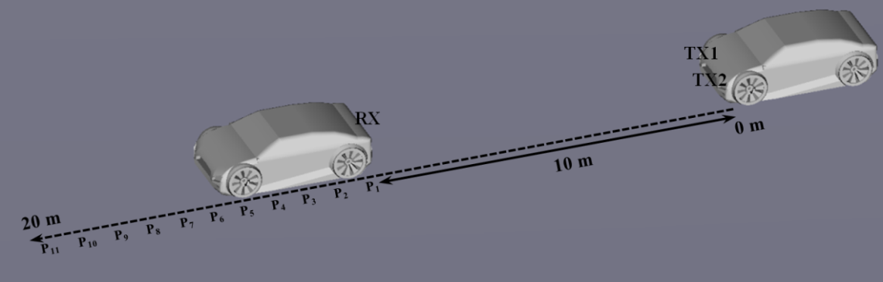
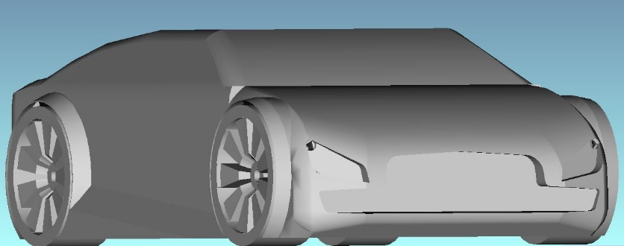
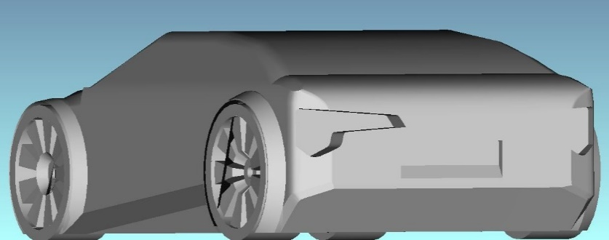
July 2018
doc.: IEEE 11-18-1237-00-00bb.
Simulation Scenario
We assume that the two vehicles are separated from each other initially at a distance of 10 meter.
PD
TX1
TX2
Submission
M. Uysal, F. Miramirkhani, T. Baykas, et al.

Slide 11
July 2018
doc.: IEEE 11-18-1237-00-00bb.
Simulation Parameters
Transmitter specifications | Type: High-beam headlamp Brand: Philips Luxeon Rebel white LED Power: 1 Watt per each headlamp
Receiver specifications | Area: 1 cm² FOV: 180º
Coating material of vehicle | Black gloss paint
Road type | R2
Weather types | Clear Rainy Foggy with visibilities of 50 m and 10 m
Submission
M. Uysal, F. Miramirkhani, T. Baykas, et al.

Slide 12
July 2018
doc.: IEEE 11-18-1237-00-00bb.
CIR Results (Clear Weather)
Submission
M. Uysal, F. Miramirkhani, T. Baykas, et al.

Slide 13
July 2018
doc.: IEEE 11-18-1237-00-00bb.
Effective Channel Responses (Clear Weather)
For the effective channel responses, the “LED Model 1” with cut-off frequency of 20 MHz is considered.
Submission
M. Uysal, F. Miramirkhani, T. Baykas, et al.

Slide 14
July 2018
doc.: IEEE 11-18-1237-00-00bb.
CIR Results (Rainy Weather)
Submission
M. Uysal, F. Miramirkhani, T. Baykas, et al.

Slide 15
July 2018
doc.: IEEE 11-18-1237-00-00bb.
Effective Channel Responses (Rainy Weather)
Submission
M. Uysal, F. Miramirkhani, T. Baykas, et al.

Slide 16
July 2018
doc.: IEEE 11-18-1237-00-00bb.
CIR Results (Foggy Weather, V=50 m)
Submission
M. Uysal, F. Miramirkhani, T. Baykas, et al.

Slide 17
July 2018
doc.: IEEE 11-18-1237-00-00bb.
Effective Channel Responses
(Foggy Weather, V=50 m)
Submission
M. Uysal, F. Miramirkhani, T. Baykas, et al.

Slide 18
July 2018
doc.: IEEE 11-18-1237-00-00bb.
CIR Results (Foggy Weather, V=10 m)
Submission
M. Uysal, F. Miramirkhani, T. Baykas, et al.

Slide 19
July 2018
doc.: IEEE 11-18-1237-00-00bb.
Effective Channel Responses
(Foggy Weather, V=10 m)
Submission
M. Uysal, F. Miramirkhani, T. Baykas, et al.

Slide 20
July 2018
doc.: IEEE 11-18-1237-00-00bb.
Channel Characteristics (1/2)
(m) | (ns)
 | Clear | Rain | Fog (V=50 m) | Fog (V=10 m) | Clear | Rain | Fog (V=50 m) | Fog (V=10 m)
10 | 7.95 | 7.95 | 7.95 | 7.97 | 1.14×10⁻⁴ | 1.08×10⁻⁴ | 8.66×10⁻⁵ | 1.95×10⁻⁵
11 | 7.95 | 7.95 | 7.95 | 7.99 | 1.06×10⁻⁴ | 1.03×10⁻⁴ | 7.44×10⁻⁵ | 1.73×10⁻⁵
12 | 7.95 | 7.95 | 7.95 | 7.95 | 9.92×10⁻⁵ | 9.56×10⁻⁵ | 6.76×10⁻⁵ | 1.55×10⁻⁵
13 | 7.95 | 7.95 | 7.95 | 7.97 | 9.01×10⁻⁵ | 8.38×10⁻⁵ | 6.08×10⁻⁵ | 1.09×10⁻⁵
14 | 7.95 | 7.95 | 7.95 | 8.56 | 8.01×10⁻⁵ | 7.68×10⁻⁵ | 4.93×10⁻⁵ | 7.91×10⁻⁶
15 | 7.95 | 7.95 | 7.95 | 7.97 | 6.92×10⁻⁵ | 6.45×10⁻⁵ | 4.03×10⁻⁵ | 4.73×10⁻⁶
16 | 7.95 | 7.95 | 7.95 | 8.02 | 6.20×10⁻⁵ | 5.89×10⁻⁵ | 3.91×10⁻⁵ | 5.08×10⁻⁶
17 | 7.95 | 7.95 | 7.95 | 8.14 | 5.66×10⁻⁵ | 5.50×10⁻⁵ | 2.91×10⁻⁵ | 4.06×10⁻⁶
18 | 7.95 | 7.95 | 7.95 | 7.99 | 5.21×10⁻⁵ | 4.82×10⁻⁵ | 3.09×10⁻⁵ | 1.64×10⁻⁶
19 | 7.95 | 7.95 | 7.95 | 8.16 | 4.71×10⁻⁵ | 4.39×10⁻⁵ | 2.37×10⁻⁵ | 1.85×10⁻⁶
20 | 7.95 | 7.95 | 7.97 | 7.96 | 4.43×10⁻⁵ | 4.05×10⁻⁵ | 2.13×10⁻⁵ | 1.64×10⁻⁶
Submission
M. Uysal, F. Miramirkhani, T. Baykas, et al.

Slide 21
July 2018
doc.: IEEE 11-18-1237-00-00bb.
Channel Characteristics (2/2)
Submission
M. Uysal, F. Miramirkhani, T. Baykas, et al.

Slide 22
July 2018
doc.: IEEE 11-18-1237-00-00bb.
Conclusions
  This contribution proposes LiFi reference channel models for vehicular communications to assist the IEEE 802.11bb.
Submission
M. Uysal, F. Miramirkhani, T. Baykas, et al.

