Slide 1
July 2018
doc.: IEEE 11-18-1236-00-00bb
Project: IEEE 802.11bb Task Group
Submission Title: IEEE 802.11bb Reference Channel Models for Indoor Environments
Date Submitted: July 06, 2018
Source: Murat Uysal (Ozyegin University), Farshad Miramirkhani (Ozyegin University), Tuncer Baykas (Istanbul Medipol University), Nikola Serafimovski (pureLiFi Ltd.), and Volker Jungnickel (Fraunhofer HHI).
Address: Ozyegin University, Nisantepe Mh. Orman Sk. No:34-36 Çekmekoy 34794 Istanbul, Turkey
Voice: +90 (216) 5649329, Fax: +90 (216) 5649450, E-Mail: murat.uysal@ozyegin.edu.tr
Abstract: This contribution proposes LiFi reference channel models for indoor environments such as office, home and manufacturing cell.
Purpose: To introduce reference channel models for the evaluation of different PHY proposals.
Notice: This document has been prepared to assist the IEEE 802.11. It is offered as a basis for discussion and is not binding on the contributing individual(s) or organization(s). The material in this document is subject to change in form and content after further study. The contributor(s) reserve(s) the right to add, amend or withdraw material contained herein.
Release: The contributor acknowledges and accepts that this contribution becomes the property of IEEE and may be made publicly available by 802.11.
Submission
M. Uysal, F. Miramirkhani, T. Baykas, et al.

Slide 2
July 2018
doc.: IEEE 11-18-1236-00-00bb
IEEE 802.11bb
Reference Channel Models for Indoor Environments
Submission
M. Uysal, F. Miramirkhani, T. Baykas, et al.

Slide 3
July 2018
doc.: IEEE 11-18-1236-00-00bb
Outline
  Introduction
  Overview of Channel Modeling Methodology
  Indoor Scenarios under Consideration: Empty Room, Office, Home, Manufacturing Cell
  Modeling of the Indoor Environment
  Source Modeling
  Illumination Level Requirements
  Channel Impulse Responses (CIRs)
  Effective Channel Responses
  Channel Characteristics
Conclusions
Submission
M. Uysal, F. Miramirkhani, T. Baykas, et al.

Slide 4
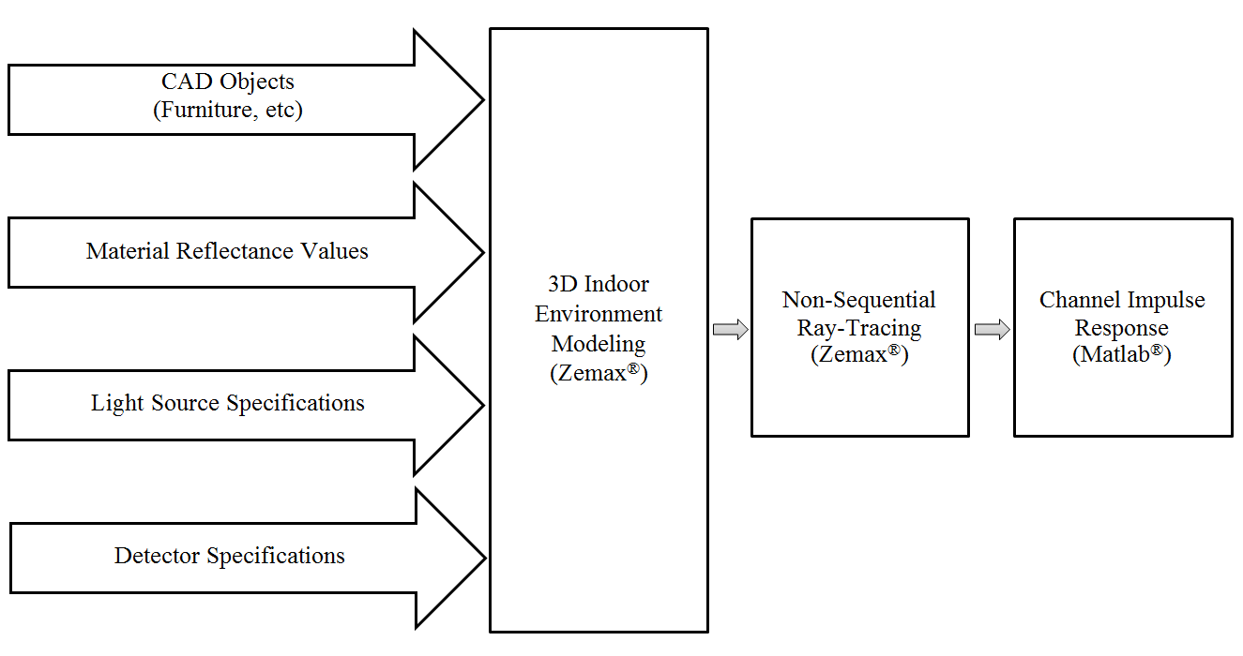
July 2018
doc.: IEEE 11-18-1236-00-00bb
Overview of Channel Modeling Methodology
  A flexible and efficient method for realistic VLC channel modeling
    Wavelength dependency
    Realistic light sources
    Effect of objects within the environment and types of surface (coating) materials
For additional details see
IEEE 15-15-0352-01-007a, “Channel Modeling for Visible Light Communications”
IEEE 15-15-0746-01-007a, “TG7r1 channel model document for high-rate PD communications”
Submission
M. Uysal, F. Miramirkhani, T. Baykas, et al.

Slide 5
July 2018
doc.: IEEE 11-18-1236-00-00bb
Channel Impulse Response (CIR)
  Based on Monte Carlo Ray Tracing.
  Sobol sampling is used for speeding up ray tracing.
  The Zemax® non-sequential ray-tracing tool generates an output file, which includes all the data about rays such as the detected power and path lengths for each ray.
  The data from Zemax® output file is imported to MATLAB® and using these information, the multipath CIR is expressed as
P_{i} = the power of the i^{th} ray
τ_{i} = the propagation time of the i^{th} ray
δ(t) = the Dirac delta function
N_{r} = the number of rays received at the detector
Submission
M. Uysal, F. Miramirkhani, T. Baykas, et al.

Slide 6
July 2018
doc.: IEEE 11-18-1236-00-00bb
Effect of LED Response
  In addition to the multipath propagation environment, the low-pass characteristics of the LED sources should be further taken into account in channel modelling.
  LED Model 1 [1]
  LED Model 2 [2]
  : 3 dB cut-off frequency of the LED
[1] L. Grobe, and K. D. Langer, “Block-based PAM with frequency domain equalization in visible light communications,” In IEEE Globecom Workshops (GC Wkshps), pp. 1070-1075, 2013.
[2] M. Wolf, S. A. Cheema, M. Haardt, and L. Grobe, “On the performance of block transmission schemes in optical channels with a Gaussian profile,” In 16th International Conference on Transparent Optical Networks (ICTON), pp. 1-8, 2014.
Submission
M. Uysal, F. Miramirkhani, T. Baykas, et al.

Slide 7
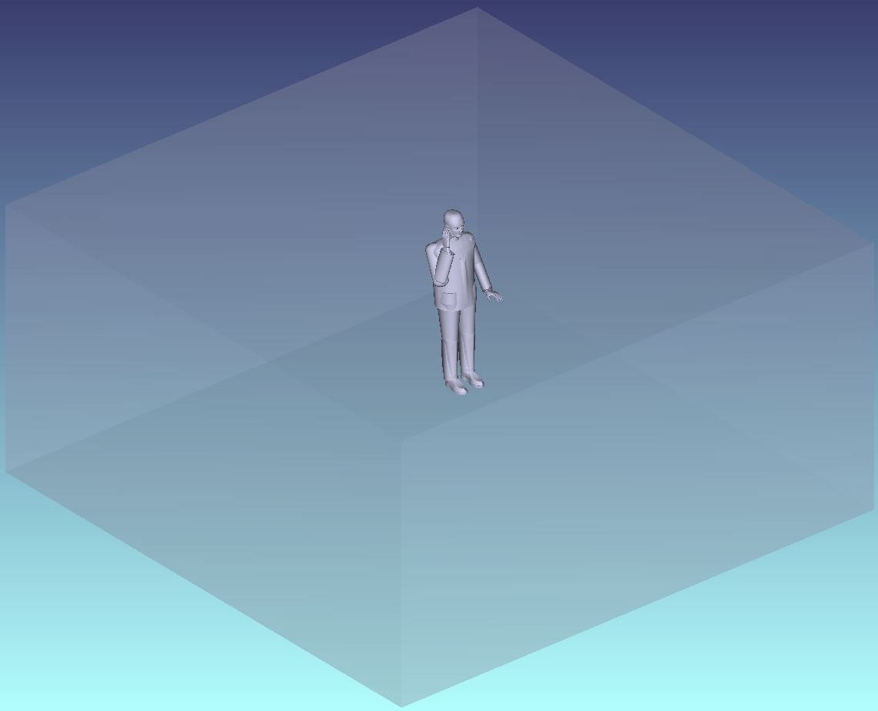
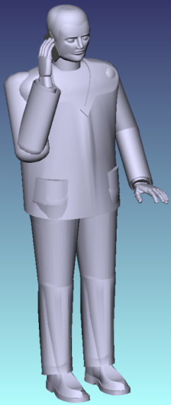
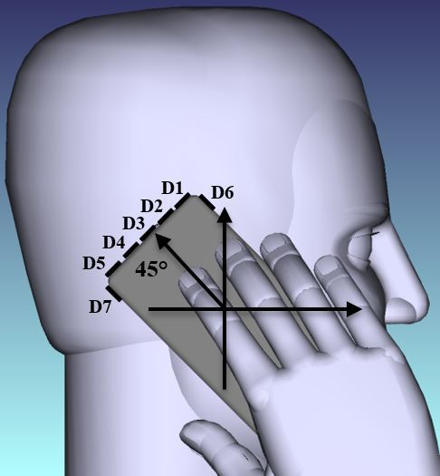
July 2018
doc.: IEEE 11-18-1236-00-00bb
Simulation Scenario 0: Empty Room
We consider an empty room with a size of 6 m × 6 m × 3 m with plaster ceiling/walls and pinewood floor.
Submission
M. Uysal, F. Miramirkhani, T. Baykas, et al.

Slide 8
July 2018
doc.: IEEE 11-18-1236-00-00bb
Simulation Parameters
Room size | 6 m × 6 m × 3 m
Materials | Walls: Plaster, Ceiling: Plaster, Floor: Pinewood
Objects specifications | Cell phone: Black gloss paint (5.5 cm × 10.5 cm × 0.5 cm) Human body: Shoes: Black gloss paint Head & Hands: Absorbing Clothes: Cotton
Luminary Specifications | Brand: CR6-800L Cree Inc. Half viewing angle: 40º
Number of luminaries | 9
Number of PDs | 7
Receiver area | 1 cm²
Submission
M. Uysal, F. Miramirkhani, T. Baykas, et al.

Slide 9

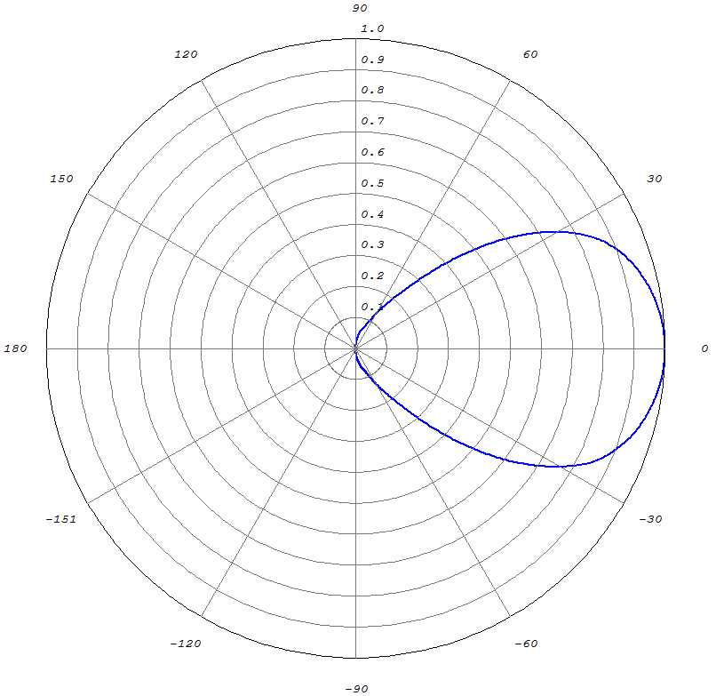
July 2018
doc.: IEEE 11-18-1236-00-00bb
Light Source
In simulation study, we use the LED luminary “CR6-800L” from Cree.
Simulated emission pattern in Zemax®
Submission
M. Uysal, F. Miramirkhani, T. Baykas, et al.

Slide 10
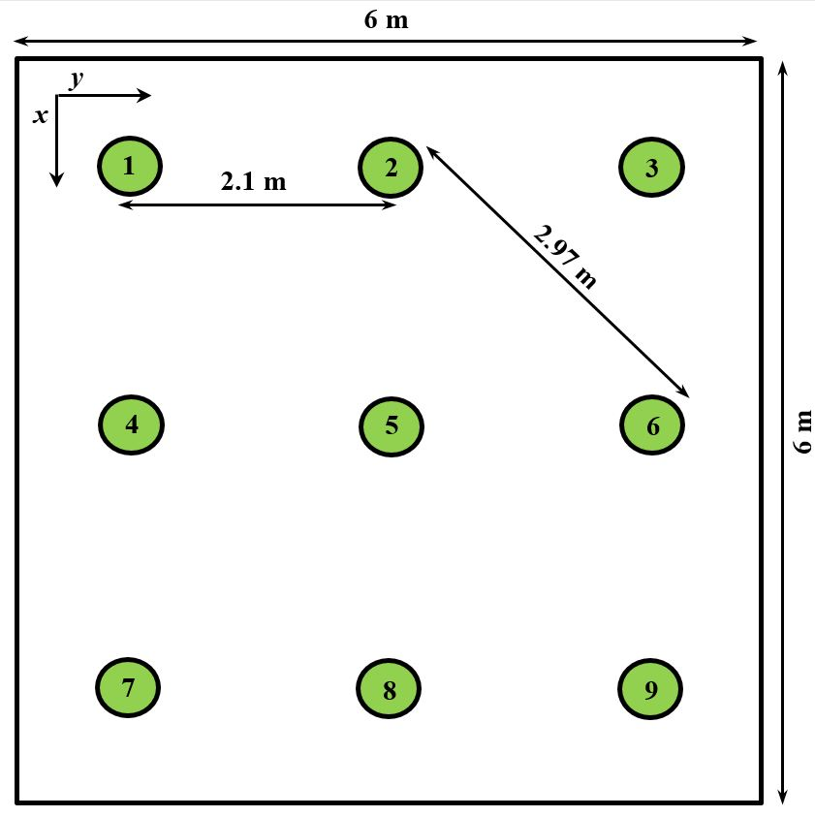
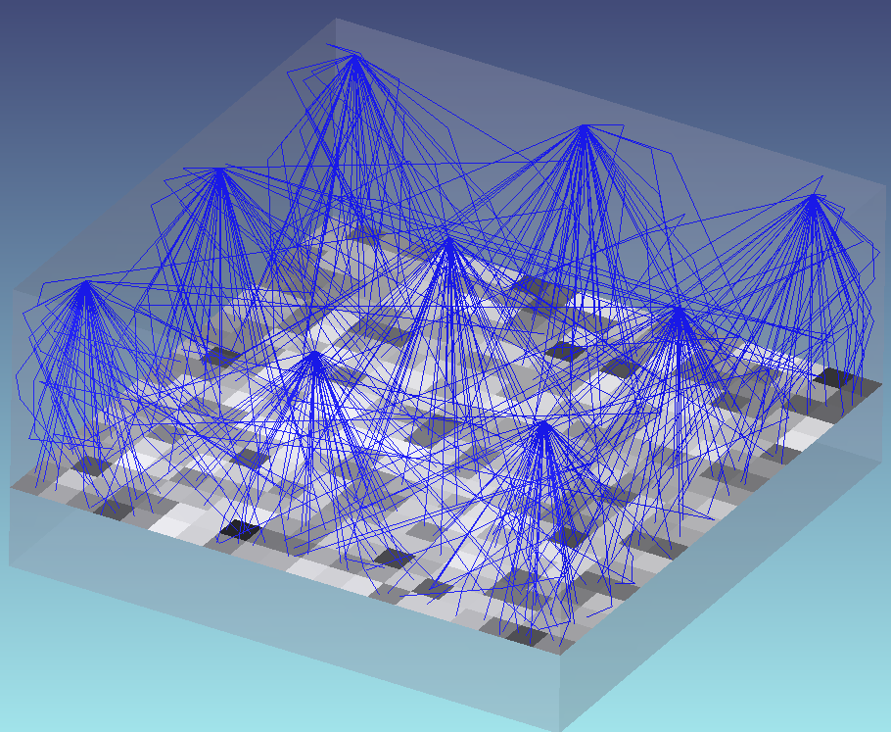
July 2018
doc.: IEEE 11-18-1236-00-00bb
Illumination Levels
Based on the properties of luminary, required illumination level (150 lx) and the size of room, we arrange the luminaries as follows:
Delivered light output from each luminary | 737 lumens
Average of illumination level | 153 lx
Uniformity of illumination | 0.6422
Arrangement of luminaries
Evaluation of illumination level in Zemax®
Submission
M. Uysal, F. Miramirkhani, T. Baykas, et al.

Slide 11
July 2018
doc.: IEEE 11-18-1236-00-00bb
Illumination Patterns
Simulated illumination levels in Zemax®
Illumination level contours in Matlab®
The minimum and maximum values of illumination are 98.69 lx and 176.40 lx.
Submission
M. Uysal, F. Miramirkhani, T. Baykas, et al.

Slide 12
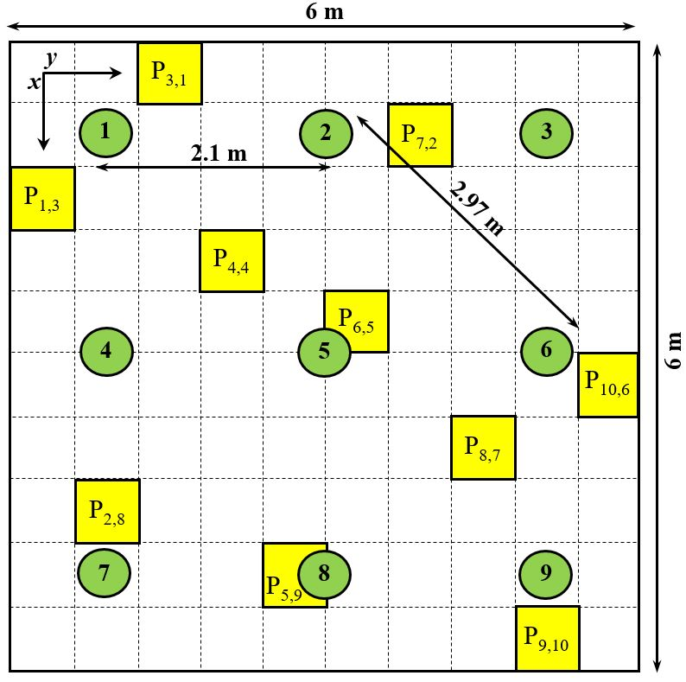
July 2018
doc.: IEEE 11-18-1236-00-00bb
Location of Test Points (Receivers)
We consider 100 cells with equidistant spacing of 0.6 m in x and y directions.
We consider a user with a height of 1.8 m who holds the phone in his hand next to his ear with 45° rotation upward the ceiling and at a height of 1.65 m. The cell phone is equipped with a single photodetector. We consider seven possible locations for the photodetectors.
Room under consideration
with green circles denoting luminaires
Location and rotation of test points
Submission
M. Uysal, F. Miramirkhani, T. Baykas, et al.

Slide 13
July 2018
doc.: IEEE 11-18-1236-00-00bb
Sample CIR Results for D5 (1/2)
Submission
M. Uysal, F. Miramirkhani, T. Baykas, et al.

Slide 14
July 2018
doc.: IEEE 11-18-1236-00-00bb
Sample CIR Results for D5 (2/2)
Submission
M. Uysal, F. Miramirkhani, T. Baykas, et al.

Slide 15
July 2018
doc.: IEEE 11-18-1236-00-00bb
Sample Optical Channel Responses for D5
Submission
M. Uysal, F. Miramirkhani, T. Baykas, et al.

Slide 16
July 2018
doc.: IEEE 11-18-1236-00-00bb
Sample Effective Channel Responses for D5
In the effective channel responses of P_{1,3}, P_{10,6} and P_{9,10}, frequency selectivity are more pronounced. It is a result of the fact that these locations are close to the walls (see p. 12) and therefore more reflected rays are received (see corresponding CIRs in p. 13 and p. 14).
In the rest of this presentation, the “LED Model 1” with cut-off frequency of 20 MHz is considered.
Submission
M. Uysal, F. Miramirkhani, T. Baykas, et al.

Slide 17
July 2018
doc.: IEEE 11-18-1236-00-00bb
Spatial Distribution of DC Gains &
Channel Characteristics (1/2)
 | Average over 100 Cells
 | (ns)
D1 | 13.92 | 6.00×10⁻⁶
D2 | 14.10 | 6.08×10⁻⁶
D3 | 14.07 | 6.33×10⁻⁶
D4 | 14.09 | 6.89×10⁻⁶
D5 | 14.10 | 7.19×10⁻⁶
D6 | 14.06 | 6.25×10⁻⁶
D7 | 13.22 | 3.05×10⁻⁶
Submission
M. Uysal, F. Miramirkhani, T. Baykas, et al.

Slide 18
July 2018
doc.: IEEE 11-18-1236-00-00bb
Spatial Distribution of DC Gains &
Channel Characteristics (2/2)
Submission
M. Uysal, F. Miramirkhani, T. Baykas, et al.

Slide 19
Cumulative Distribution Function (CDF)
of Path Loss
It can be noted that D1, D2, D3, D4, D5 and D6 have similar path loss values in the range of 51.95 dB-52.94 dB. In comparison to them, D7 has about 2.2 dB-3.2 dB more path loss on average since there is no LOS component.
Submission
M. Uysal, F. Miramirkhani, T. Baykas, et al.

Slide 20
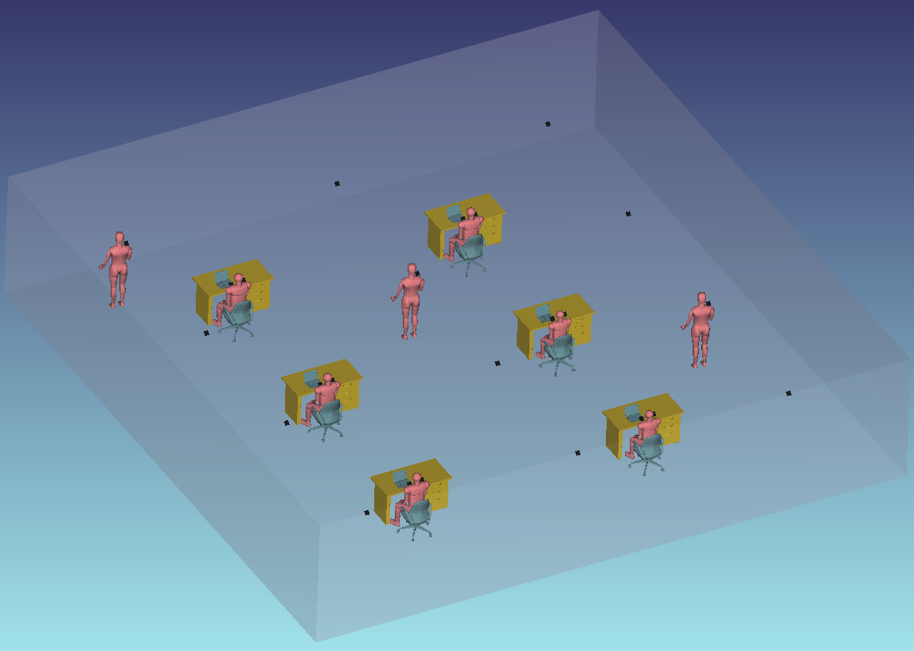
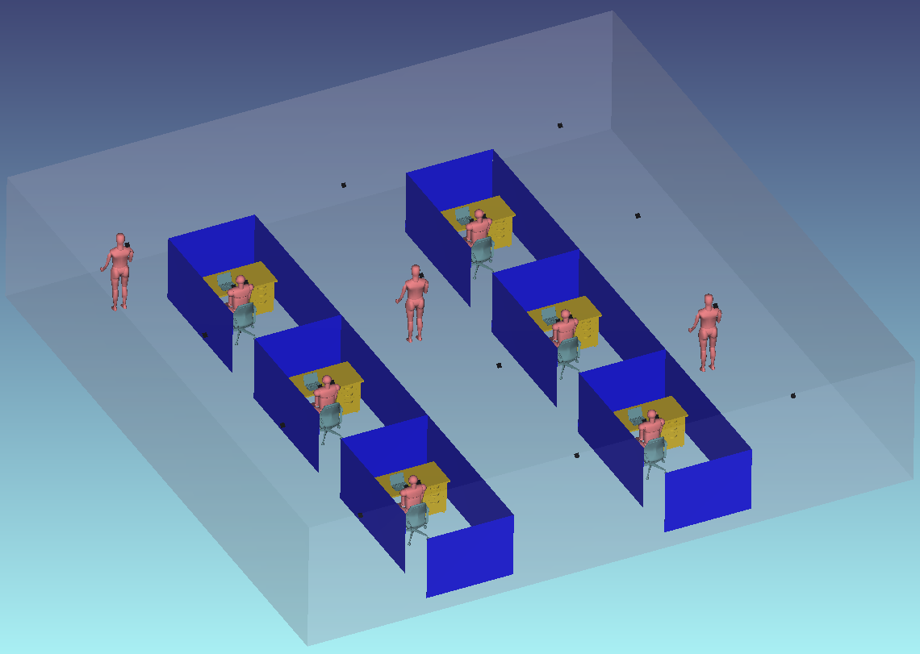
July 2018
doc.: IEEE 11-18-1236-00-00bb
Simulation Scenario 1: Office
Typical office places include furniture (e.g., desk, chairs, cubicles etc), various equipments (e.g., computers, printers etc) and personnel.
Open Office
Office With Cubicles
Submission
M. Uysal, F. Miramirkhani, T. Baykas, et al.

Slide 21
July 2018
doc.: IEEE 11-18-1236-00-00bb
Simulation Parameters
Room size | 14 m × 14 m × 3 m
Materials | Walls: Plaster, Ceiling: Plaster, Floor: Pinewood
Objects | 6 desks and a chair paired with each desk 6 laptops on each desk 6 cubicles (optional) 9 human bodies
Objects specifications | Cubicles: Plaster Desk: Pinewood (Typical height of 0.85 m) Chair: Pinewood Laptop: Black gloss paint Human body: Shoes: Black gloss paint Head & Hands: Absorbing Clothes: Cotton
Luminary Specifications | Brand: LR24-38SKA35 Cree Inc. Half viewing angle: 40º
Number of luminaries | 32
Receiver area | 1 cm²
Submission
M. Uysal, F. Miramirkhani, T. Baykas, et al.

Slide 22
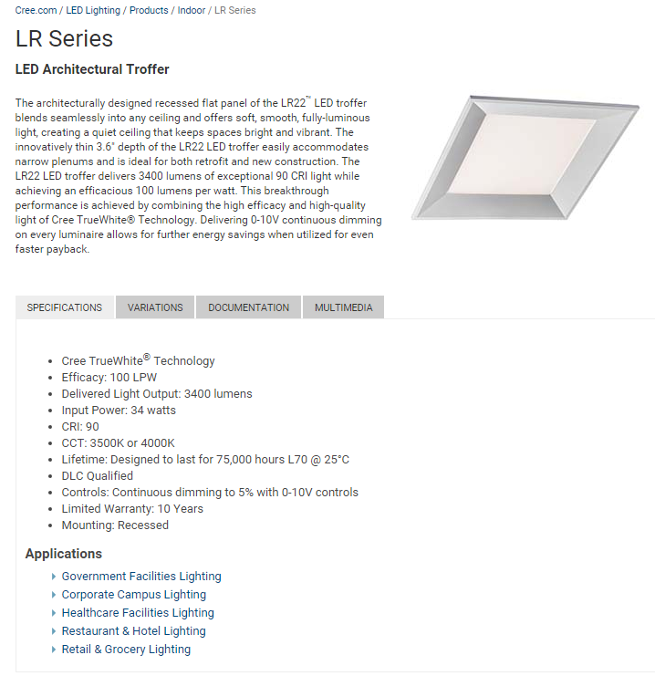
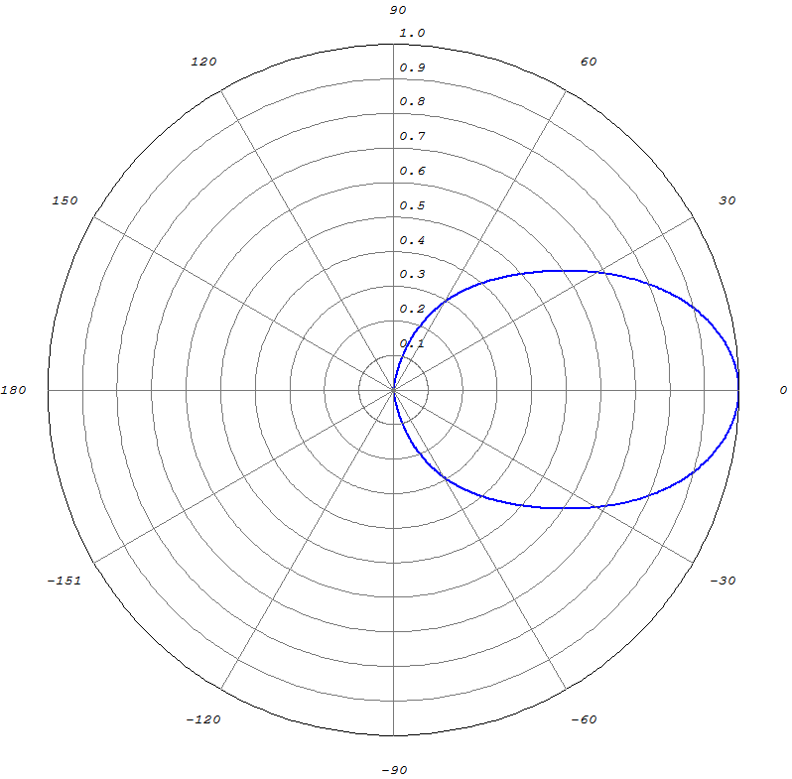
July 2018
doc.: IEEE 11-18-1236-00-00bb
Light Source (Transmitter)
In simulation study, we use the LED luminary “LR24-38SKA35” from Cree.
Simulated emission pattern in Zemax®
Submission
M. Uysal, F. Miramirkhani, T. Baykas, et al.

Slide 23
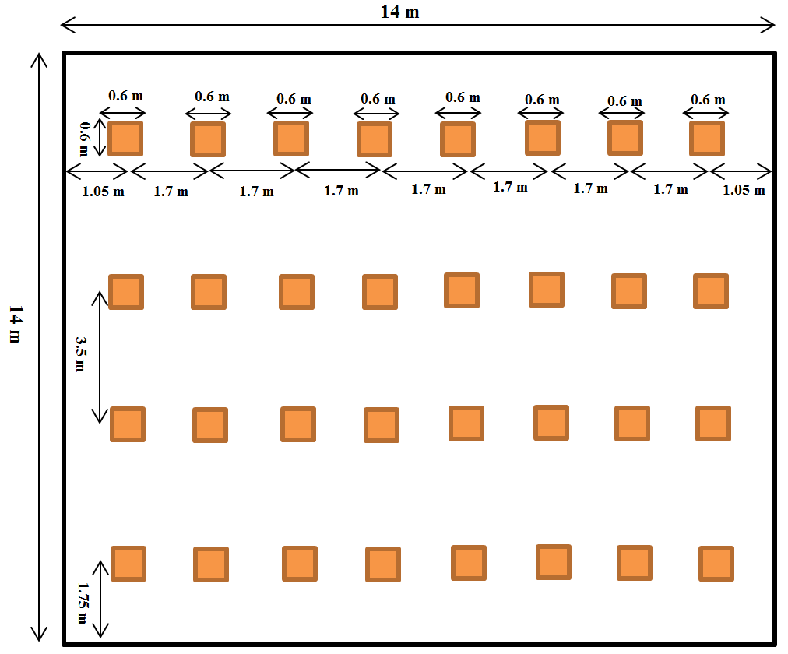
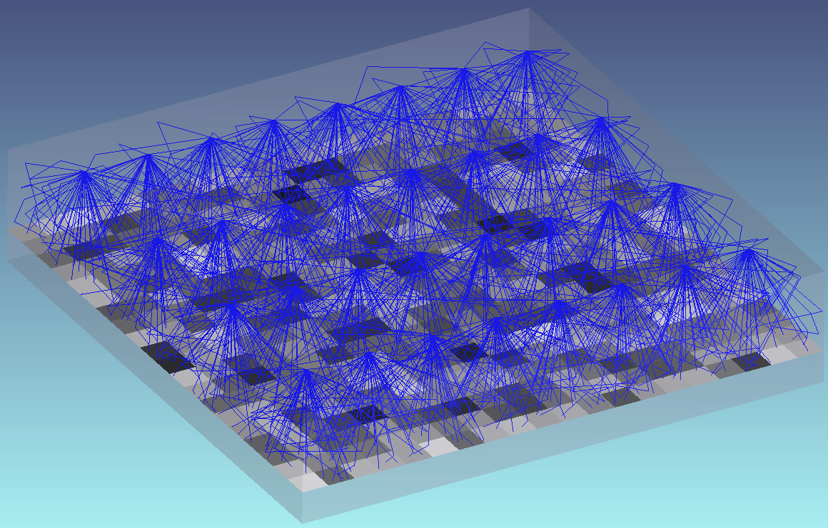
July 2018
doc.: IEEE 11-18-1236-00-00bb
Illumination Levels
Based on the properties of employed luminary, required illumination level (500 lx) and the size of office place, we arrange the luminaries as follows:
Delivered light output from each luminary | 3504 lumens
Average of illumination level | 533 lx
Uniformity of illumination | 0.5211
Arrangement of luminaries
Evaluation of illumination levels in Zemax®
Submission
M. Uysal, F. Miramirkhani, T. Baykas, et al.

Slide 24
July 2018
doc.: IEEE 11-18-1236-00-00bb
Illumination Patterns
Simulated illumination levels in Zemax®
Illumination level contours in Matlab®
Different colors show different values of illumination (lx) at the height of desk in office place. Red indicates the highest illumination level.
The minimum and maximum values of illumination are 278 lx and 712 lx respectively.
Submission
M. Uysal, F. Miramirkhani, T. Baykas, et al.

Slide 25
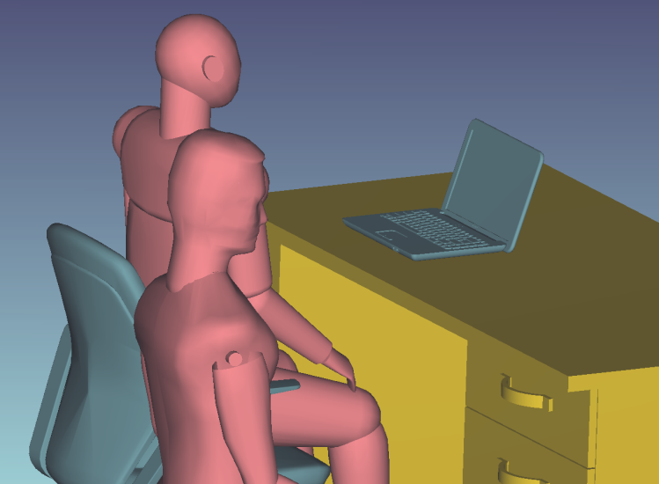
July 2018
doc.: IEEE 11-18-1236-00-00bb
Location of Test Points (Receivers)
24 test points are chosen which are categorized into three groups:
In the corridors at a height of 1.7 m with 45º rotation (e.g., people who stand with a cell phone in hand) | D1-D12
On the top of chairs at a height of 0.95 m with 45º rotation (i.e., people with a cell phone in hand) | D13-D18
On the top of chairs at a height of 1.1 m with 45º rotation (e.g., people who sit with a cell phone in hand to his/her ear) | D19-D24
D19
D13
D1
Location and rotation of test points
Submission
M. Uysal, F. Miramirkhani, T. Baykas, et al.

Slide 26
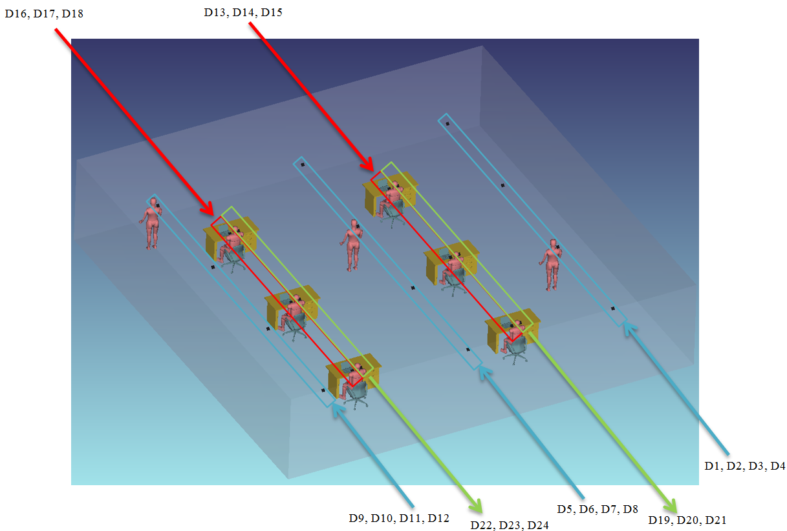
July 2018
doc.: IEEE 11-18-1236-00-00bb
Test Points (Open Office)
Submission
M. Uysal, F. Miramirkhani, T. Baykas, et al.

Slide 27
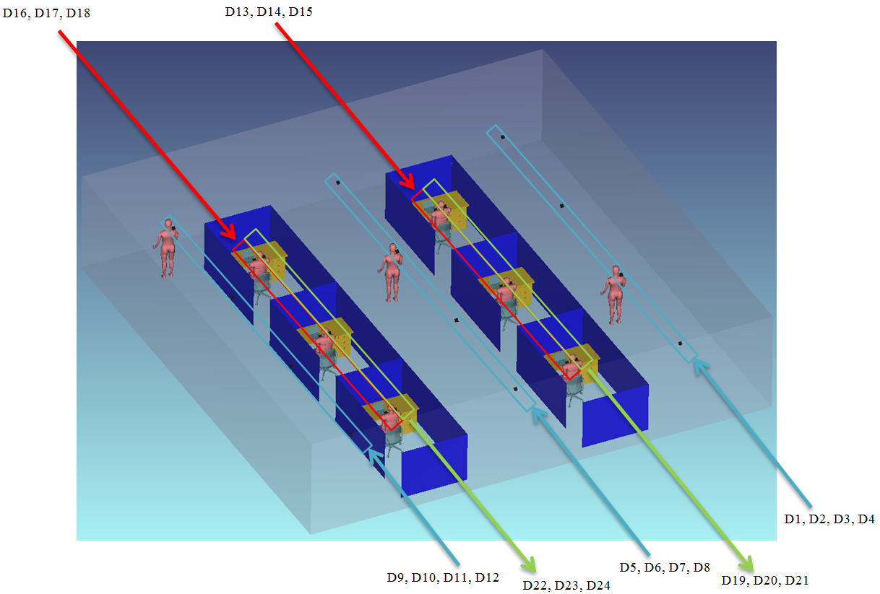
July 2018
doc.: IEEE 11-18-1236-00-00bb
Test Points (Office with Cubicles)
Submission
M. Uysal, F. Miramirkhani, T. Baykas, et al.

Slide 28
July 2018
doc.: IEEE 11-18-1236-00-00bb
Optical Channel Responses (Open Office)
Submission
M. Uysal, F. Miramirkhani, T. Baykas, et al.

Slide 29
July 2018
doc.: IEEE 11-18-1236-00-00bb
Effective Channel Responses (Open Office)
Submission
M. Uysal, F. Miramirkhani, T. Baykas, et al.

Slide 30
July 2018
doc.: IEEE 11-18-1236-00-00bb
Channel Characteristics
 | (ns)
D1 | 15.51 | 2.60×10⁻⁶
D2 | 18.84 | 1.36×10⁻⁶
D3 | 18.92 | 2.40×10⁻⁶
D4 | 16.97 | 3.32×10⁻⁶
D5 | 16.75 | 2.34×10⁻⁶
D6 | 17.33 | 2.60×10⁻⁶
D7 | 20.44 | 1.36×10⁻⁶
D8 | 17.83 | 2.79×10⁻⁶
D9 | 16.11 | 2.40×10⁻⁶
D10 | 15.97 | 3.12×10⁻⁶
D11 | 18.99 | 2.40×10⁻⁶
D12 | 19.57 | 1.82×10⁻⁶
D13 | 15.37 | 2.27×10⁻⁶
D14 | 16.09 | 2.21×10⁻⁶
D15 | 17.70 | 1.36×10⁻⁶
D16 | 14.74 | 2.34×10⁻⁶
D17 | 18.10 | 1.30×10⁻⁶
D18 | 16.67 | 1.95×10⁻⁶
D19 | 15.25 | 2.73×10⁻⁶
D20 | 15.81 | 1.82×10⁻⁶
D21 | 17.36 | 1.69×10⁻⁶
D22 | 18.02 | 1.36×10⁻⁶
D23 | 17.99 | 1.49×10⁻⁶
D24 | 17.85 | 1.75×10⁻⁶
Submission
M. Uysal, F. Miramirkhani, T. Baykas, et al.

Slide 31
July 2018
doc.: IEEE 11-18-1236-00-00bb
Optical Channel Responses
(Office with Cubicles)
Submission
M. Uysal, F. Miramirkhani, T. Baykas, et al.

Slide 32
July 2018
doc.: IEEE 11-18-1236-00-00bb
Effective Channel Responses
(Office with Cubicles)
Submission
M. Uysal, F. Miramirkhani, T. Baykas, et al.

Slide 33
July 2018
doc.: IEEE 11-18-1236-00-00bb
Channel Characteristics
 | (ns)
D1 | 13.80 | 2.48×10⁻⁶
D2 | 17.33 | 1.30×10⁻⁶
D3 | 16.47 | 2.30×10⁻⁶
D4 | 14.39 | 3.18×10⁻⁶
D5 | 15.17 | 2.16×10⁻⁶
D6 | 16.14 | 2.48×10⁻⁶
D7 | 18.87 | 1.24×10⁻⁶
D8 | 16.77 | 2.76×10⁻⁶
D9 | 13.91 | 2.30×10⁻⁶
D10 | 14.80 | 2.97×10⁻⁶
D11 | 16.64 | 2.39×10⁻⁶
D12 | 17.80 | 1.79×10⁻⁶
D13 | 12.80 | 2.08×10⁻⁶
D14 | 14.31 | 1.38×10⁻⁶
D15 | 14.74 | 1.27×10⁻⁶
D16 | 12.36 | 2.31×10⁻⁶
D17 | 14.92 | 1.07×10⁻⁶
D18 | 13.35 | 1.76×10⁻⁶
D19 | 13.49 | 1.95×10⁻⁶
D20 | 13.36 | 1.73×10⁻⁶
D21 | 13.38 | 1.67×10⁻⁶
D22 | 15.79 | 1.23×10⁻⁶
D23 | 15.45 | 1.44×10⁻⁶
D24 | 14.54 | 1.62×10⁻⁶
Submission
M. Uysal, F. Miramirkhani, T. Baykas, et al.

Slide 34
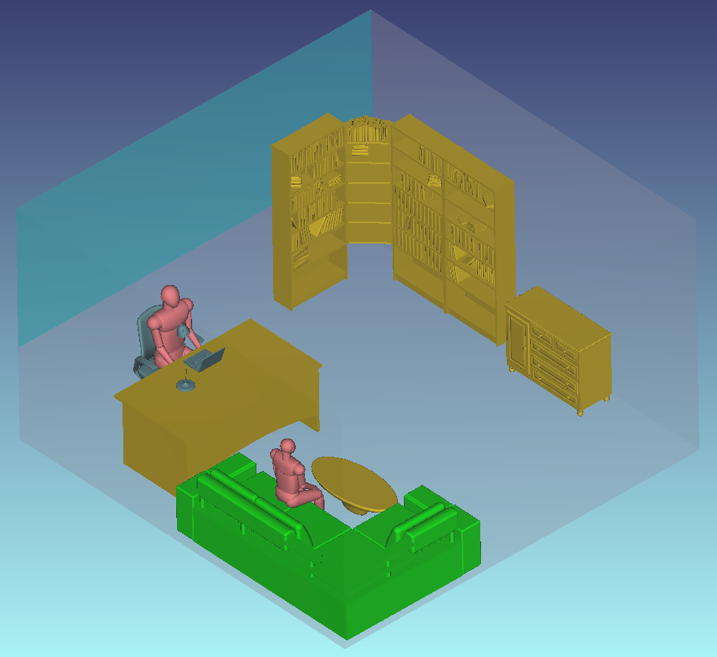
July 2018
doc.: IEEE 11-18-1236-00-00bb
Simulation Scenario 2:
Office with Secondary Light
In this office environment, there are two light sources; one of them is the main light source at the ceiling and the other one is mounted on the desk to provide task lighting.
Submission
M. Uysal, F. Miramirkhani, T. Baykas, et al.

Slide 35
July 2018
doc.: IEEE 11-18-1236-00-00bb
Simulation Parameters
Room size | 5 m × 5 m × 3 m
Materials | Walls: Plaster, Ceiling: Plaster, Floor: Pinewood
Objects | 1 desk and a chair paired with desk 1 laptop on the desk, 1 desk light on the desk, 1 library 1 couch, 1 coffee table, window, 2 human bodies
Objects specifications | Desk: Pinewood (Typical height of 0.88 m) Chair: Black gloss paint, Laptop: Black gloss paint Desk light: Black gloss paint, Library: Pinewood, Window: Glass Couch: Cotton, Coffee table: Pinewood Human body: Shoes: Black gloss paint Head & Hands: Absorbing Clothes: Cotton
Luminary Specifications | Brand: LR24-38SKA35 Cree Inc. Half viewing angle: 40º
Number of luminaries | 1 on the ceiling 1 for the desk light
Receiver area | 1 cm²
Submission
M. Uysal, F. Miramirkhani, T. Baykas, et al.

Slide 36
July 2018
doc.: IEEE 11-18-1236-00-00bb
Light Source (Transmitter)
In simulation study, we use the LED luminary “LR24-38SKA35” from Cree.
Simulated emission pattern in Zemax®
Submission
M. Uysal, F. Miramirkhani, T. Baykas, et al.

Slide 37
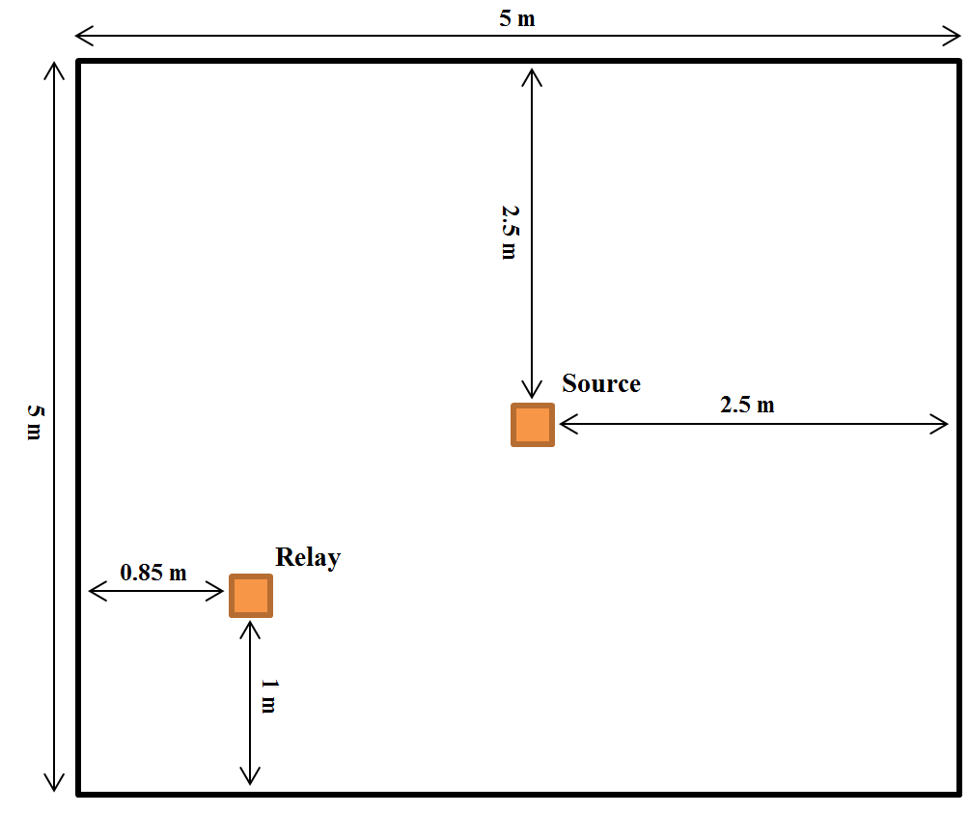
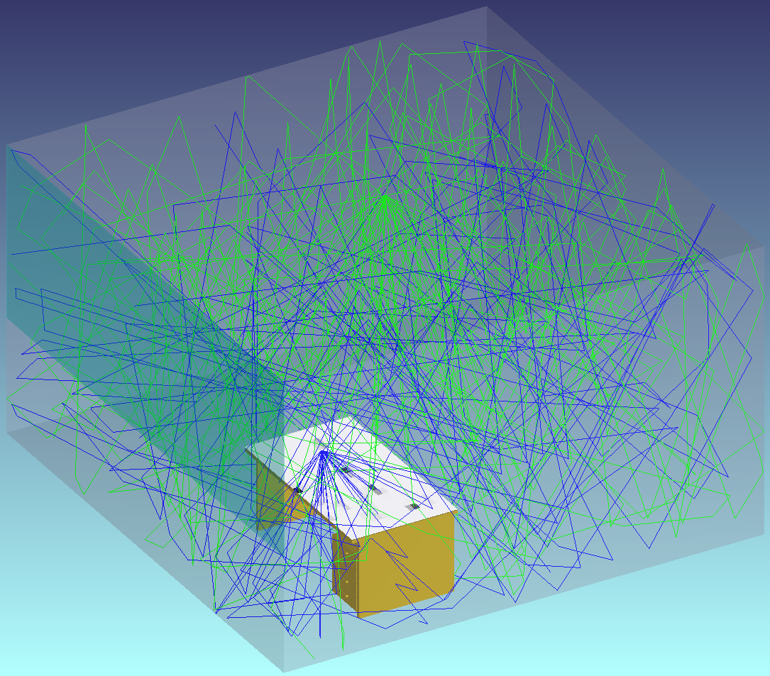
July 2018
doc.: IEEE 11-18-1236-00-00bb
Illumination Levels
Based on the properties of employed luminary, required illumination level (500 lx) and the size of office place, we arrange the luminaries as follows:
Delivered light output from each luminary | 3796 lumens
Average of illumination level | 270 lx
Uniformity of illumination | 0.4409
Arrangement of luminaries
Evaluation of illumination levels in Zemax®
Submission
M. Uysal, F. Miramirkhani, T. Baykas, et al.

Slide 38
July 2018
doc.: IEEE 11-18-1236-00-00bb
Illumination Patterns
Simulated illumination levels in Zemax®
Illumination level contours in Matlab®
The minimum and maximum values of illumination are 119 lx and 902 lx respectively.
Submission
M. Uysal, F. Miramirkhani, T. Baykas, et al.

Slide 39
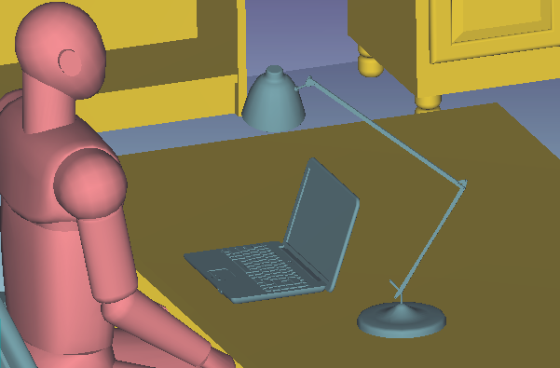
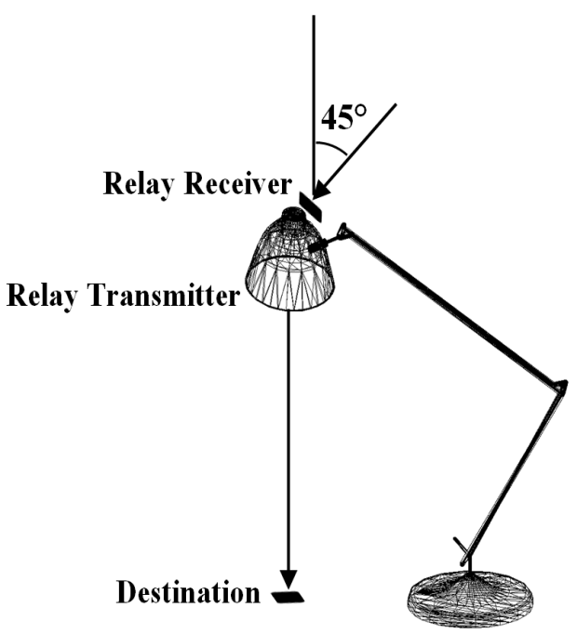
July 2018
doc.: IEEE 11-18-1236-00-00bb
Location of Test Points (Receivers)
2 test points are chosen:
On the desk next to the laptop at a height of 0.88 m (e.g., a USB-type device connected to laptop) | D1
On the top of desk light at a height of 1.5 m with 45º rotation toward the source on the ceiling | D2
D1
D2
Submission
M. Uysal, F. Miramirkhani, T. Baykas, et al.

Slide 40
July 2018
doc.: IEEE 11-18-1236-00-00bb
Optical and Effective Channel Responses &
Channel Characteristics
 | (ns)
S→R | 11.52 | 2.84×10⁻⁵
R→D | 8.07 | 5.21×10⁻⁴
S→D | 11.11 | 1.12×10⁻⁵
Submission
M. Uysal, F. Miramirkhani, T. Baykas, et al.

Slide 41
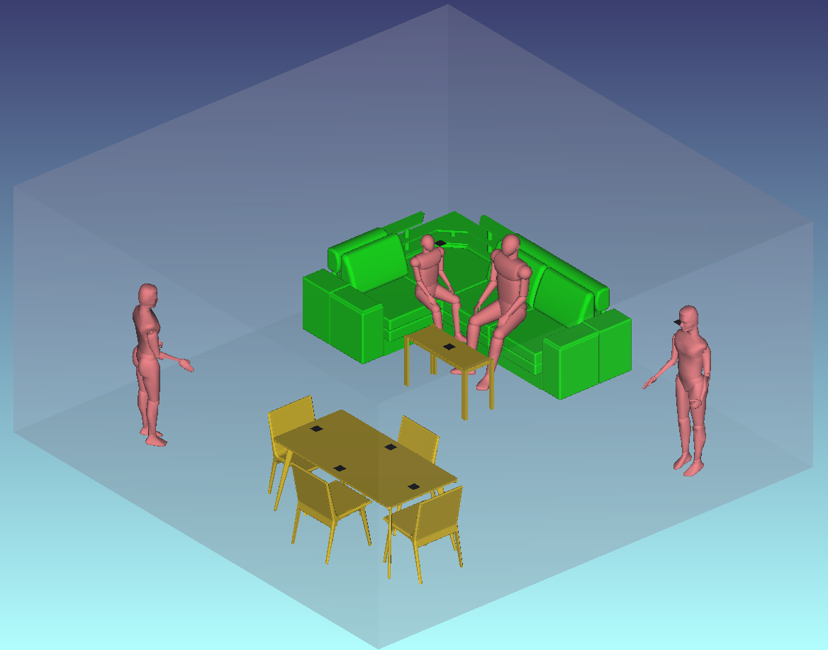
July 2018
doc.: IEEE 11-18-1236-00-00bb
Simulation Scenario 3: Home
We consider a living room with table, chairs, couch, coffee table and human bodies.
Submission
M. Uysal, F. Miramirkhani, T. Baykas, et al.

Slide 42
July 2018
doc.: IEEE 11-18-1236-00-00bb
Simulation Parameters
Room size | 6 m × 6 m × 3 m
Materials | Walls: Plaster, Ceiling: Plaster, Floor: Pinewood
Objects | Table with 4 chairs Couch Coffee table 4 human bodies
Object Specifications | Tables: Wooden with size of 2 m × 1 m × 0.9 m Chairs: Wooden matched with table Couch: Cotton Coffee table: Glass Human body: Shoes: Black gloss paint Head & Hands: Absorbing Clothes: Cotton
Luminary Specifications | Brand: CR6-800L Cree Inc. Half viewing angle: 40º
Number of luminaries | 9
Receiver area | 1 cm²
Submission
M. Uysal, F. Miramirkhani, T. Baykas, et al.

Slide 43
July 2018
doc.: IEEE 11-18-1236-00-00bb
Light Source
In simulation study, we use the LED luminary “CR6-800L” from Cree.
Simulated emission pattern in Zemax®
Submission
M. Uysal, F. Miramirkhani, T. Baykas, et al.

Slide 44
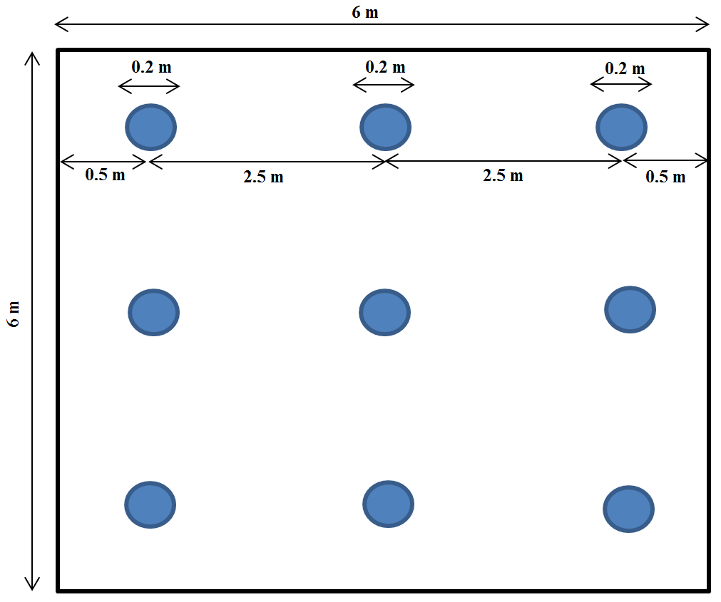
July 2018
doc.: IEEE 11-18-1236-00-00bb
Illumination Levels
Based on the properties of luminary, required illumination level (150 lx) and the size of room, we arrange the luminaries as follows:
Delivered light output from each luminary | 804 lumens
Average of illumination level | 153 lx
Uniformity of illumination | 0.9068
Arrangement of luminaries
Evaluation of illumination level in Zemax®
Submission
M. Uysal, F. Miramirkhani, T. Baykas, et al.

Slide 45
July 2018
doc.: IEEE 11-18-1236-00-00bb
Illumination Patterns
Simulated illumination levels in Zemax®
Illumination level contours in Matlab®
The minimum and maximum values of illumination are 139 lx and 169 lx.
Submission
M. Uysal, F. Miramirkhani, T. Baykas, et al.

Slide 46
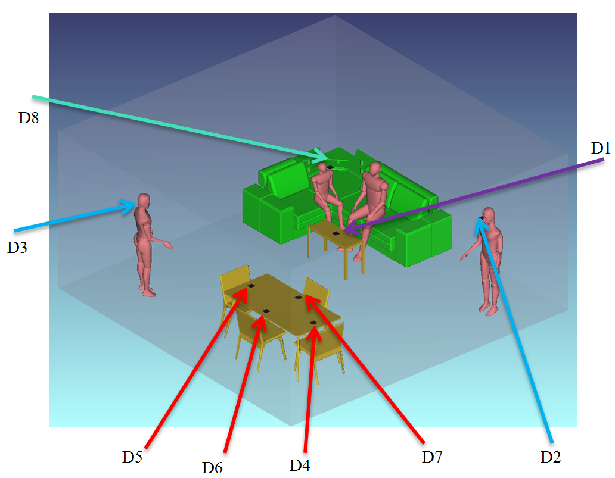
July 2018
doc.: IEEE 11-18-1236-00-00bb
Location of Test Points (Receivers)
8 test points are chosen which are categorized into four groups:
On the coffee table at a height of 0.6 m with 45º rotation | D1
Next to the wall at a height of 1.7 m (e.g., standing people) with 45º rotation | D2-D3
On the table at a height of 0.9 m | D4-D7
On the top of couch at height of 1.1 m (e.g., sitting people) with 45º rotation | D8
Submission
M. Uysal, F. Miramirkhani, T. Baykas, et al.

Slide 47
July 2018
doc.: IEEE 11-18-1236-00-00bb
Optical Channel Responses
Submission
M. Uysal, F. Miramirkhani, T. Baykas, et al.

Slide 48
July 2018
doc.: IEEE 11-18-1236-00-00bb
Effective Channel Responses
Submission
M. Uysal, F. Miramirkhani, T. Baykas, et al.

Slide 49
July 2018
doc.: IEEE 11-18-1236-00-00bb
Channel Characteristics
 | (ns)
D1 | 12.49 | 6.75×10⁻⁶
D2 | 11.50 | 1.22×10⁻⁵
D3 | 10.72 | 1.20×10⁻⁵
D4 | 12.70 | 9.03×10⁻⁶
D5 | 12.90 | 9.56×10⁻⁶
D6 | 12.48 | 1.01×10⁻⁵
D7 | 13.01 | 8.55×10⁻⁶
D8 | 11.88 | 9.13×10⁻⁶
Submission
M. Uysal, F. Miramirkhani, T. Baykas, et al.

Slide 50
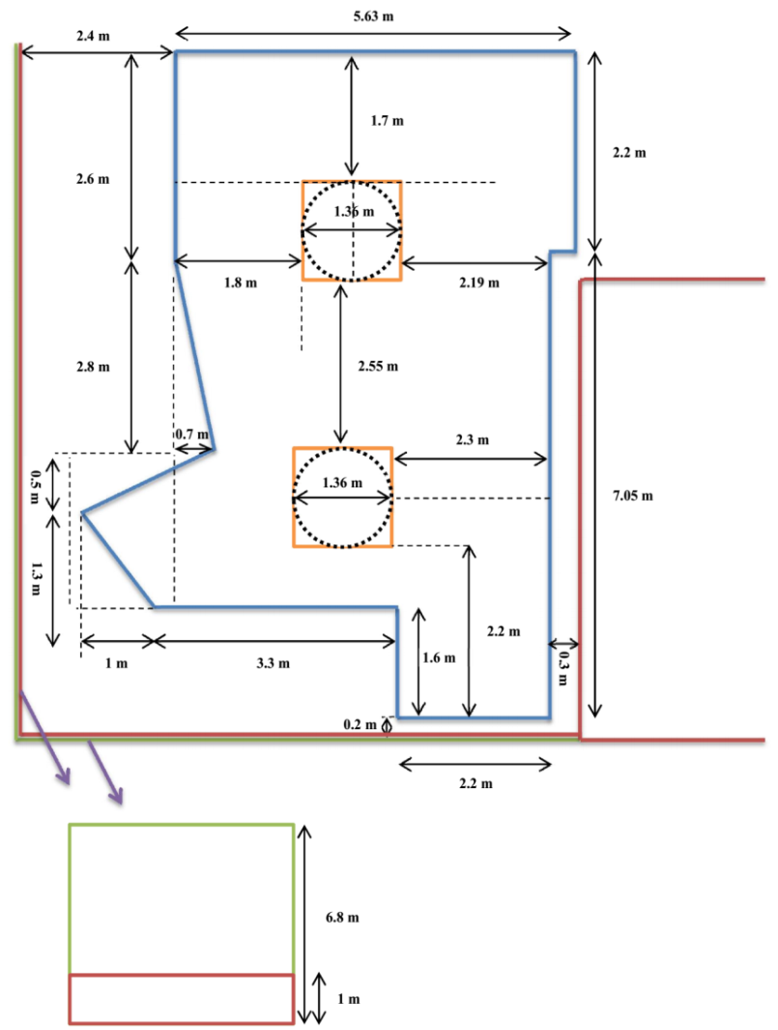
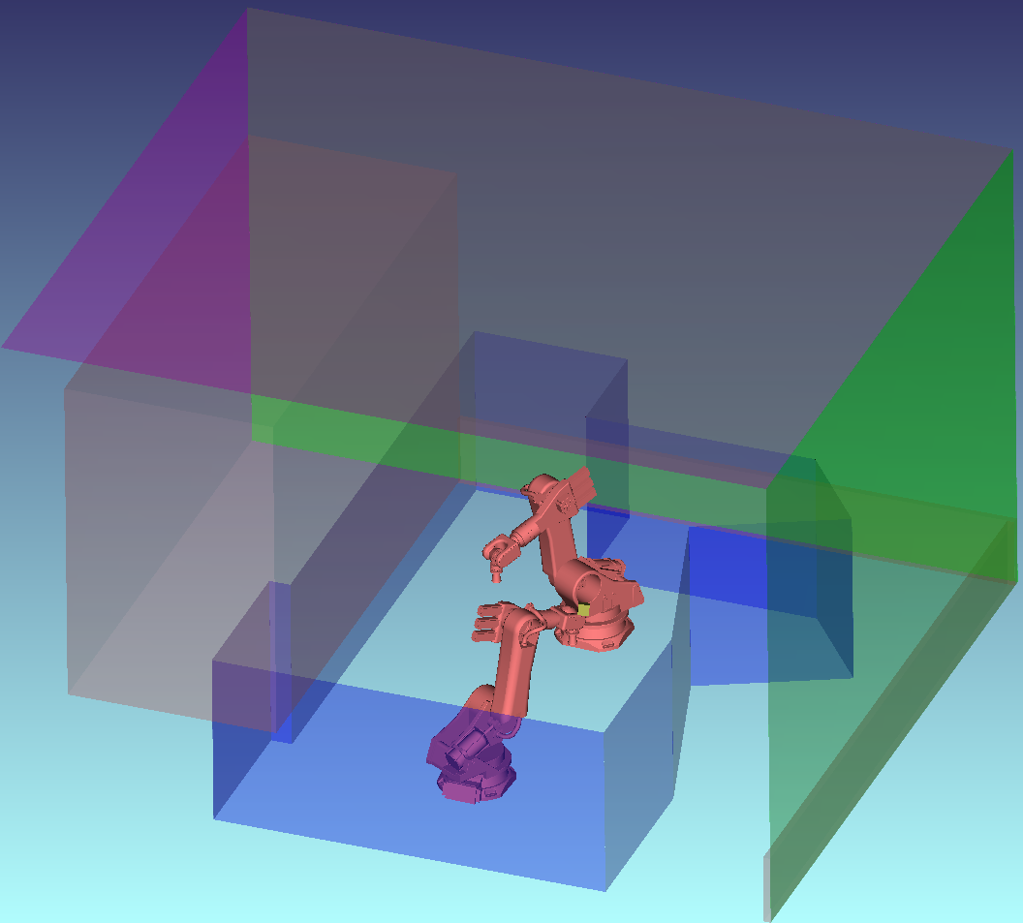
July 2018
doc.: IEEE 11-18-1236-00-00bb
Simulation Scenario 4: Manufacturing Cell
We consider a manufacturing cell with two robots.
Submission
M. Uysal, F. Miramirkhani, T. Baykas, et al.

Slide 51
July 2018
doc.: IEEE 11-18-1236-00-00bb
Simulation Parameters
Room size | 8.03 m × 9.45 m × 6.8 m (See p.48 for exact layout)
Materials | Red Walls: Concrete Green Walls: Aluminum metal Blue Walls: Plexiglas (PMMA) Ceiling: Aluminum metal Floor: Concrete
Objects | Two robots
Object Specifications | Robot: Galvanized steel metal Height of Robot: 2.7 m Height of Plexiglas boundary: 2.5 m
LED Specifications | Brand: MC-E Cree Xlamp Inc. Half viewing angle: 60º
Number of LEDs | 6
Receiver area | 1 cm²
Submission
M. Uysal, F. Miramirkhani, T. Baykas, et al.

Slide 52
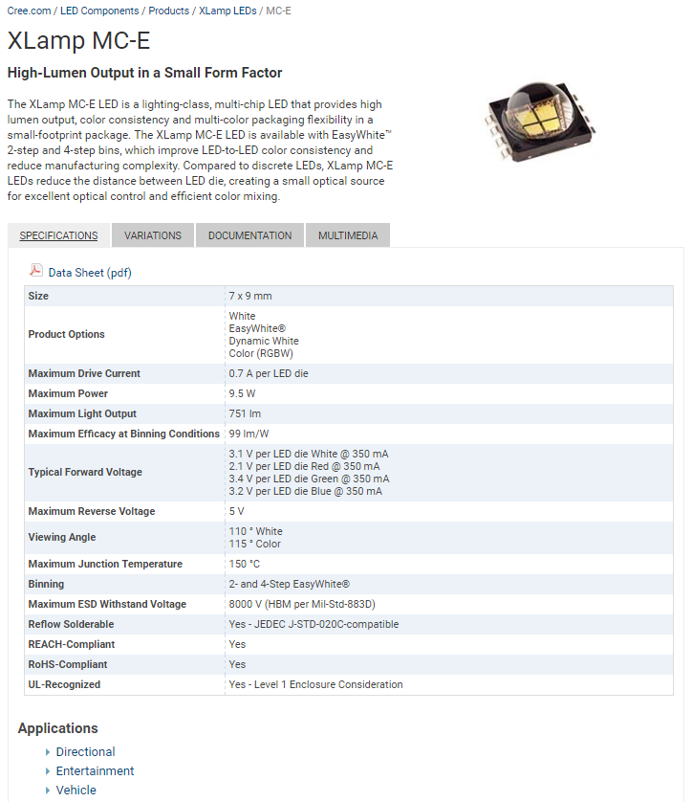
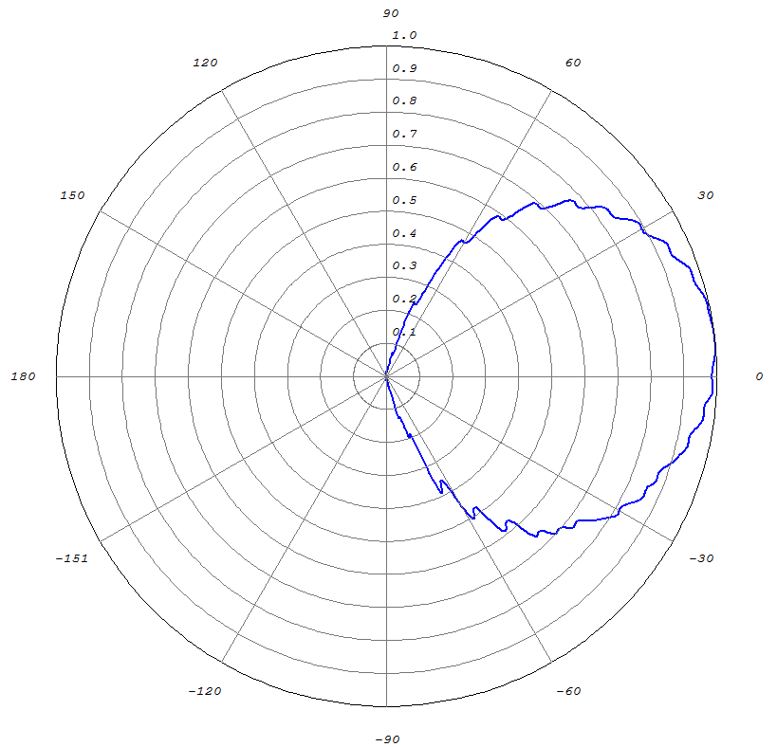
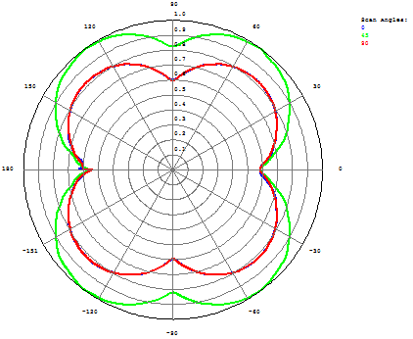
July 2018
doc.: IEEE 11-18-1236-00-00bb
Light Source (Transmitter)
In simulation study, we use the LED “Xlamp MC-E” from Cree.
Simulated emission pattern in Zemax®
Emission pattern of six LEDs which cover 360º
Submission
M. Uysal, F. Miramirkhani, T. Baykas, et al.

Slide 53
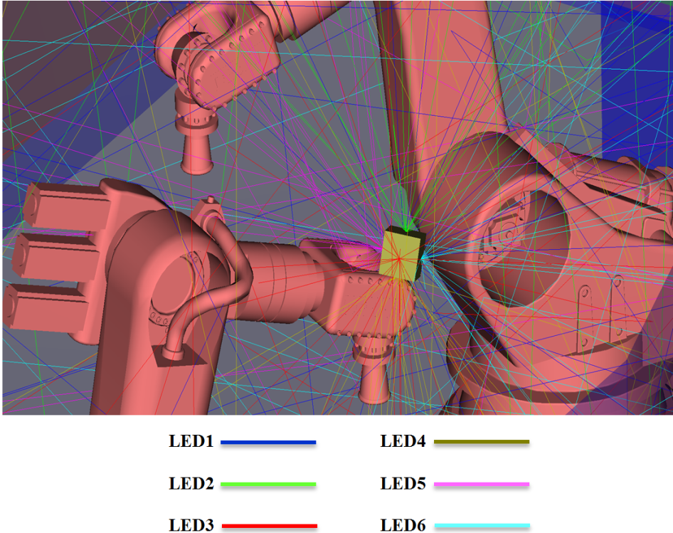
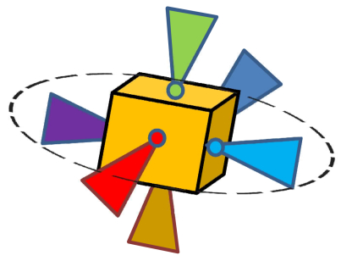
July 2018
doc.: IEEE 11-18-1236-00-00bb
Location of Luminaries (Transmitters)
6 transmitters are located at the head of the robot, arranged on the six sides of a cube to cover 360º.
LED2
LED1
LED5
LED3
LED6
LED4
Submission
M. Uysal, F. Miramirkhani, T. Baykas, et al.

Slide 54
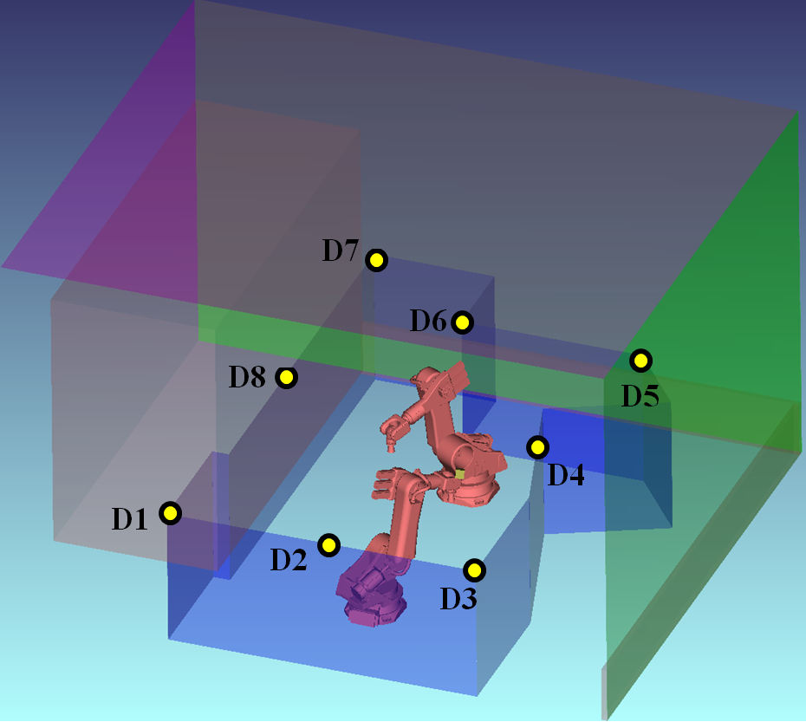
July 2018
doc.: IEEE 11-18-1236-00-00bb
Location of Test Points (Receivers)
Test points are considered on the top of the Plexiglas boundary which are looking in the direction of the robots.
Submission
M. Uysal, F. Miramirkhani, T. Baykas, et al.

Slide 55
July 2018
doc.: IEEE 11-18-1236-00-00bb
Optical Channel Responses
Submission
M. Uysal, F. Miramirkhani, T. Baykas, et al.

Slide 56
July 2018
doc.: IEEE 11-18-1236-00-00bb
Effective Channel Responses
Submission
M. Uysal, F. Miramirkhani, T. Baykas, et al.

Slide 57
July 2018
doc.: IEEE 11-18-1236-00-00bb
Channel Characteristics
TX-RX |  | (ns)
LED1 | D1 | 15.20 | 5.81×10⁻⁷
 | D2 | 15.68 | 1.08×10⁻⁶
 | D3 | 17.84 | 4.64×10⁻⁷
 | D4 | 17.53 | 1.01×10⁻⁶
 | D5 | 10.96 | 5.79×10⁻⁶
 | D6 | 15.13 | 7.67×10⁻⁷
 | D7 | 15.03 | 4.82×10⁻⁷
 | D8 | 12.11 | 4.77×10⁻⁶
LED2 | D1 | 13.29 | 6.94×10⁻⁷
 | D2 | 13.51 | 5.21×10⁻⁷
 | D3 | 13.66 | 4.68×10⁻⁷
 | D4 | 9.64 | 2.50×10⁻⁵
 | D5 | 14.03 | 6.30×10⁻⁷
 | D6 | 16.79 | 4.05×10⁻⁷
 | D7 | 13.00 | 5.47×10⁻⁷
 | D8 | 18.82 | 1.96×10⁻⁶
LED3 | D1 | 13.93 | 8.78×10⁻⁷
 | D2 | 11.16 | 6.35×10⁻⁶
 | D3 | 10.09 | 1.09×10⁻⁵
 | D4 | 17.59 | 5.70×10⁻⁷
 | D5 | 14.66 | 1.32×10⁻⁷
 | D6 | 15.94 | 3.55×10⁻⁷
 | D7 | 14.29 | 3.53×10⁻⁷
 | D8 | 14.24 | 1.13×10⁻⁶
TX-RX |  | (ns)
LED4 | D1 | 12.71 | 6.79×10⁻⁷
 | D2 | 13.23 | 1.01×10⁻⁶
 | D3 | 17.82 | 5.61×10⁻⁷
 | D4 | 16.81 | 6.60×10⁻⁷
 | D5 | 16.81 | 2.17×10⁻⁷
 | D6 | 12.92 | 3.90×10⁻⁷
 | D7 | 11.66 | 4.29×10⁻⁷
 | D8 | 11.48 | 1.27×10⁻⁶
LED5 | D1 | 16.99 | 2.55×10⁻⁷
 | D2 | 15.89 | 4.21×10⁻⁷
 | D3 | 12.96 | 4.32×10⁻⁷
 | D4 | 16.52 | 6.92×10⁻⁷
 | D5 | 14.77 | 2.88×10⁻⁷
 | D6 | 13.00 | 7.10×10⁻⁷
 | D7 | 14.48 | 3.37×10⁻⁷
 | D8 | 10.08 | 8.34×10⁻⁶
LED6 | D1 | 14.81 | 1.05×10⁻⁶
 | D2 | 13.98 | 2.68×10⁻⁶
 | D3 | 12.19 | 5.75×10⁻⁶
 | D4 | 8.84 | 5.78×10⁻⁵
 | D5 | 15.39 | 3.48×10⁻⁷
 | D6 | 14.40 | 1.25×10⁻⁶
 | D7 | 14.24 | 9.74×10⁻⁷
 | D8 | 13.19 | 2.75×10⁻⁶
TX-RX |  | (ns)
All LEDs | D1 | 15.66 | 7.78×10⁻⁷
 | D2 | 15.52 | 1.99×10⁻⁶
 | D3 | 14.13 | 2.96×10⁻⁶
 | D4 | 10.45 | 1.43×10⁻⁵
 | D5 | 16.42 | 1.29×10⁻⁶
 | D6 | 14.85 | 8.15×10⁻⁷
 | D7 | 15.83 | 3.78×10⁻⁷
 | D8 | 13.58 | 3.10×10⁻⁶
Submission
M. Uysal, F. Miramirkhani, T. Baykas, et al.

Slide 58
July 2018
doc.: IEEE 11-18-1236-00-00bb
Conclusions
  This contribution proposes LiFi reference channel models for indoor environments to assist the IEEE 802.11bb.
  Our results are extended versions of the previous contribution in 802.15.7r1 where the effect of LED response is further considered.
Submission
M. Uysal, F. Miramirkhani, T. Baykas, et al.

Slide 59
July 2018
doc.: IEEE 11-18-1236-00-00bb
Acknowledgement
The work of M. Uysal and T. Baykas was supported by the Turkish Scientific and Research Council (TUBITAK) under Grant 215E311.
Submission
M. Uysal, F. Miramirkhani, T. Baykas, et al.

