Slide 1
FD Architecture in 802.11
Date: 2018-07-05
Authors:

Slide 2
Introduction
FD TIG mandated to study feasibility of FD transmission in 802.11
Discussions have covered FD use cases [1] [2], a technical survey of FD techniques [1] [3], potential FD operations within a BSS [3][4][5] and full duplex benefits [1].
In this contribution we discuss possible FD architectures in 802.11, defined based on the physical components of the network, their configuration and channel access for each configuration.
  Networks with FD components may be asymmetric or symmetric
We also highlight issues that need to be resolved for asymmetric FD 802.11 networks.

Slide 3
FD Architecture

Slide 4
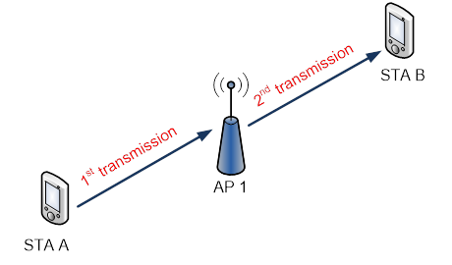
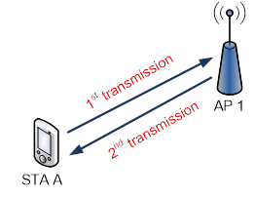
Asymmetric and Symmetric FD
Asymmetric FD
Symmetric FD
Asymmetric FD for 802.11
  Usually three or more nodes involved in FD operation.
  APs are FD-capable while STAs are half-duplex devices
  Only the AP is capable of transmitting and receiving at the same time.
(Pairwise) Symmetric FD for 802.11
  Two nodes involved in FD operation.
  Both APs and STAs are FD-capable
  Both nodes are transmitting and receiving at the same time

Slide 5
FD Architectures
Synchronized Asymmetric FD
Opportunistic Downlink Asymmetric FD
Opportunistic Uplink Asymmetric FD
Symmetric FD

Slide 6
Synchronized Asymmetric FD
Uplink and Downlink FD Transmissions are synchronized
AP controls entire FD transmission
  AP may indicate start of FD transmission to STA B and reception of data from STA A

Slide 7
Opportunistic Downlink Asymmetric FD
AP transmission is opportunistic to STA B based on specific STA A
AP starts a downlink transmission to STA B based on the reception of data from STA A
  As STA A is already transmitting, AP has to communicate start of its transmission to STA B only.

Slide 8
Opportunistic Uplink Asymmetric FD
AP starts downlink transmission to STA B. Then AP starts reception of data from STA A
AP transmission is opportunistic from STA A based on STA B
  As STA B is already transmitting, mechanism is needed to identify start of transmission from STA A. More difficult than opportunistic DL asymmetric FD.

Slide 9
Symmetric FD
AP starts DL transmission to STA A and receives uplink transmission from STA A.
AP may indicates start of FD transmission to STA A and reception of data from STA A
May also be synchronized or opportunistic.

Slide 10
Impact on 802.11 Standards

Slide 11
  Impacts on the 802.11 standard (1)
  A FD training sequence/preamble is needed to train the FD PHY.
  This may be:
    A FD standalone training frame.
    A FD preamble added to the existing frames

Slide 12
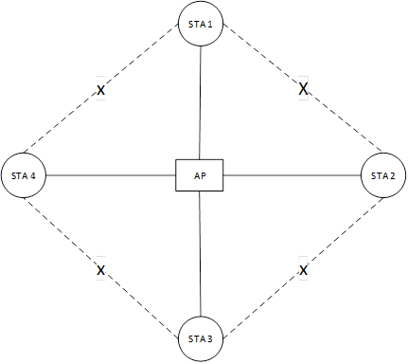
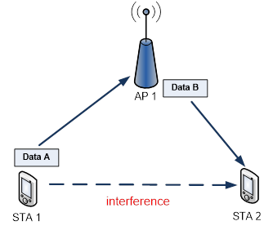
Impacts on the 802.11 standard (2)
Figure 1: Asymmetric FD Interference
Figure : Asymmetric FD compatible STAs
Need for interference discovery procedures to ensure that potential interference from STA 1 to STA 2 in Figure 1 is minimized
  Procedures will enable AP identify FD compatible STAs.
  e.g. in Figure 2, STAs NOT linked by “X” are “FD compatible”

Slide 13
Impacts on the 802.11 standard (3)
FD transmission initiation
  The 802.11 specification should include specific ways to initiate the FD transmission.
  This may include element that informs the specific STAs the start and duration of the FD transmission in the case of an explicitly synchronized FD transmission.
  It may also include in information that may inform a specific STA about the start and duration of a transmission when the FD transmission is opportunistic.

Slide 14
Conclusion
In this contribution, we present two possible FD architectures and corresponding transmission configurations. These are:
  Asymmetric Full Duplex
  Symmetric Full Duplex
We discuss two impacts the introduction of a FD mechanism in 802.11 will have on the standard. These include:
  The need for a FD preamble/training sequence.
  The need to identify FD compatible STAs in an asymmetric FD network.

Slide 15
References
11-18-0549-00-00fd-full-duplex-for-802-11
11-18-0758-00-00fd-full-duplex-usage-model
11-18-0880-00-00fd-self-interference-cancellation-in-full-duplex-for-802-11
11-18-0938-00-00fd-psss-cdd-full-duplex-phy
11-18-1019-01-00fd-improving-system-efficiency-using-full-duplex-based-collision-detection

