Slide 1
Example OFDM symbols for the spec.
Date: 2018-07-09
Authors:

Slide 2
Abstract
During the March meeting in Chicago, the people active in the PHY specification agreed to provide 3 examples of OFDM symbols in the specification text, both for the 4 µs and the 2 µs symbols.
Here, we propose 3 examples to include for the single channel case.

Slide 3
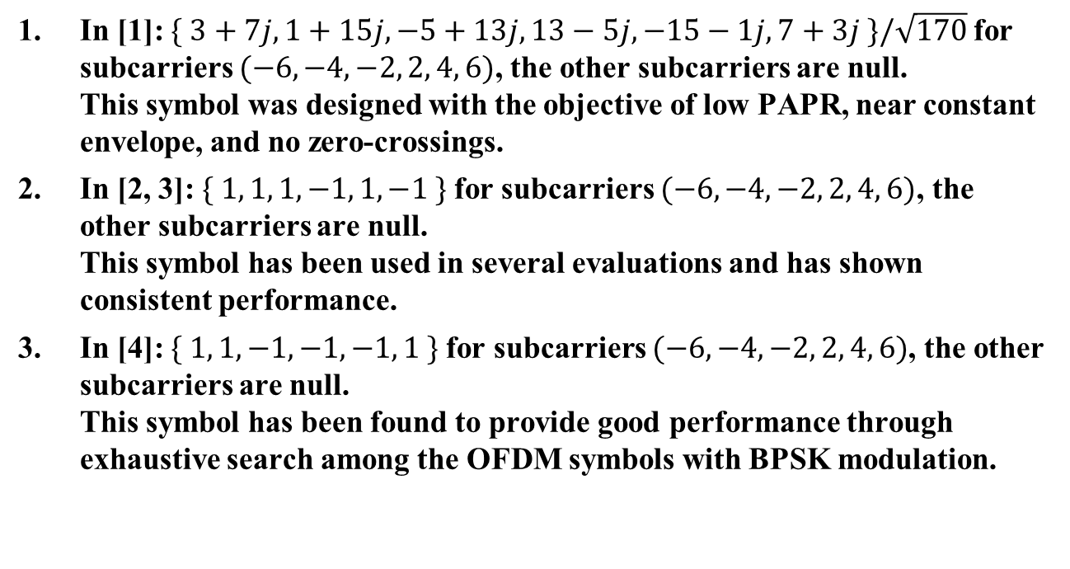
Examples of 2 µs OFDM Symbols for a Single Channel
In [1]: $\{ 3+7j, 1+15j, −5+13j, 13−5j, −15−1j, 7+3j \}/\sqrt{170}$for subcarriers $(−6, −4, −2, 2, 4, 6)$, the other subcarriers are null.
This symbol was designed with the objective of low PAPR, near constant envelope, and no zero-crossings.
In [2, 3]: $\{ 1, 1, 1, −1, 1, −1 \}$for subcarriers $(−6, −4, −2, 2, 4, 6)$, the other subcarriers are null.
This symbol has been used in several evaluations and has shown consistent performance.
In [4]: $\{ 1, 1, −1, −1, −1, 1 \}$for subcarriers $(−6, −4, −2, 2, 4, 6)$, the other subcarriers are null.
This symbol has been found to provide good performance through exhaustive search among the OFDM symbols with BPSK modulation.

Slide 4
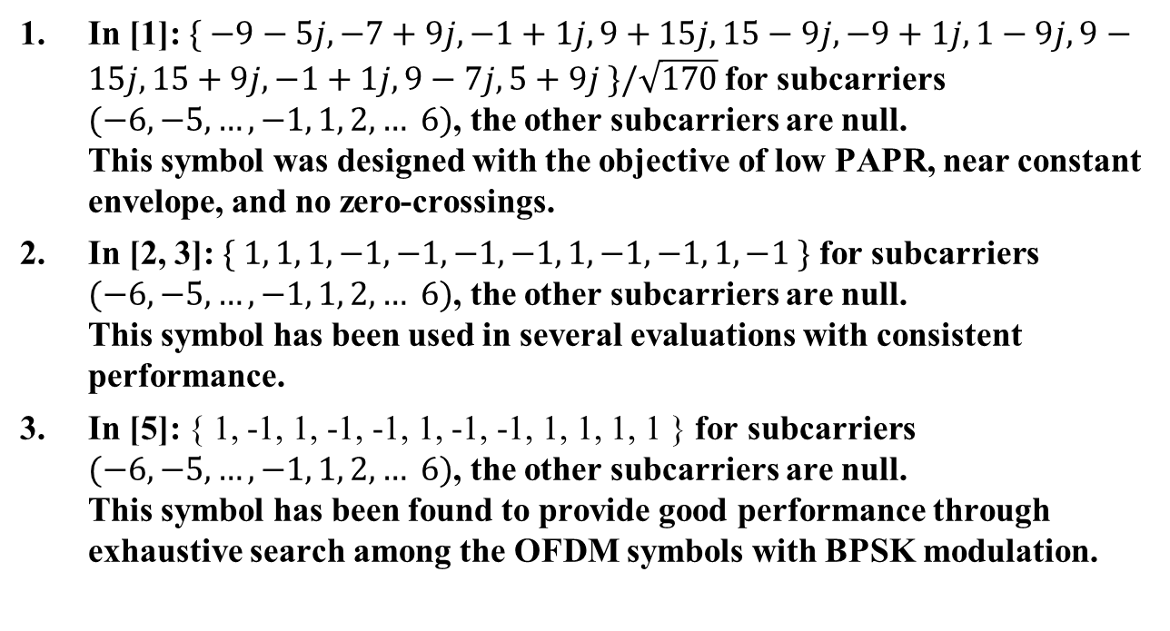
Examples of 4 µs OFDM Symbols for a Single Channel
In [1]:$\{ −9−5j, −7+9j, −1+1j, 9+15j, 15−9j, −9+1j, 1−9j, 9−15j, 15+9j, −1+1j, 9−7j, 5+9j \}/\sqrt{170}$for subcarriers $(−6, −5, …, −1, 1, 2, … 6)$, the other subcarriers are null.
This symbol was designed with the objective of low PAPR, near constant envelope, and no zero-crossings.
In [2, 3]: $\{ 1, 1, 1, −1, −1, −1, −1, 1, −1, −1, 1, −1 \}$ for subcarriers $(−6, −5, …, −1, 1, 2, … 6)$, the other subcarriers are null.
This symbol has been used in several evaluations with consistent performance.
In [5]: { 1, -1, 1, -1, -1, 1, -1, -1, 1, 1, 1, 1 } for subcarriers $(−6, −5, …, −1, 1, 2, … 6)$, the other subcarriers are null.
This symbol has been found to provide good performance through exhaustive search among the OFDM symbols with BPSK modulation.

Slide 5
Straw Poll #1
Do you agree that we should include 3 examples of ON-symbols for the 4 µs symbol and 3 examples of for the 2 µs symbol in the specification?
Y/N/A:

Slide 6
Straw Poll #2
Do you agree we should include the 3 example symbols for the 2 µs OFDM symbol defined on Slide 3?
Y/N/A:

Slide 7
Straw Poll #3
Do you agree we should include the 3 example symbols for the 4 µs OFDM symbol defined on Slide 4?
Y/N/A:

Slide 8
References
[1]: 802.11-18/0479r2, M. Lopez et al, “MC-OOK Symbol Design”
[2]: 802.11-18/0421r1, E. Park et al, “OOK Waveform Generation Follow-up”
[3]: 802.11-18/0824r1, S. Shellhammer et al, “WUR Power Spectral Density”
[4]: 802.11-18/0492r2, V. Kristem et al, “2 us OOK waveform generation”
[5]: 802.11-18/1164r0, V. Kristem et al, “Recommendations on OOK waveform and CSD setting”

