Slide 1
Vehicular-to-Pedestrian Channel Models
Date: 2018-07-10
Authors:

Slide 2
Abstract
Protect vulnerable road users with reliable vehicle-to-pedestrian communications to reduce accidents
Accurate vehicle-to-pedestrian channel models to design reliable vehicle-to-pedestrian communications
Comparison of V2X channels
Related work on vehicle-to-pedestrian channel models
V2P path loss models

Slide 3
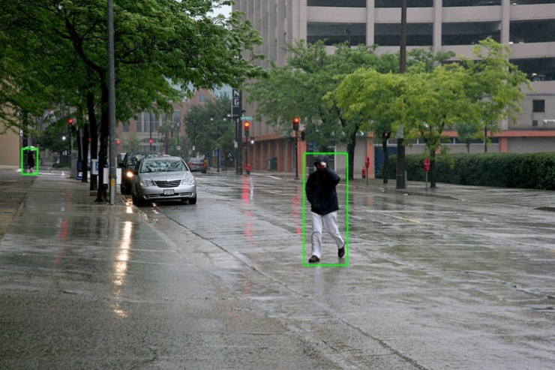
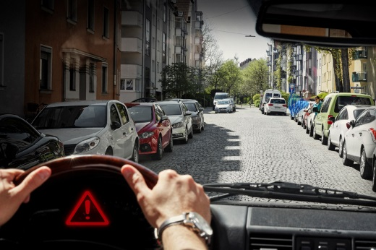
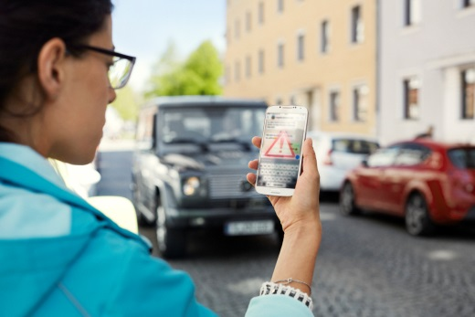
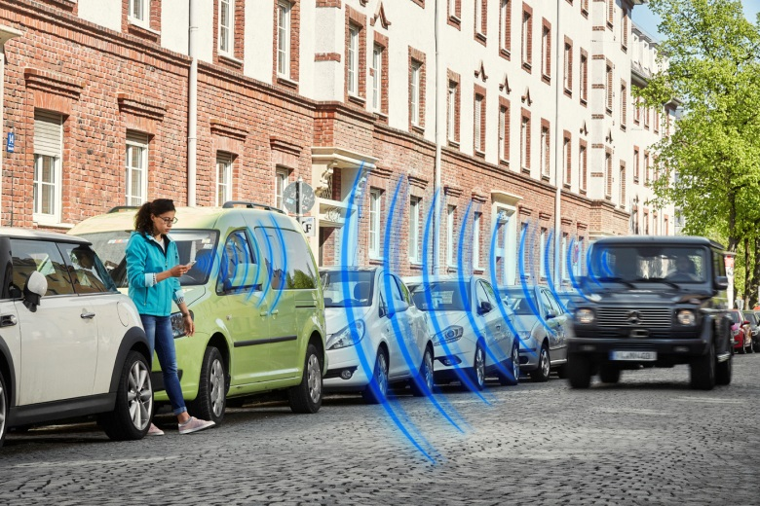
Motivation
Vulnerable road users account for 30% of road fatalities in Europe.
Sensor-based crash avoidance systems suffer from limitations.
360 degree awareness by direct exchange of information between
vehicles and pedestrians
[1]

Slide 4
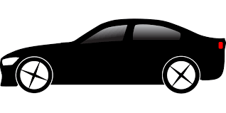

Motivation
Accurate V2P channel models required for reliable communication system
Extensive work has been done for
vehicle-to-vehicle (V2V)
vehicle-to-infrastructure (V2I)
person-to-network (P2N)
V2P channel models only 3 recent papers
[2] @ 1.85 GHz, [3] @ 3.8 GHz, [4] @ 5.2 GHz
Much work to be done!
V2I
V2V
P2N
V2P

Slide 5
Comparison of V2X Channels
V2V, V2I and V2P: Different antenna height, mobility pattern, and propagation scenarios
➔ different propagation aspects
Nonstationary V2V and V2P channels:
Time-variant channel statistics due to moving TX, RX, and dynamic environment
Signal attenuation: Strong spatio-temporal correlations
Stochastic channel models [2]: Large-scale VANET simulators e.g., ns3 and OMNet++
➔ Average packet delivery ratio, but difficult to account for geometry dependent correlations
Geometry-based stochastic channel model (GSCM) [3], [4]: Link level and system level simulations in particular for safety-relevant applications such as platooning, automated and remote driving
➔ Geometry dependent packet outages, but higher complexity

Slide 6
Related Work: 3GPP 5G V2X Channel Models & Evaluation Methodology
3GPP 5G V2X use case groups [5]:
Vehicle platooning
Extended sensors
Automated driving
Remote driving
5G V2V performance evaluation for use case groups:
Adapted parameter sets of GSCM [6] for below and above 6 GHz
V2P and V2I models assume same parameters as V2V
  Realistic?

Slide 7
Related Work: V2P Channel Models
V2P stochastic channel models (SCM) @ 1.85 GHz [2]
In-vehicle to pedestrian
LOS/NLOS and in pocket/next to face
Path loss, shadow, small scale, and multi scale fading parameters based on measurements
SCM with combination of Weibull and Rayleigh distributions
V2P channel models @ 3.8 GHz [3]
Only LOS evaluated
RX antenna fixed on long wooden stick ➔ untypical, best case pedestrian scenario
Two-ray path loss model < 32 meters

Slide 8
V2P Path Loss Models
Based on [4] @ 5.2 GHz:
Line-of-Sight (LOS):
  Static pedestrian: Two-ray ground reflection path loss model
  Moving pedestrian, texting: Log-distance path loss model + increased shadow fading
NLOS due to other nearby pedestrians:
5-10 dB additional path loss due to shadowing
NLOS due to parked vehicles:
Multiple knife edge diffraction model
NLOS due to buildings:
Log-distance path loss model (propagation through building) + knife edge diffraction (+ reflections/scattering)

Slide 9
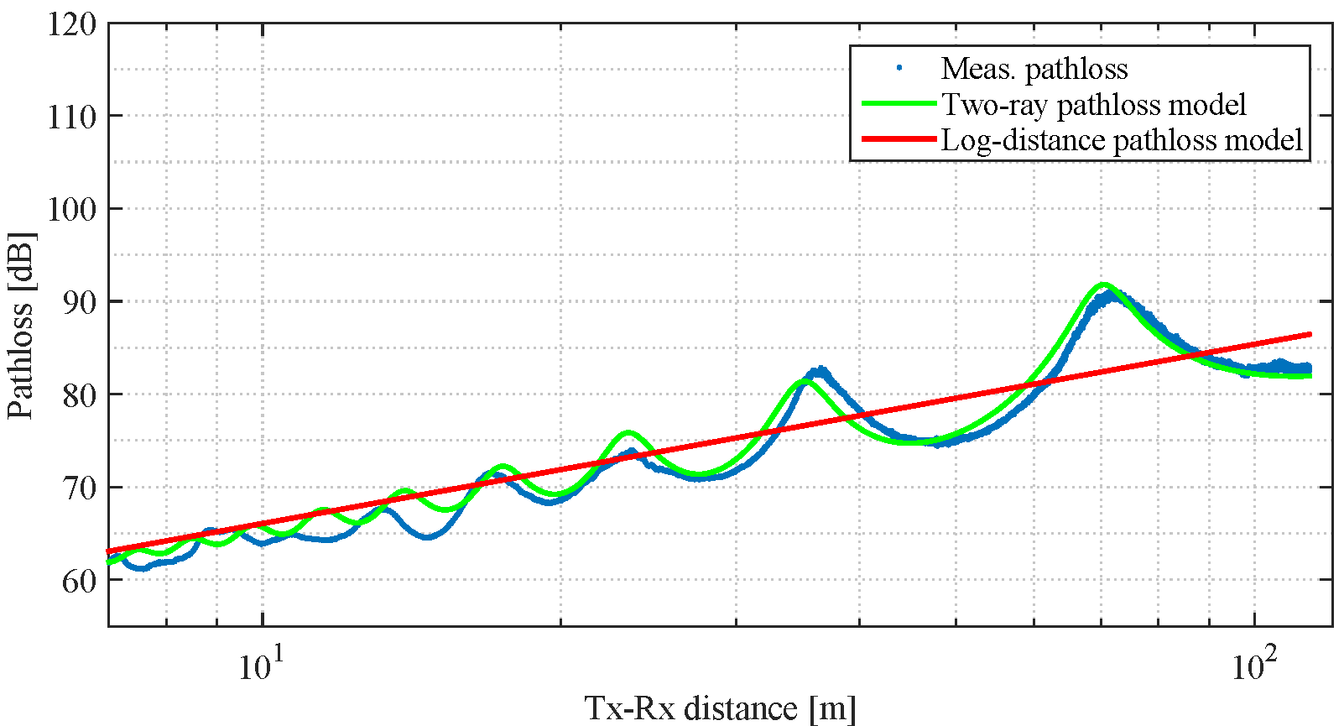
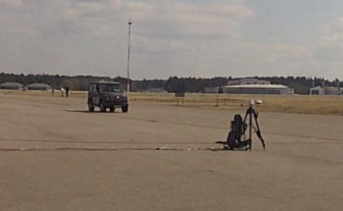
V2P Path Loss Models: LOS – Static Tripod
Log-distance path loss model
Reference distance d₀ = 1 m
Loss at d₀ P_{L}(d₀) = 46.77 dB
Path loss exponent n = 2.03
Log-normal shadow fading
Standard deviation 𝜎 = 3.23 dB
TX
2 m
RX
1.1 m
7 m

Slide 10
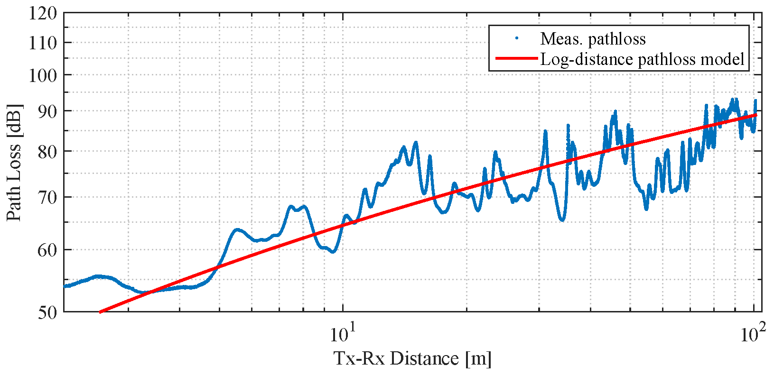
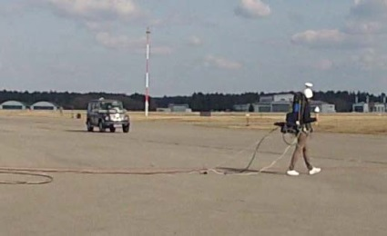
V2P Path Loss Models: LOS – Moving Pedestrian, Texting
Pedestrian antenna at low elevation and close to body → self-body shadowing
Log-distance path loss model
Reference distance d₀ = 1 m
Loss at d₀ P_{L}(d₀) = 40 dB
Path loss exponent n = 2.44
Log-normal shadow fading
Standard deviation 𝜎 = 5.47 dB
1.3 m

Slide 11
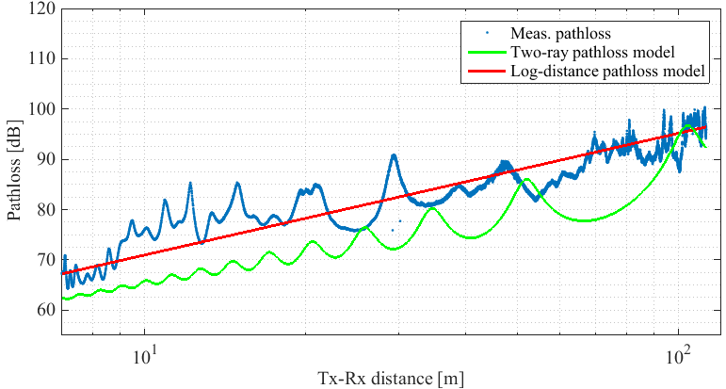
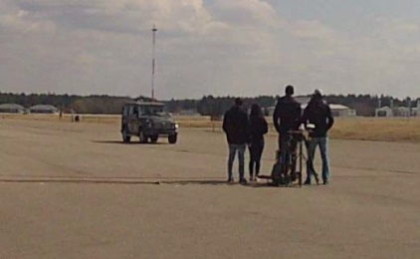
V2P Path Loss Models: NLOS, Crowd Shadowing
Nearby other pedestrians → 5-10 dB additional path loss due to shadowing
Log-distance path loss model
Reference distance d₀ = 1 m
Loss at d₀ P_{L}(d₀) = 67 dB
Path loss exponent n = 1.26
Log-normal shadow fading
Standard deviation 𝜎 = 3.35 dB

Slide 12
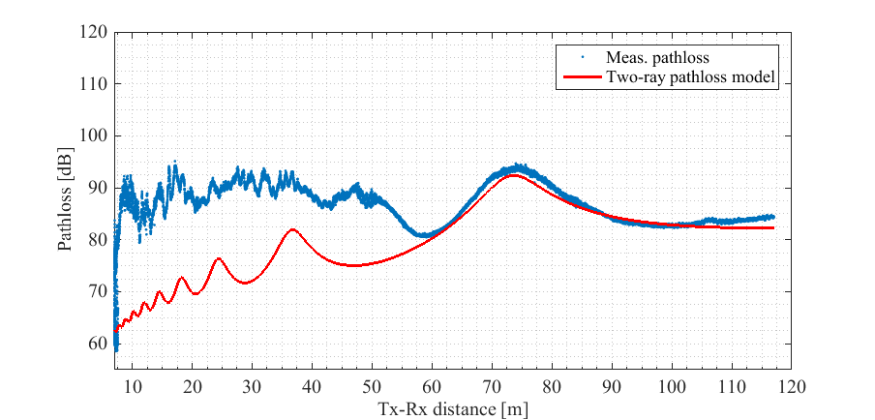
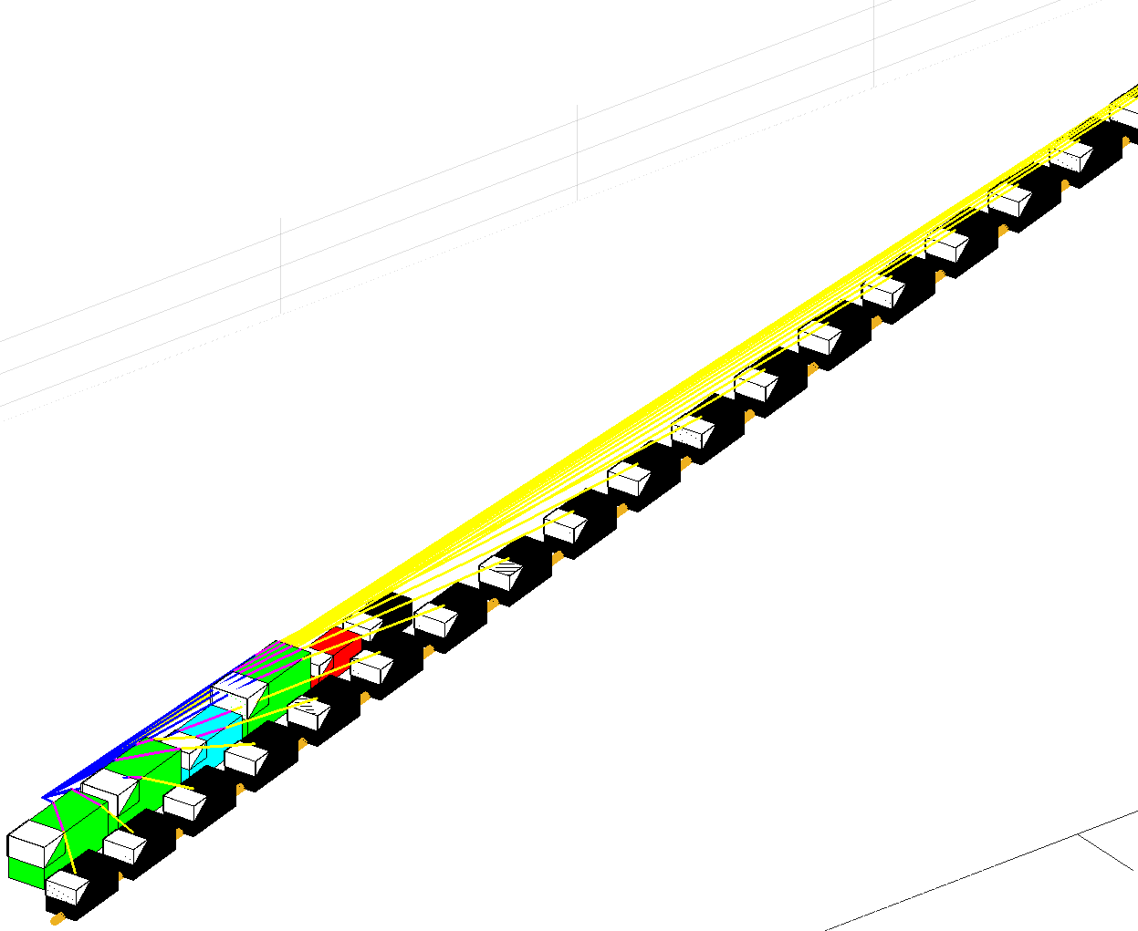
V2P Path Loss Models: Parking Cars, NLOS, Diffraction – First Results

Slide 13
V2P Path Loss Models: Parking Cars, NLOS, Diffraction – First Results

Slide 14
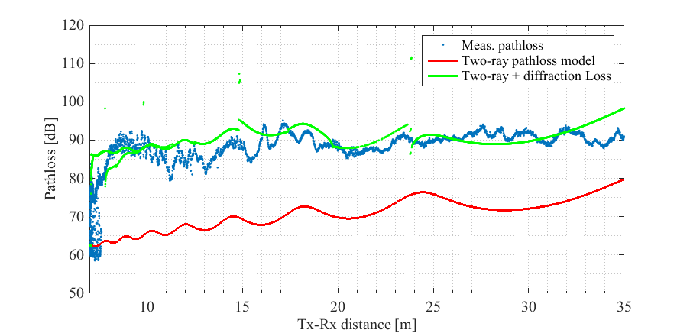
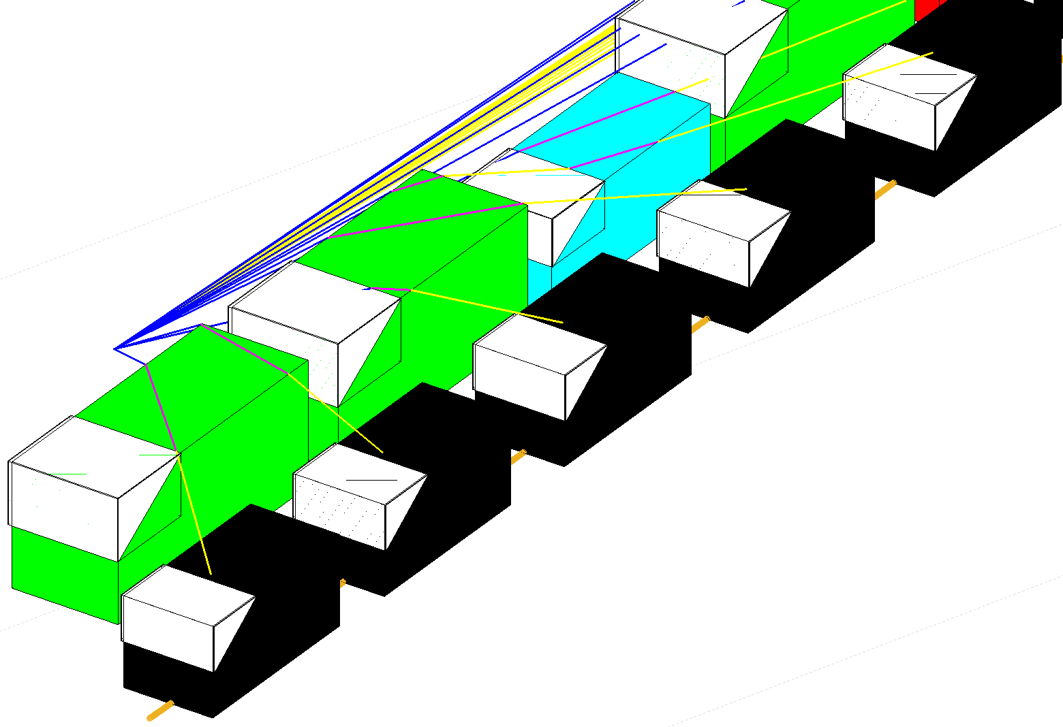
V2P Path Loss Models: Parking Cars, NLOS, Diffraction – First Results
Multiple knife-edge diffraction model +
two-ray path loss model

Slide 15
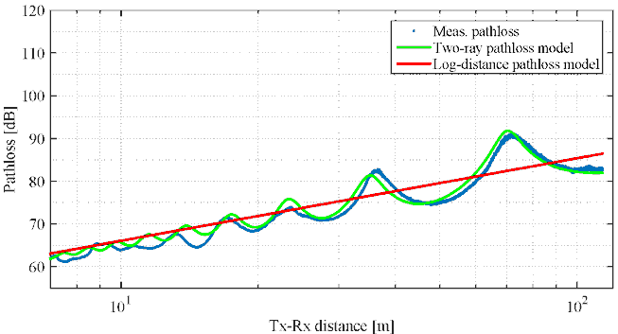

Conclusions
V2P channel different from V2V/V2I channel ➔ 3GPP 5G approach realistic?
V2P channel models: Recent papers [2] @ 1.85 GHz, [3] @ 3.8 GHz, [4] @ 5.2 GHz
V2P path loss models based on [4]:
LOS static pedestrian:
Two-ray pathloss model
LOS moving pedestrian, texting: increased shadow fading
NLOS due to other nearby pedestrians:
5-10 dB additional path loss due to shadowing
NLOS due to parked vehicles: Multiple knife edge diffraction model

Slide 16
Conclusions
V2P channel different from V2V/V2I channel ➔ 3GPP 5G approach realistic?
V2P channel models: Recent papers [2] @ 1.85 GHz, [3] @ 3.8 GHz, [4] @ 5.2 GHz
V2P path loss models based on [4]:
LOS static pedestrian:
Two-ray pathloss model
LOS moving pedestrian, texting: increased shadow fading
NLOS due to other nearby pedestrians:
5-10 dB additional path loss due to shadowing
NLOS due to parked vehicles: Multiple knife edge diffraction model
Accurate V2P channel models
Design reliable V2P communications
Protect vulnerable road users

Slide 17
References
[1] Wikipedia https://commons.wikimedia.org/wiki/File:D%C3%A9tection_de_personne_-_exemple_3.jpg
[2] Ibdah, Yazan and Ding, Yanwu (2015) Mobile-to-Mobile Channel Measurements at 1.85 GHz in Suburban Environments. IEEE Transactions on Communications, vol. 63, no. 2, Feb. 2015, pp. 466-475
[3] Makhoul, Gloria and D’Errico, Raffaele and Oestges, Claude (2018) Wideband Vehicle to Pedestrian Propagation Channel Characterization and Modeling. EuCAP 2018, 9.-13. Apr. 0218, London, UK.
[4] Rashdan, Ibrahim and Ponte Müller, Fabian and Wang, Wei und Schmidhammer, Martin und Sand, Stephan (2018) Vehicle-to-Pedestrian Channel Characterization: Wideband Measurement Campaign and First Results. EuCAP 2018, 9.-13. Apr. 2018, London, UK.
[5] 3GPP (2018) Study on evaluation methodology of new Vehicle-to-Everything V2X use cases for LTE and NR;(Release 15). TR 37.885, V15.0.0 (2018-06).

Slide 18
References
[6] 3GPP (2018) Study on channel model for frequencies from 0.5 to 100 GHz (Release 15). TR 38.901, V15.0.0 (2018-06).

