Slide 1
Backward Compatible PHY Feasibility
Date: 2018-07-06
Authors:

Slide 2
Backward Compatibility PHY Enhancements
PHY enhancement is considered backward compatible if a legacy device can decode the data
Packet modification isn’t possible
Adding post-packet data is a potential change
Shouldn’t harm legacy device operation and access to the network

Slide 3
Concatenated Error Protection
Outer error correction code can be appended to packet, protecting it without changing it
Outer code
(enc.)
Inner code (conv.)
802.11p data
802.11p data
Parity
802.11p packet
Coded parity
Channel
Outer code
(dec.)
Inner code (Viterbi)
802.11p data
802.11p data
Parity
802.11p packet
Coded parity

Slide 4
Adding Parity Bytes Without Harming Backward Compatibility
Parity bytes can be appended to packet till SIFS
Using 802.11 5GHz SIFS (16us) and not the unnecessary long 802.11p SIFS (32us)
Parity bytes are ignored by DIFS state machine
Caveat: very close vehicles might exceed -62dBm energy detect threshold
Legacy device receives packet while ignoring parity bytes
NGV device benefits from coding gain
802.11p packet
Parity
16uS SIFS
58uS 11p DIFS

Slide 5
Outer Error Correction Code
Reed-Solomon (RS) is commonly used as outer code
Can correct (N-K)/2 bytes by adding (N-K) parity bytes to N bytes block
Low complexity decoding
Packet is divided to blocks where each block is encoded / decoded independently. Last block may be shorter
Validation of parity bytes existence isn’t needed
Decoding isn’t performed on packets with good CRC
When CRC is bad, and parity bytes are missing, RS decoding may introduce more errors, but packet isn’t good anyhow, so no harm is done
802.11p packet
Parity
Block 1
Block 2
Block 3
P1
P2
P3

Slide 6
Outer Code Construction
Entire parity bytes should fit 5 symbols (58-16=42us)
Avoiding tailing bits is recommended
Increases number of available parity bytes, but complicates coding
Code can be selected per packet according to packet length
Code | Max. decoded length | MCS | Tail bits
RS(86, 80) | 400 | 1 | No
RS(166, 160) | 800 | 1 | No
RS(250, 244) | 1220 | 1 | No
RS(248, 244) | 1708 | 1 | Opt.
RS(250, 244) | 2440 | 3 | No

Slide 7
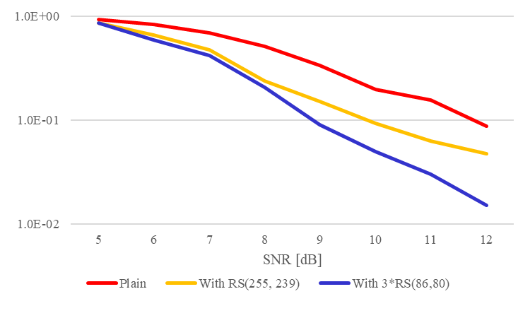
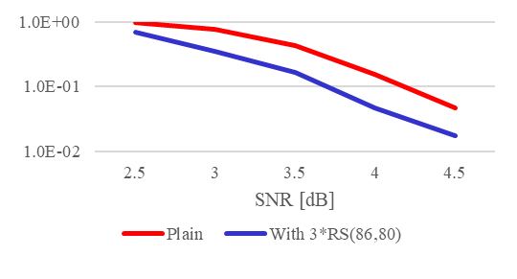
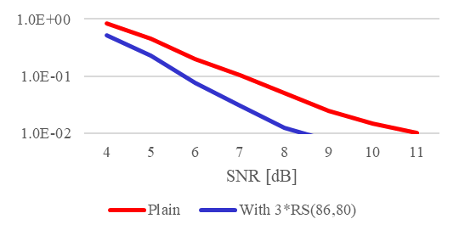
Outer Code Gain MCS=1, 239 bytes packet, 1RX
~3dB gain
[C2C_highway_NLOS_enhanced (Doppler=2352Hz)]
~0.5dB gain [AWGN]
~1.5dB [C2C_highway_LOS_enhanced (Doppler = 1176Hz)]

Slide 8
Summary
Enhanced PHY messages are received by 802.11p devices and increase NGV devices communication range
Not impacting legacy IEEE802.11p reception, network access and fairness
Forward looking solution, supporting high network load
Utilizing long DIFS period for outer error correction code bytes
High gain (~3dB) is achieved on complex channels, where range increase is desired
Simple channels have low gain (~1dB) but communication range already surpasses requirements by far

