Slide 1
mmW for V2X use cases
Date: 2018-7-11
Authors:

Slide 2
Why mmW for V2X?
Enhances V2X for rich data sharing
  Lots of potential applications utilizing
  P2P-near range communication
  Complements 5.9GHz V2X technologies
Can reuse mature PHY/MAC technologies
from 11ad (and 11ay)
  Shares design strategy/policy with 5.9GHz NGV
Data rate,
Accurate positioning
P2P
mmW
60GHz
NGV-
5.9GHz
11p
5.9GHz
Broadcast
Coverage,
Availability
IEEE PHY/MAC
for V2X

Slide 3
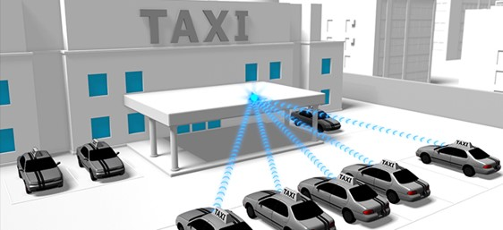
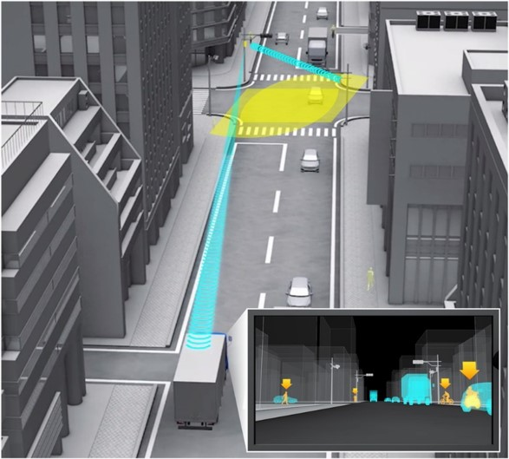
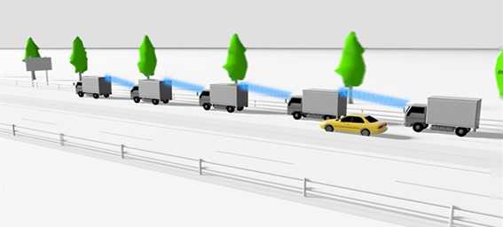
Use cases
Data rate,
Accurate positioning
P2P
mmW
60GHz
Rich sensor data sharing
3D/dynamic
map sharing
Real-time
sensor sharing
Platooning
w/ sensor sharing
NGV
5.9GHz
Comfort driving
/services
11p
5.9GHz
Broadcast
Safety/BSM
Coverage,
Availability

Slide 4
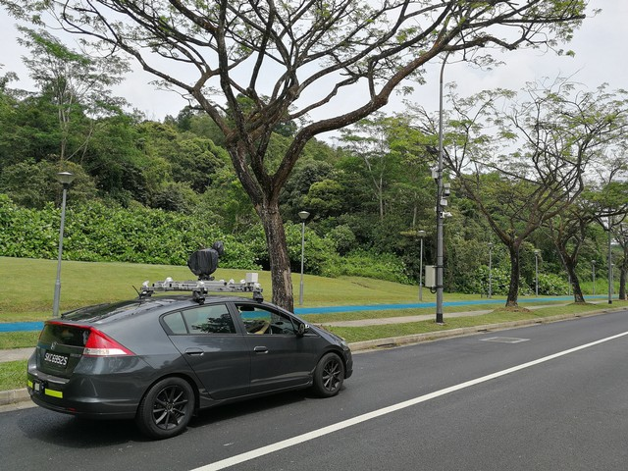
Technologies
NGV mmW may
  be included in the multiband management scheme of NGV
  develop improvement/optimization on discovery and initial link setup
  not change 11ad/ay PHY but reuse it
based on 11ad/11ay 60GHz technologies
NGV mmW provides
  1+ Gbps data rate for V2X
  low latency provided by 11ad
  reuse of 11az DMGz positioning
On board unit
Road side unit

Slide 5
Conclusion
11ad/ay-based mmW technology enhances V2X to enable lots of potential applications
Propose to consider mmW as one of the scope of NGV

Slide 6
References
[1] Hongyuan Zhang, et al., 11-18-0513-02-0wng-802-11-for-next-generation-v2x-communication
[2] Onn Haran, et al., 11-18-1072-00-0ngv-proposed-ngv-use-case-document
[3] Irie et al., “60 GHz multi-gigabit wireless technology for connected vehicles,“ ITSWC2018

Slide 7
Straw poll
Do you agree to include the 60 GHz band, as defined in 11ad/11ay, in the scope of NGV?
- Scope is limited to non-PHY changes to 11ad/11ay
Y: 31 N: 25 A: 21

