Slide 1
mmW for V2X use cases
Date: 2018-7-9
Authors:

Slide 2
Why mmW for V2X?
Enhances V2X for rich data sharing
Lots of potential applications utilizing P2P-near range communication
Complements 5.9GHz V2X technologies
Can reuse mature PHY/MAC technologies from 11ad (and 11ay)
Shares design strategy/policy with 5.9GHz NGV
Data rate,
Accurate positioning
P2P
mmW
60GHz
NGV-
5.9GHz
11p
5.9GHz
Broadcast
Coverage,
Availability
IEEE PHY/MAC
for V2X

Slide 3
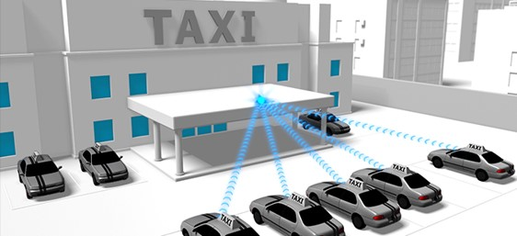
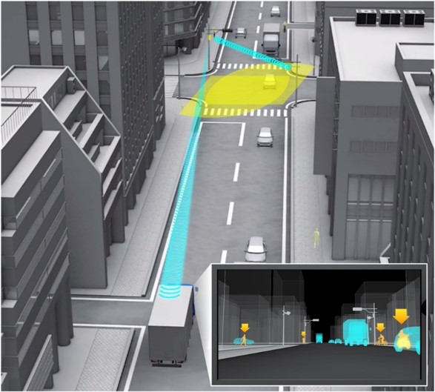
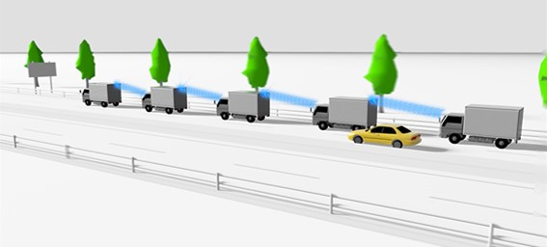
Use cases
Data rate,
Accurate positioning
P2P
mmW
60GHz
Rich sensor data sharing
3D/dynamic
map sharing
Real-time
sensor sharing
Platooning
w/ sensor sharing
NGV
5.9GHz
Comfort driving
/services
11p
5.9GHz
Broadcast
Safety/BSM
Coverage,
Availability

Slide 4
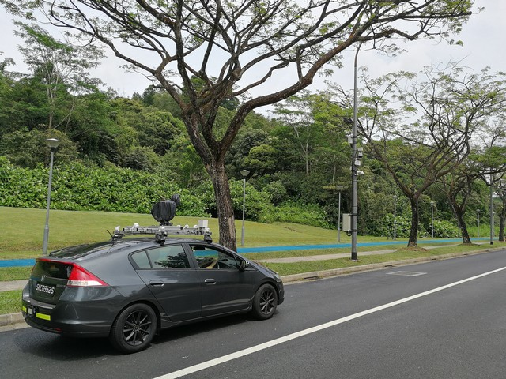
Technologies
NGV mmW may
focus on single channel, single stream operation
develop improvement/optimization on discovery and initial link setup
not develop new PHY
based on 11ad/11ay 60GHz technologies
NGV mmW provides
1+ Gbps data rate for V2X
low data latency similar to 11ad
no conflict with 11az DMGz positioning
for P2P links
On board unit
Road side unit

Slide 5
Conclusion
11ad/ay-based mmW technology enhances V2X to enable lots of potential applications
Propose to consider mmW as one of the scope of NGV

Slide 6
References
[1] Hongyuan Zhang, et al., 11-18-0513-02-0wng-802-11-for-next-generation-v2x-communication
[2] Onn Haran, et al., 11-18-1072-00-0ngv-proposed-ngv-use-case-document
[3] Irie et al., “60 GHz multi-gigabit wireless technology for connected vehicles,“ ITSWC2018

