Slide 1
WUR PSD studies
Date: 2018-07-09
Authors:

Slide 2
Introduction
Strong spectral lines were observed in WUR power spectral density [1]
Transmit power in 3 KHz subband exceeds the specified FCC limits
In this presentation, we study different approaches to address this issue

Slide 3
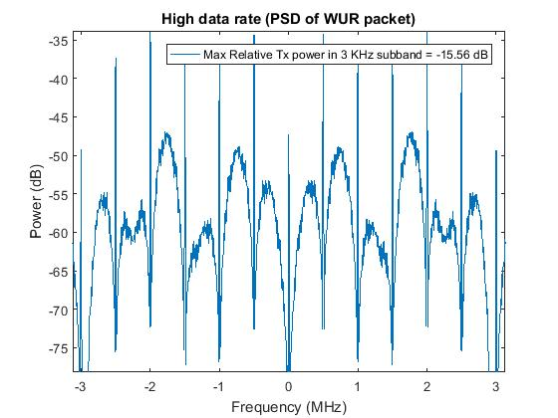
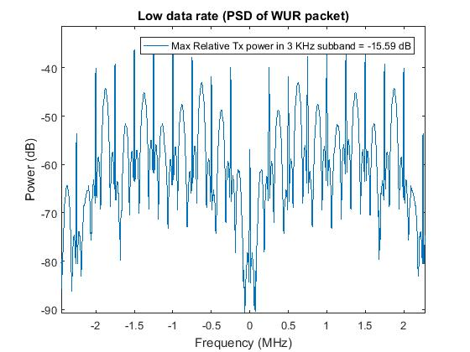
PSD of the WUR Transmit signal
PSD computed on WUR packet comprising of Sync sequence and 1000 data bits
Strong spectral lines with spacing proportional to Manchester symbol rate
Issue: When AP transmits with Max TX power of 30 dBm, the max Tx power in 3 KHz subband is 14.4 dBm
Larger than the 8 dBm FCC limit in 3 KHz subband

Slide 4
Spectral lines in the PSD
Reason for spectral lines in the WUR PSD
Manchester coding and OOK signaling
Same OOK pulse transmitted on air for all ON Manchester data bits/preamble bits
Methods to mitigate spectral lines
Transmit different OOK pulse on air for different ON Manchester data bits/preamble bits
Random phase approach [1]
Apply random phase +1/-1 to the OOK pulse
Random cyclic delay (shift) approach
Apply different (random) amount of cyclic shift to the OOK pulses for different ON manchester data bits/preamble bits
Receiver performance not impacted by applying random cyclic shift or random phase
Energy detector: sum (abs(.)^2) of RX samples
Envelope detector: sum(abs(.)) of RX samples
These two metrics remain same with or without phase/cyclic shift

Slide 5
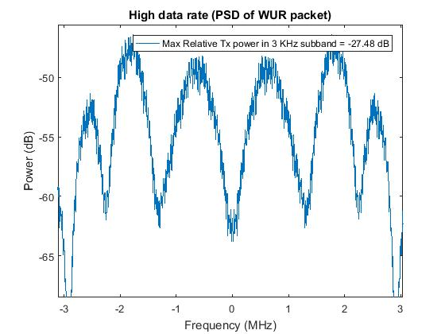
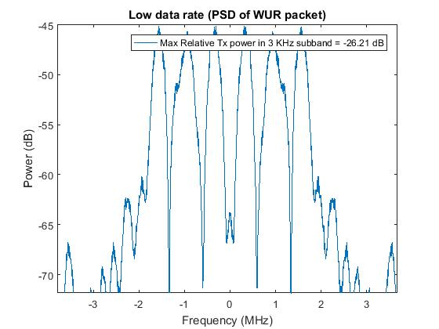
WUR PSD with random phase approach
No strong spectral lines
When AP transmits with Max TX power of 30 dBm, the max Tx power in 3 KHz subband is 2.52 dBm (High rate) and 3.79 dBm (Low rate)
Below the 8 dBm FFC limit

Slide 6
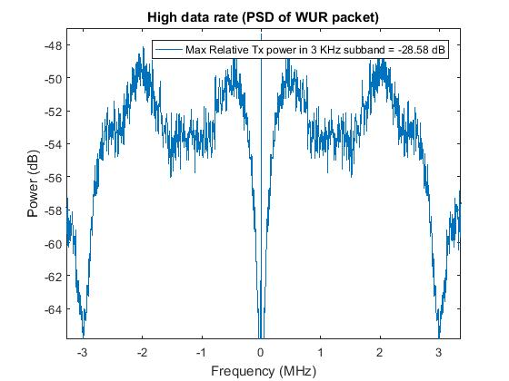
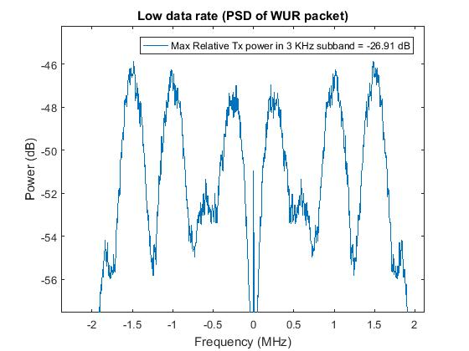
WUR PSD with random cyclic shift approach
No strong spectral lines
When AP transmits with Max TX power of 30 dBm, the max Tx power in 3 KHz subband is 1.42 dBm (High rate) and 3.09 dBm (Low rate)
Below the 8 dBm FFC limit

Slide 7
Random cyclic shift approach
A random cyclic shift is applied to the OOK pulse transmitted for ON Manchester bits/preamble bits
One way to realize this is to use a fixed length, predetermined cyclic shift sequence
This CSD sequence is known at the transmitter, but appear random to the current generation wakeup receiver
More advanced receivers can regenerate the sequence, and can perform coherent detection
Length of CSD sequence can be smaller than total ON bits
Repeat the cyclic shift sequence
Larger the length, smaller the spacing between spectral lines in PSD
Larger the length, smaller the magnitude of spectral lines

Slide 8
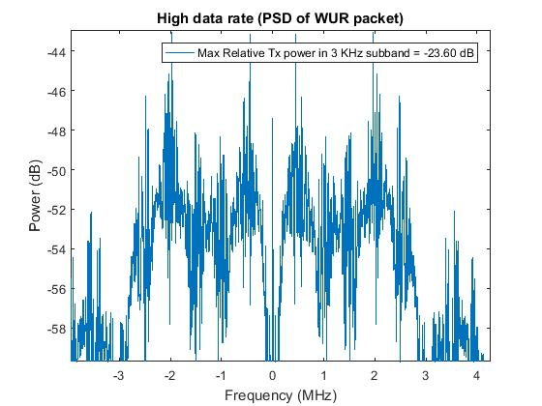
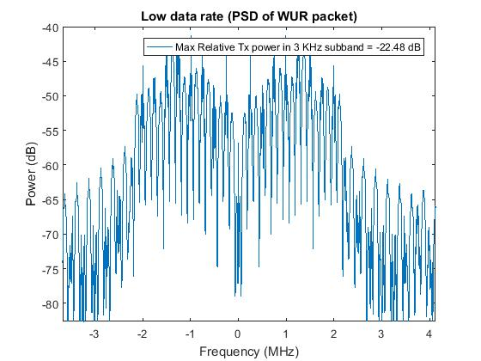
WUR PSD with fixed length cyclic shift seq (Length = 16)
When AP transmits with Max TX power of 30 dBm, the max Tx power in 3 KHz subband is 6.40 dBm (High rate) and 7.52 dBm (Low rate)
Below the 8 dBm FFC limit

Slide 9
With fixed length cyclic shift sequence
CSD Sequence length | Max Tx power in 3 KHz subband (Low Data Rate) | Max Tx power in 3 KHz subband (High Data Rate)
8 | 9.26 dBm | 7.65 dBm
16 | 7.52 dBm | 6.40 dBm
32 | 6.68 dBm | 5.75 dBm
64 | 5.77 dBm | 3.40 dBm
128 | 4.98 dBm | 1.43 dBm
As sequence length increases, the magnitude of spectral lines decreases
16 length sequence is sufficient enough to meet the FCC regulations
Results generated for packet size of 1000 bits
Smaller length sequences might be sufficient for small packet sizes

Slide 10
Summary
Observed spectral lines in WUR transmit signal
Tx power exceeds FCC limits in certain regulatory domains
Studied two different approaches to mitigate this
Random phase approach proposed earlier in [1]
Proposed random cyclic shift (CSD) approach
Both are effective in mitigating the spectral lines and meet FCC regulations
Random CSD approach provides relatively flat spectrum, independent of underlying OOK pulse

Slide 11
Straw Poll
Do you support the method of random cyclic shift (CSD) to mitigate the spectral lines issue?
Yes/No/Abstain

Slide 12
References
[1] Steve Shellhammer, Bin Tian, Richard van Nee, “WUR Power Spectral Density, IEEE 802.11-18/0824r1,” May 2018

