Slide 1
Recommendations on OOK waveform and CSD setting
Date: 2018-07-09
Authors:

Slide 2
Introduction
It has been agreed by the TGba group not to mandate any OOK waveform, but specify few examples that does into the spec draft
In [1,2], we studied the WUR performance for different pulse shapes and CSD values
In this presentation, we compare the WUR performance with different OOK pulse designs [1-6] and CSD values and investigate the reasons for differences between reported PER vs. SNR results
We provide recommendations on OOK waveform and the CSD settings for multi-antenna transmission

Slide 3
OOK pulse designs
For the low data rate, the 4 us OOK pulse was generated by populating the center 13 subcarriers with subcarrier spacing of 312.5 KHz. Center sub-carrier is nulled.
For the high data rate, the 2 us OOK pulse was generated by populating every other subcarrier out of these 13 subcarriers.
We have 6 non-zero subcarriers
In [1], we studied the PER and PAPR performance for 64 different pulse shapes
Identified a pulse shape that provides good tradeoff between PER and PAPR
The proposed design provides best performance in Channel D
The PAPR of proposed design is significantly smaller than legacy preamble (STF, LTF, and SIG)

Slide 4
Why do we see different PER results?
Pulse design proposals
Our proposed design (Proposal 1)
High data rate: [1 0 1 0 -1 0 0 0 -1 0 -1 0 1]
Low data rate: [1 -1 1 -1 -1 1 0 -1 -1 1 1 1 1]
The proposed design [3] (Proposal 2)
High data rate: [1 0 1 0 1 0 0 0 -1 0 1 0 -1]
Low data rate: [1 1 1 -1 -1 -1 0 -1 1 -1 -1 1 -1]
Differences:
Receiver architectures for performance evaluation
WUR decoding based on Energy detection (Example: [3])
Metric used: Sum(abs(.)^2)
WUR decoding based on Envelope detection (Example: [5])
Metric used: Sum(abs(.))
SNR Calculation: before or after 4 MHz filter

Slide 5
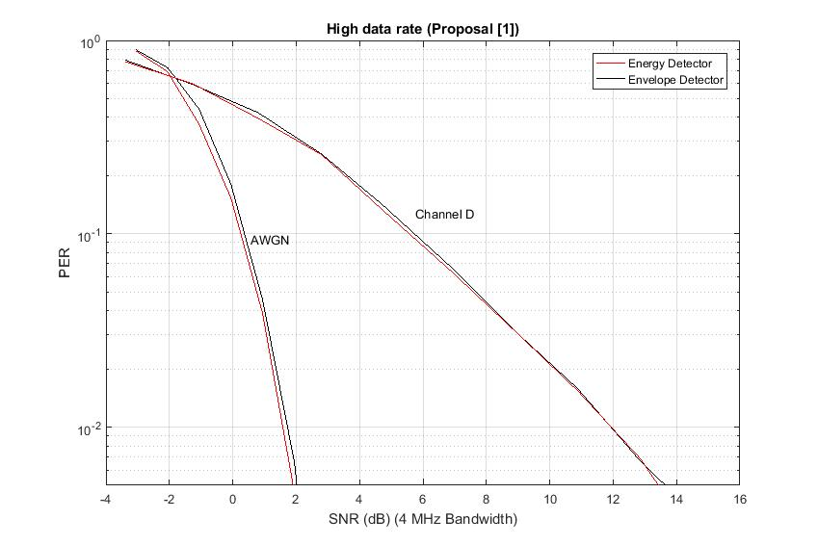
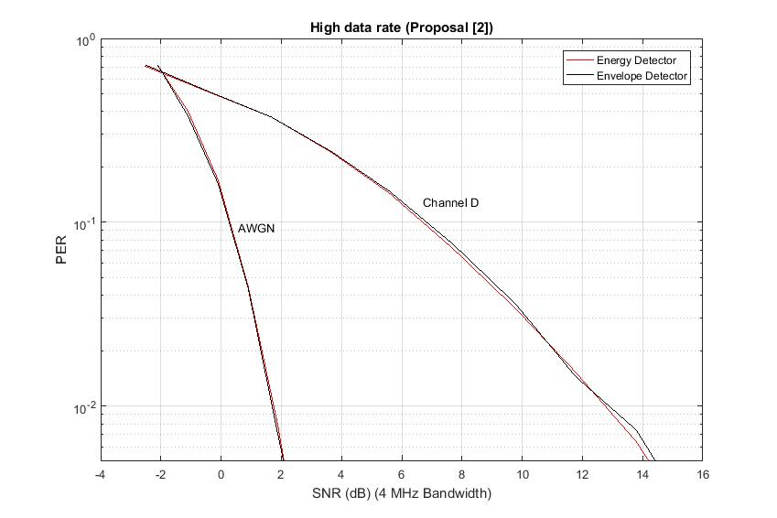
Energy detection vs. Envelope detection
Very similar performance for both receivers: energy detection and envelope detection
Comparison between different pulse designs
Our proposed design performs better in Channel D
In [5], it was confirmed that equal allocation of power in frequency domain provides best performance in fading channel (due to gains from frequency diversity), while low PAPR pulse provides best performance in AWGN

Slide 6
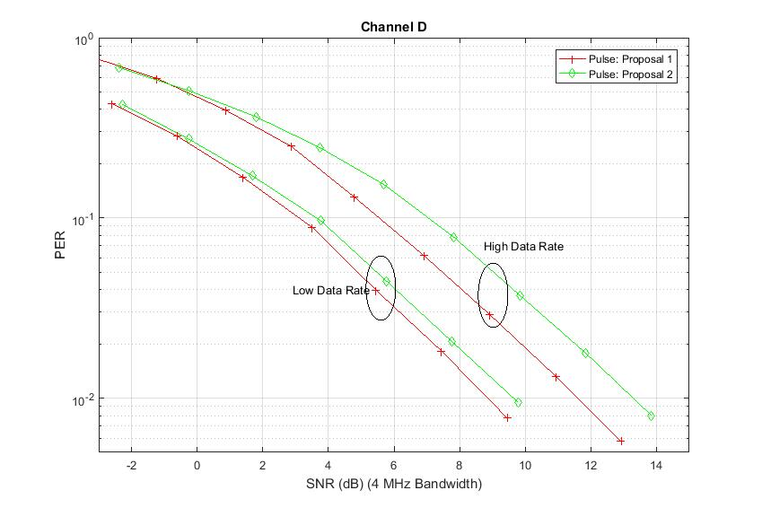
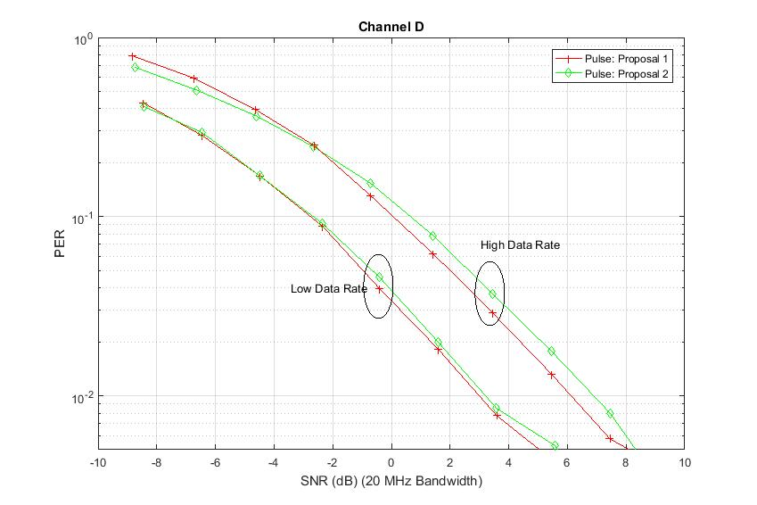
PER Performance SNR @20 MHz BW vs. SNR @ 4MHz
Performance gap between two designs is different for different SNR measurements (SNR @ 20 MHz bandwidth or SNR @ 4 MHz bandwidth)
Partly due to the different frequency domain pulse shapes
Filter itself further changes the shape of the OOK pulse
For a practical receiver, SNR in the 4 MHz, post filter is more relevant

Slide 7
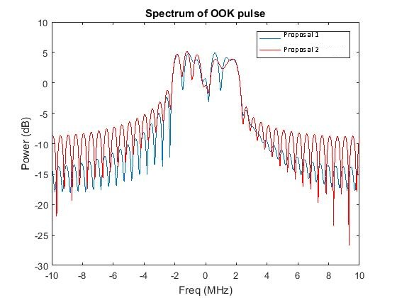
Difference in spectrum of the pulses
The pulse in proposal 2 [3] has significantly higher side lobes
Relatively smaller energy in the 4 MHz WUR signal bandwidth
Requires a sharper filter at the receiver to mitigate the ACI, which increases receiver complexity and power consumption

Slide 8
OOK waveform comparison
Proposal 1
Low Data Rate: reuses the L-STF coefficients, which are already implemented in PCR, and we have shown that they have good performance and low PAPR
S = [1 -1 1 -1 -1 1 0 -1 -1 1 1 1 1] (PAPR = 2.28 dB)
High Data Rate
S = [1 0 1 0 -1 0 0 0 -1 0 -1 0 1] (PAPR = 3.4 dB)
We compare the performance of the above proposed sequences to [3-6]
Proposal 2 [3]
Low Data Rate: [1 1 1 -1 -1 -1 0 -1 1 -1 -1 1 -1] (PAPR = 2.09 dB)
High Data Rate: [1 0 1 0 1 0 0 0 -1 0 1 0 -1] (PAPR = 2.6 dB)
Proposal 3 [5]
Low Data Rate: [-9-5j -7+9j -1+1j 9+15j 15-9j -9+1j 0 1-9j 9-15j 15+9j -1+1j 9-7j 5+9j] (PAPR = 1.23 dB)
High Data Rate: [3+7j 0 1+15j 0 -5+13j 0 0 0 13-5j 0 -15-1j 0 7+3j] (PAPR = 0.8 dB)

Slide 9
CSD recommendations
Based on the studies in [2] and further, we recommend the following CSD settings:
4 us OOK waveform
2 us OOK waveform
Number of antennas | CSD setting (ns)
2 | [0 3000]
3 | [0 1500 3000]
4 | [0 1000 2000 3000]
5 | [0 750 1500 2250 3000]
6 | [0 600 1200 1800 2400 3000]
7 | [0 500 1000 1500 2000 2500 3000]
8 | [0 450 850 1300 1700 2150 2550 3000]
Number of antennas | CSD setting (ns)
2 | [0 1500]
3 | [0 750 1500]
4 | [0 500 1000 1500]
5 | [0 400 750 1150 1500]
6 | [0 300 600 900 1200 1500]
7 | [0 250 500 750 1000 1250 1500]
8 | [0 200 450 650 850 1050 1300 1500]

Slide 10
Multi-antenna performance study with different designs
Considered waveform proposals 1, 2 and 3
Study the performance to these waveforms with our recommended CSD values
Simulation settings
Low data rate and high data rate
Considered 1 Tx, 2 Tx, 4 Tx and 8 Tx antennas
Channel model D
SNR measured post 4 MHz filter
Filter: 3 rd order Butterworth filter with 2.5 MHz cutoff frequency

Slide 11
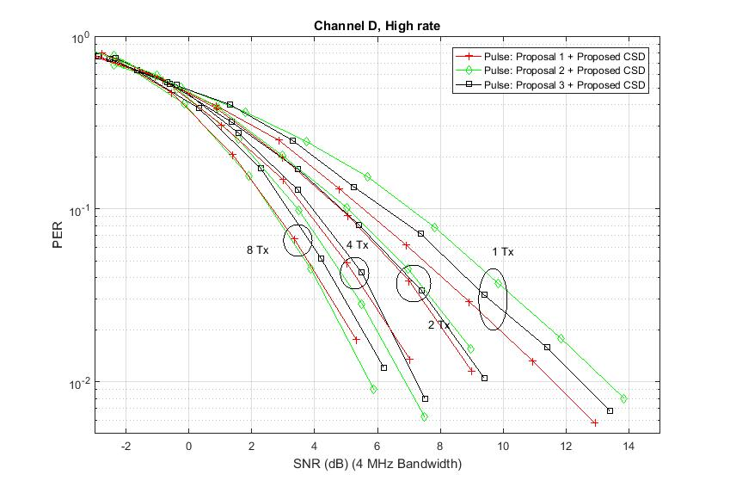
HDR Performance in Channel D
Observations
Single Tx antenna: Proposal 1 waveform was 1.50 dB better than Proposal 2 waveform
For 2, 4 and 8 Tx antennas, proposed CSD works very well with different pulse shapes

Slide 12
SNR @ 10% PER (Channel D, HDR)
 | Pulse: Proposal 1 +Proposed CSD | Pulse: Proposal 2 +Proposed CSD | Pulse: Proposal 3 +Proposed CSD
1 TX antenna | 5.54 dB | 7.04 dB | 6.25 dB
2 TX antenna | 4.33 dB | 4.82 dB | 4.85 dB
4 TX antenna | 3.71 dB | 3.46 dB | 3.93 dB
8 TX antenna | 2.65 dB | 2.60 dB | 3.15 dB
Observations
Single Tx antenna: Proposal 1 waveform was 1.50 dB better than Proposal 2 waveform
For 2, 4 and 8 Tx antennas, proposed CSD works very well with different pulse shapes

Slide 13
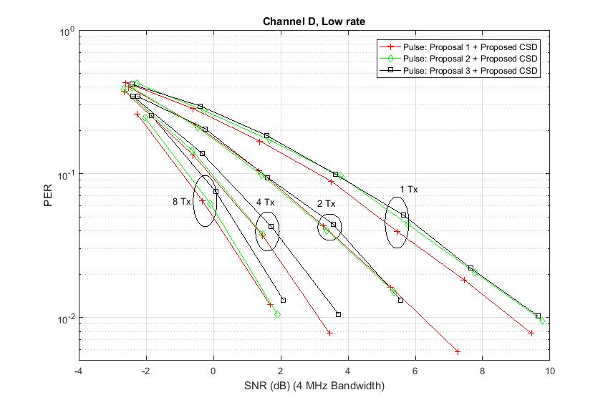
LDR Performance in Channel D
Observations
Single Tx antenna: Proposal 1 waveform is marginally better (0.4 dB) than Proposal 2 waveform
For 2, 4 and 8 Tx antennas, proposed CSD works very well with different pulse shapes

Slide 14
SNR @ 10% PER (Channel D, LDR)
 | Pulse: Proposal 1 +Proposed CSD | Pulse: Proposal 2 +Proposed CSD | Pulse: Proposal 3 +Proposed CSD
1 TX antenna | 3.10 dB | 3.63 dB | 3.59 dB
2 TX antenna | 1.46 dB | 1.38 dB | 1.46 dB
4 TX antenna | -0.12 dB | -0.05 dB | 0.23 dB
8 TX antenna | -0.93 dB | -0.76 dB | -0.38 dB
Observations
Single Tx antenna: Proposal 1 waveform is marginally better (0.4 dB) than Proposal 2 waveform
For 2, 4 and 8 Tx antennas, proposed CSD works very well with different pulse shapes

Slide 15
Conclusions
The proposed pulse shape has been optimized for good tradeoff between Channel D performance and PAPR
Proposal 2 [3,6] and Proposal 3 [5] pulse shape was optimized for AWGN performance and PAPR
The recommended CSD values work very with different pulse shapes
We recommend to have multiple examples of sequences & CSD values in the Draft 1.0, optimized for performance in different channel conditions

Slide 16
Straw poll 1
Do you support to have three examples of ON pulse shapes, for 2 us and 4 us?
Yes/No/Abstain:

Slide 17
Straw poll 2
Do you support to include the following IFFT coefficients for construction of 2 us OOK pulse, as one of the example in the draft?
S = [0 0 0… 0 1 0 1 0 -1 0 0 0 -1 0 -1 0 1 0….0 0 0]
Yes:
No:
Abstain:

Slide 18
Straw poll 3
Do you support the following CSD that goes with 2 us OOK waveform, as one of the examples in the draft?
Use linear CSD spacing, with max CSD of 1500 ns between first and last antenna
Yes:10
No:0
Abstain:4
Number of antennas | CSD setting (ns)
2 | [0 1500]
3 | [0 750 1500]
4 | [0 500 1000 1500]
5 | [0 400 750 1150 1500]
6 | [0 300 600 900 1200 1500]
7 | [0 250 500 750 1000 1250 1500]
8 | [0 200 450 650 850 1050 1300 1500]

Slide 19
Straw poll 4
Do you support to include the following IFFT coefficients for construction of 4 us OOK pulse, as one of the example in the draft?
S = [0 0 0… 0 1 -1 1 -1 -1 1 0 -1 -1 1 1 1 1 0…0 0 0]
Yes:
No:
Abstain:

Slide 20
Straw poll 5
Do you support the following CSD that goes with 4 us OOK waveform, as one of the examples in the draft?
Use linear CSD spacing, with max CSD of 3000 ns between first and last antenna
Yes:
No:
Abstain:
Number of antennas | CSD setting (ns)
2 | [0 3000]
3 | [0 1500 3000]
4 | [0 1000 2000 3000]
5 | [0 750 1500 2250 3000]
6 | [0 600 1200 1800 2400 3000]
7 | [0 500 1000 1500 2000 2500 3000]
8 | [0 450 850 1300 1700 2150 2550 3000]

Slide 21
References
[1] Vinod Kristem, Shahrnaz Azizi, Thomas Kenney, “IEEE 802.11-18/97r0 2 us OOK pulse for high rate,” January 2018
[2] Vinod Kristem, Shahrnaz Azizi, Thomas Kenney, “IEEE 802-11/772r0 Updated results on WUR performance with multiple TX antennas,”, May 2018
[3] Steve Shellhammer, et.al, “IEEE 802.11-18/97r0 Multiantenna TX Diversity,” May 2018
[4] Steve Shellhammer, et.al, “IEEE 802.11-18/1198r0 Simulations with Recommended Symbols and CSD”, July 2018
[5] Miguel Lopez, Dennis Sundman, Leif Wilhelmsson, “MC-OOK Symbol Design,” IEEE 802.11-18/479r2,” March 2018
[6] Eunsung Park , et.al, “11-18-0421-01-00ba-ook-waveform-generation-follow-up,” March 2018

Slide 22
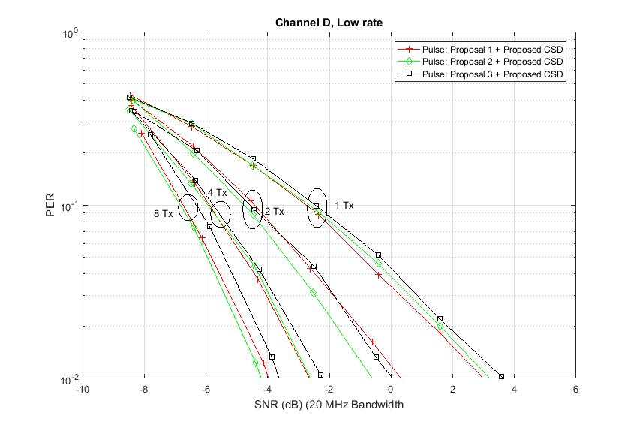
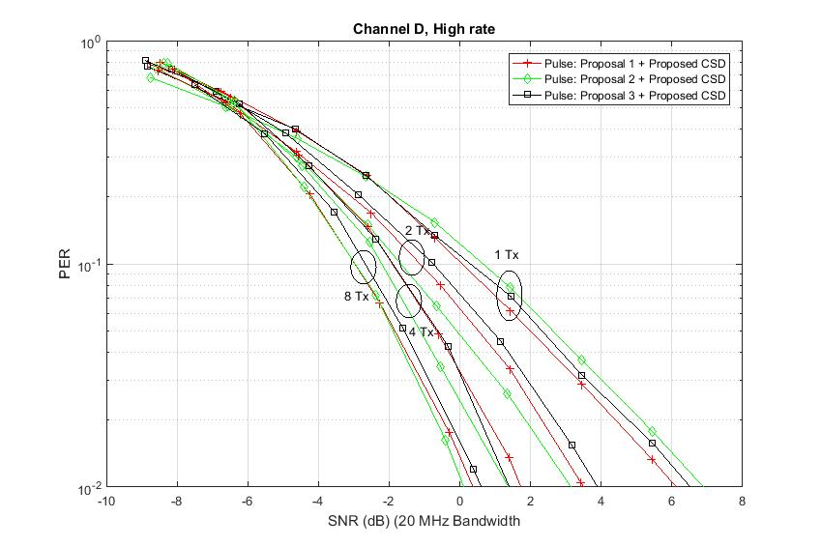
Channel D performance of different waveforms (SNR in 20 MHz bandwidth)
Performance with different waveforms
Low rate: Proposal 1 waveform is marginally better (0.2 dB)
High rate: Proposal 1 waveform is better by 0.6 dB

Slide 23
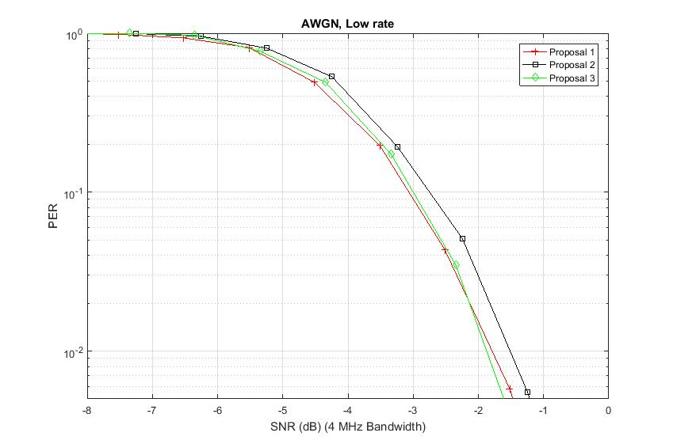
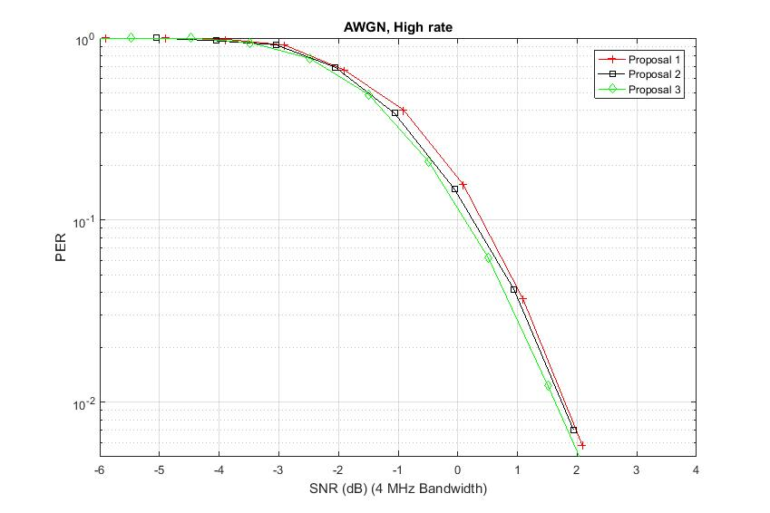
AWGN performance of different waveforms (SNR in 4 MHz bandwidth)
Comparable performance with different waveforms
Low rate: Proposal 1 and proposal 3 are marginally better than proposal 2 (around 0.25 dB)
High rate: Proposal 3 and proposal 2 are marginally better (around 0.4 dB)

Slide 24
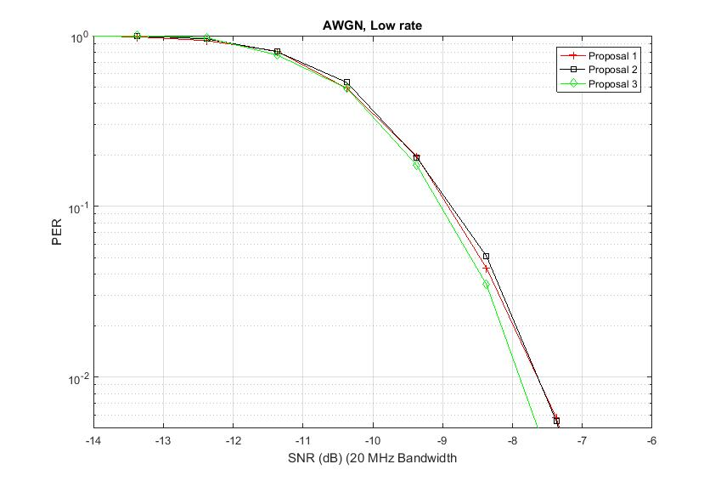
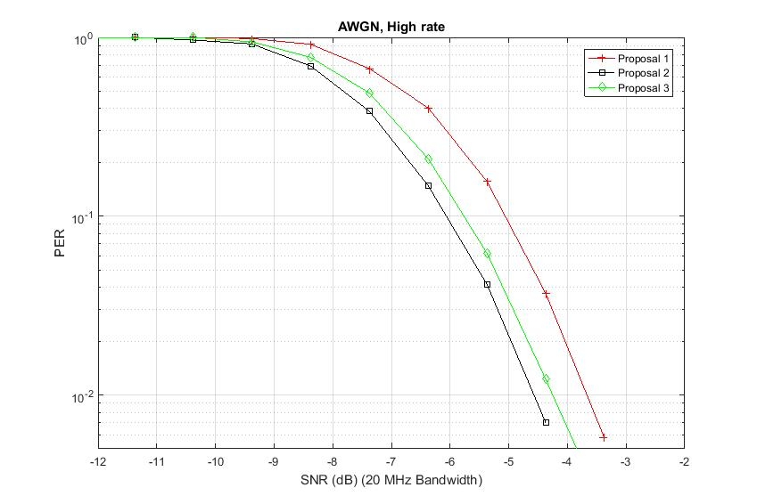
AWGN performance of different waveforms (SNR in 20 MHz bandwidth)
Performance with different waveforms
Low rate: Very similar performance with all proposals
High rate: Proposal 2 and proposal 3 are better than proposal 1 (by 1 dB and 0.8 dB)

