Slide 1
EHT Technology Candidate Discussions
Date: 2018-07-08
Authors:

Slide 2
Introduction
EHT TIG was initiated in May by [1], where candidate features include: 320MHz, NSS=16, Multichannel Aggregation/Operation.
Pushing high peak PHY throughput is good, but also want to discuss the candidate features based on more direct and practical need of improvements from current WLAN deployments.
  Major EHT Differentiation Features:
    Multiple (Dual) channel operation.
    Multiple AP coordination
  Other (incremental) improvements

Slide 3
I. Multi Channel Operation
Nowadays many APs are operating with dual/tri radios concurrently and independently, while STAs are typically with single radio.
(Nowadays)

Slide 4
Multi Channel Operation (2)
We see a trend that STAs are moving into dual band concurrent architectures in the near future.
In EHT, we may explore concurrent dual band at both AP and STA to obtain higher per user throughput or efficiency.
(EHT)

Slide 5
Multi Channel Operation (3)
Multi Channel Aggregation: Higher throughput (BW)
  E.g. 80+80, 40+80, 20+80, 2GHz and 5GHz/6GHz aggregation
  160+160MHz (i.e. 320MHz) is one case of channel aggregation to achieve higher peak throughput.
Flexible channel planning around 5GHz DFS channels, or 6GHz incumbent devices.
Multi-Channel Full Duplex (FDD): improves efficiency and reduce latency.
  Useful in applications such as gaming, video streaming, etc

Slide 6
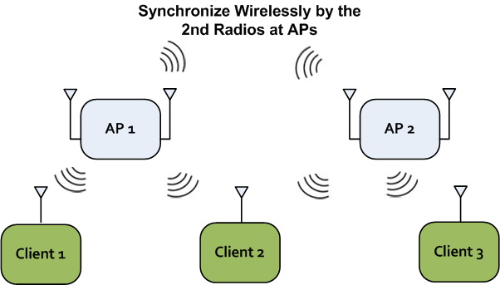
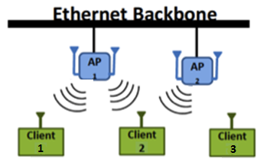
II. Multi AP Coordination
Leverage wired (e.g. enterprise) or wireless (e.g. home mesh) backbones for data + clock synchronization.
Better link budget and regulatory power limitation than a single AP with big antenna array.
Example Technologies:
  Null Steering for Interference Avoidance
  Joint Beamforming
  Joint MUMIMO

Slide 7
Multi AP Coordination (2)
Example-1: Interference Avoidance Steering
  Useful when APs are with large dimension (4x4 or 8x8).
STA1
AP1
AP2
Spatial Null
STA2

Slide 8
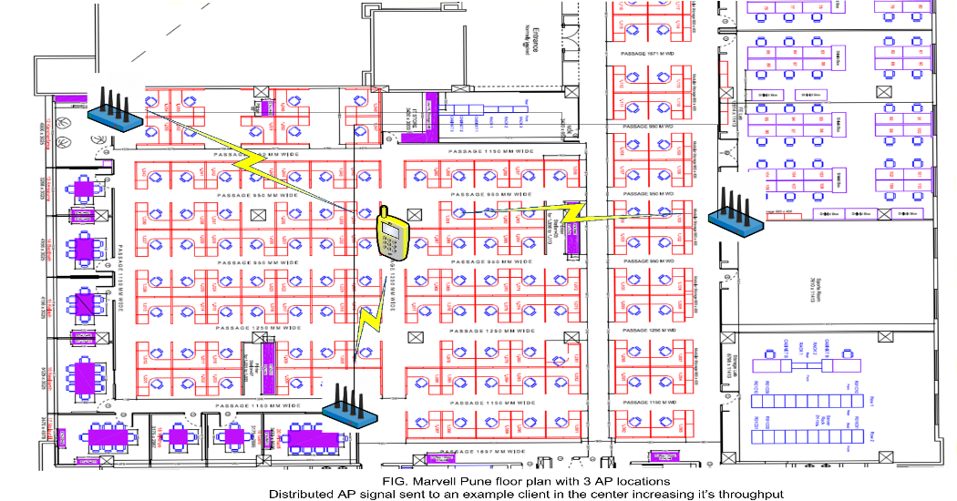
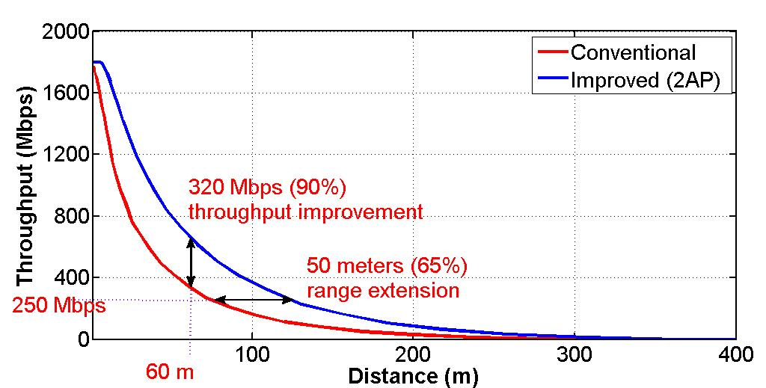
Multi AP Coordination (3)
Example-2: Joint Beamforming
AP(s): 4Tx
STA: 3Rx

Slide 9
III. Other Incremental Improvements
Outdoor long range and high mobility improvements from 11ax—if needed.
SR improvements
OFDMA/MUMIMO improvements from 11ax.
Modulation and coding improvements.
Others…

Slide 10
References
[1] 11-18-0789-10-0wng-extreme-throughput-802-11

