Slide 1
Controling latency in 802.11
Date: 2018-07-10
Authors:
Name | Affiliation | Address | Phone | Email
Dave Cavalcanti | Intel | 2111 NE 25th Ave, Hillsboro OR 97124, USA | +1-503-712-5560
Mamun Rashid
Laurent Cariou
Ganesh Venkatesan
Robert Stacey

Slide 2
Key messages
Traditionally, 802.11 has focused on improving peak throughput, capacity, and efficiency
Emerging applications require not only high throughput, but also more accurate time synchronization and predictable, usually low, latency
802.11 latency can be very low already in non congested environments.
  200us for the basic sequence (data+Ack) for 100B packets (20MHz MCS0)
  This makes it already a great fit for a large range of latency-constraints applications (Class A and B)
For [1ms-above] latencies, congestion is the main challenge to control jitter and reliability (predictability) – shorter term goal
  This presentation discusses how to get low latency with higher predictability (reliability) in such scenario
    Admission control and congestion control (e.g. mapping of 802.1TSN protocols to 802.11)
For [100us-1ms] latencies, overhead becomes the bottleneck – longer term goal
This presentation discusses a possible roadmap for defining the needed features for Wi-Fi
Slide 2
Dave Cavalcanti, Intel

Slide 3
Outline
A simple 802.11 latency analysis and experiments
New applications and requirements
Potential areas for improvement
Slide 3
Dave Cavalcanti, Intel

Slide 4
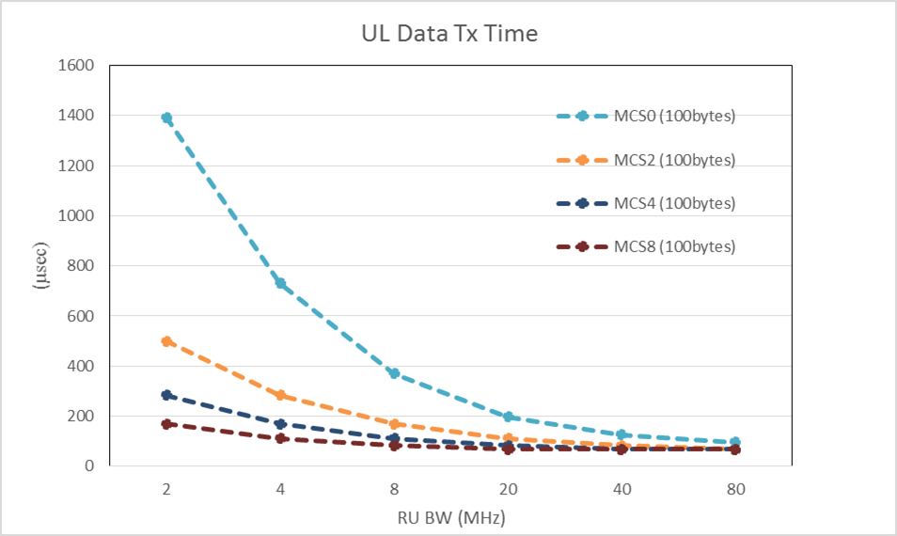
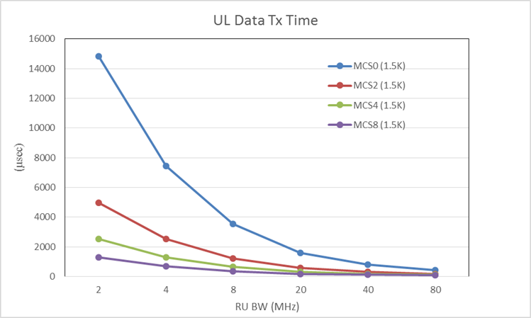
A simple 802.11 latency analysis
PPDU tx times as a function of RU size and MCS
  Once channel is acquired, latency can be very low for typical 1500bytes packets depending on bandwidth and channel/MCS
  For small packets (e.g. 100 bytes), low latency can be achieved with smaller RU sizes if channel condition is good enough
  Latency vs. reliability tradeoffs are possible
Dave Cavalcanti, Intel

Slide 5
Latency improvement with 802.11ax trigger-based access
Single User transmission
Example latency with single user transmission
  Assuming: 802.11ac, 20 MHz BW, AC_VO (default parameters), average backoff (31µs), A-MPDU size (256 bytes), MCS 8 with SISO transmission
  Single User transmissions from 9 STAs will take ~ 1.3 ms.
With 802.11ax trigger-based Multi User UL transmissions, the same amount of data will take approximately 758 µs.
Reliability can be improved by selecting lower MCSs
  Smart scheduling can also help assign RUs to improve reliability
  Depending on BW and channel conditions, impact on PPDU tx time can be small (but need to be taken into account for larger packets)
BUSY
SU PPDU
ACK
AIFS
Backoff
SIFS
~152 µs
Trigger-based MU OFDMA UL transmission in 802.11ax
BUSY
AIFS
Backoff
~758 µs
Dave Cavalcanti, Intel

Slide 6
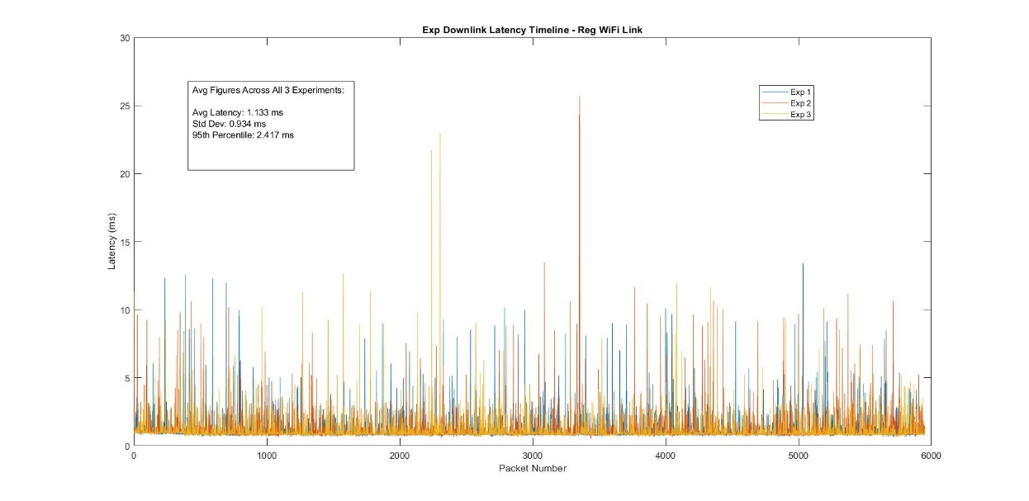
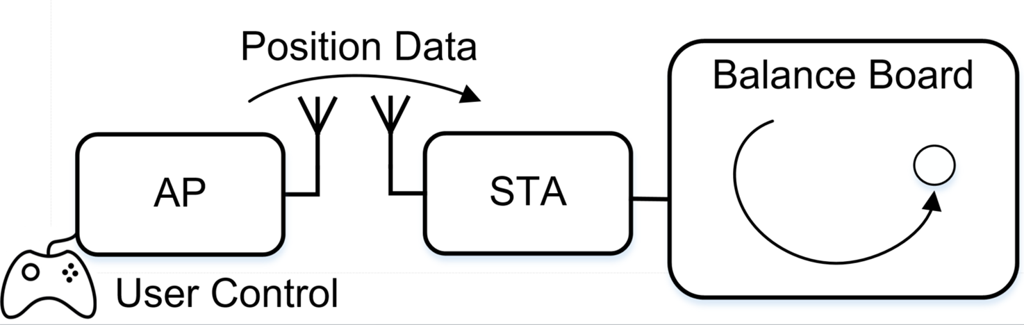
A Simple Experiment
1-way application layer latency
  Avg Latency = 1.222 ms
  Std Dev = 1.782 ms
  95th % = 2.234 ms
Results from a gaming application (balancing board control):*
Experiment configuration:
User commands (small packets) are sent from AP to STA (laptops with 802.11ac/2.4GHz)
AP and STAs are separated by a short-distance at an office environment.
Although average latency is low, worst case latency can be several times higher than the average.
* Demo presented at IEEE INFOCOM 2018, April 2018.
Dave Cavalcanti, Intel

Slide 7
Low latency application requirements
Emerging time sensitive applications require more accurate time synchronization and predictable, usually low, latency
Reliability requirements vary per application, but some need predictable worst case latency with high reliability
Application | Worst Case Latency* | Throughput Requirement
Wireless VR | 5 msec | High
Immersive VR & Pro Gaming | 1- 10 msec | High
High Quality Wireless AV | 10 – 20 msec | Moderate to High
Robotics, Autonomous Systems and Industrial Control | 250 µsec – 50 msec | Moderate to Low
*Source: Consolidated Use cases for the Tactile Internet, IEEE P1918.1 working group
Dave Cavalcanti, Intel

Slide 8
Low latency Application Classes and 802.11 Capabilities
Class of Service*
Class A
Class B
Class C
Latency
50 – 10 msec
10 – 1 msec
1 msec - …
Reliability
99% - 99.9%
99.9% - 99.99%
99.999% - …
High quality AV, soft-real-time control, mobile robotics/Automated Guided Vehicles (AGV)
AR/VR, Professional AV, gaming, HMI, hard-real-time cyclic control
Hard-real-time isochronous control, motion control
Application Examples
IEEE 802 (Wired) Solutions**
802.1 Time Sensitive Networking (TSN) - Ethernet
3GPP Solutions
Private LTE Networks
5G Ultra Reliable Low Latency Communications (URLLC) modes
Phase 1 (802.11ac/802.11ax)
Phase 2 (Enhanced 802.11ax)
Phase 3 (Beyond 11ax)
Potential 802.11 Roadmap
802.11 + TSN Capabilities needed
Time synchronization (802.1AS over 802.11) - DONE
Control congestion: Admission control, Latency-optimized (time-aware) scheduling (802.1Qbv)
Capacity increase: MU operation, …
Reduce duration of basic data exchange sequence: reduce overhead …
Short-term goal
Long-term goal
*References: 3GPP 5G requirements, Springer Handbook of Automation ** Not applicable to all use cases
Dave Cavalcanti, Intel

Slide 9
How to get (predictable) low latency?
802.11 latency can be very low without congestion
  Basic sequence: EDCA+DATA+ACK (~100’s µs for 100 bytes)
  This allows to cover a wider range of very low latency use cases (Class A and B)
The main challenge is predictability/reliability and jitter, depending on the environment (congestion)
  Congestion with OBSS is very hard to control
  Congestion with managed OBSSs can be addressed
  Congestion within BSS is easier to address with congestion control solutions
For congestion control, we believe we miss 2 important features today: admission control and time-aware scheduling (802.1Qbv)
Dave Cavalcanti, Intel

Slide 10
802.11 Congestion Control Solutions (1)
Admission control
  Ensure only a certain number/group of STAs are admitted to a BSS
    Control load to ensure good latency performance
    Required MAC capabilities for BSS admission control exist in 802.11
  Multi-band operation and the new 6 GHz band is a great opportunity to define a very simple multi-band admission control:
    Most APs will become tri-band APs (2.4/5/6GHz)
    Example of admission control within a collocated AP: Access restricted at 6GHz, unrestricted at 2.4/5GHz
    802.11ax is currently defining operation at 6GHz and should define this simple mechanism
Dave Cavalcanti, Intel

Slide 11
802.11 Congestion Control Solutions (2)
Adaptation of 802.1Qbv to 802.11
  802.1Qbv addresses congestion over Ethernet through Time-Aware Scheduling
  Coordinate transmissions across the beacon interval to reduce contention and ensure predictable (time-aware) access
    STAs are synchronized (e.g. 802.1AS and TM supported in 802.11)
    Each STA is given a transmission schedule indicating the time to release the packet from its scheduled traffic queue and start channel access
    A specific target time for reception can also be given to each STA, at which it has to be available for reception
Simple 802.11 changes to enable 802.1Qbv
  Ensure admission control and 802.1Qbv can work together over 802.11
  Definition of action/management frames to exchange the 802.1Qbv schedule
  Include rules to certify the release of packets from the queue only according to the 802.1Qbv defined times
Dave Cavalcanti, Intel

Slide 12
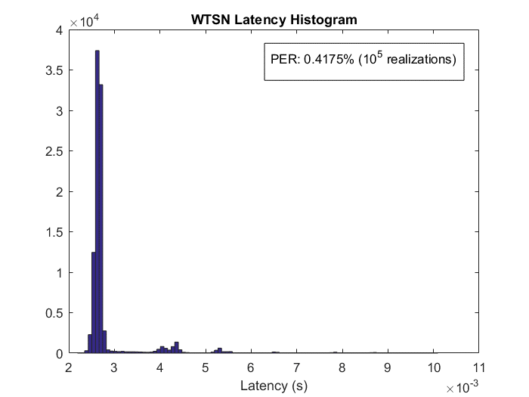
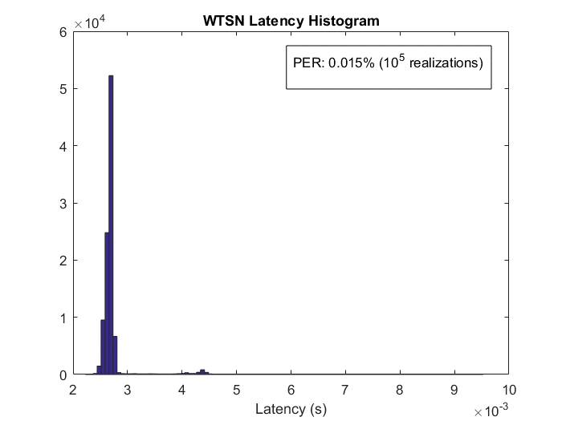
Short term goal experiment: Admission control and Time-Aware Scheduling over the 802.11 MAC
STA and AP are time synchronized through 802.1AS over 802.11
Time-Aware Schedule: STA and AP hold the packet into the application queue until the schedule release time (same concept as in 802.1Qbv)
Application layer latency and PER (office environment)
d
Busy/Office hours
Overnight hours
STA
AP
Packet arrivals according to a schedule
DL
UL
DL
…
Slot Duration = 10 ms
802.11ac 2.4 GHz, d=10 m range (NLOS)
Application packet size = 100 Bytes
PER= Packet is considered lost if not delivered within the slot duration (10 ms)
Dave Cavalcanti, Intel

Slide 13
Support lower latency bounds
(longer term goal)
Need to reduce basic data exchange latency to achieve lower latency bounds with higher reliability (e.g. Class C) in non-congested cases
  Potential direction: Reduce overhead of trigger-based access
UL Transmission from 9 STAs each with 256 bytes of data (MCS 8). Excludes channel access/contention overhead.
Dave Cavalcanti, Intel

Slide 14
Conclusion
802.11 latency can be very low, but predictability (reliability) and jitter can be improved
  This would enable 802.11 to address many low latency applications (also being addressed by 5G standards) in non-congested and managed network scenarios
Congestion control solutions can be defined in REVmd and 802.11ax to ensure 802.11 competitiveness for application classes A&B: urgent need / short-term goal
  Admission control: add support in 802.11ax, along with changes needed for 6GHz
  Introduce 802.1Qbv (Time-Aware Scheduling) over 802.11 in REVmd
Supporting more stringent applications (Class C: lower latency with higher reliability) will require other latency improvements and could be considered once congestion control is defined and market gets traction
  E.g. Reduce overhead of Trigger-based access
Slide 14
Dave Cavalcanti, Intel

