Slide 1
A comparison of BPSK-Mark Options
Date: 2018-07-09
Authors:

Slide 2
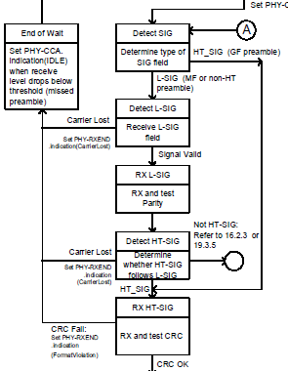
Introduction
The original purpose of the BPSK-mark is to imitate the behavior of 11a to avoid potential CCA-idle at .11n receiver procedure [1]
In this study, we discuss several options for BPSK-mark construction and their pros and cons
Receive level may drop because of narrow-band OOK symbols
If BPSK mark exists (WUR PPDU will be recognized as 11a packet)
If BPSK mark does not exist
Receiver procedure given in [1] for .11n

Slide 3









Recap: Several .11 PPDUs (First 28 $μs$)
BPSK
M-QAM
M-QAM
11a:
Legacy STF
Legacy LTF
Legacy SIG
CP
Data
CP
Data
BPSK
Rotated BPSK
11n:
Legacy STF
Legacy LTF
Legacy SIG
HT SIG 1
HT SIG 2
8 $μs$
8 $μs$
4 $μs$
4 $μs$
4 $μs$
BPSK
BPSK
Rotated BPSK
11ac:
Legacy STF
Legacy LTF
Legacy SIG
VHT SIG A1
VHT SIG A2
LENGTH%3=0
8 $μs$
8 $μs$
4 $μs$
4 $μs$
4 $μs$
BPSK
BPSK
BPSK
11ax:
Legacy STF
Legacy LTF
Legacy SIG
RL-SIG
HE-SIGA
LENGTH%3!=0
8 $μs$
8 $μs$
4 $μs$
4 $μs$
4 $μs$
BPSK
OOK
11ba:
Legacy STF
Legacy LTF
Legacy SIG
BPSK-Mark
SYNC
8 $μs$
8 $μs$
4 $μs$
4 $μs$
4 $μs$

Slide 4
Problem Statement
The original purpose of having BPSK-mark is to spoof .11n receivers to treat WUR PPDU as .11a PPDU
In recent discussion about the design of BPSK-mark, there has been interests to use it also for
  WUR PPDU identifier for future .11 devices
  Preventing .11ax devices from threating the WUR PPDU as .11a PPDU
    .11ax devices may stop receiving earlier to reduce the power consumption
  Providing additional information for future .11 devices
    E.g., BSS color

Slide 5
Possible Solutions
Sequence-based method
  Desired features
    Create identifier for WUR PPDU
    Low PAPR to minimize nonlinear distortion
    Enable orthogonal sequences for passing small amount of information
Encoding-based method
  Desired features
    Create identifier for WUR PPDU
    Minimize false detection as other PPDUs
    Reduce power consumption for devices with earlier .11 amendments
      Exploiting End-of-Wait state of a typical .11ax receiver [2] to avoid spending power in receiving and decoding long > 600usec WUR packet

Slide 6





Option 1: Specific Sequence
One of the options is to use a specific sequence for the construction of BPSK-Mark field
  Pros: Allow explicit WUR PPDU indication
    May allow reducing power consumption for future .11 devices
    Can carry certain information by using different sequences
  Cons: May not allow reducing power consumption for .11ax devices
    11ax RX may process WUR PPDU as an .11a PPDU
  The sequence for BPSK Mark is TBD
    A BPSK Golay sequence is a good option
A specific BPSK sequence
11ba:
Legacy STF
Legacy LTF
Legacy SIG
BPSK-Mark
…
SYNC
8 $μs$
8 $μs$
4 $μs$
4 $μs$
4 $μs$

Slide 7





Option 2: RL-SIG and LENGTH%3 = 0
This option repeats L-SIG where the LENGTH subfield is an integer multiple of 3
  Cons: Cannot explicitly indicate WUR PPDU
  Cons: May not allow reducing power consumption for .11ax devices
    All .11 devices may process it as .11a PPDU, even for future .11 devices
RL-SIG and LENGTH%3 = 0
11ba:
Legacy STF
Legacy LTF
Legacy SIG
BPSK-Mark
…
SYNC
8 $μs$
8 $μs$
4 $μs$
4 $μs$
4 $μs$

Slide 8
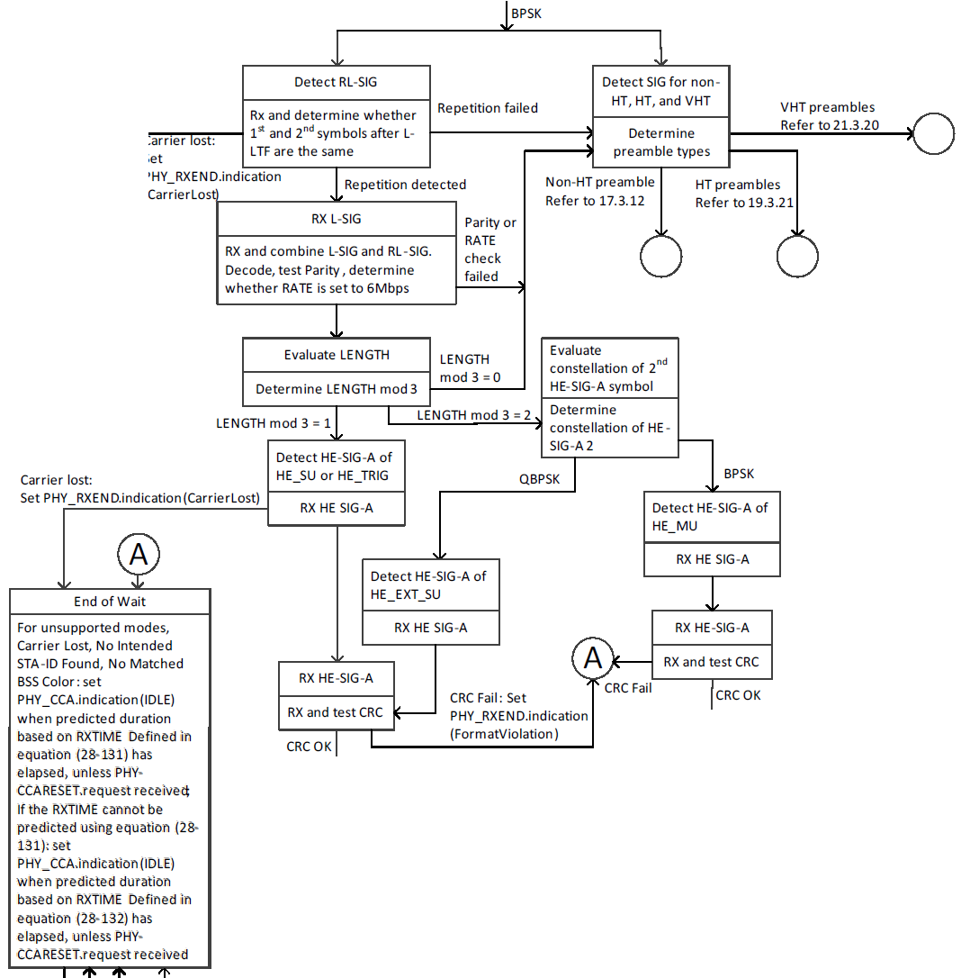
11ax Receiver Procedure (D3.0)
A typical .11ax RX applies hieratical detection: 1) Repetition, 2) LENGTH%3 != 0. If the detection fails, it goes back to legacy modes
  WUR PPDU with RL-SIG and LENGTH%3 = 0 may still be treated as .11a PPDU
Receiver procedure given in [2] for .11ax

Slide 9
Option 3: Negative RL-SIG
This option uses negative of L-SIG
  Pros: Future .11 devices can differentiate 11ax PPDU from WUR PPDU by searching negative or positive RL-SIG
  Cons: May not allow reducing power consumption for .11ax devices
    All previous .11 devices may process it as .11a PPDU,
-RL-SIG
11ba:
Legacy STF
Legacy LTF
Legacy SIG
BPSK-Mark
…
SYNC
8 $μs$
8 $μs$
4 $μs$
4 $μs$
4 $μs$

Slide 10





Option 4: RL-SIG and LENGTH%3 != 0
In this option, L-SIG is repeated and the LENGTH subfield is not an integer multiple of 3 (i.e., 11ax spoofing)
  Cons: Cannot explicitly indicate WUR PPDU
  Pros: May allow reducing power consumption for .11ax devices
    Need to change LENGTH definition in .11ba D0.3
    Future .11 devices can differentiate .11ax PPDU from WUR PPDU by validating the CRC in a new SIG field (similar to HE SIG field)
RL-SIG and LENGTH%3 != 0
11ba:
Legacy STF
Legacy LTF
Legacy SIG
BPSK-Mark
…
SYNC
8 $μs$
8 $μs$
4 $μs$
4 $μs$
4 $μs$

Slide 11
11ax Receiver Procedure (D3.0)
If the CRC for HE-SIG-A is not valid, a typical .11ax receiver will wait based on RXTIME
  WUR PPDU with RL-SIG and LENGTH%3 != 0 can still be recognized as an unsupported mode and RX can reduce power consumption by terminating the demodulation
Receiver procedure given in [2] for .11ax ➔

Slide 12



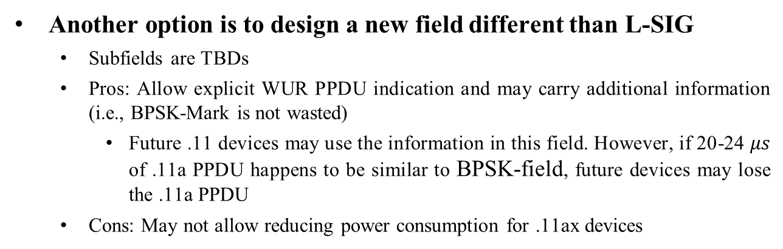



Option 5: A New Coded Field Different than L-SIG
Another option is to design a new field different than L-SIG
  Subfields are TBDs
  Pros: Allow explicit WUR PPDU indication and may carry additional information (i.e., BPSK-Mark is not wasted)
    Future .11 devices may use the information in this field. However, if 20-24 $μs$ of .11a PPDU happens to be similar to BPSK-field, future devices may lose the .11a PPDU
  Cons: May not allow reducing power consumption for .11ax devices
A new encoded field ($≠$L-SIG)
11ba:
Legacy STF
Legacy LTF
Legacy SIG
BPSK-Mark
…
SYNC
8 $μs$
8 $μs$
4 $μs$
4 $μs$
4 $μs$

Slide 13
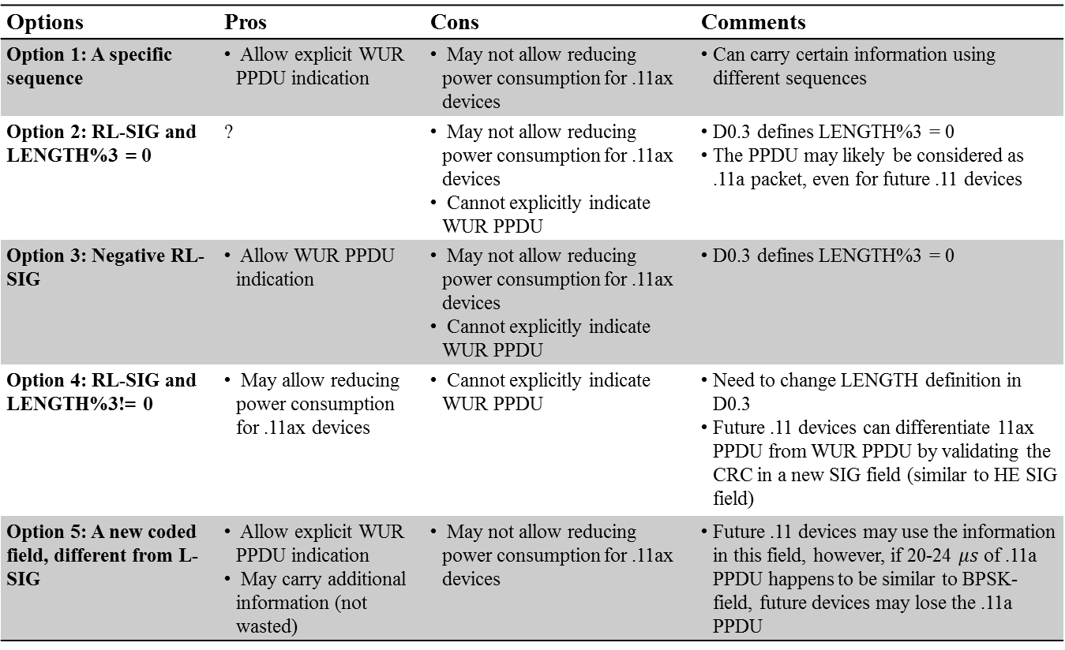
Summary
Options | Pros | Cons | Comments
Option 1: A specific sequence | • Allow explicit WUR PPDU indication | • May not allow reducing power consumption for .11ax devices | • Can carry certain information using different sequences
Option 2: RL-SIG and LENGTH%3 = 0 | ? | • May not allow reducing power consumption for .11ax devices • Cannot explicitly indicate WUR PPDU | • D0.3 defines LENGTH%3 = 0 • The PPDU may likely be considered as .11a packet, even for future .11 devices
Option 3: Negative RL-SIG | • Allow WUR PPDU indication | • May not allow reducing power consumption for .11ax devices • Cannot explicitly indicate WUR PPDU | • D0.3 defines LENGTH%3 = 0
Option 4: RL-SIG and LENGTH%3!= 0 | • May allow reducing power consumption for .11ax devices | • Cannot explicitly indicate WUR PPDU | • Need to change LENGTH definition in D0.3 • Future .11 devices can differentiate 11ax PPDU from WUR PPDU by validating the CRC in a new SIG field (similar to HE SIG field)
Option 5: A new coded field, different from L-SIG | • Allow explicit WUR PPDU indication • May carry additional information (not wasted) | • May not allow reducing power consumption for .11ax devices | • Future .11 devices may use the information in this field, however, if 20-24 $μs$ of .11a PPDU happens to be similar to BPSK-field, future devices may lose the .11a PPDU

Slide 14
Straw Poll
How should 802.11ba BPSK-mark be constructed?
Sequence-based BPSK-mark (e.g., Option 1, sequence is TBD):
Encoded BPSK-mark (e.g., Option 2-5, all subfields are TBD):
Abstain:

Slide 15
References
[1] “Part 11: Wireless LAN Medium Access Control (MAC) and Physical Layer (PHY) Specifications”, 2016
[2] “IEEE P802.11ax™/D3.0, Amendment 6: Enhancements for High Efficiency WLAN”, 2018

