Slide 1
Framework for enhancing DN-SRD coexsitence
Date: July 2018
DCN: 11-18-1150-00-00ay
Name | Affiliation | Address | Phone | Email
Aditya V. Padaki | Samsung | 1301 E. Lookout Dr, Richardson, TX 75082. |  | a.padaki@samsung.com
Jianhua Mo |  |  |  | jianhua.m@samsung.com
Boon Loong Ng |  |  |  | b.ng@samsung.com
Charlie Zhang |  |  |  | jianzhong.z@samsung.com

Slide 2
Co-existence framework
DN-SRD co-existence framework should
protect the interests of both DN and SRDs
offer flexibility in design and deployment without rigid requirements
desirably be forward compatible
given that DN infrastructure could well be a long term deployment
More analysis, simulations will help in forming informed assessments
With this view, we provide some charts that can be used for further analysis in upcoming discussions and deployment guidelines

Slide 3
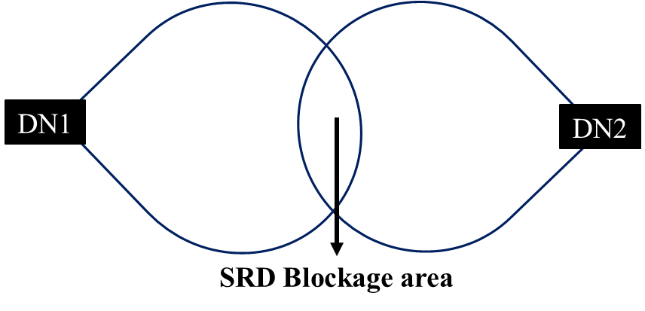
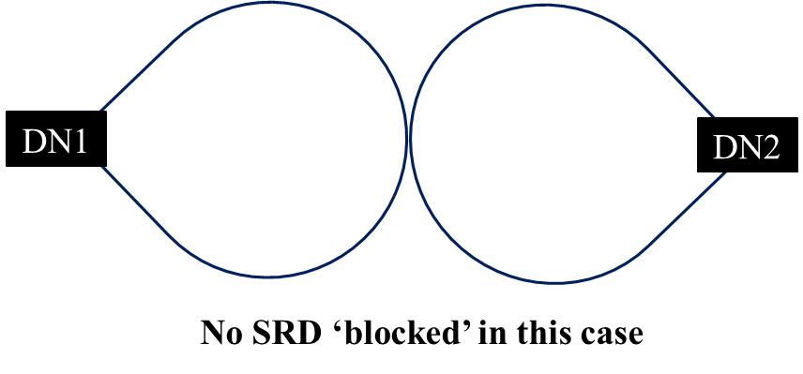
Transmit Power/EIRP considerations
Recap: Dual DN blockage is when both the DNs exceed the CCA threshold
Rx Power > –68 dBm
Rx Power > –68 dBm

Slide 4
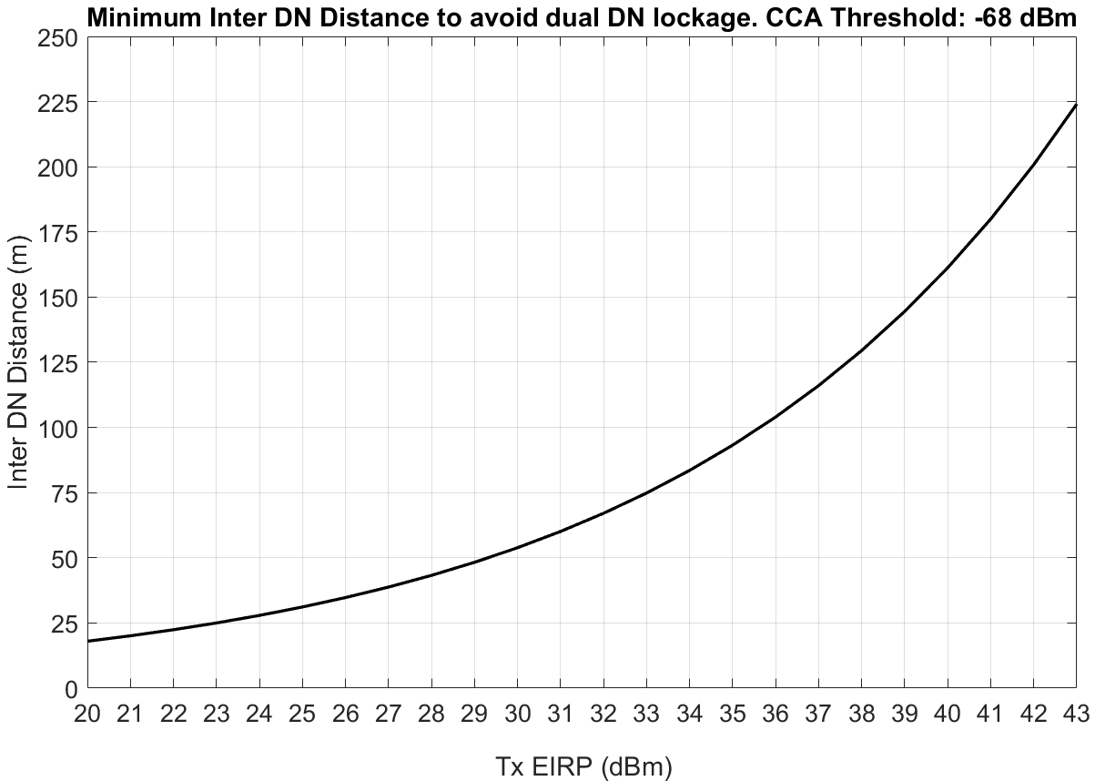
Min Inter DN Distance to avoid Dual Blockage
Path loss model: $PL_{LOS}=32.4+21\log_{10}\left(d_{3D}\right)+20\log_{10}{f_{c}}$

Slide 5
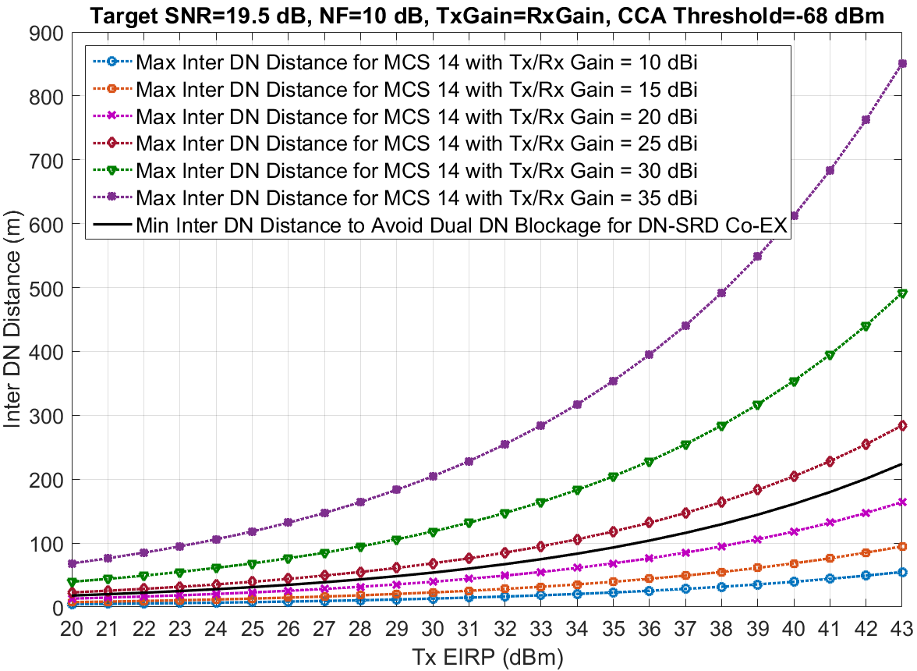
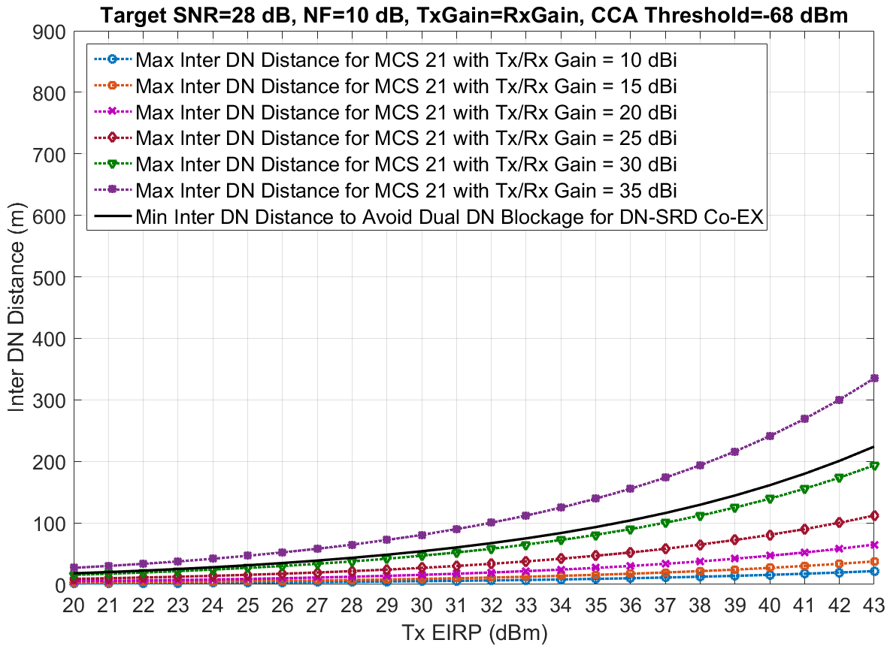
EIRP to meet a target SNR and required inter DN distance to avoid dual DN blockage
Region of operation avoid dual DN blockage
Region of operation avoid dual DN blockage
Observation for deployment guidelines: Higher DN Tx/Rx Gain helps in meeting the MCS/SNR target while ensuring Co-EX.

Slide 6
Outlook
More analysis and simulations will help develop frameworks and use case based deployment guidelines in enhancing DN-SRD co-existence

