Slide 1
ECR ad hoc Output Report
Date: 2018-07-02
Authors:

Slide 2
Abstract
This document is the ECR ad hoc group output and recommendation to the IEEE 802.11 WG.
Revision History:
  R0: Initial draft
  R1: changes made based on July 3rd teleconference. Added a couple of slides on tri-band and EHT.
  R2: changes made based on the discussion on Tuesday AM1

Slide 3
Background
In October 2014 members of IEEE 802.3 took the initiative to start a group new Ethernet speed(s) between 1 Gb/s and 10 Gb/s over 100 meters of installed base of Cat 5e or better, in support of data rates needed for Enterprise Access Points using 802.11ac.
This effort resulted in 802.3bz amendment to 802.3-2015.
Ethernet Media Access Control (MAC) parameters, Physical Layer specifications, and management objects for the transfer of Ethernet format frames at 2.5 Gb/s and 5 Gb/s over balanced twisted-pair transmission media used in structured cabling are defined in this amendment to IEEE Std 802.3-2015

Slide 4
ECR Scope
From https://mentor.ieee.org/802.11/dcn/18/11-18-0624-04-0000-may-2018-working-group-chair-supplementary-material.ppt
Request from David Law, 802.3 Chair, to 802.11 to identify the potential need for new 802.3 standards to support cabling requirements of future 802.11ax/ad/ay systems. Target timeframe: July 2018

Slide 5
List of Related Issues
Identify at the peak throughput supported by current and future 802.11 amendment in the next 5-10 years.
  As a rule of thumb the cabling speed is set at 75% of the peak throughput.
Power requirements
Cable Reach.
Others
The focus of this report is on the peak throughput. Power and cable reach are not addressed here

Slide 6
Enterprise Network Structure [1] Network Structure today [1]
Enterprise campus networks are typically built using a three tier design shown at the right
This design (very different to DC spine/leaf) has proven stable and durable over a number of technology evolutions.
The links between the Enterprise Access switches and the APs are the key focus of this presentation
Enterprise
Core
Enterprise
Distribution
Enterprise
Access
AP
AP
AP
AP
APs and
End Devices
Notes:
PJ 10/6/14 PM – rewords and moves.

Slide 7
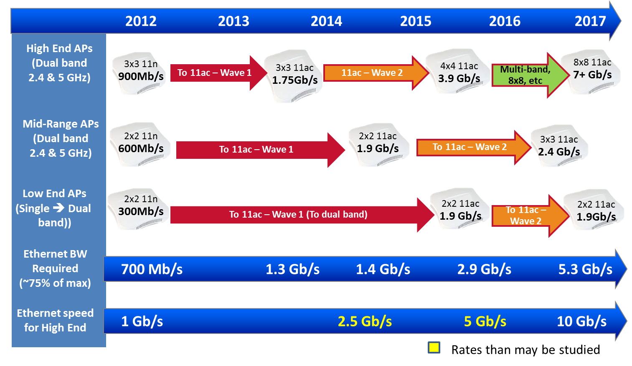
802.11ac Enterprise AP Radio Bandwidth Trends [1]
Notes:
Removing AD
[YK] Speaker Notes:
The managed AP market is segmented into High-end high-performance, and Low-end hot-spot-oriented and some mid-range.
Here we are showing Ethernet edge switch port speeds, relative to AP bandwidth needs for the three segments.
802.11n is the LAST radio on 2.4 GHz band. 802.11ac does not work in 2.4 GHz band.
High-end and Mid-Range APs support simultaneous 2.4 GHz and 5 GHz bands,
so 802.11ac transition assumes 802.11n support @ 2.4 GHz band and .11ac transition @ 5 GHz band.
Low End typically does not. Low-end supports legacy 2.4 GHz b/g/n uses.
But with proliferation of 802.3ac wireless clients, low-end transitions to support dual band.
[YK] Background info:
802.11 n radio rates are multiples of 72.2 Mb/s (20 MHz) or 150 Mb/s (40 MHz) per [MIMO] antenna.
802.11ac radio rates are multiple of 867 Mb/s (80 MHz) per [MIMO] antenna.

Slide 8
Ethernet Switch Ports [2]
Dell’OroGroup Ethernet Switch 5-year Forecast Jan 2018
1000BASE-T is still the dominate link in the enterprise.
803.bz (2.5 and 5 Gbps) is slowly finding its way to the enterprise.

Slide 9
IEEE 802.11 PHY/MAC Amendments
Two new 802.11 amendments are on the horizon
  IEEE 802.11ax: This amendment defines standardized modifications to both the IEEE 802.11 physical layers (PHY) and the IEEE 802.11 Medium Access Control layer (MAC) that enable at least one mode of operation capable of supporting at least four times improvement in the average throughput per station (measured at the MAC data service access point) in a dense deployment scenario, while maintaining or improving the power efficiency per station.
  IEEE 802.11ay: This amendment defines standardized modifications to both the IEEE 802.11 physical layers (PHY) and the IEEE 802.11 medium access control layer (MAC) that enables at least one mode of operation capable of supporting a maximum throughput of at least 20 gigabits per second (measured at the MAC data service access point), while maintaining or improving the power efficiency per station. This amendment defines operations for license-exempt bands above 45 GHz while ensuring backward compatibility and coexistence with legacy directional multi-gigabit stations (defined by the IEEE 802.11ad amendment) operating in the same band
    The expected range if 11ad/ay is 10 m.

Slide 10


IEEE 802.11ax Use Cases [3]
Dense deployments including:
  Stadiums and sporting events
  Shopping centers
  Airports and public transportation.
  Large Enterprise.

Slide 11







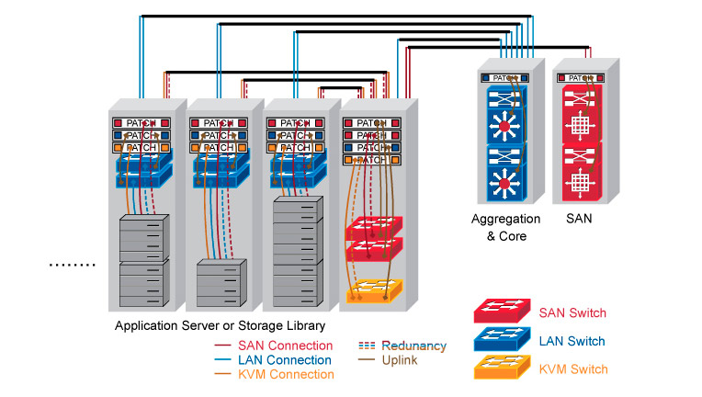
IEEE 802.11ay Use Cases [4]
Train Station
IEEE 802.11ay use cases include:
  Ultra Short-range communications
  Wireless backhaul/fronthaul
  Data Centers
  Virtual Reality/Augmented Reality
Video/audio clip, magazine, newspaper, etc.
Backhaul @60GHz
11ay AP
N-LOS Access
11ay AP
LOS Access
BUS STOP

Slide 12
WLAN Trends - I [2]
650 Group WLAN Long-Term Forecast 2017
802.11ac Wave 2 is replacing 802.11n and 802.11ac Wave 1.
Eventually (starting at 2020) enterprise is expected to upgrade to 802.11ax.
11ax is focusing on the improvement (at least 4 times) on the average per user throughput.
  802.11ax doesn’t have the goal of a significant peak throughput improvement compared to 802.11ac

Slide 13
WLAN Trends II – TriBand Devices
Tri-band devices including 11ay are expected around 2022

Slide 14
WLAN Trends III
The IEEE 802.11 WG is looking beyond 802.11ax.
Extremely High Throughput activity (EHT) was discussed during the May 2018 interim meeting with the goal to investigate the feasibility of:
  Wider bandwidth at 320 MHz enabled by the availability of a new spectrum (6 GHz)
  Support for 16 spatial streams doubling the number in 802.11ax and 802.11ac
  Other technologies
The net effect is to improve the peak throughput by a factor of 4 compared to 802.11ax.
  An increase of the peak rate up to about 36 Gbps.

Slide 15
WLAN Future Evolution
2017
2018
2019
2020
2021
2022
2023
2.4
&
5
GHz
EHT
4x rate
16 – 38 Gbps
802.11ac Wave 2
3 – 6.9 Gbps
802.11ax Wave 1
2.4 - 4.8 Gbps
802.11ax Wave 2
4.8 – 9.6 Gbps
802.11ad Wave 1
2.5 Gbps
60
GHz
802.11ad Wave 2
4.6 Gbps
802.11ay Wave 1
16 Gbps
802.11ay Wave 2
32 Gbps
2021 seems to be the year where an increase in the Ethernet speed is needed to support emerging IEEE 802.11 technologies and beyond.

Slide 16
Recommendations
802.3bz is sufficient to satisfy current 802.11ac and 802.11ax generations.
Given the expected increase in WLAN speed around the year 2021, a higher cabling speed is needed.
Using the 75% rule of thumb the cabling speed requirement is in the range of 25-27 Gbps.

Slide 17
References
[1] https://mentor.ieee.org/802.11/dcn/14/11-14-1385-00-0000-ethernet-base-t-speed-upgrade-cfi-in-support-of-802-11ac-enterprise-aps.pptx
[2] Peter Jones, Ethernet Past and Future- Finding the Right Leverhttp://chinog.org/wp-content/uploads/2018/05/chinog08_jones_ethernet.pdf
[3] https://mentor.ieee.org/802.11/dcn/13/11-13-0657-06-0hew-hew-sg-usage-models-and-requirements-liaison-with-wfa.ppt
[4] https://mentor.ieee.org/802.11/dcn/15/11-15-0625-07-00ay-ieee-802-11-tgay-usage-scenarios.pptx

