Slide 1
ECR ad hoc Output Report
Date: 2018-07-02
Authors:

Slide 2
Abstract
This document is the ECR ad hoc group output and recommendation to the IEEE 802.11 WG.
Revision History:
  R0: Initial draft

Slide 3
Background
In October 2014 members of IEEE 802.3 took the initiative to start a group to explore the need for one or more new Ethernet speed(s) between 1 Gb/s and 10 Gb/s over balanced twisted pair cabling [1].
The driving force at this time was the emerging 802.11ac APs capable of supporting more than 1 Gb/s data rates.
This effort resulted in 802.3bz amendment to 802.3-2015.
Ethernet Media Access Control (MAC) parameters, Physical Layer specifications, and management objects for the transfer of Ethernet format frames at 2.5 Gb/s and 5 Gb/s over balanced twisted-pair transmission media used in structured cabling are defined in this amendment to IEEE Std 802.3-2015

Slide 4
ECR Scope
From https://mentor.ieee.org/802.11/dcn/18/11-18-0624-04-0000-may-2018-working-group-chair-supplementary-material.ppt
Request from David Law, 802.3 Chair, to 802.11 to identify the potential need for new 802.3 standards to support cabling requirements of future 802.11ax/ad/ay systems. Target timeframe: July 2018

Slide 5
Enterprise Network Structure [1] Network Structure today [1]
Enterprise campus networks are typically built using a three tier design shown at the right
This design (very different to DC spine/leaf) has proven stable and durable over a number of technology evolutions.
The links between the Enterprise Access switches and the APs are the key focus of this presentation
Enterprise
Core
Enterprise
Distribution
Enterprise
Access
AP
AP
AP
AP
APs and
End Devices
Notes:
PJ 10/6/14 PM – rewords and moves.

Slide 6
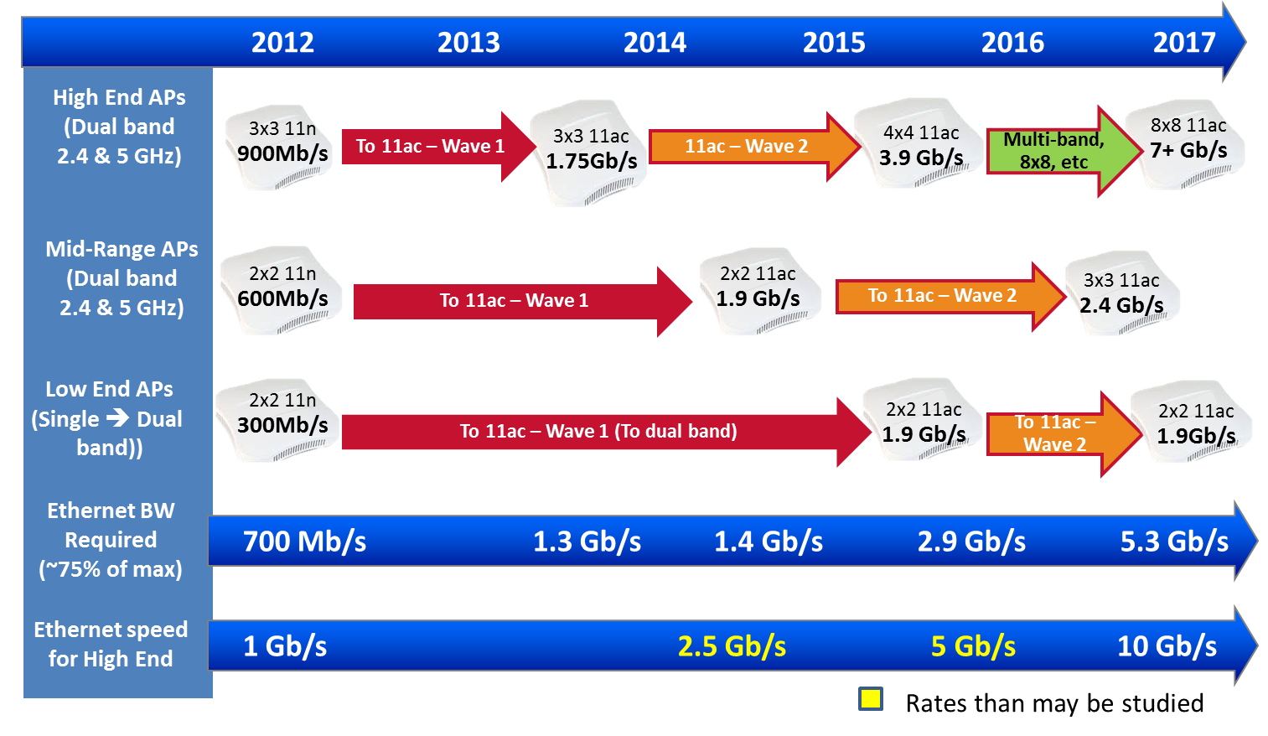
802.11ac Enterprise AP Radio Bandwidth Trends [1]
Notes:
Removing AD
[YK] Speaker Notes:
The managed AP market is segmented into High-end high-performance, and Low-end hot-spot-oriented and some mid-range.
Here we are showing Ethernet edge switch port speeds, relative to AP bandwidth needs for the three segments.
802.11n is the LAST radio on 2.4 GHz band. 802.11ac does not work in 2.4 GHz band.
High-end and Mid-Range APs support simultaneous 2.4 GHz and 5 GHz bands,
so 802.11ac transition assumes 802.11n support @ 2.4 GHz band and .11ac transition @ 5 GHz band.
Low End typically does not. Low-end supports legacy 2.4 GHz b/g/n uses.
But with proliferation of 802.3ac wireless clients, low-end transitions to support dual band.
[YK] Background info:
802.11 n radio rates are multiples of 72.2 Mb/s (20 MHz) or 150 Mb/s (40 MHz) per [MIMO] antenna.
802.11ac radio rates are multiple of 867 Mb/s (80 MHz) per [MIMO] antenna.

Slide 7
Ethernet Switch Ports [2]
1000BASE-T is still the dominate link in the enterprise.
803.bz (2.5 and 5 Gbps) is slowly finding its way to the enterprise.

Slide 8
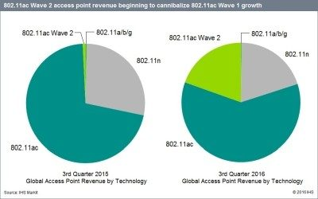
WLAN Trends [2]
802.11ac Wave 2 is replacing 802.11n and 802.11ac Wave 1.
Eventually (starting at 2020) enterprise will upgrade to 802.11ax.
802.11ax doesn’t offer a significant throughput improvement compared to 802.11ac

Slide 9
WLAN Future Evolution
2017
2018
2019
2020
2021
2022
2023
2.4
&
5
GHz
EHT
4x rate
16 – 38 Gbps
802.11ac Wave 2
3 – 6.9 Gbps
802.11ax Wave 1
2.4 - 4.8 Gbps
802.11ax Wave 2
4.8 – 9.6 Gbps
802.11ad Wave 1
2.5 Gbps
60
GHz
802.11ad Wave 2
4.6 Gbps
802.11ay Wave 1
16 Gbps
802.11ay Wave 2
32 Gbps
2021 seems to be the year where a significant increase in the Ethernet speed is needed

Slide 10
Recommendations
TBD

Slide 11
References
[1] https://mentor.ieee.org/802.11/dcn/14/11-14-1385-00-0000-ethernet-base-t-speed-upgrade-cfi-in-support-of-802-11ac-enterprise-aps.pptx
[2] http://chinog.org/wp-content/uploads/2018/05/chinog08_jones_ethernet.pdf

