Slide 1
LC Usage Model Document
Date: 2018-07-09
Authors:

Slide 2
Background
To support the definition of light communication (LC) WLAN standard, this document attempts to list several usage models.

Slide 3
Terminology
Usage Model – A usage model is the combination of all the things below; not to be confused with a use case which is the specific set of steps to accomplish a particular task.
Pre-Conditions – Initial conditions before the use case begins.
Environment – The type of place in which the network of the use case is deployed, such as home, outdoor, hot spot, enterprise, metropolitan area, etc.
Application – A source and/or sink of wireless data that relates to a particular type of user activity. Examples are streaming video and VoIP.
Traffic Conditions – General background traffic or interference that is expected while the use case steps are occurring. Overlapping BSSs, existing video streams, and interference from cordless phones are all examples of traffic conditions.
Use case – A use case is task oriented. It describes the specific step-by-step actions performed by a user or device. One use case example is a user starting and stopping a video stream.

Slide 4
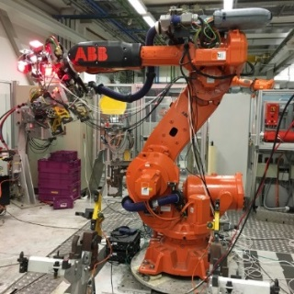
Usage Model 1: Industrial wireless
Pre-Conditions
Devices may experience unstable radio frequency (RF) connection due to electromagnetic compatibility (EMC) issues such as jamming in factories. LC is deployed to provide reliable wireless connectivity for industrial wireless networks.
Environment
All communications are within a large metal building, industrial or automated work cell. The area of these environments range from tens to thousands of square meters, equipped with industrial robot and other equipment. The environment is very electrically noisy, for example radiation from all kinds of noise-generating electronic devices. Lighting level of 150 lux is recommended (1500 lux for dedicated work).
Applications
Ultra-high-definition (UHD) video streaming for surveillance or production monitoring (quality control) applications, as well as for video collaboration for team, customer, and supplier meetings. Lightly compressed UHD video: ~2 Gbps, delay < 5 ms, 1x10⁻⁸ PER, 99.9% reliability.
Fully connected factory—for real-time communications, application execution, and remote access.
Distance between LC APs ranges from 2~20 meters.
Traffic Conditions
Both uplink and downlink are using LC.
Interference between LC access points (APs) belonging to the same managed Extended Service Set (ESS) due to very high density deployment.
Potential interference from surrounding environments such as artificial-light.
Multiple LC modules are deployed on the robot/equipment and on the ceiling/walls to provide multiple light links for a robust connectivity in case a single line-of-sight (LOS) link is blocked.
Use Case
An industrial robot is powered on and ready for operation.
Operating instructions are transmitted to the robot via LC.
The robot is working (e.g., repaid movement) according to the instructions and provides real-time feedback information and/or video monitoring data for quality control to control center also via LC. Upon command, the robot finishes the task and is ready for the next one.

Slide 5
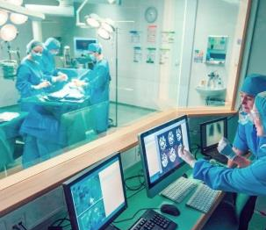
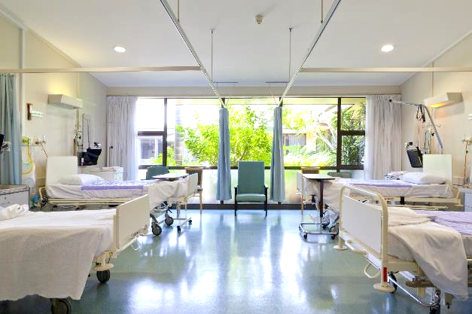
Usage Model 2: Wireless access in medical environments
Pre-Conditions
IEC 60601-1-2 standard recommends the minimum separation distance between medical electrical (ME) equipment and RF wireless communications equipment (e.g., wireless local area network (WLAN)) be 30 cm to avoid performance degradation of the ME equipment. LC is deployed to ensure the performance of all ME equipment.
Environment
The size of a operating theater and MRI room ranges from 30~60 m². Multiple LC-APs are deployed on the ceiling to provide specialized illumination. The central illuminance of the operating light: 160k and 40k lux. The size of a four beds ward is about 60 m², light level: 300 lux on the bed and >100 lux between the beds and in the central area.
Applications
LC-WLAN is used to allow wireless data exchange in medical environments with ME equipment or system.
Medical multimedia and diagnostic information can be transmitted to provide telemedicine services; ME equipment can also be wirelessly controlled via LC.
Provide Intranet/ Internet access, audio or video call for doctors, nurses and patients using LC-based devices.
Traffic Conditions
No interference caused by RF radiation.
Both uplink and downlink are using LC.
High Quality of Service (QoS) and high reliability are required.
Potential interference from surrounding environments such as artificial-light.
Use Case
Doctors enter an operating theater, turn on the LC enabled LED lights and ME equipment. Doctors can interact with the remote doctors and share information using LC. ME equipment connectivity is also supported by LC. Doctors finish the treatment, then turn off the lights and medical equipment.
A patient is monitored by ME equipment which communicate with the nurses/doctors in control room via LC.
© vm
Operating theater
Hospital ward

Slide 6
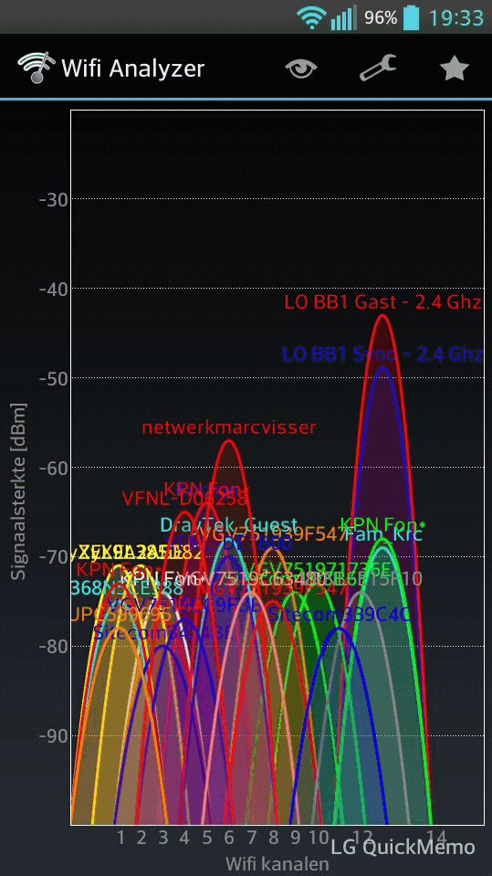
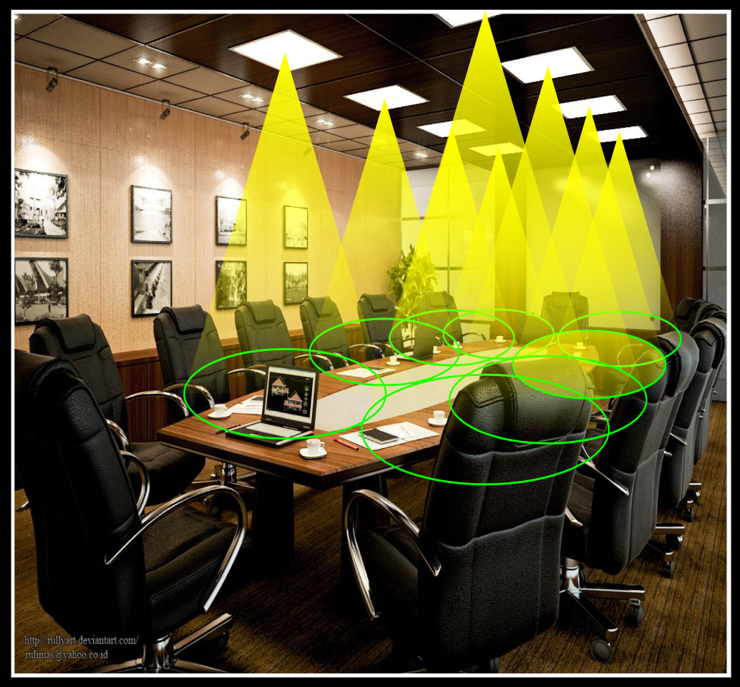
Usage Model 3: Enterprise network
Pre-Conditions
The density of users may be very high in the space such as enterprise environment leading to slow speed or even dropped or lost connections. LC is deployed to provide wireless connectivity escaping the limitation.
Environment
Recommended size of a meeting room for 30 seats ~ 50 m². Mostly LOS with a few obstacles for example slow moving people. Dense stations (STAs) (20~40 STAs) in one meeting room with up to ~10 APs.
Max distance between AP and STA ~ 5 m. The inter- LC AP distance is in the range of 1~3 m. Lighting level of 500 lux is recommended.
Applications
UHD Video conference up to 1Gbps
Virtual desktop, Intranet/ Internet access.
File exchange between two/multiple users in the same room.
Traffic Conditions
Both uplink and downlink are using LC.
Interference between LC APs belonging to the same managed ESS due to very high density deployment.
Interference with peer-to-peer networks within each meeting room.
Potential interference from surrounding environments such as sunlight and artificial-light.
Use Case
UHD video teleconferencing starts in multiple meeting rooms simultaneously. People can see each other and demonstrate their desktop to each other via the LC network. Some people are walking in the meeting room.
Crowded WLAN channel
LC meeting room

Slide 7
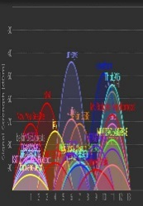
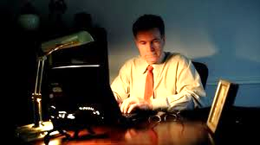
Usage Model 4: Secure home network
Pre-Conditions
RF based WLAN signal can be received by surrounding devices belonging to legal users or hackers. This potential risk causes concerns among wireless users who are especially aware of the their data security and privacy. LC is (densely) deployed to provide wireless connectivity with limited coverage and solve this problem.
Environment
A living room with a area of up to ~ 30 m², installed with 5-30 ceiling lamps, a floor lamp and a table lamp.
Mostly LOS with a few obstacles for example furniture. Up to ~10 STAs in one room, the distance between AP and STA 0.5 ~ 3 m. The inter- LC AP distance is in the range of 0.5 ~ 2 m. Recommended illuminance levels for general lighting, recreation and reading are 50 lux, 200 lux and 500 lux, respectively.
Applications
Secure wireless Internet access (20 Mbps per user)
VR games, video resolution per eye: 1080 x 1200 @ 90 Hz (>1Gbps)
3D UHD lightly compressed video (3.6 Gbps)
IoT applications
Traffic Conditions
Both uplink and downlink are using LC.
Interference between LC APs belonging to the same managed ESS due to very high density deployment.
Interference with peer-to-peer networks within the same room.
Potential interference from surrounding environments such as sunlight and artificial-light.
Use Case
Two users play Virtual Reality (VR) games together.
Another user perform a mixture of applications, including Internet access, online video chat, without worrying about wireless signal leaking into other places.
WLAN signal from neighbors
Internet access with LC

Slide 8
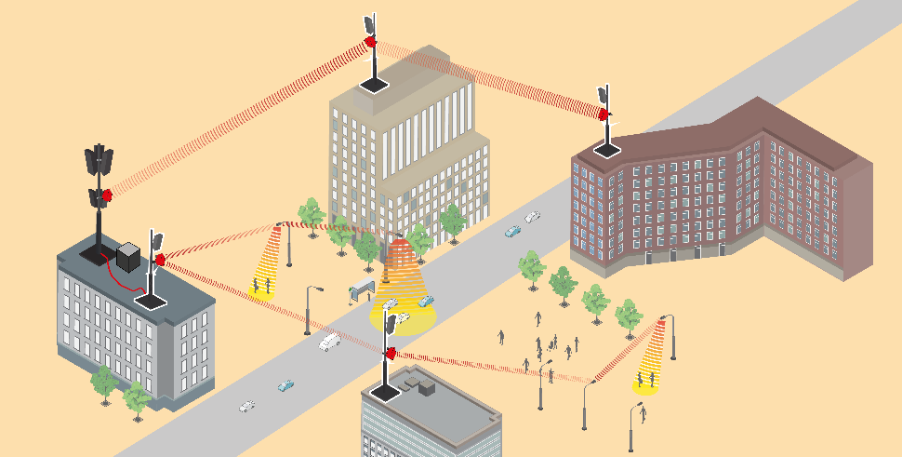
Usage Model 5: Backhaul
Pre-Conditions
During roll-out of new networks, the backbone for Internet, mobile radio and surveillance cameras is often wireless. In unlicensed spectrum, coexistence with WLAN access networks operated near the end points of the backhaul link is a critical issue. LC is deployed to provide wireless backhaul and solve interference issues.
Environment
In outdoor scenarios, distances range from 10 to 200 m. LC devices are deployed on rooftops, at building walls, at streetlights, in metro and railway stations and other indoor locations. LOS is mandatory. Two STAs are deployed, where the light is directed using a lens or mirrors. Outdoors, devices are weather-proof. The data rate is usually adapted to variable signal to noise ratio (SNR) due to weather conditions.
Applications
Simple deployment of wireless backhaul between 100 Mbps and 5 Gbps, suitable for different services. For mobile backhaul support, synchronization is needed.
Traffic Conditions
Both link directions are using LC (e.g., using near Infrared band).
Interference between LC STAs is negligible outside the illuminated spot size (one to few meters). Interference with sunlight requires optical band-pass filters.
Use Case
An existing backhaul network shall be extended and new sites integrated but the fixed backbone crosses public or private areas and would be costly and delay the deployment. Use cases are the deployment of small radio cells for WLAN and 4G/5G e.g. on streetlights and the additional deployment of wireless cameras for video surveillance.

Slide 9
Summary of Key metrics [12]
UC # | Distance | Throughput | Latency | Signal strength (lux) | Applications and Characteristics
1 | <20m | 10Mbps~2Gbps | <5ms | 150-1500 | -UHD production monitoring -Static, Low Mobility -Multi-AP, Multi-STAs
2 | <3m | 10Mbps~3Gbps | <5ms | 40,000-160,000 100-300 | -Uncompressed UHD -Static, Low Mobility -Multi-AP, Multi-STAs
3 | <5m | 10Mbps~1Gbps | <5ms | 500 | -Video broadcasting -Static, Low Mobility -Multi-AP, Multi-STAs
4 | <3m | 10Mbps~5Gbps | <3ms | 50-500 | -VR gaming, Internet, Video -Low Mobility, -Multi-AP, Multi-STAs
5 | 10-200m | 100Mbps~5Gbps | <5ms | - | -Wireless surveillance cameras -Static -Point to point

Slide 10
References
11-17/1603r9 “A CSD Proposal for Light Communications (LC)” Nikola Serafimovski (pureLiFi)
11-17/1604r10 “A PAR Proposal for Light Communications (LC)” Nikola Serafimovski (pureLiFi)
Design Techniques for EMC – Part 2 Cables and Connectors http://www.compliance-club.com/archive/keitharmstrong/design_techniques2.html
Electronic Noise Is Drowning Out the Internet of Things https://spectrum.ieee.org/telecom/wireless/electronic-noise-is-drowning-out-the-internet-of-things
IEC 60601-1-2, Medical electrical equipment — Part 1-2: General requirements for basic safety and essential performance — Collateral standard: Electromagnetic disturbances — Requirements and tests, 2014.
11-17/1631r1 “Use Cases for 802.11 Light Communications” Tuncer Baykas (Medipol University)
11-17/1500r1 “Light Communications Experience of a Lighting Systems Manufacturer” Christophe Jurczak (Lucibel)
11-17/1609r0 “Light Communications opportunities for a Mobile Service Offering” Simon Clement (Liberty Global)
11-17/1686r1 “Use Cases for Light Communications” Mohammad Noshad (VLNComm Inc)
11-17/1643r1 “Light Communications High Throughputs Use cases” Olivier Bouchet (Orange)
11-17/1710r0 “LC use cases & requirements for PAR/CSD” Volker Jungnickel (Fraunhofer)
11-17-1778r1 “Consolidated KPI for PAR/CSD” Nikola Serafimovski (pureLiFi)

Slide 11
Motion
Move to approve this document (11-18/1109r0) as the baseline TGbb Usage Model document
Mover: Oliver Pengfei Luo
Second:
Y
N
A

