Slide 1
Network Simulations for
FWA Mesh Distribution Networks
Date: July 2018
DCN: 11-18-1086-00-00ay
Name | Affiliation | Address | Phone | Email
Aditya V. Padaki | Samsung Research America | 1301 E. Lookout Dr, Richardson, TX |  | a.padaki@samsung.com
Jianhua Mo |  |  |  | jianhua.m@samsung.com
Boon Loong Ng |  |  |  | b.ng@samsung.com
Charlie Zhang |  |  |  | jianzhong.z@samsung.com

Slide 2
Overview
Network Layout
System Level Parameters
Network Modeling
Simulation Results

Slide 3
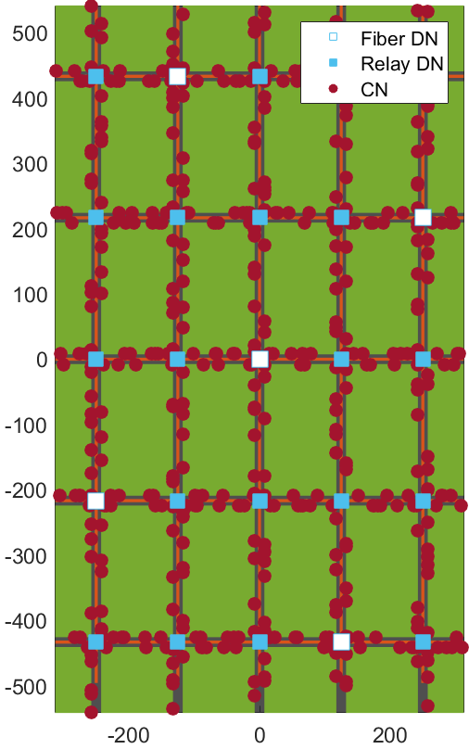
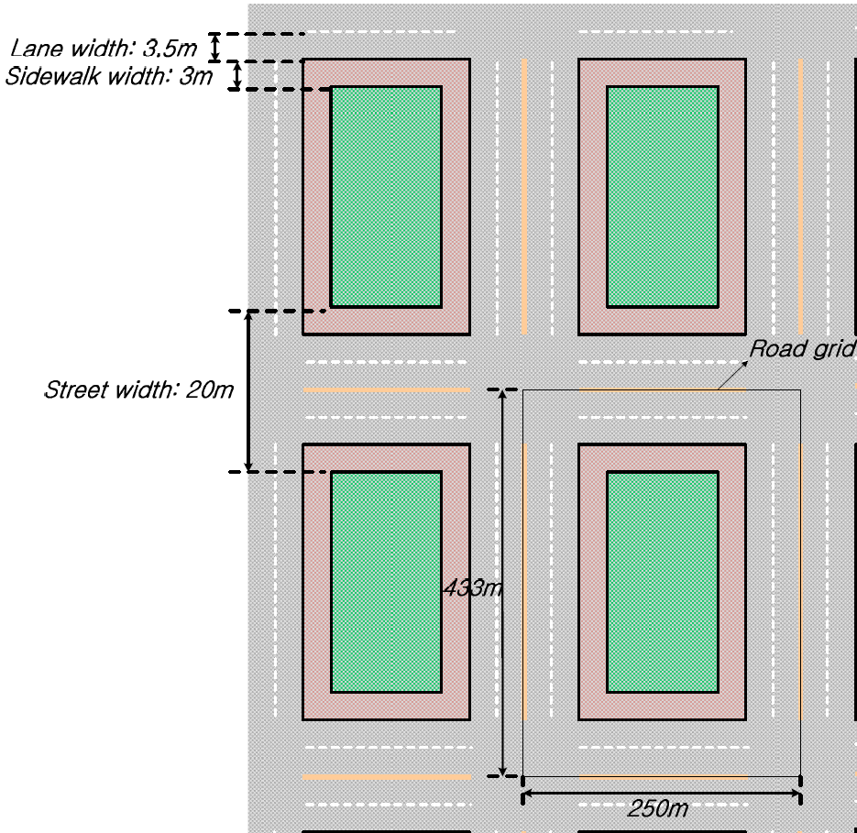
Network Layout
Urban Grid Layout
  25 DN nodes with wrap around
  Inter DN distance varied
  Number of Fiber DN nodes varied
Street Width = 20m
CN Distribution
  CNs distributed uniformly at random along the pavement

Slide 4
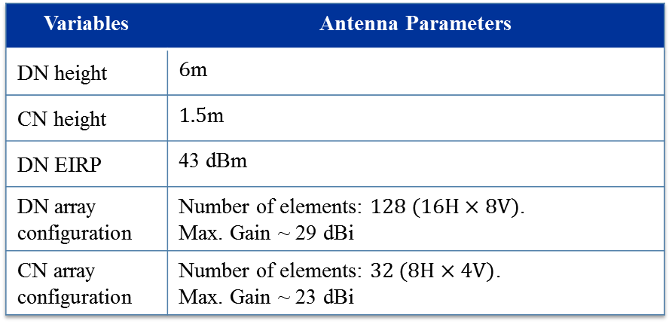
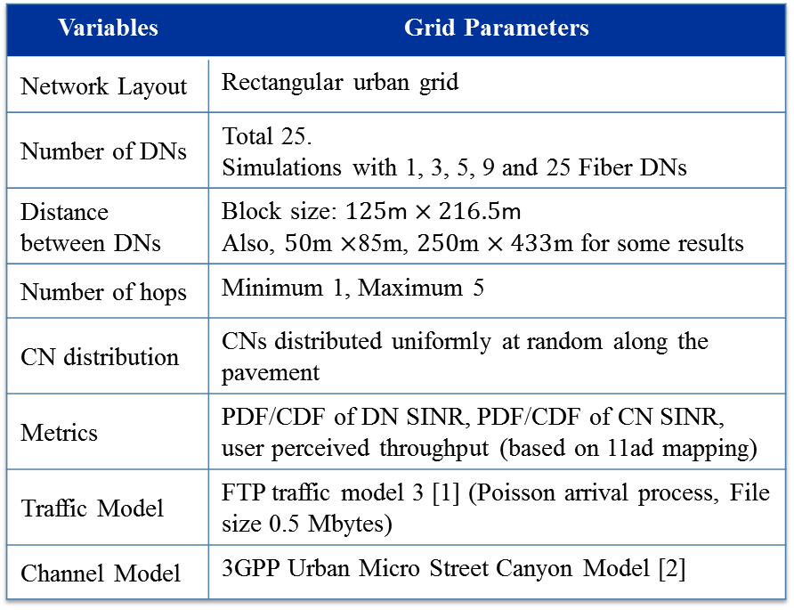
System Level Parameters
This simulation study is downlink only
Variables | Grid Parameters
Network Layout | Rectangular urban grid
Number of DNs | Total 25. Simulations with 1, 3, 5, 9 and 25 Fiber DNs
Distance between DNs | Block size: $125$m $×216.5$m Also, $50$m $×$85m, $250$m $×433$m for some results
Number of hops | Minimum 1, Maximum 5
CN distribution | CNs distributed uniformly at random along the pavement
Metrics | PDF/CDF of DN SINR, PDF/CDF of CN SINR, user perceived throughput (based on 11ad mapping)
Traffic Model | FTP traffic model 3 [1] (Poisson arrival process, File size 0.5 Mbytes)
Channel Model | 3GPP Urban Micro Street Canyon Model [2]
Variables | Antenna Parameters
DN height | $6$m
CN height | $1.5$m
DN EIRP | 43 dBm
DN array configuration | Number of elements: $128 (16H×8V)$. Max. Gain ~ 29 dBi
CN array configuration | Number of elements: $32 (8H×4V)$. Max. Gain ~ 23 dBi

Slide 5
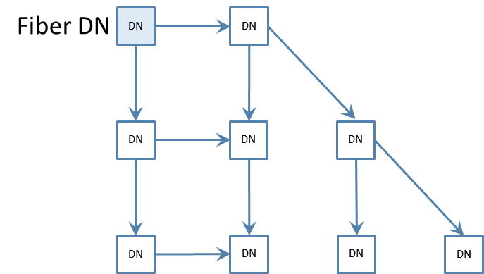
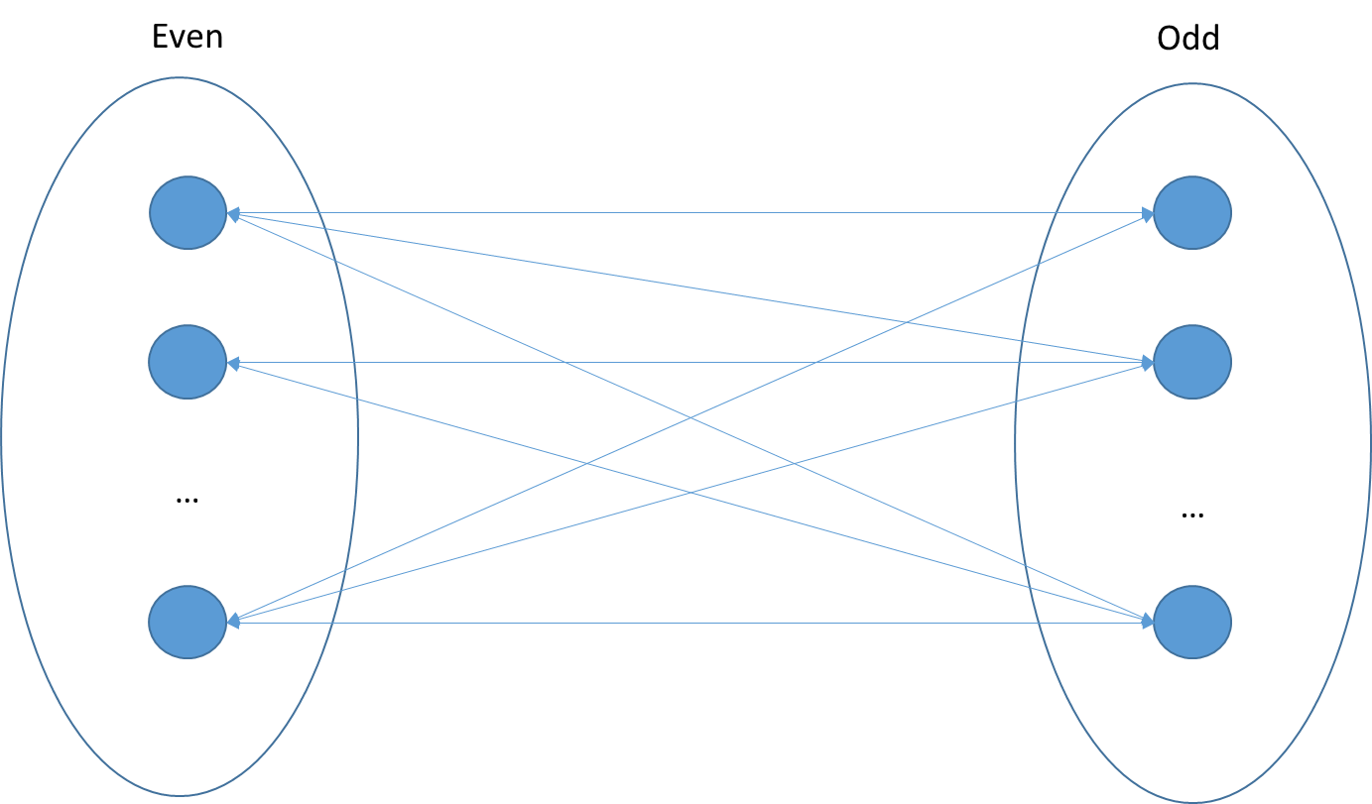
Network Modeling
Topology formulation
  Breadth first search algorithm to assign ‘tiers’ to the DNs
  Tier 1: Fiber DNs, Tier 2: DNs with 1 hop to Fiber DNs, and so on.
DN-DN and DN-CN transmission on orthogonal time slots
TDD polarity assignment based on Tiers
DN TX
DN RX
CN

Slide 6
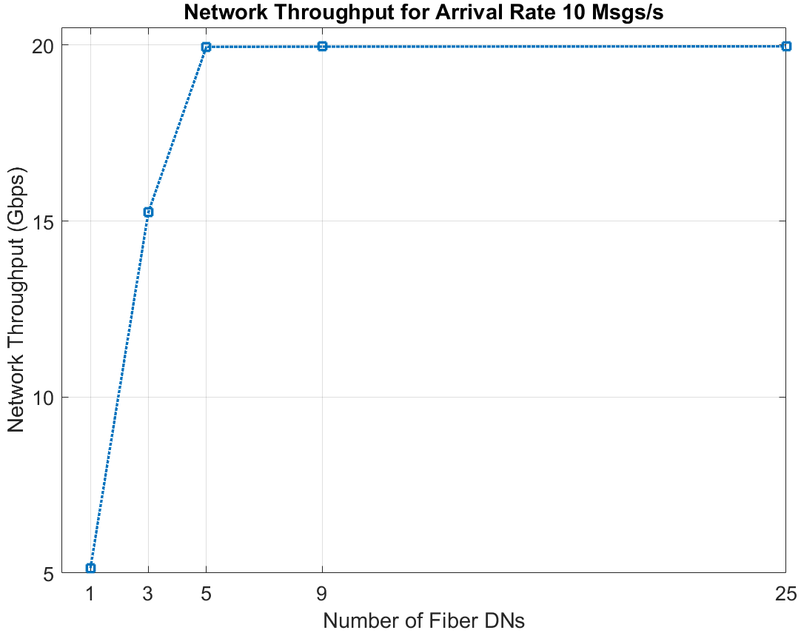
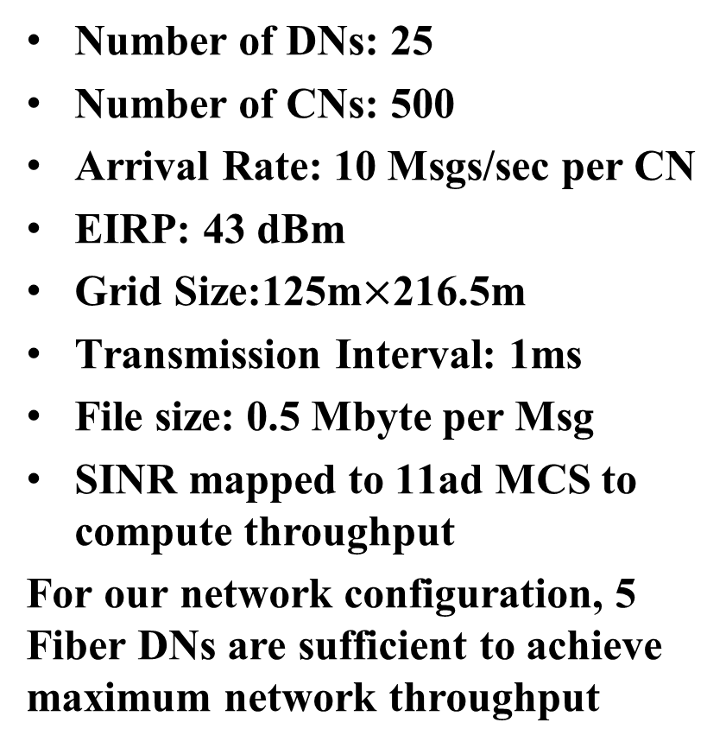
Network Throughput
Number of DNs: 25
Number of CNs: 500
Arrival Rate: 10 Msgs/sec per CN
EIRP: 43 dBm
Grid Size:125m$×$216.5m
Transmission Interval: 1ms
File size: 0.5 Mbyte per Msg
SINR mapped to 11ad MCS to compute throughput
For our network configuration, 5 Fiber DNs are sufficient to achieve maximum network throughput

Slide 7
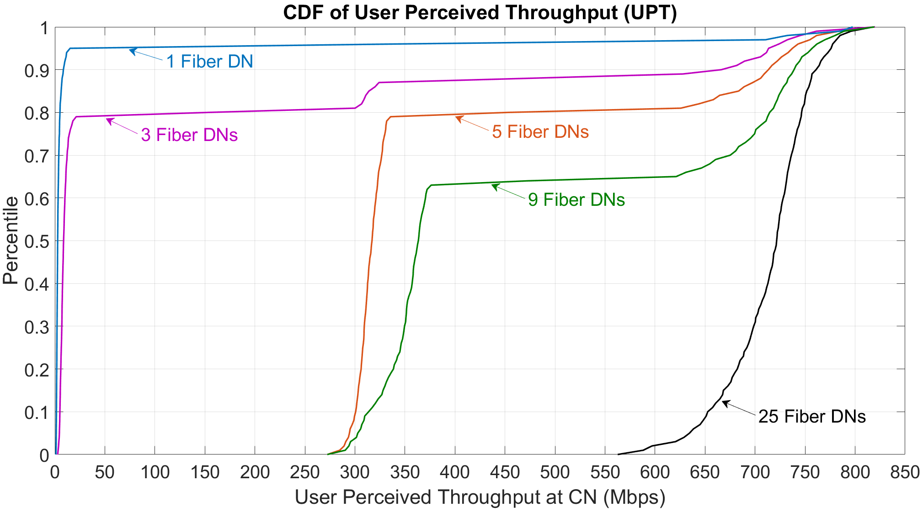
User Perceived Throughput (UPT)
User perceived throughput (during active time), defined as the size of a burst divided by the time between the arrival of the first packet of a burst and the reception of the last packet of the burst
Tier 1 links are bottleneck
  UPT drastically reduces with number of hops
  This is irrespective of resource utilization of links for relay DNs as links of fiber DNs form bottleneck

Slide 8
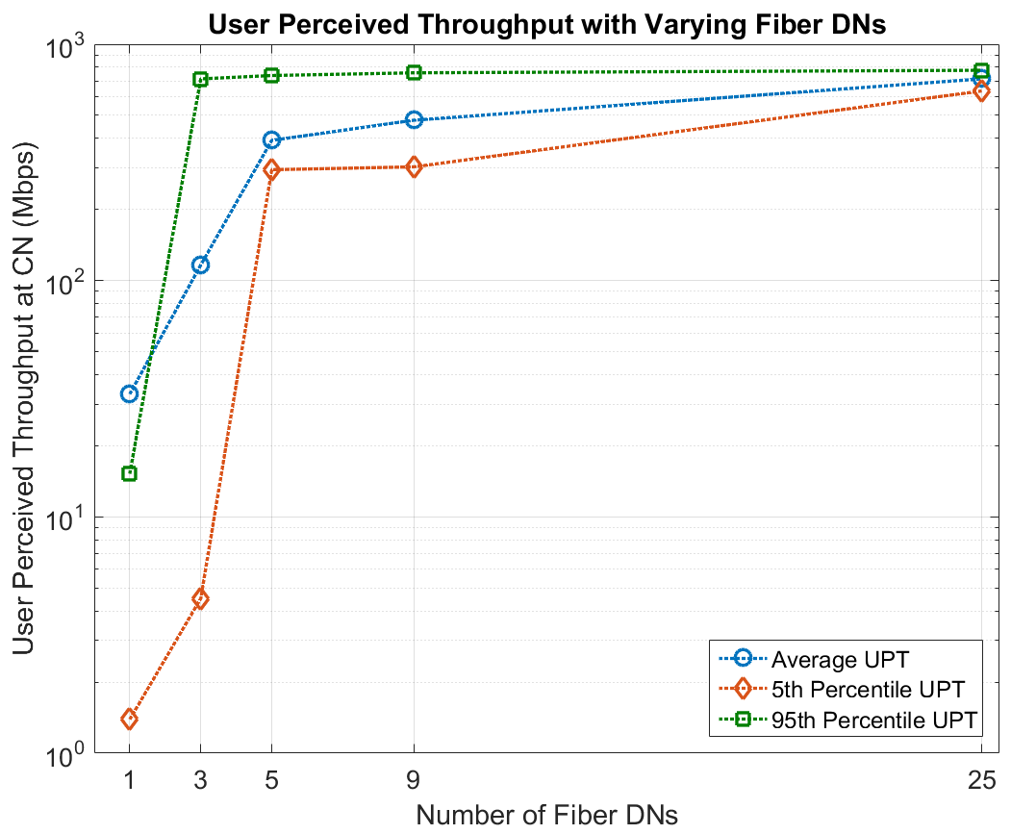
UPT vs Number of Fiber DNs
Average perceived throughput of a user defined as the average from all perceived throughput for all bursts intended for this user
Tail (Head) perceived throughput defined as the worst 5% (best 5%) perceived throughput among all bursts intended for a user
Note: As number of hops increases (Fiber DN=1), across the network only those connected to Fiber DNs get very high UPT. Rest get disproportionately low UPT as links from Fiber DNs have to serve most of the traffic. Thus, average UPT is skewed as seen from the result (95 percentile UPT is lower than average UPT)

Slide 9
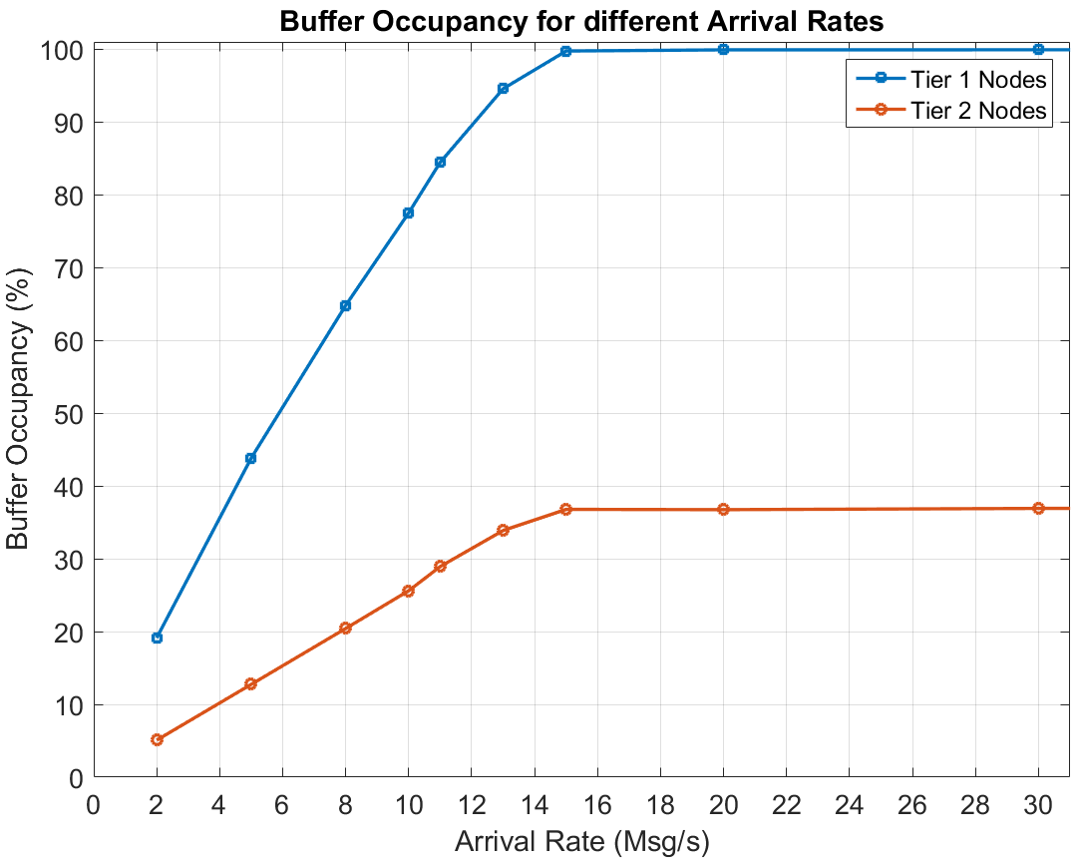
Varying Arrival Rates
Message arrival rate varied
5 Fiber DNs – Two Tiers*
  Tier 1: Fiber DNs
  Tier 2: One hop to Fiber DN
We study the network throughput and UPT for various arrival rates
Clearly, fiber DN links are bottlenecks
*Note: Tier 3, 4, etc would be nodes for 2, 3, etc hops to nearest Fiber DN. In this network, there are none.

Slide 10
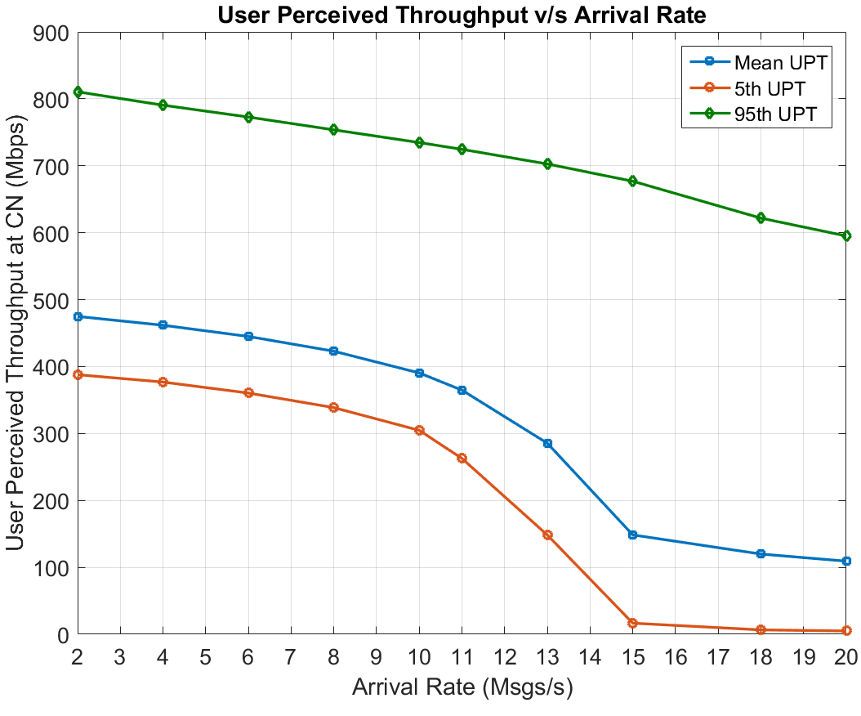
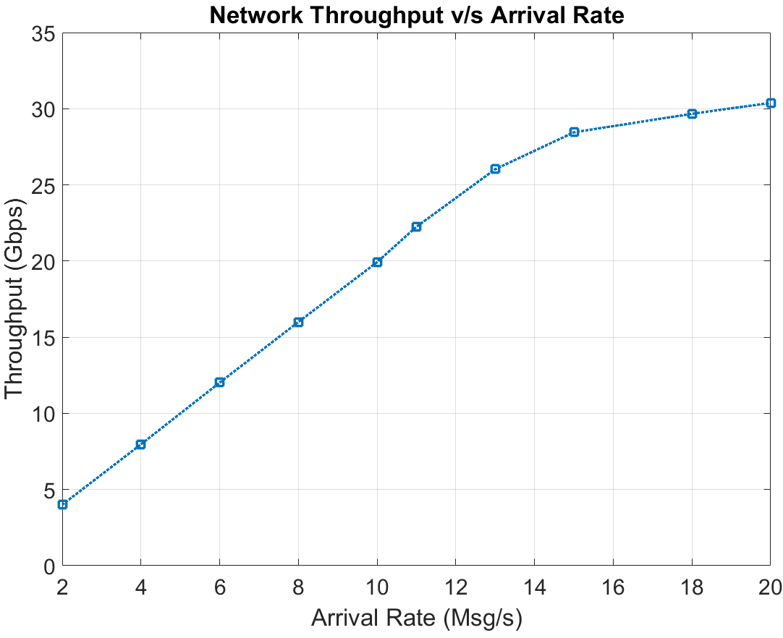
UPT and Network Throughput with Arrival Rate
UPT (a measure of latency) decreases steeply with arrival rate even if network not saturated
Tier 1 links are the bottleneck (saturate at 15 Msgs/sec) – this increases latency (msgs wait longer in buffer)

Slide 11
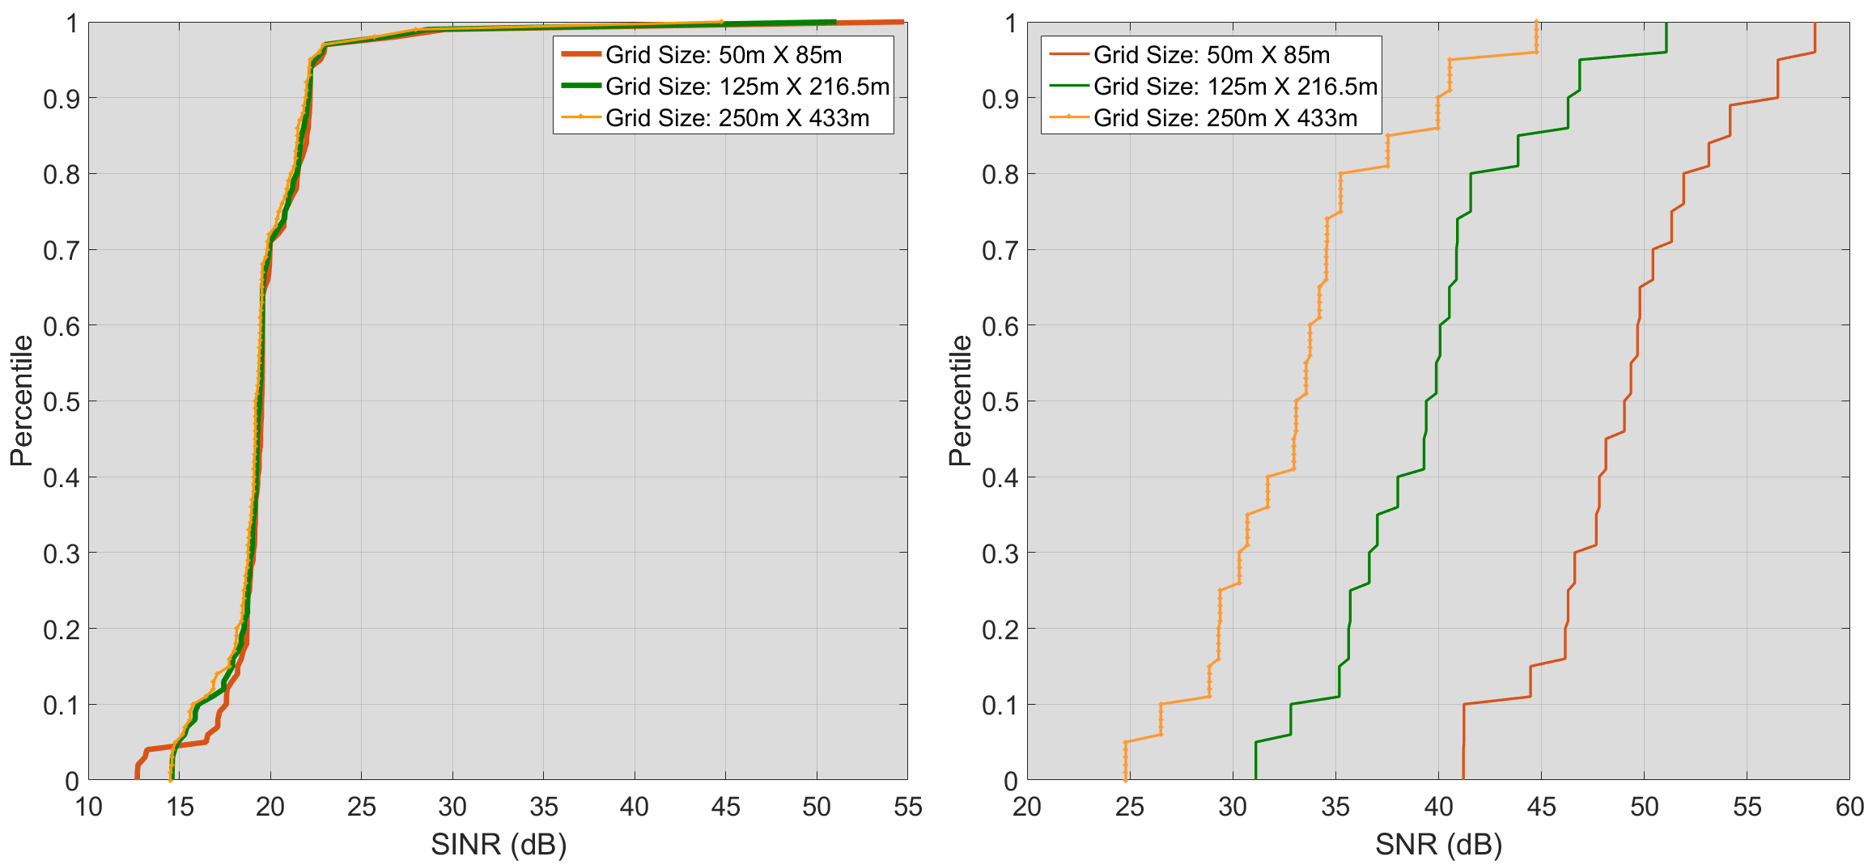
CDF of Instantaneous DN-DN link SINR/SNR with varying Grid Size

Slide 12
Summary
For our network configuration, 5 Fiber DNs are sufficient to achieve maximum network throughput
Links originating from Fiber DNs are bottlenecks
  This bottleneck reduces UPT for CNs connected to Relay DNs
  This is irrespective of Relay DN link resource utilization
UPT (a measure of latency) decreases steeply with arrival rate even if network not saturated
Simulations indicate mesh networks could be interference limited
  Possibly depends on the network layout of simulation, Tx Power
  This can potentially be overcome by scheduling, power control, etc.
Opening up avenues for potentially more simulation studies and calibration
  Provide insights to network design and deployment strategies

Slide 13
References
“Further advancements for E-UTRA physical layer aspects,” 3GPP TR 36.814 V9.2.0 (2017-03), Available: http://www.3gpp.org/ftp/Specs/archive/36_series/36.814/36814-920.zip
“Study on channel model for frequencies from 0.5 to 100 GHz,” 3GPP TR 38.901 V15.0.0 (2018-06), Available: http://www.3gpp.org/ftp/Specs/archive/38_series/38.901/38901-f00.zip

