Slide 1
Roaming mechanism for duty cycle mode
Date: 2018-05-13
Authors:

Slide 2
Abstract
This submission illustrates the roaming considerations and mechanism for WUR non-AP STA operating in a duty cycled mode.

Slide 3
Introduction
Duty cycled operation mode[1] for WUR has been considered for multiple use cases[2].
In the current SFD[3], Beacon/SYNC and Discovery frames have two distinct purposes.
  Beacon – Periodic packet for TSF.
  Discovery – Discovering the BSS.
According to the current SFD[3], IEEE 802.11ba shall provide mechanisms to enable re-discovery of WUR stations by AP.
Based on the above two features we present the roaming considerations and a mechanism for WUR non-AP STA operating in a duty cycled mode in this submission with the help of a usage model.

Slide 4
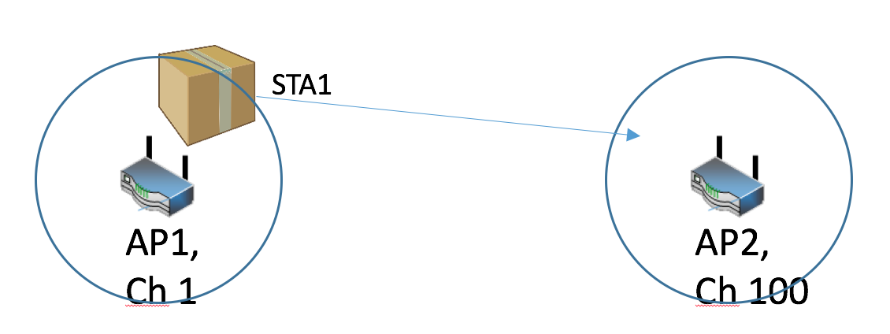
Usage Model: Asset Tracking: Know the location of valued assets in your facility
Environment
High valued, moveable assets in a large and complex location, such as a hospital or warehouse.
Thousands of WUR devices are within one ESS/WUR group’s coverage.
Applications
Location request/report, wake up request/response
Traffic Conditions
Interference with wake up packet transmission
Use case
While asleep, STA1 has been moved from a location in AP1’s BSS to a location in AP2’s BSS.
AP1 and AP2 may be on different channels
Facility manager wishes to locate STA1 after its been moved.
Requirements
  APs are able to send WUR message periodically or by event to a WUR, expecting to locate the WUR device.
  STA needs to know its moved within an ESS, within a short amount of time, and maintain connectivity within the ESS.

Slide 5
Roaming considerations
Action: The WUR non-AP STA is physically roamed from one BSS to another within the same ESS.
What happens when a WUR non-AP STA misses Beacon frames?
  How many Beacon frames does it need to miss before an action is taken?
What happens when the WUR non-AP STA falls back to the discovery channel for the Discovery frames and not hear them as well?
  How many Discovery frames does it need to miss before an action is taken?
When should the non-AP STA’s WUR turn on the PCR to re-associate?
These questions are not only relevant in the use case mentioned on slide but also for all the use cases in [2] and need to be answered.

Slide 6
Proposed solution for the roaming considerations
We propose a state machine at the WUR non-AP STA for addressing the roaming concerns.
The parameters given on the next two slides are used in the state machine.

Slide 7
Parameters for the state machine
Beacon Timer (BT)–Timer for receiving the next Beacon frame.
Beacon Counter (BC)–Counter for missed Beacon frames.
Beacon Missed Threshold (BMT)–Threshold for number of permissible missed Beacon frames.
Discovery Timer (DT)–Timer for receiving the next Discovery frame.
Discovery Counter (DC)–Counter for missed Discovery frames.
Discovery Missed Threshold (DMT)–Threshold for number of permissible missed Discovery frames.

Slide 8
Parameters for the state machine (contd.)
Discovery and beacon frames can be sent on different channels. Therefore, since interference is completely different on those channels, it could lead to a situation where the WUR non-AP STA is hearing Discovery frames but missing the Beacons.
The following two counters are used to handle such situation:
  DMBC = Received Discovery frames but missed Beacons counter.
  DMBT = Received Discovery frames but missed Beacons threshold.

Slide 9
Roaming state machine
Red: Discovery frame loop
Blue: Beacon frame loop
Green: Special handling when receiving discovery frame but not beacon

Slide 10
Determination of parameter values for the state machine
Already existing parameters:
  BT = Duty cycle parameters.
For all other parameters (BMT, DMT, DMBT) there are multiple options to determine the threshold values for the WUR non-AP STA to follow:
Option 1:
  The AP determines the threshold parameters. These can be exchanged during the WUR negotiation over the PCR.
  Eg: BMT = 2, DMT = 2, DMBT = 3

Slide 11
Determination of parameter values for the state machine (contd)
Option 2:
  AP defines range of parameter values from which the WUR non-AP STA can choose to operate. These can be exchanged during the WUR negotiation over the PCR.
  Eg: BMT = {1,2} , DMT = {2,3} , DMBT = {2,3}
Option 3:
  Sets of predefined parameters should be specified in the draft for different types of use cases. The AP sends the non-AP STA the list of sets during WUR negotiation and the WUR non-AP STA can choose a set from among the list.
  Eg: Set1= {BMT = 1, DMT = 2, DMBT = 2} , Set2= {BMT = 2, DMT = 2, DMBT = 3}

Slide 12
Changes in spec required for the state machine implementation
All the options mentioned require an additional element in the WUR negotiation action frames sent from the AP to the PCR of the WUR non-AP STA.
Spec text + diagram describing the state machine for roaming behavior.

Slide 13
Conclusion
There is a need to consider the roaming behavior of WUR non-AP STAs.
A roaming mechanism along with its state machine is proposed.
Threshold parameters for Beacon Misses and Discovery Frame Misses need to be defined in order for non-AP WUR STAs to roam in an efficient way.
Three options are provided to define and exchange these parameters from the AP to the non-AP WUR STA. We propose to use option 3.

Slide 14
References
03-17-0342-04-00ba-WUR-Negotiation-and-Acknowledgement-Procedure-Follow-up.
11-17-0029-10-00ba-wur-usage-model-document
11-17-0575-11-00ba-spec-framework

Slide 15
Strawpoll
Do you agree there is a need to answer the roaming considerations for a WUR STA given on slide 5?
Y/N/A

Slide 16
Strawpoll
Do you agree to use proposed state machine mechanism to address the issues for roaming WUR STAs?
Y/N/A

Slide 17
Strawpoll
Which of the defined parameter options do you agree to use?
Option1/Option 2/Option 3/Other option/More discussion required/Abstain

