Slide 1
Clock Attack Threat Model for 11az
Date: 2018-05-07
Authors:

Slide 2
Abstract
11az FRD [1] describes Type A and Type B adversaries that are characterized according to attacker’s response time.
  Type A: 1 ms response time.
  VHT/HE Type B: 1 μs response time.
  DMG/EDMG Type B: 10 ns response time.
  A few security threat models are listed in [2][3][4].
Another threat model, “clock attack” is presented in this submission.
  We consider an I-STA which attempts to estimate the frequency offset between its own clock and that of R-STA and uses this estimate to correct timing information reported by R-STA.
  Attacker exploits the estimation and correction process performed by the I-STA to decrease the estimated range between I-STA and R-STA.
  Can be realized by a Type B adversary.

Slide 3
Round Trip Time (RTT)
RTT = (t₄’ - t₁’) - (t₃ - t₂)
t₄’ , t₁’: determined by I-STA from (t₄, t₁) reported by R-STA.
  R-STA reports (t₄, t₁) based on its clock and time-of-arrival and departure of packets (see figure).
  Transformation of (t₄, t₁) to (t₄’ , t₁’) requires an estimate of clock difference between R-STA and I-STA.
  I-STA can reduce the ranging error by utilizing the clock difference in certain cases.

Slide 4
Clock Attack (1)
Method of attack:
  Isolate I-STA and R-STA involved in FTM (either opportunistically as in figure below or by amplifying the modified signal).
  Attacker relays the received signal by intentionally mixing the signal from R-STA to a slightly different frequency.
    Introduced frequency offset affects estimated range by I-STA.
    Attacker capability:
      Mixing can be performed by analog components with nanosecond delay.
      Attacker does not necessarily have to operate in full-duplex mode; it can use two co-located hardware for Rx and Tx, respectively.
  As a result, the processing delay of the attacker is ignored.

Slide 5
Clock Attack (2)
Definitions
  T_{1->4} = SIFS + Duration_{FTM_pkt} + 2 x propagation_delay.
    True time between FTM is transmitted and ACK is received.
  T_{2->3} = SIFS + Duration_{FTM_pkt}.
    True time between FTM is received and ACK is transmitted.
  f_{R-STA}: Clock at R-STA.
  f_{I-STA}: Clock at I-STA
  Δf_{spoof}: Spoofed clock offset, i.e., the amount of frequency offset introduced by attacker.
  Duration_{FTM_pkt}: Depends on MCS and payload size.
T_{2->3}
T_{1->4}
Note: The attack is illustrated using the FTM packet sequence, but it is also applicable to HEz and VHTz.

Slide 6
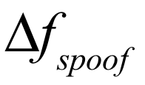
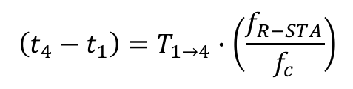
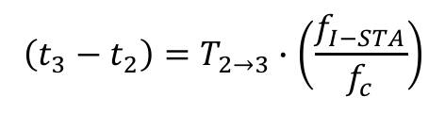
Clock Attack (3)
Relationship between reported and true elapsed time:
  The following expressions represent the relationship between true and reported values (on the left hand side):
  When a device’s clock is operating at a lower rate than nominal value, the reported elapsed time is smaller than true elapsed time.
I-STA estimates the frequency offset ( Δf ) between the received R-STA waveform and its own clock:
  is the amount of frequency offset introduced by attacker.
$$\left(t_{4}−t_{1}\right)=T_{1→4}∙\left(\frac{f_{R−STA}}{f_{c}}\right)$$
$$\left(t_{3}−t_{2}\right)=T_{2→3}∙\left(\frac{f_{I−STA}}{f_{c}}\right)$$
$$Δf≈{(f}_{R−STA}+Δf_{spoof})−f_{I−STA}=(f_{R−STA}−f_{I−STA})+Δf_{spoof}$$

Slide 7
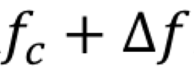
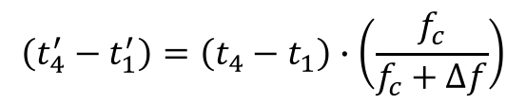
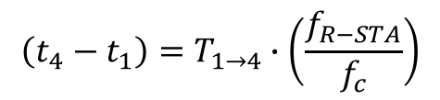
Clock Attack (4)
I-STA ‘corrects’ the timing reported by R-STA assuming its own clock is perfect (i.e., equal to f_{c} ):
  Since true value of elapsed time is related to reported time as:
  And estimated R-STA clock frequency by I-STA is:
By substitution:
  is the amount of frequency offset introduced by attacker.
$$\left(t_{4}^{′}−t_{1}^{′}\right)=\left(t_{4}−t_{1}\right)∙\left(\frac{f_{c}}{f_{c}+Δf}\right)$$
$$\left(t_{4}−t_{1}\right)=T_{1→4}∙\left(\frac{f_{R−STA}}{f_{c}}\right)$$
$$\left(t_{4}^{′}−t_{1}^{′}\right)=T_{1→4}∙\left(\frac{f_{R−STA}}{f_{c}}\right)∙\left(\frac{f_{c}}{f_{c}+Δf}\right)=T_{1→4}∙\left(\frac{f_{R−STA}}{f_{c}+(f_{R−STA}−f_{I−STA})+Δf_{spoof}}\right)$$

Slide 8
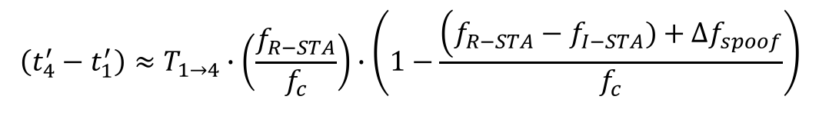

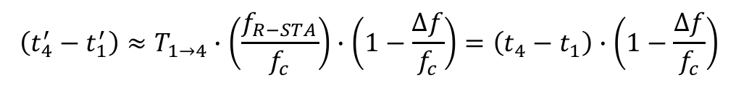
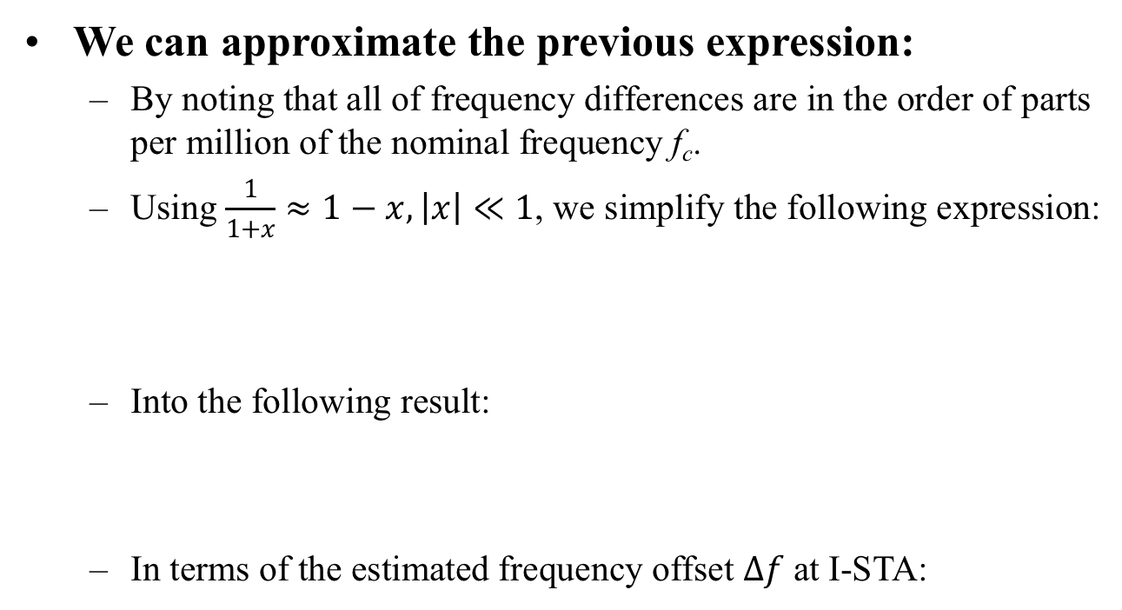
Clock Attack (5)
We can approximate the previous expression:
  By noting that all of frequency differences are in the order of parts per million of the nominal frequency f_{c}.
  Using $\frac{1}{1+x}≈1−x, \left|x\right|≪1$, we simplify the following expression:
  Into the following result:
  In terms of the estimated frequency offset $Δf$at I-STA:
$$\left(t_{4}^{′}−t_{1}^{′}\right)=T_{1→4}∙\left(\frac{f_{R−STA}}{f_{c}}\right)∙\left(\frac{f_{c}}{f_{c}+Δf}\right)=T_{1→4}∙\left(\frac{f_{R−STA}}{f_{c}+(f_{R−STA}−f_{I−STA})+Δf_{spoof}}\right)$$
$$\left(t_{4}^{′}−t_{1}^{′}\right)≈T_{1→4}∙\left(\frac{f_{R−STA}}{f_{c}}\right)∙\left(1−\frac{\left(f_{R−STA}−f_{I−STA})+Δf_{spoof}\right.}{f_{c}}\right)$$
$$\left(t_{4}^{′}−t_{1}^{′}\right)≈T_{1→4}∙\left(\frac{f_{R−STA}}{f_{c}}\right)∙\left(1−\frac{Δf}{f_{c}}\right)=\left(t_{4}−t_{1}\right)∙\left(1−\frac{Δf}{f_{c}}\right)$$
$$Δf≈{(f}_{R−STA}+Δf_{spoof})−f_{I−STA}$$

Slide 9
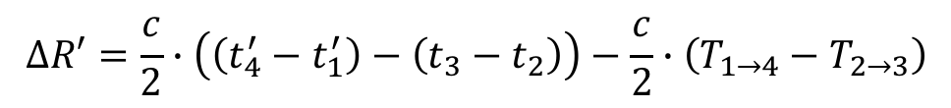
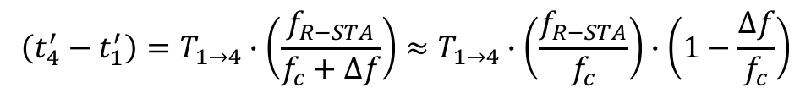


Clock Attack (6)
Error in estimated range ($ΔR′$) due to I-STA ‘correction’ attempt under clock attack:
  Attacker’s goal is to make the range error negative so that R-STA appears closer to the I-STA than it actually is.
  $\left(t_{4}^{′}−t_{1}^{′}\right)$ is open to manipulation, and attacker will try to make this as small as possible to reduce range.
  It is possible to do so by introducing a large (but tolerable) positive frequency offset on R-STA transmissions ($Δf_{spoof})$.
$$ΔR′=\frac{c}{2}∙\left(\left(t_{4}^{′}−t_{1}^{′}\right)−\left(t_{3}−t_{2}\right)\right)−\frac{c}{2}∙\left(T_{1→4}−T_{2→3}\right)$$
$$\left(t_{4}^{′}−t_{1}^{′}\right)=T_{1→4}∙\left(\frac{f_{R−STA}}{f_{c}+Δf}\right)≈T_{1→4}∙\left(\frac{f_{R−STA}}{f_{c}}\right)∙\left(1−\frac{Δf}{f_{c}}\right)$$
$$Δf≈{(f}_{R−STA}+Δf_{spoof})−f_{I−STA}$$

Slide 10
Numerical Results (1)
Range error= range_{est}-range_{true}
  Note: Attacker wants to induce a large negative range error.
HT (11n), 20MHz.
Assumption:
  Case 1: f_{I-STA}=f_{c}.
  Case 2: f_{I-STA} – f_{c} = 25 ppm.
  Case 3: f_{I-STA} – f_{c} = -25 ppm.
Packet duration:
  MCS-1: worse-case scenario.
  Distance=20m. propagation delay is negligible.
  Case 1: without option fields, Duration_{FTM pkt}=64 μs
  Case 2: with LCI=44Bytes, Duration_{FTM pkt}=120 μs

Slide 11
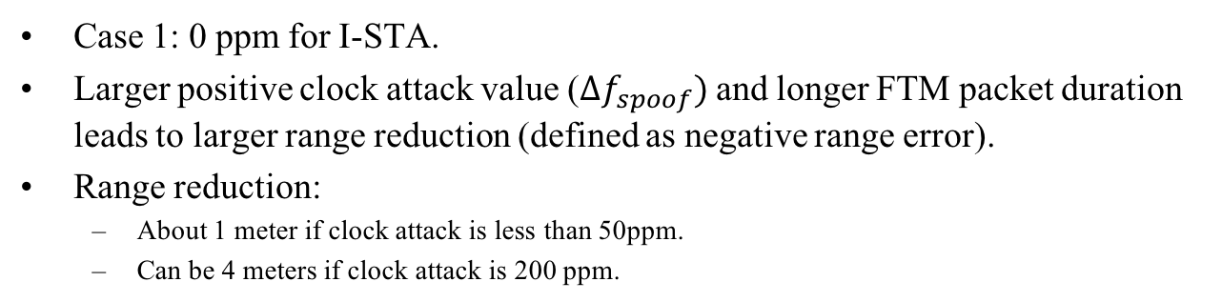
Numerical Results (2)
Case 1: 0 ppm for I-STA.
  Larger positive clock attack value ($Δf_{spoof})$ and longer FTM packet duration leads to larger range reduction (defined as negative range error).
  Range reduction:
  About 1 meter if clock attack is less than 50ppm.
  Can be 4 meters if clock attack is 200 ppm.

Slide 12
Numerical Results (3)
Case 2: 25 ppm for I-STA.
Similar observations as in Case 1: 0 ppm for I-STA.

Slide 13
Numerical Results (4)
Case 3: -25 ppm for I-STA.
Similar observations as in Case 1: 0 ppm for I-STA.

Slide 14
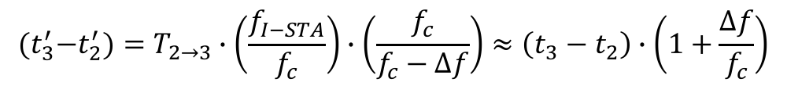
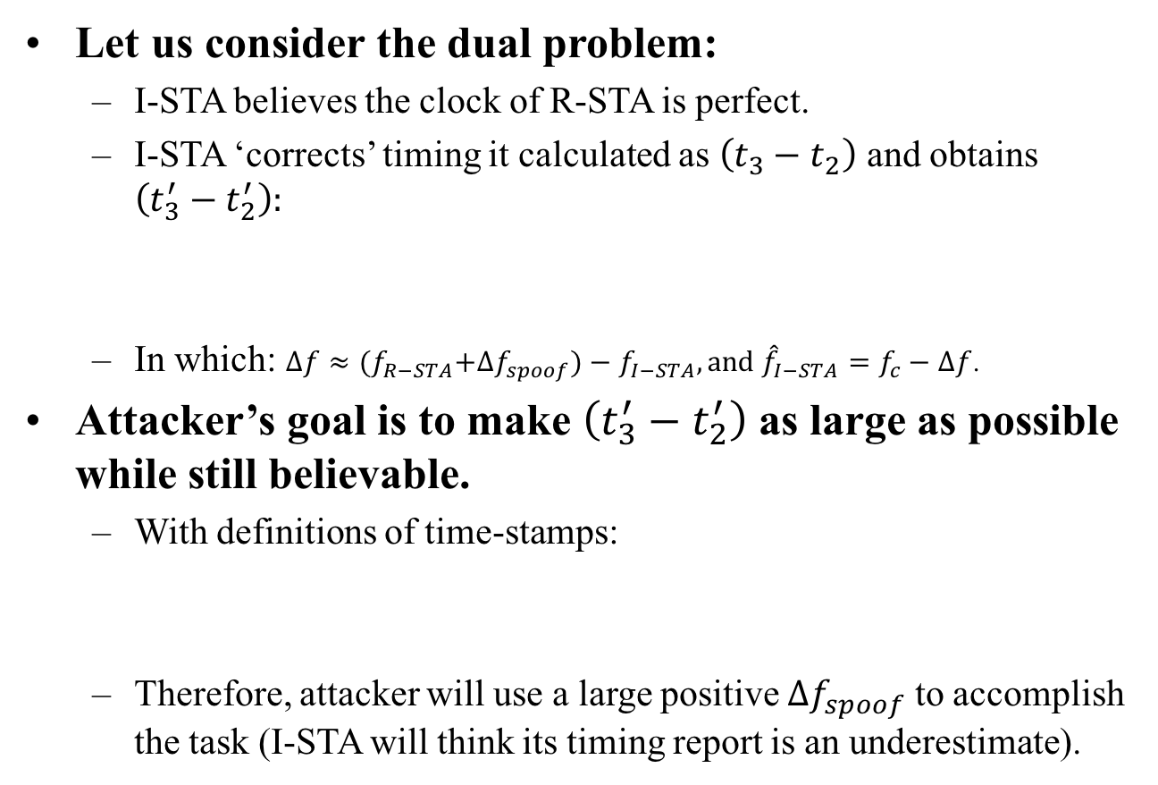
Clock Attack (7)
Let us consider the dual problem:
  I-STA believes the clock of R-STA is perfect.
  I-STA ‘corrects’ timing it calculated as $\left(t_{3}−t_{2}\right)$ and obtains $\left(t_{3}^{′}−t_{2}^{′}\right):$
  In which: $Δf≈{(f}_{R−STA}+Δf_{spoof})−f_{I−STA}, and {\hat{f}}_{I−STA}=f_{c}−Δf$.
Attacker’s goal is to make $\left(t_{3}^{′}−t_{2}^{′}\right)$ as large as possible while still believable.
  With definitions of time-stamps:
  Therefore, attacker will use a large positive $Δf_{spoof}$ to accomplish the task (I-STA will think its timing report is an underestimate).
$\left(t_{3}−t_{2}\right)=T_{2→3}∙\left(\frac{f_{I−STA}}{f_{c}}\right)$ $→$ $\left(t_{3}^{′}−t_{2}^{′}\right)=\left(t_{3}−t_{2}\right)$ $∙\left(\frac{f_{c}}{f_{c}−Δf}\right)$
$${(t}_{3}^{′}−t_{2}^{′})=T_{2→3}∙\left(\frac{f_{I−STA}}{f_{c}}\right)∙\left(\frac{f_{c}}{f_{c}−Δf}\right)≈\left(t_{3}−t_{2}\right)∙\left(1+\frac{Δf}{f_{c}}\right)$$

Slide 15
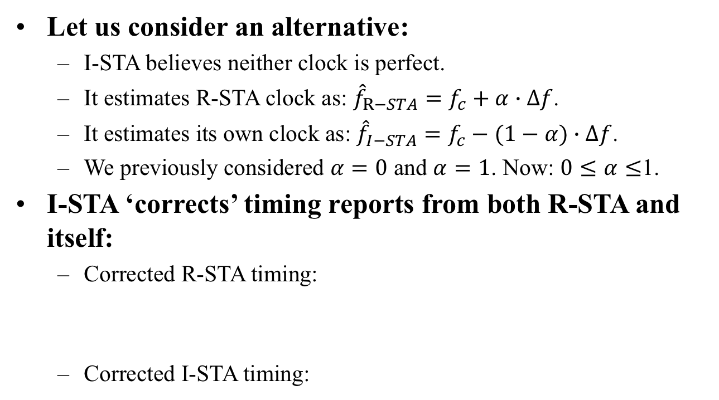
Clock Attack (8)
Let us consider an alternative:
  I-STA believes neither clock is perfect.
  It estimates R-STA clock as: ${\hat{f}}_{R−STA}=f_{c}+α∙Δf$.
  It estimates its own clock as: ${\hat{f}}_{I−STA}=f_{c}−(1−α)∙Δf$.
  We previously considered $α=0$ and $α=1$. Now: $0≤α≤$1.
I-STA ‘corrects’ timing reports from both R-STA and itself:
  Corrected R-STA timing:
  Corrected I-STA timing:
$${(t}_{4}^{′}−t_{1}^{′})=T_{1→4}∙\left(\frac{f_{R−STA}}{f_{c}}\right)∙\left(1−\frac{α∙Δf}{f_{c}}\right)≈\left(t_{4}−t_{1}\right)∙\left(1−\frac{α∙Δf}{f_{c}}\right)$$
$${(t}_{3}^{′}−t_{2}^{′})=T_{2→3}∙\left(\frac{f_{I−STA}}{f_{c}}\right)∙\left(1+\frac{(1−α)∙Δf}{f_{c}}\right)≈\left(t_{3}−t_{2}\right)∙\left(1+\frac{(1−α)∙Δf}{f_{c}}\right)$$

Slide 16
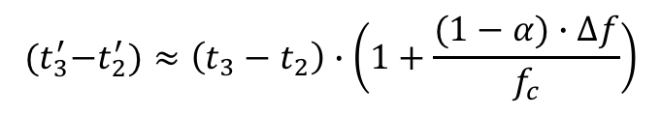
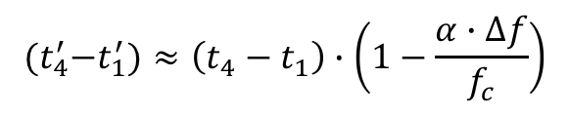
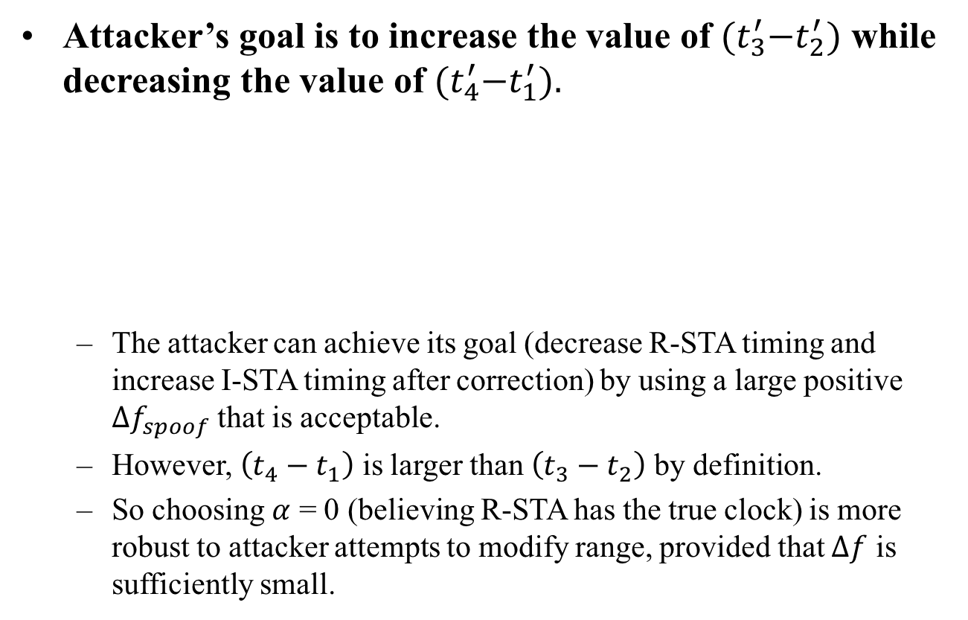
Clock Attack (9)
Attacker’s goal is to increase the value of ${(t}_{3}^{′}−t_{2}^{′})$ while decreasing the value of ${(t}_{4}^{′}−t_{1}^{′}).$
  The attacker can achieve its goal (decrease R-STA timing and increase I-STA timing after correction) by using a large positive $Δf_{spoof}$ that is acceptable.
  However, $\left(t_{4}−t_{1}\right)$ is larger than $\left(t_{3}−t_{2}\right)$ by definition.
  So choosing $α$ = 0 (believing R-STA has the true clock) is more robust to attacker attempts to modify range, provided that $Δf$ is sufficiently small.
$${(t}_{4}^{′}−t_{1}^{′})≈\left(t_{4}−t_{1}\right)∙\left(1−\frac{α∙Δf}{f_{c}}\right)$$
$${(t}_{3}^{′}−t_{2}^{′})≈\left(t_{3}−t_{2}\right)∙\left(1+\frac{(1−α)∙Δf}{f_{c}}\right)$$

Slide 17
Discussion
Range reduction vs. Clock attack:
  Range reduction is <1m if clock attack is <50ppm.
  Range reduction is ~4m if clock attack is 200ppm.
Discussion:
  25ppm: 802.11 spec requirement for carrier frequency accuracy (for 2.4GHz, 20ppm for 5GHz).
  If I-STA believes that the clock difference cannot be large than 25x2=50ppm,
  Then I-STA can detect the clock attack and range reduction is about 1.5 meters.
Question: Can I-STA discard measurements if estimated clock difference is beyond a threshold?

Slide 18
Summary
Clock attack is possible if attacker relays received signal with frequency offset intentionally added.
We presented a threat model titled as “Clock Attack” and showed that spoofed range can be large if there is a wide range of valid clock difference.
Clock attack can be detected and avoided if there is stringent requirement on carrier frequency offset.
  I-STA can discard measurement if the estimated clock difference is beyond a specified threshold.

Slide 19
Recommendation to 11az
Add an informative note on receiver behavior in 802.11az spec.
To state that an I-STA should discard ranging measurements or terminate a range session when it detects an unacceptable amount of clock error.
Suggested text:
  “Note: A device should discard ranging measurements when it detects that its ranging peer’s clock drift exceeds the values specified in 802.11”.

Slide 20
References
[1] IEEE 802.11-16/424r11, 11az FRD.
[2] IEEE 802.11-17/0120r2: “Intel secured location threat model”, B. Abramovsky, O. Bar-Shalom, and C. Ghosh, January 2017.
[3] IEEE 802.11-17/0612r0: “CP-replay attack threat model”, M. Xu, J. Dogan, K. Brogle, AJ Ringer, SK Yong, and Q. Wang, June 2017.
[4] “Secure LTF processing”, C. Berger, N. Grandhe, and L. Chu, February 2018.

