Slide 1
[PSSS_CDD Full Duplex PHY]
Date: 2018-04-30
Authors:

Slide 2
Abstract
PSSS_CDD is a CDD technology which can be combined with PSSS, even with OFDM. First evaluations have shown promising features for a full duplex PHY. DWW has delivered full duplex PHY even with FDD for the Industrial 4.0 project. First results are presented.

Slide 3
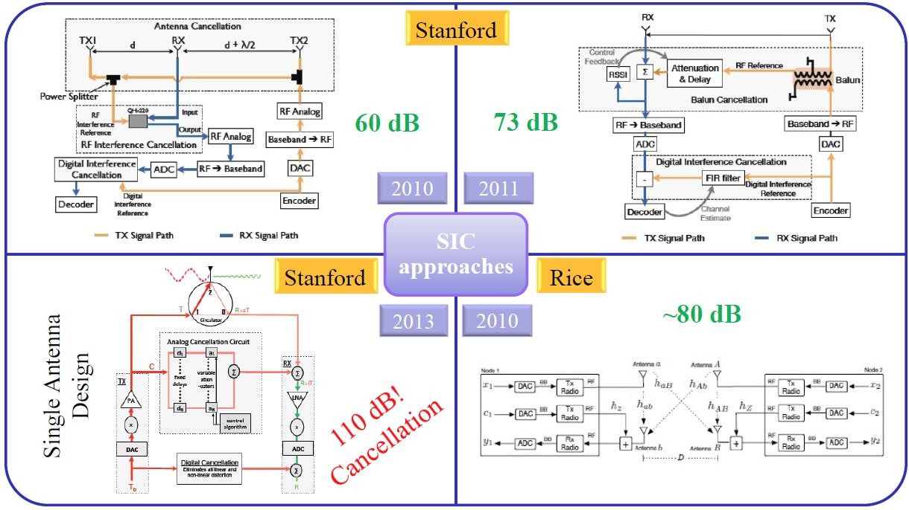
State of the Art in SiC [1]

Slide 4
SiC based on CDD with PSSS
Based on simulations and some hardware test we got SiC about:
Non-linearity is tolerated by PSSS_CDD.

Slide 5
SiC Solution based on CDD and PSSS
CDD could be used in analog and digital domain combined.
MiMo and Multi BS are supported.

Slide 6
Some Simple Simulation Results
CDD Up- Down Link BB Simulation.
Signal from Tx2 could be separated at Rx1 from Tx1.

Slide 7
CDD Code Division Duplex
Encoding
  PSSS Symbols (or OFDM symbols) are spread with separate orthogonal codes for up and down link.
Decoding
  Received CDD encoded symbols are despread to separate up- and down link.
Performance
  Separation during decoding tolerates non linearity of PA, LNA and is mainly depending in digital domain of ADC resolution.
Optional Analog Domain CDD
  Simple one TAP FIR filter for separating up- and down link.

Slide 8
All Snake Oil? No! What are DWW references?
PSSS presented 2004 as 802.11n alternate analog implemented PHY for 1 Gbps. Today used for the Real100G.com research project: 100Gbps@240GHz over a distance of 50 km.
PSSS (Parallel Sequence Spread Spectrum) positioned as optional PHY for IEEE802.15.4-2011.
Industrial 4.0 PHY low latency (<100 µS P2P) SDE platform based on PSSS_CDMA.
A lot of national and international patents.

Slide 9
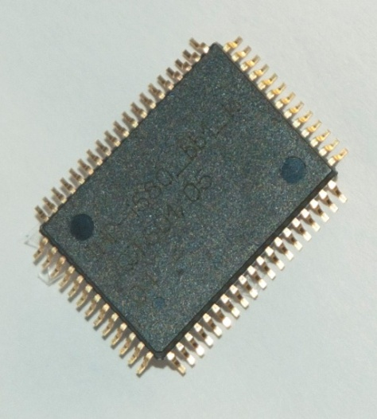
PSSS Prototypes
Two Chip test board with own BB processor ASIC for PSSS 250kbps@868MHz (IEEE802.15.4-2011 optional PHY).

Slide 10
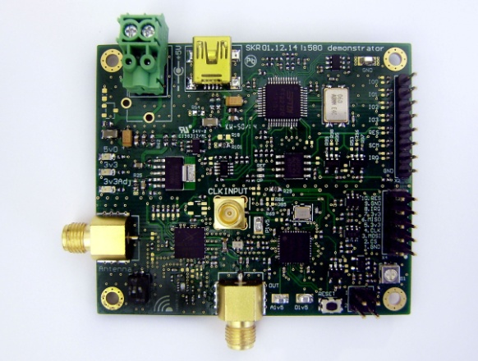
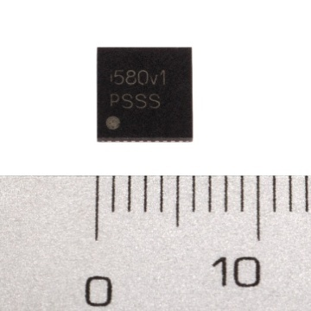
PSSS Prototypes
Single Chip Prototype PSSS 250kbps@868MHz PSSS 250kbps@915MHz (IEEE802.15.4-2011 optional PHY).
5 mm
5 mm

Slide 11
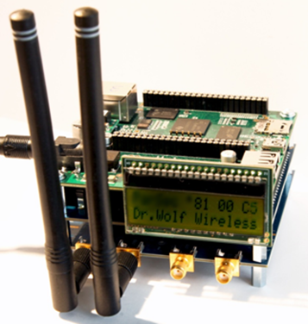
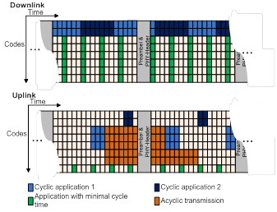
Industrial 4.0 Full Duplex
DWW delivers 20 Mbps full duplex system with low latency (<100 µs P2P) based on DWWs SDE Platform for the PARSEC project (Bosch, NXP, ...).
BB technology PSSS_CDMA@5GHz
with FDD.
Star Network. BS and Mobiles.
[3]

Slide 12
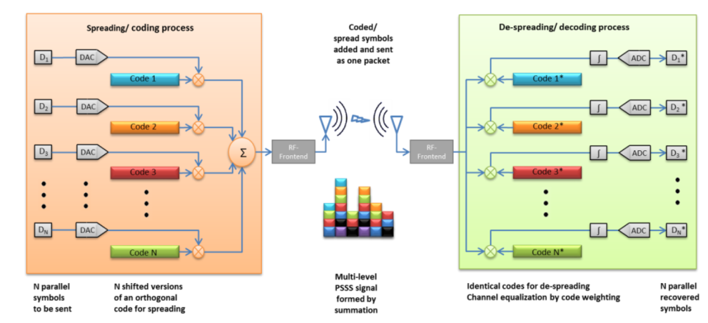
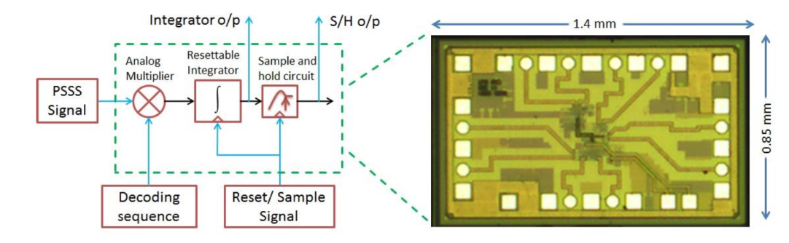
100Gbps@240GHz
DWW presented 2004 at 802.11 PSSS analog implemented as an alternate PHY for 1 Gbps.
The rest of the story is know. But we got traction for 15.4.
Now DWW PSSS technology and system design is used analog implemented the DFG funded project “Real100G.com” [2].

Slide 13
Interest to work on New Wireless Solutions
I was not interested just to work on OFMD systems and therefore decided to be self-employed (> 25 Years).
Therefore I founded DWA/DWW and we successful positioned our PSSS (Parallel Sequence Spread Spectrum) Technology as optional PHY at IEEE802.15.4 Standard.
The promised coverage and data rate (10 kbps -> 250kbps) is confirmed by different customers, i.e. eQ-3, a leading home automation vendor.

Slide 14
What we are looking for?
Partners/Investors to build CDD systems for Full Duplex Solutions and offer it the 802.11 community.

Slide 15
Thank You for Your Attention!

Slide 16
References
IEEE 802.11-13/1122r1, “Considerations for In-Band Simultaneous Transmit and Receive (STR) Feature in Hew”
Parallel Sequence Spread Spectrum System Simulation with RAPP Model, Conference: Eighth International Conference on Networks & Communications, 2016.
ParSec: A PSSS Approach to Industrial Radio with Very Low and Very Flexible Cycle Timing, EUSIPCO 2016.

