Slide 1
HEz RTT Location Using Anchor Stations and Client Cooperation
Date: 2018-05-08
Authors:

Slide 2
Introduction
The purpose of this presentation is to make the case for adding reporting of ‘cross’ RTT measurements in the regular HEz ranging protocol, just as we have for passive location.
The main reason for this is that such cross RTT measurements are useful for enabling anchor client STAs to facilitate (active) locationing.
In addition this enables cooperative client location which can be useful is some cases.

Slide 3
Generalized HEz Ranging Location Signaling Topology
AP
Access Point
AS
Clients to be located - Red, gold, and yellow stars
AP
AP
AS - Client Anchor Station
AS
AS
Types of ranging exchanges:
Between AP and Client to be located.
Between AS and Client to be located.
Between Clients to be located.

Slide 4
Example of HEz Ranging Locationing Using Client Anchor Stations

Slide 5
HEz Ranging Location Using Anchor Client STAs
AP
Access Point
AS
Clients to be located - Red star
AP
AP
AS - Client Anchor Station
AS
AS

Slide 6
HEz-Ranging Using Anchor Station
Broadcasting
of LCI and time stamps
Green arrows – Exchanges in HEz ranging protocol today.
UL
NDP
TF
UL
NDP
TF
rSTA to
iSTA
LMR
iSTA to rSTA
LMR
TF
Frame
1
Frame
2
Responder
AP
Poll
TF
DL
NDPA
DL
NDP
iSTA to rSTA
LMR
Initiator AS
PR
UL
NDP
iSTA to rSTA
LMR
PR
UL
NDP
Initiator
Client STA
Exchanges not in HEz ranging protocol today, except when for support for passive location.
In this case, because of utilization and time-stamping of the ‘blue’ ranging exchanges, the client STA ranges to both the AP and the AS (a client Anchor station), both with known and shared locations.

Slide 7
Summary for HEz Ranging Location Using Anchor Client STAs
By enabling measuring and reporting of TOAs of NDPs between client (anchor) STAs in the general HEz ranging protocol, we enable the use client anchor STAs in HEz locationing.
For example, this enables locationing in scenarios with single AP and two anchor client STAs.

Slide 8
Example of HEz Ranging with Client Cooperative Locationing

Slide 9
HEz Ranging Signaling Topology with Client Cooperative Locationing
AP
Access Point
Clients to be located - Red, gold, and yellow stars
AP
AP
AS

Slide 10
HEz-Ranging Using Client Cooperation
Broadcasting
of time stamps
(TBD)
Green arrows – Exchanges in HEz ranging protocol today.
UL
NDP
TF
UL
NDP
TF
rSTA to
iSTA
LMR
iSTA to rSTA
LMR
TF
Frame
1
Frame
2
Responder
AP
Poll
TF
DL
NDPA
DL
NDP
iSTA to rSTA
LMR
Initiator Client STA 1
PR
UL
NDP
iSTA to rSTA
LMR
PR
UL
NDP
Initiator
Client STA 2
Exchanges not in HEz ranging protocol today, except when for support of passive location.
In this case, because of utilization and time-stamping of the ‘blue’ ranging exchanges, the client STA ranges to AP as well as to each other. With the broadcasting of the time-stamps at the end of the HEz ranging opportunity, all stations, the AP as well as the client STAs all end up with the same time-stamp information. These time stamps enables location based on the ranging to the AP (or APs assuming the above measurement is repeated to multiple APs), and ranging between the clients. This can give increased accuracy, especially in scenarios with few APs.

Slide 11
General Simulation Procedure
Setup:
3 APs in circle with 15 m radius
8 clients
AP2
Clients
AP1
Modeling of imperfections:
0.25 ns stdev Gaussian clock gitter
1 m stdev Gaussian multipath error
All errors independent
AP3

Slide 12
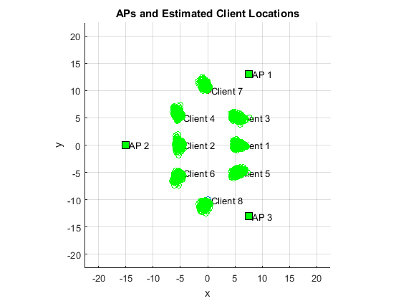
Location of 8 Clients Using 3 APs

Slide 13
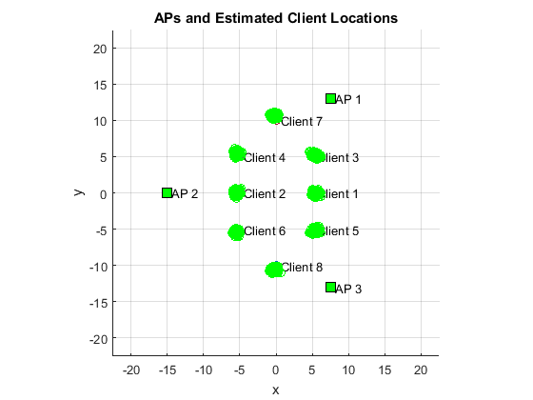
Cooperative Location Among 8 Clients Using 3 APs

Slide 14
Relative Performance with Cooperative Location

Slide 15
Summary for HEz Ranging with Client Cooperative Locationing
By enabling measuring and reporting of TOAs of NDPs between client STAs in the general HEz ranging protocol, we enable client cooperative locationing.
In scenarios with a small number of APs this can give a performance improvement.
Also, not shown here, but it can enable locationing in scenarios with only two APs.

Slide 16
Appendix:
Example Regular RTT and Cooperative RTT Localization Estimation Calculations

Slide 17
Example RTT Location Estimation Calculations
In two dimensions with 3 APs:
R_{ij}
Unknowns:
Client coordinates x₀,y₀
2 unknowns
AP1
AP2
t₁
ToF₁=(t₂-t₁+t₄-t₃)/2
t₄
t₂
Client
(x₀,y₀)
Equations:
ToF equations
ToF₁ = R₁/c
ToF₂ = R₂/c
ToF₃ = R₃/c
3 equations
R₁(x₀,y₀)
t₃
Solve for location, e.g. with Newton iterations – described in following slides.
AP3
(x₃,y₃)

Slide 18
Newton’s method for solving non-linear equation
Solve equation:
x
x₁
x₃
x₂
etc.

Slide 19
Solving of non-linear system of equations
Non linear system of equations:
- solve for x*
Use Newton’s method for multiple variables:
Linearization:
where
Over-determined non-linear system of equation to solve for Δx:
Least squares solution for iterative step:
Iterate according to:

Slide 20
RTT Location Derivatives
To simplify the equations, measure time in light seconds - the distance light travels in one second.

Slide 21
Iterative solution for client position (x₀,y₀) for RTTL
Step calculation. LS solution to:
Note: Time in units of light seconds
Iterations:

Slide 22
Additional Equations and Derivatives for Cooperative RTT Location Derivatives
To simplify the equations, measure time in light seconds - the distance light travels in one second.
For each pair, (i,j) of clients add equation:
where
The derivatives in the Newton iterations become:

Slide 23
Iterative solution for client position (x₀,y₀) for CRTTL
Iterate with Newtons method to find LS solution to set of equations for all users jointly with one RTT ranging equation per client and AP and one per each pair of clients. The equation for a pair of clients is:
Note: Time in units of light seconds
Iterations:

Slide 24
Thank You!

