Slide 1
Next Generation Vehicular
- The Car2Car Communication Consortium -
Date: 2018-05-08
Authors:

Slide 2

The European
CAR 2 CAR Communication Consortium an industrial-driven, non-commercial association founded by European vehicle manufacturers

Slide 3
About the C2C-CC
enhancing road safety & traffic efficiency by means of Cooperative Intelligent Transport Systems and Services (C-ITS)
founded in 2002 by vehicle manufacturers
clear focus on
  wireless Vehicle-to-Vehicle communication (V2V) supported by Vehicle-to-Infrastructure communication (V2I) based on ETSI ITS-G5
  creating standards ensuring the interoperability of cooperative systems spanning all vehicles classes, across borders and brands
evolved into one of the key players in preparing initial C-ITS deployment and next innovation phases.
working in close cooperation with European and international standardisation organisations, e.g. ETSI and CEN

Slide 4

CAR 2 CAR Members

Slide 5

CAR 2 CAR Members
Status March 2018:
17 Vehicle Manufacturers
28 Suppliers
29 Research Organisations

Slide 6
Objectives & Achievements
conceiving applications relevant for traffic safety & efficiency facilitated by ETSI ITS-G5 ad-hoc communication based on IEEE technologies between vehicles and ITS roadside stations
proving technical feasibility & ensuring interoperability of C-ITS across borders and brands
royalty free 5.9 GHz frequency band for safety relevant V2V communication in Europe allocated in 2008
making C-ITS benefits visible in demonstrations (Dudenhofen 2008, Vienna 2012)
Memorandum of Understanding on joint deployment signed in 2012
pilot Public Key Infrastructure (PKI) ensuring integrity of systems and protection of privacy established, in use by C2C-CC members since July 2013

Slide 7
Objectives & Achievements
supporting standardisation for C-ITS in Europe by CEN and ETSI
(EC-Mandate M/453, finalised in February 2014)
continuous cooperation with European and international partners to harmonise standards & discuss deployment approaches
support to C-ITS Deployment Platform of the European Commission from 2014 to 2017
networking stakeholders in workshops, exhibitions and congresses
engaging stakeholder attention for idea of cooperative road traffic, outstanding issues and road maps to deployment
Initial deployment started in 2017/18
C-ITS mass deployment in Europe starting in 2019

Slide 8
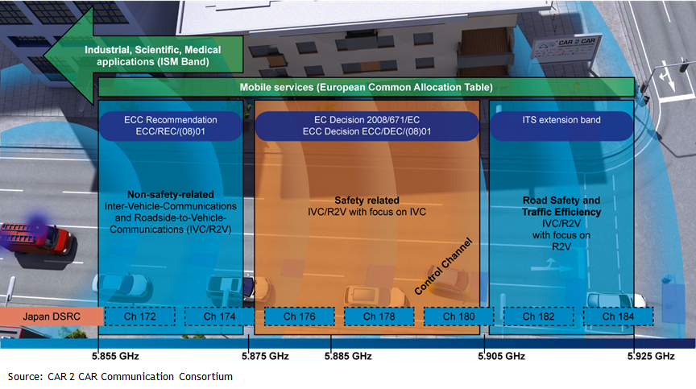
5.9GHz Spectrum Allocation in Europe

Slide 9
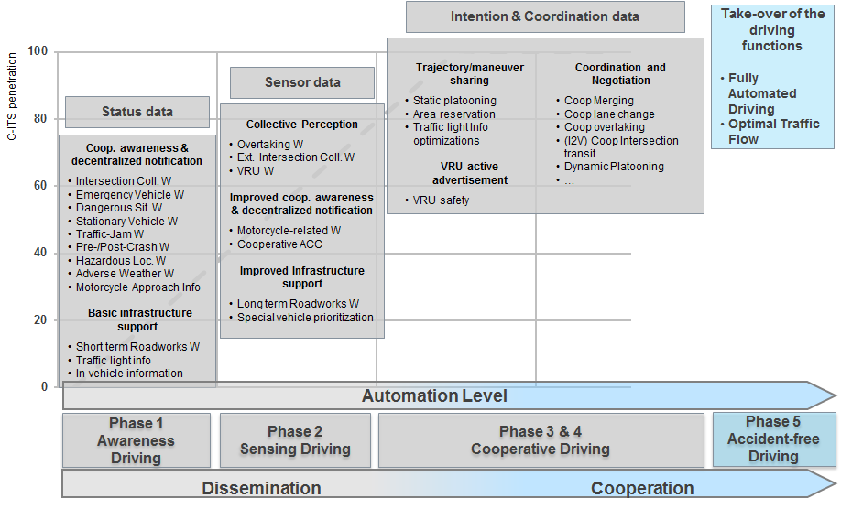
Roadmap for Deployment – Phased Approach

Slide 10
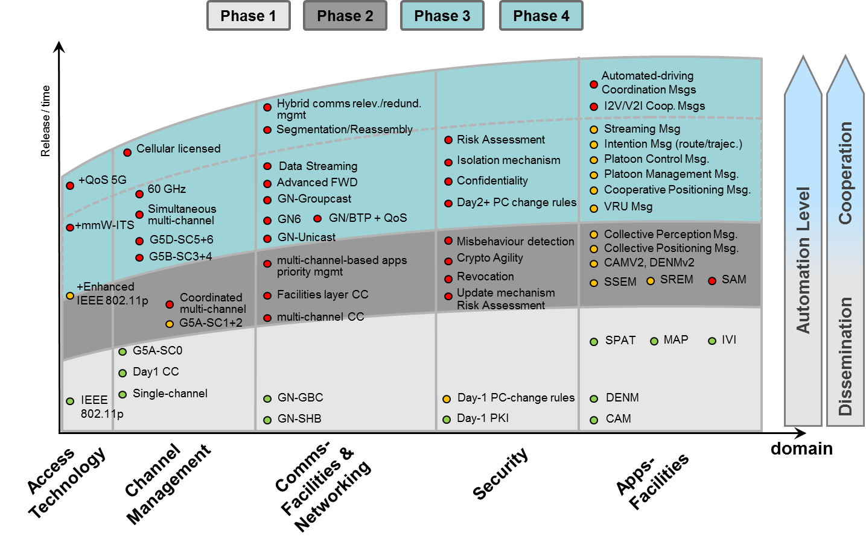
Roadmap for Deployment – Phased Approach

Slide 11
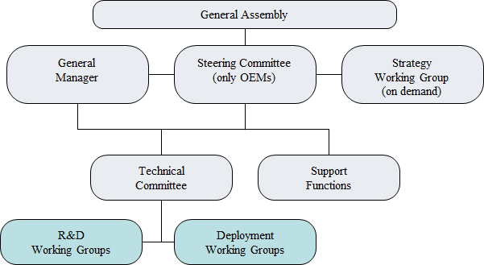
Organisational structure

Slide 12

Cooperation in the Amsterdam Group
Objective:
getting cooperative ITS
on the roads and in the cars
Members:
ASECAP:
the European professional association of operators of toll road infrastructures
CEDR:
the European organisation for the national road administrations
POLIS:
the network of European cities and regions working together to develop innovative technologies and policies for local transport
C2C-CC:
non-profit, industry driven organisation of European vehicle manufacturers, equipment suppliers and research organisations

Slide 13

Cooperation with C-Roads
During the European ITS Congress 2017 at Strasbourg the C2C-CC and C-Roads Platform signed a Cooperation Agreement

Slide 14
Conclusion and Proposal
Deployment of 11p system in on its way in Europe, US and Japan
NGV must be fully interoperable with these system when operating in the band 5.9GHz
NGV should not replace 11p!
NGV should envisage mobile deployment in additional bands in support of new services and redundancy
Stake holders need to be strongly involved in the process to develop a successful extension of 11p

