Slide 1
An Automaker Perspective on Next Gen V2X
Authors:
Date: May 8, 2018

Slide 2

CAUTION – DANGEROUS ROAD AHEAD

Slide 3
Outline
V2X Background – importance of interoperability
Technology migration implications
Need for long and stable operation lifetime
Applications, requirements, performance
3 Principles for NGV – importance of interoperability

Slide 4
DSRC/V2X Background
Dedicated Short Range Communication
Vehicle-to-{Vehicle, Infrastructure, Pedestrian, …} = V2X
Direct & Ad hoc – no BSS, no AP, no manager
Extremely low latency
Most applications single hop
Many applications broadcast
Some normal 802.11 functions (security) moved to higher layers

Slide 5
Background continued
Applications: safety, traffic efficiency, automated driving, …
Standards above 802.11: IEEE 1609, SAE, ETSI, ARIB
DSRC devices do not have time to negotiate capabilities. Often do not even know who they are communicating with
INTEROPERABILITY across all devices at all times and places!
Interoperability defined as: application data transmitted from one device is successfully received at another device
Spectrum is scarce and valuable – must be efficient
  70 or 75 MHz in 5.9 GHz band most places
  10 MHz in 760 MHz band in Japan

Slide 6
Background – Spectrum and channel switching
5.850 GHz
5.925 GHz
DSRC
Spectrum
CH
172
CH
174
CH
176
CH
178
CH
180
CH
182
CH
184
5 MHz
Reserved
Service
Service
Service
Control
Service
Service
Service
10
MHz
10
MHz
10
MHz
10
MHz
10
MHz
10
MHz
10
MHz
freq
Time Division
Sync period 100 msec
time
Announce
services on CCH
Access services
on SCHs
Announce services on CCH
Access services
on SCHs
50 msec
50 msec
Objective: Multiplex one radio effectively among multiple channels
Optional – Not used for Basic Safety Message Channel 172 in US
  2 radios cover all 7 channels
Implication: same MAC/PHY should be used in all channels. FCC requires use of DSRC.

Slide 7
Interoperability
Best way to ensure interoperability:
  One set of standards, either industry consensus or required by law
  Test, test, test
  Ok to add applications, but don’t change underlying protocols
This is what we’ve done!
Best way to ruin interoperability:
  Introduce multiple lower layer technologies into ad hoc network
Best way to kill V2X:
  Ruin interoperability

Slide 8
NHTSA on Interoperability
USDOT NHTSA published V2V NPRM December 2016
Uses “interoperable” and “interoperability” 92 times
  “The ability of vehicles to both transmit and receive V2V communications from all other vehicles equipped with a V2V communications technology is referred to in this document as ‘interoperability,’ and it is vital to V2V’s success.” – NHTSA NPRM (emphasis added)
  “This section is intended to recognize and support the continual progression of communication technology. It proposes alternative interoperable technologies performance requirements grounded in today’s DSRC technology, which would enable the deployment of potential future V2V communications technologies that meet or exceed the proposed performance requirements, including interoperability with all other V2V communications technologies transmitting BSMs.” -NHTSA NPRM (emphasis added)

Slide 9
Implications for technology migration
MAC/PHY V2X migration is VERY DIFFICULT
  Equally true for IEEE, 3GPP and any other technology
New technology features that maintain interoperability with 802.11p are OK.
Protocols that operate outside 5.9 GHz in US & EU are ok:
  Example: 100s Mbps in mmWave bands may be a useful complement to DSRC, e.g. raw sensor data sharing
  Redundant transmissions in another band may boost robustness
What about non-interoperable features in 5.9 GHz?

Slide 10
Non-interoperable, 5.9 GHz MAC/PHY features
Two suggested constraints for such features
Assume channel is shared with 802.11p. So, new features must allow effective co-existence with 802.11p
  Fair channel access, equal to all-802.11p network
  Fair contributions to congestion control, equal to all-802.11p network
New features should reflect actual application requirements that 802.11p cannot meet.
  Principle: If two V2X protocols support an application, implement it over the more widely deployed protocol (e.g. 802.11p)
  Penetration overrules performance (in general, to a point)
  Possible performance improvement not a sufficient rationale for NGV (or 3GPP Rel. n+1)

Slide 11
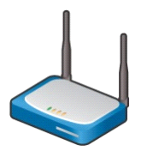
Contrast with traditional Wi-Fi migration
802.11 has a long history of publishing evolved versions:
  802.11a/g/n/ac/ax …
STAs with capabilities different than each other can co-exist in the same WLAN, or in spatially overlapping WLANs
AP generally has multi-generational capability, to translate/mediate across generations as needed for STAs
Infrastructure-based approaches (Wi-Fi, 3GPP) have a relatively easier evolution path than ad hoc V2X
backhaul
802.11a
802.11ac

Slide 12
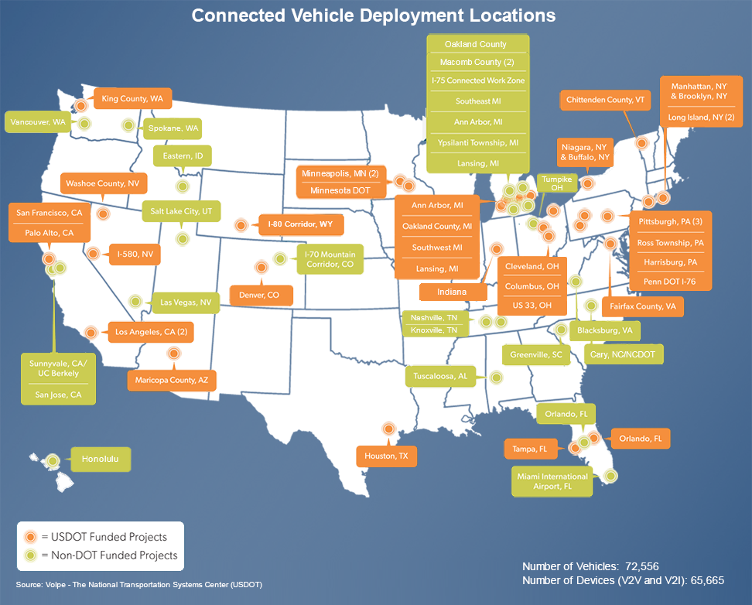
IEEE 802.11p Deployment Status
US:
  10s of thousands of devices
  already deployed
  GM began selling 2017
  Toyota announced broad
  deployment starting 2021
  More than 30 states have
  active deployments
Japan:
  More than 100,000 vehicles starting 2015
Europe:
  Thousands deployed
  Large scale VW Group deployment starting 2019
Source USDOT

Slide 13
Challenges to deployment
V2X is “Cooperative”. Quite different from most auto technology
Benefit to my customer depends on what other automakers have done and will do
  Small benefit to being first to market
  Best approach is for industry to come to market at same time
Car lifetimes are an order of magnitude longer than consumer electronics
Benefits of V2V grow with square of penetration
Safety features carry the highest rigor for design and performance

Slide 14
Implications of deployment challenges
Automakers/Road Operators have to take a long view in deployment decisions
Decisions to deploy have positive feedback
Must be assured that systems will continue to work as designed
  Adding applications during car lifetime is ok, but no h/w changes
Best guarantor of interoperability is stability of standards
802.11p stable since 2010, IEEE 1609/SAE stable since 2015
Risk: NGV (or any non-interoperable technology) can dissuade DSRC stakeholders from deploying. Negative feedback. This is a major issue.

Slide 15
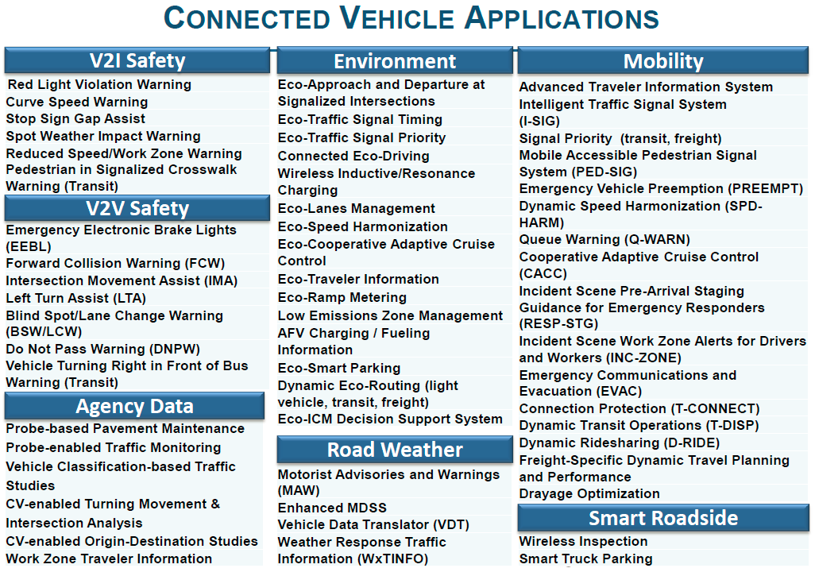
DSRC Applications
Dozens identified so far:
New classes emerging, e.g. automated driving
Applications can be added to cars post-deployment, if underlying protocols support them
Opportunities for innovation
Source: USDOT

Slide 16
MAC/PHY Requirements
There is no single set of requirements for all applications
Here are some that we considered when developing 802.11p
  Low latency (hence no BSS association/authentication)
  Range: sufficient to reach proximate devices on the roadway. Rule of thumb: 300 meters for most use cases, varies with circumstances like speed
  Must operate in high mobility and multipath (hence 10 MHz bandwidth to mitigate delay spread)
  Minimize cross-channel interference (hence steep spectral masks and optional enhanced channel rejection)
  Avoid dependencies that lead to blocks of consecutive lost packets
802.11p meets all requirements for 5.9 GHz apps that I am aware of

Slide 17
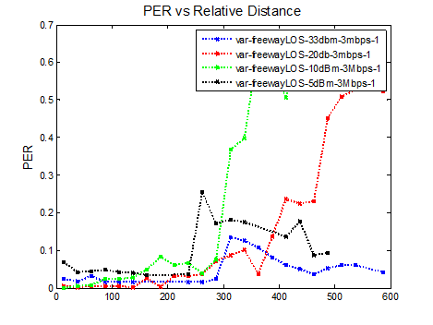
Sample performance: Highway PER vs Distance vs Power
Note: 20 dBm is considered “default” power for most DSRC applications
Figure 73: Comparison of PER versus Distance Curves for Various Power
Levels in a Freeway-LOS Scenario when Transmitter is Set to 3 Mbps
(from VSC-A Final Report, 2011)

Slide 18
Summary: 3 Principles for NGV
NGV should only consider MAC/PHY changes that fit in one of the following three constraints:
New technology features that maintain interoperability with 802.11p.
Protocols that will operate outside 5.9 GHz in US & EU
New technology features that do not maintain interoperability with 802.11p, but only if both of the following are true:
  Effective same-channel co-existence with 802.11p
  The features enable new applications that 802.11p cannot support

Slide 19
Conclusions
DSRC is a key technology for making our roads safer and more efficient
DSRC is in deployment
Deployment challenges for a cooperative technology mean underlying technology must be stable
Technology migration is quite different for ad hoc DSRC than for mainstream BSS-based 802.11
Interoperability, Interoperability, Interoperability
If NGV work goes forward, it should be constrained as indicated in this submission

