Slide 1
LC Usage Model
Date: 2018-05-08
Authors:

Slide 2
Background
In the CSD proposal for light communication [1], broad market potential has been observed from two areas: 1. broad sets of applicability, and 2. multiple vendors and numerous users:
Among those use-case is the complimentary deployment in traditional markets for IEEE 802.11, such as industrial wireless, wireless access in medical environments, enterprise and home networks, backhauling scenarios, underwater communication and more.
Stakeholders include chip makers to deliver PHY & MAC sub-systems, system integrators and lighting companies, telecom operators, Internet Service Providers (ISPs), IoT companies, industrial manufacturers, aviation and transportation industries.
Based on the above statements, this presentation provides a number of usage models to help guide standardization effort.

Slide 3
Terminology
Usage Model – A usage model is the combination of all the things below; not to be confused with a use case which is the specific set of steps to accomplish a particular task.
Pre-Conditions – Initial conditions before the use case begins.
Environment – The type of place in which the network of the use case is deployed, such as home, outdoor, hot spot, enterprise, metropolitan area, etc.
Application – A source and/or sink of wireless data that relates to a particular type of user activity. Examples are streaming video and VoIP.
Traffic Conditions – General background traffic or interference that is expected while the use case steps are occurring. Overlapping BSSs, existing video streams, and interference from cordless phones are all examples of traffic conditions.
Use case – A use case is task oriented. It describes the specific step-by-step actions performed by a user or device. One use case example is a user starting and stopping a video stream.

Slide 4
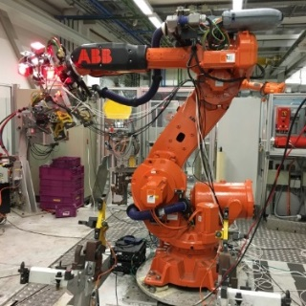
Usage Model 1: Industrial wireless
Pre-Conditions
Devices may experience unstable RF connection due to electromagnetic compatibility (EMC) issues such as jamming in factories. LC is deployed to provide reliable wireless connectivity for industrial wireless networks.
Environment
All communications are within a large metal building, industrial or automated work cell. The area of those environments range from tens to thousands of square meters, equipped with industrial robot and other equipment. The environment is very electrically noisy, for example EMI radiation from all kinds of noise-generating electronic devices. Lighting level of 150 lux is recommended (1500 lux for dedicated work).
Applications
UHD video streaming for surveillance or production monitoring (quality control) applications, as well as for video collaboration for team, customer, and supplier meetings. Lightly compressed UHD video: ~2 Gbps, delay < 5 ms, 1.0E-8 PER, 99.9% reliability.
Fully connected factory—for real-time communications, application execution, and remote access.
Distance between LC APs ranges from 2-20 meters.
Traffic Conditions
Both uplink and downlink are using LC.
Interference between LC APs belonging to the same managed ESS due to very high density deployment.
Potential interference from surrounding environments such as sunlight and other artificial-light.
Multiple LC modules are deployed on the robot/equipment and on the ceiling/walls to provide multiple light links for a robust connectivity in case a single line-of-sight link is blocked.
Use Case
An industrial robot is powered on and ready for operation.
Operating instructions are transmitted to the robot via LC.
The robot is working according to the instructions and provides real-time feedback information and/or video monitoring data for quality control to control center also via LC.
Upon command, the robot finishes the task and is ready for the next one.
Industrial robot

Slide 5
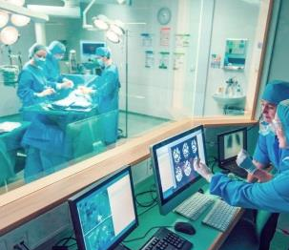
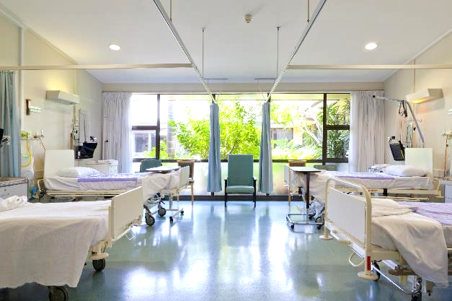
Usage Model 2: Wireless access in medical environments
Pre-Conditions
RF communication is prohibited for EMI issue. LC is deployed to provide wireless connectivity with higher diagnostic efficiency and better patient experience.
Environment
The size of a normal operating theater and MRI room ranges from 30~60 m². Multiple LC-APs are deployed on the ceiling to provide specialized illumination. The central illuminance of the operating light: 160,000 and 40,000 lux. The size of a four beds ward is about 60 m², light level: 300 lux on the bed and >100 lux between the beds and in the central area.
Applications
LC-WLAN is used to allow wireless data exchanges in environments that are constrained in terms of electromagnetic compatibility such as operating rooms or areas equipped with MRI machines.
Medical multimedia and diagnostic information can be transmitted to provide telemedicine services; medical equipment can also be wirelessly controlled via LC.
Provide Intranet/ Internet access, audio or video call for doctors, nurses and patients using LC-based devices .
Traffic Conditions
No interference caused by RF radiation.
Both uplink and downlink are using LC.
High QoS and high reliability are required.
Potential interference from surrounding environments such as artificial-light.
Use Case
Doctors enter an operating theater, turn on the LC enabled LED lights and medical equipment. Doctors can interact with the remote doctors and share information using LC. Medical equipment connectivity is also supported by LC. Doctors finish the treatment, then turn off the lights and medical equipment.
If a patient in a ward has any adverse effects, the nurse can immediately call for assistance through the LC-based wireless device without leaving the patient alone.
© vm
Operating theater
Hospital ward

Slide 6
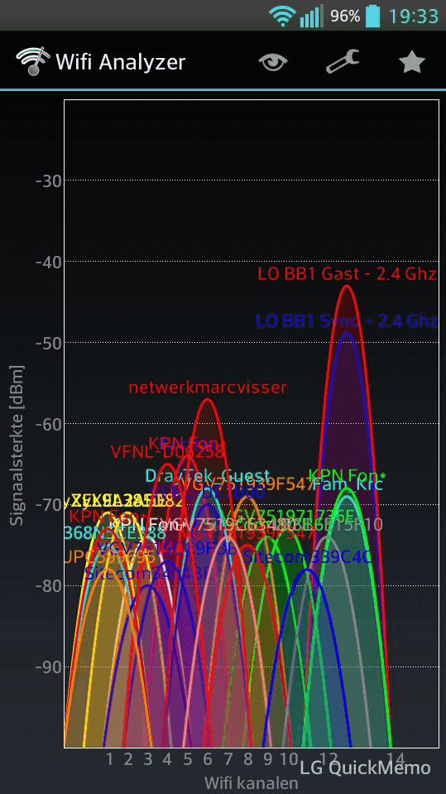
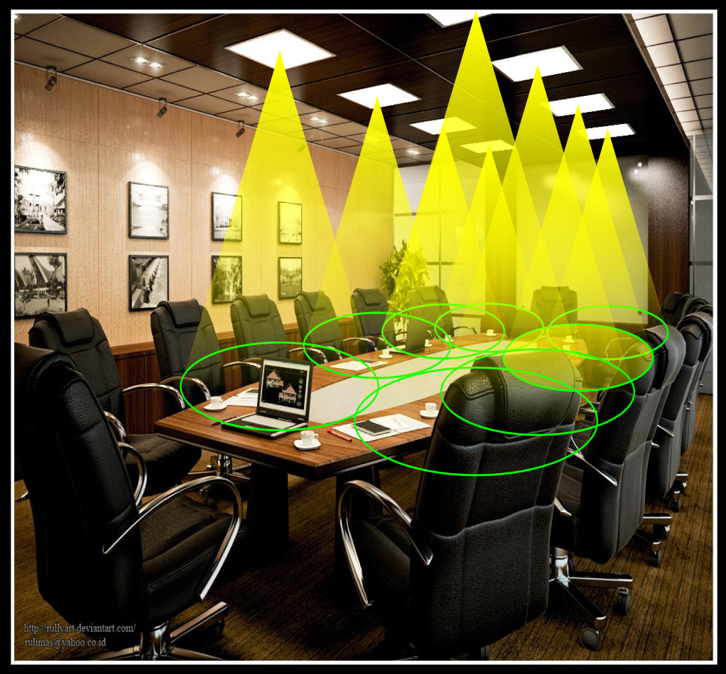
Usage Model 3: Enterprise network
Pre-Conditions
The density of users may be very high in the space putting pressure on the RF network. In addition, the interference from other RF systems (possibly used for IoT applications) as well as the possibility of security or privacy concerns could limit the deployment or effectiveness of RF solutions. LC is deployed to provide wireless connectivity escaping the limitation.
Environment
Recommended size of a meeting room for 30 seats ~ 50 m². Mostly LOS with a few obstacles for example slow moving people. Dense STAs (20~40 STAs) in one meeting room with up to ~10 APs.
Max distance between AP and STA ~ 5 m. The inter- LC AP distance is in the range of 1~3 m. Lighting level of 500 lux is recommended.
Applications
UHD Video conference up to 1Gbps
Virtual desktop, Intranet/ Internet access.
File exchange between two/multiple users in the same room.
Traffic Conditions
Both uplink and downlink are using LC.
Interference between LC APs belonging to the same managed ESS due to very high density deployment.
Interference with peer-to-peer networks within each meeting room.
Potential interference from surrounding environments such as sunlight and artificial-light.
Use Case
UHD video teleconferencing starts in multiple meeting rooms simultaneously. People can see each other and demonstrate their desktop to each other via the LC network. Some people are walking in the meeting room.
Crowded Wi-Fi channel
LC meeting room

Slide 7
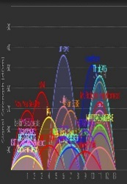
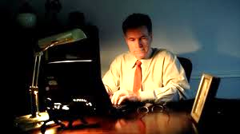
Usage Model 4: Secure home network
Pre-Conditions
Interference and security problems are becoming serious with more connected devices, expansion of Internet of Things (IoT), and overloaded networks. LC is (densely) deployed to provide wireless connectivity and solve this problem.
Environment
A living room with a area of up to ~ 30 m², installed with 5-30 ceiling lamps, a floor lamp and a table lamp.
Mostly LOS with a few obstacles for example furniture. Up to ~10 STAs in one room, the distance between AP and STA 0.5 ~ 3 m. The inter- LC AP distance is in the range of 0.5 ~ 2 m. Recommended illuminance levels for general lighting, recreation and reading are 50 lux, 200 lux and 500 lux, respectively.
Applications
Secure wireless Internet access (20 Mbps per user)
VR games, resolution per eye: 1080 x 1200 @ 90 Hz (>1Gbps)
3D UHD lightly compressed video (3.6 Gbps)
IoT applications
Traffic Conditions
Both uplink and downlink are using LC.
Interference between LC APs belonging to the same managed ESS due to very high density deployment.
Interference with peer-to-peer networks within the same room.
Potential interference from surrounding environments such as sunlight and artificial-light.
Use Case
Two user play VR games together.
Another user perform a mixture of applications, including Internet access, online video chat, without worrying about wireless signal leaking into other places.
Wi-Fi signal from neighbors
Internet access with LC

Slide 8
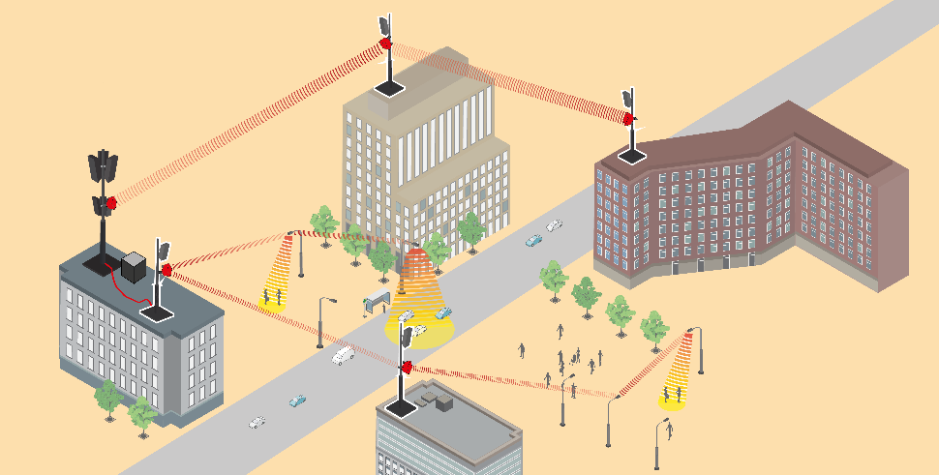
Usage Model 5: Backhaul
Pre-Conditions
During roll-out of new networks, the backbone for Internet, mobile radio and surveillance cameras is often wireless. In unlicensed spectrum, coexistence with Wi-Fi access networks operated near the end points of the backhaul link is a critical issue. LC is deployed to provide wireless backhaul and solve interference issues.
Environment
In outdoor scenarios, distances range from 10 to 200 m. LC devices are deployed on rooftops, at building walls, at streetlights, in metro and railway stations and other indoor locations. LOS is mandatory. Two STAs are deployed, where the light is directed using a lens or mirrors. Outdoors, devices are weather-proof. The data rate is usually adapted to variable SNR due to weather conditions.
Applications
Simple deployment of wireless backhaul between 100 Mbps and 5 Gbps, suitable for different services. For mobile backhaul support, synchronization is needed.
Traffic Conditions
Both link directions are using LC.
Interference between LC STAs is negligible outside the illuminated spot size (one to few meters). Interference with sunlight requires optical band-pass filters.
Use Case
An existing backhaul network shall be extended and new sites integrated but the fixed backbone crosses public or private areas and would be costly and delay the deployment. Use cases are the deployment of small radio cells for Wi-Fi and 4G/5G e.g. on streetlights and the additional deployment of wireless cameras for video surveillance.

Slide 9
Summary of Key metrics [12]
UC # | Distance | Throughput | Latency | Signal strength (lux) | Applications and Characteristics
1 | <20m | 10Mbps~2Gbps | <5ms | 150-1500 | -UHD production monitoring -Static, Low Mobility -Multi-AP, Multi-STAs
2 | <3m | 10Mbps~3Gbps | <5ms | 40,000-160,000 100-300 | -Uncompressed UHD -Static, Low Mobility -Multi-AP, Multi-STAs
3 | <5m | 10Mbps~1Gbps | <5ms | 500 | -Video broadcasting -Static, Low Mobility -Multi-AP, Multi-STAs
4 | <3m | 10Mbps~5Gbps | <3ms | 50-500 | -VR gaming, Internet, Video -Low Mobility, -Multi-AP, Multi-STAs
5 | 10-200m | 100Mbps~5Gbps | <5ms | - | -Wireless surveillance cameras -Static -Point to point

Slide 10
References
11-17/1603r9 “A CSD Proposal for Light Communications (LC)” Nikola Serafimovski (pureLiFi)
11-17/1604r10 “A PAR Proposal for Light Communications (LC)” Nikola Serafimovski (pureLiFi)
Design Techniques for EMC – Part 2 Cables and Connectors http://www.compliance-club.com/archive/keitharmstrong/design_techniques2.html
Electronic Noise Is Drowning Out the Internet of Things https://spectrum.ieee.org/telecom/wireless/electronic-noise-is-drowning-out-the-internet-of-things
Patton McGinley “The Impact of Wireless Technologies on Patient Safety” https://www.psqh.com/analysis/the-impact-of-wireless-technologies-on-patient-safety/
11-17/1631r1 “Use Cases for 802.11 Light Communications” Tuncer Baykas (Medipol University)
11-17/1500r1 “Light Communications Experience of a Lighting Systems Manufacturer” Christophe Jurczak (Lucibel)
11-17/1609r0 “Light Communications opportunities for a Mobile Service Offering” Simon Clement (Liberty Global)
11-17/1686r1 “Use Cases for Light Communications” Mohammad Noshad (VLNComm Inc)
11-17/1643r1 “Light Communications High Throughputs Use cases” Olivier Bouchet (Orange)
11-17/1710r0 “LC use cases & requirements for PAR/CSD” Volker Jungnickel (Fraunhofer)
11-17-1778r1 “Consolidated KPI for PAR/CSD” Nikola Serafimovski (pureLiFi)

