Slide 1
Omni-directional multi-antenna TX through OFDM symbol diversity
Date: 2018-05-06
Authors:

Slide 2
Abstract
There are TX diversity techniques other than cyclic shift diversity (CSD) [1,2]. In this presentation we compare CSD with another technique that we call OFDM symbol diversity (OSD).

Slide 3
TX Diversity for OOK
Since the receiver is only concerned with the envelope/power of the signal (non-coherent detection), there is no need to use CSD.

Slide 4
OFDM Symbol Diversity
An example of a TX diversity technique is OFDM symbol diversity (OSD)
Different OFDM symbols are transmitted through the TX antennas [1]
The OFDM symbols are chosen to avoid unintentional spatial nulling

Slide 5
Simulation results
Low data rate
Genie-aided synchronization
Two TX antennas
CSD of 1 us

Slide 6
OFDM symbol diversity, example 1
Subcarrier | Single antenna and CSD [3] | OFDM symbol diversity
 |  | Antenna 1 | Antenna 2
-6 -5 -4 -3 -2 -1 DC 1 2 3 4 5 6 | -0.6903 - 0.3835i -0.5369 + 0.6903i -0.0767 + 0.0767i 0.6903 + 1.1504i 1.1504 - 0.6903i -0.6903 + 0.0767i 0.0000 + 0.0000i 0.0767 - 0.6903i 0.6903 - 1.1504i 1.1504 + 0.6903i -0.0767 + 0.0767i 0.6903 - 0.5369i 0.3835 + 0.6903i | -0.3835 - 0.6903i -0.8437 - 0.2301i 0.0767 + 0.0767i 1.1504 - 0.2301i 0.6903 - 1.1504i 0.5369 - 0.3835i 0.0000 + 0.0000i 0.3835 - 0.5369i -1.1504 + 0.6903i 0.2301 - 1.1504i 0.0767 + 0.0767i 0.2301 + 0.8437i -0.6903 - 0.3835i | -0.6903 - 0.3835i -0.5369 + 0.6903i -0.0767 + 0.0767i 0.6903 + 1.1504i 1.1504 - 0.6903i -0.6903 + 0.0767i 0.0000 + 0.0000i 0.0767 - 0.6903i 0.6903 - 1.1504i 1.1504 + 0.6903i -0.0767 + 0.0767i 0.6903 - 0.5369i 0.3835 + 0.6903i

Slide 7
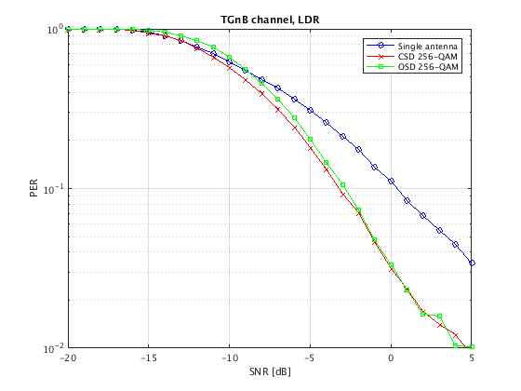
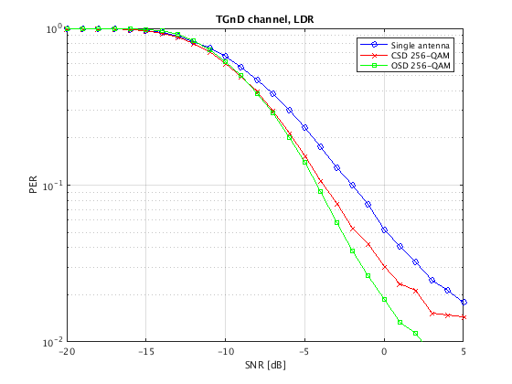
Performance results TGn

Slide 8
OFDM symbol diversity, example 2
Subcarrier | Single antenna and CSD [4] | OFDM symbol diversity
 |  | Antenna 1 | Antenna 2
-6 -5 -4 -3 -2 -1 DC 1 2 3 4 5 6 | 1 1 1 -1 -1 -1 0 1 -1 1 1 -1 1 | 1 1 1 -1 -1 -1 0 1 -1 1 1 -1 1 | -1 1 -1 -1 1 -1 0 1 1 -1 -1 -1 1

Slide 9
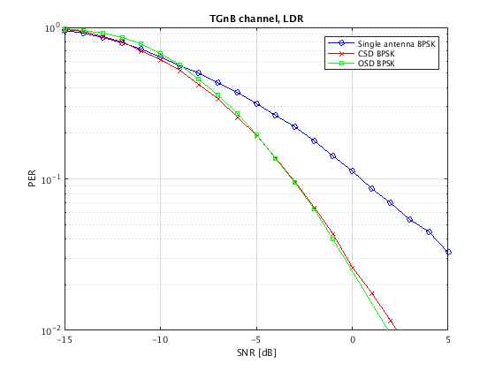
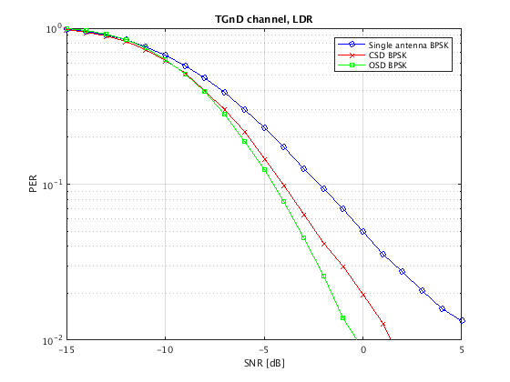
Performance results TGn

Slide 10
Conclusion and discussion
CSD is one among several TX diversity techniques
The magnitude of the cyclic shifts in CSD can be tuned in several ways, and the performance depends on the choice of the MC-OOK ‘ON’ symbol [2],[4]
There are other TX diversity techniques that exhibit performance comparable to CSD
There is no need to specify which TX diversity technique to use for the OOK part of the wake-up signal

Slide 11
References
[1]: 11-18-0144-02-00ba, “Omni-directional Multiple Antenna Transmission for WUS”, D. Sundman, L. Wilhelmsson, M. Lopez.
[2]: 11-18-0413-02-00ba, “Discussion on WUR Multi-Antenna Transmission”, R. Cao, S. Srinivasa, H. Zhang.
[3]: 11-18-0144-02-00ba, “MC-OOK Symbol Design”, M. Lopez, D. Sundman, L. Wilhelmsson.
[4]: 11-18-0773-00-00ba, “Multiantenna TX Diversity”, S. Shellhammer, B. Tian.

