Slide 1
NGV PHY Feasibility Discussions
Date: 2018-05-08
Authors:

Slide 2
Introduction
NGV SG was formed to enhance the throughput and possibly range from 11p [1].
High throughput applications rather than collision avoidance safety application enhancements are preferred.
NGV PAR scope description may need to specify quantitative “performance enhancement”.
Some preliminary “estimation” on the PHY feasibility might be necessary.
PHY Technology Candidates
Channelization and Coex with 11p

Slide 3
Possible Use Cases for NGV
11p mostly used for basic safety: vehicles broadcast basic safety message (BSM) : vehicle status, speed, position, direction, etc.
NGV may assist with more usage cases, for example:
Enhanced safety features: more vehicle information (sensors), intention awareness, condition awareness, local map, etc.
Assisting autonomous driving

Slide 4
I. PHY Technology Candidates-1
As stated in [1], there are quite some “low hanging fruits” PHY features developed along with the 802.11 amendments in the recent decade (after 802.11p).
By reusing these existing technologies we may get enhancements especially for high throughputs:
OFDM Numerology Design: Tone Spacing, GI Duration
LDPC
STBC
Multi-Antenna, CSD
Midamble
Range Extension
DCM
20MHz PHY (Ch181, Ch175)

Slide 5
PHY Technology Candidates-2
PHY Parameter Comparison
 | CV2X (Mode 4) | 802.11p | NGV
Modulation | SC-FDM | OFDM | OFDM
Tone Spacing | 15 kHz | 156.25 kHz | Candidates: 156.25 kHz, 78.125 kHz, others?
GI | 4.69us, 5.2us | 1.6us | Candidates: 1.6us, 3.2us, others?
Doppler Target (speed) | 250km/h | 200km/h | TBD (250km/h?)
Coding | Turbo, BCC (tail biting) | BCC | Candidates: LDPC, others?
Lowest Rate (long range) | QPSK 1/3 Coding | 3Mbps (BPSK, ½) | Candidates: MCS0, MCS0+DCM, range extension mode, others?
Highest Rate | 16QAM 1/3 Coding (V2V) 256QAM 0.9 (eNB assisted) | 27Mbps (64QAM, ¾) | Candidates: MCS7, MCS9, others?
Doppler Recovery Method | High density DMRS (demodulation reference signal) symbols | None (Up to Rx implementation) | Candidates: High density midambles, others?

Slide 6
PHY Technology Candidates-3
No optional feature, since the MAC might still be based on Outside the Context of a BSS (OCB), same as 11p.
Since original 11p, MIMO was commonly applied in regular 802.11 designs in 2.4GHz and 5GHz, it is natural to use multi-antenna also in DSRC, e.g. 2x2 design.
With OCB, when multiple antenna is deployed, we may not define >1SS rates, since there could be mixture of 1x1 and 2x2 (or larger) deployments.
Suggest only define 1SS, and define CSD: for both NGV rates and 11p rates.

Slide 7
Simulations-1
Compare 11p 1x1, and a new design with:
11ac 20MHz down-clocked 2x (10MHz, 156.25kHz tone spacing)
LDPC
2x2, 1SS, CSD as 11ac
Midambles every 4 symbols
Aggressive Highway NLOS channel model ([4])
1000B packet size (high throughput)
Draw throughput vs SNR (extracting overheads from preamble and midambles)

Slide 8
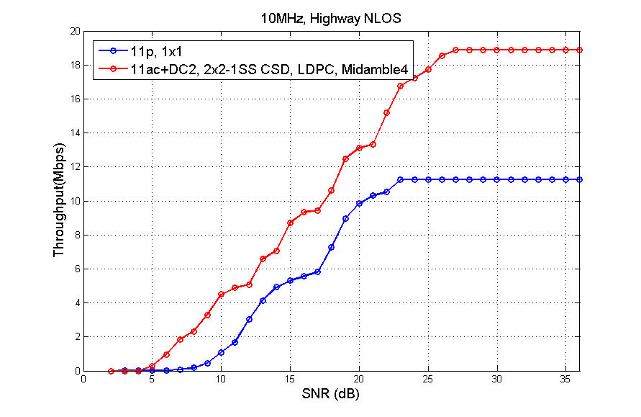
Simulations-2

Slide 9
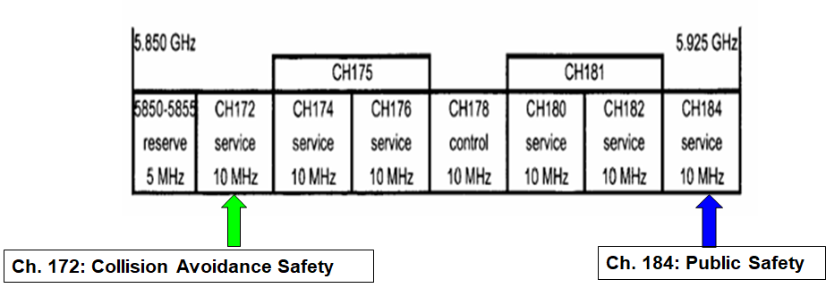
2. Channelization & Coex
Reuse the same 5.85 ~ 5.925 GHz band
Ch172 is dedicated for safety where legacy 11p device will mostly operate in with 6Mbps (QPSK ½), may consider enhance efficiency and be backward compatible.
PHY backward compatible: preamble design
Double PPDU broadcasting + higher broadcasting rate (PHY enhancements)
Other channels are mostly not occupied by 11p devices.
May define 20MHz NGV PHY: Ch181, Ch175

Slide 10
Summary
Candidate PHY technologies are discussed
It is reasonable to target NGV to achieve at least 2x throughput gain over 11p in aggressive Doppler channels.
Channelization and coex are discussed

Slide 11
Reference
[1] Hongyuan Zhang, et al, “802.11 For Next Generation V2X Communications”, IEEE 802.11-18/0513r2.

