Slide 1
Availability Window Advertisement
Date: 2018-05-04
Authors:

Slide 2
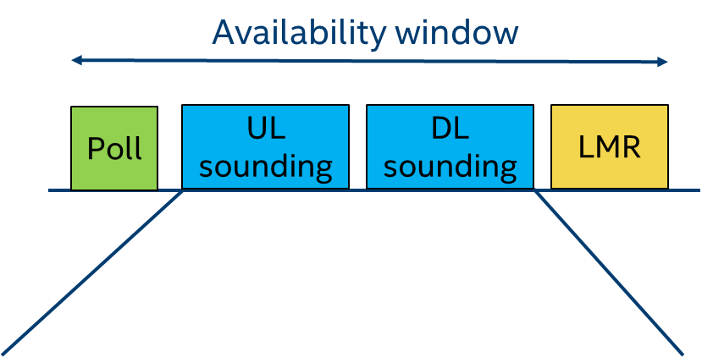
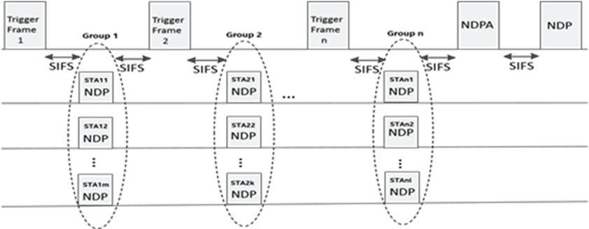
Introduction
Availability Window: periodic time windows when group of ISTAs are scheduled together for location measurement.
  Availability Window schedule: temporal location (i.e., offset, periodicity) of an Availability Window.
Benefits:
  Improve medium efficiency by sharing DL sounding and UL amongst multiple ISTAs.
  Improve power efficiency via single TxOP scheduled windows.
Currently agreed in SFD: one Txop nominally, windows can be negotiated/scheduled, nominally one poll [Nov-2017, SFD].

Slide 3
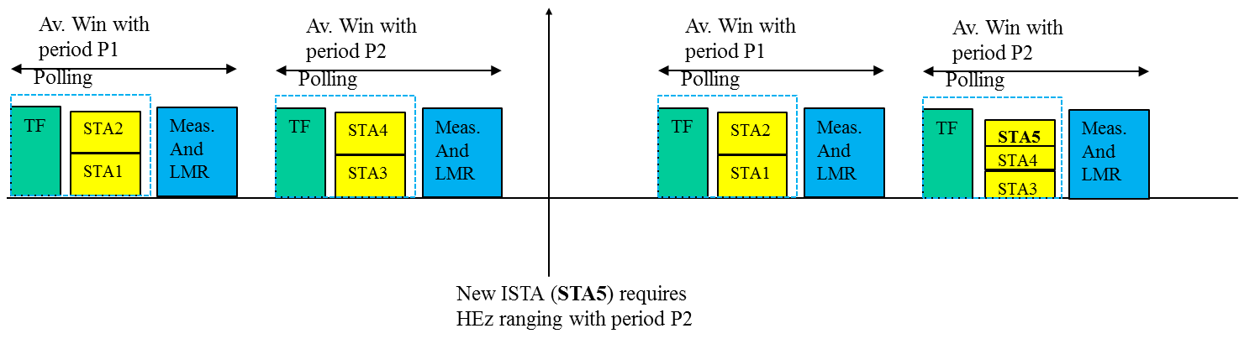
Introduction (contd.)
To benefit from Availability Windows, an RSTA needs to group ISTAs based on their scheduling constraints.
Objective of the presentation: propose signaling to enable an RSTA to group ISTAs and execute the ranging protocol while meeting the ISTAs’ constraints.

Slide 4
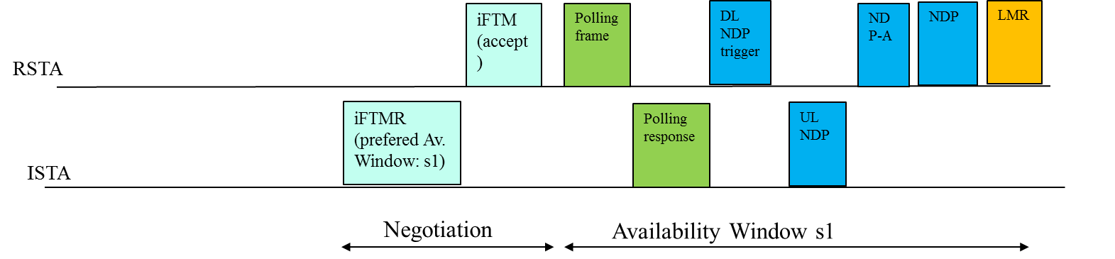
How to communicate ISTA constraints?
Option 1 (REVmc):
  ISTA signals its preferred availability schedule to RSTA in IFTMR.
  RSTA assigns a scheduling which may be identical or different from the preferred scheduling using the IFTM.
  If assigned schedule does not meet ISTA requirements, it may terminate.

Slide 5
Option 1 (contd.)
Pro:
  Simple: limited changes to baseline scheme.
Con:
  Latency in sessions establishment if assigned scheduling conflicts with ISTA’s other scheduling constraints. Note: no feedback as to what constitute acceptable scheduling at RSTA if modified.
  Medium inefficiency as ISTA may need to negotiate with several RSTAs before finding one that meets its scheduling constraints.
  Power inefficiency as ISTA may have to be active for long time before finding an RSTA to perform ranging with.

Slide 6
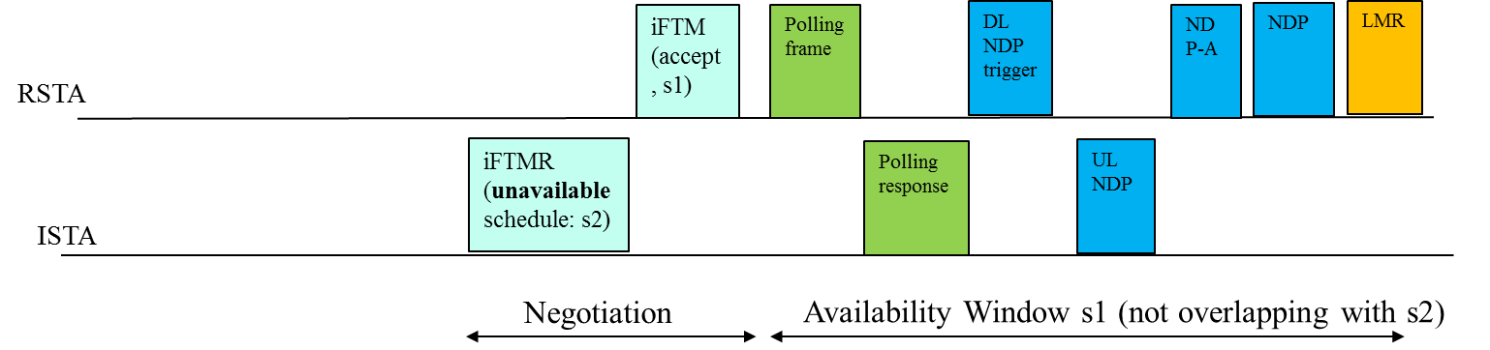
How to communicate ISTA constraints (contd.)?
Option 2:
  ISTA signals its unavailability to RSTA in IFTMR
  RSTA assigns a scheduling that does not overlap with ISTA’s unavailability schedule using the IFTM.
  If assigned schedule does not meet ISTA requirements, it may terminate.

Slide 7
Option 2 (contd.)
Pro:
  Simple.
  More robust and power efficient than Option 1 since RSTA is less likely to assign ISTA an unacceptable schedule.
Con:
  likely harder for the RSTA to create an assignment from unavailability constraint.
  Medium inefficiency as ISTA may need to negotiate with several RSTAs before finding one that meets its scheduling constraints.
  Still high power consumption as ISTA may have to be active for long time before finding an RSTA to perform ranging with.

Slide 8
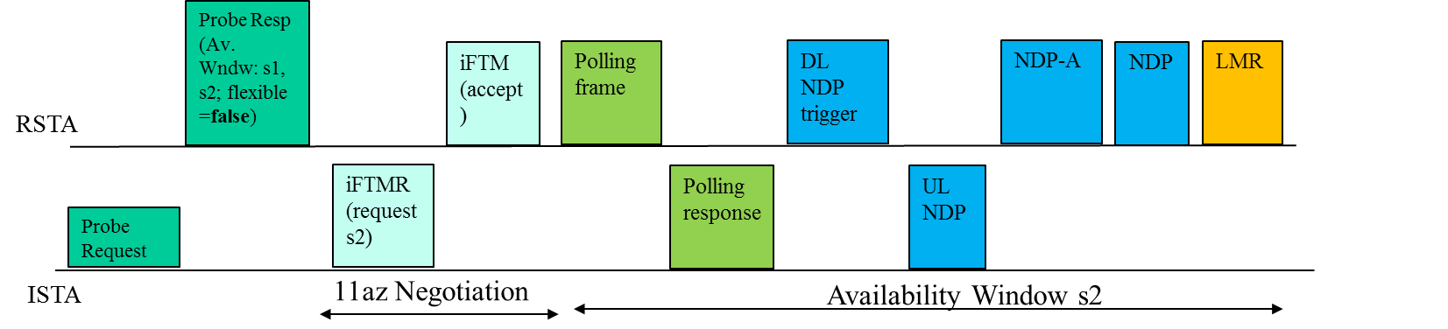
How to communicate ISTA constraints (contd.)?
Option 3:
  RSTA advertises a set of Available Window schedules in Management frame (e.g., Probe Response).
    The frame also indicates if RSTA can accept new schedule requests (i.e., in addition to advertised ones).
  ISTA requests the Availability Windows schedule which best meets its requirements.
  Preferred option compared to Option 1 and 2.

Slide 9

How to communicate ISTA constraints (contd.)?
Option 3:
  RSTA advertises a set of Available Window schedules in Management frame (e.g., Probe Response).
    The frame also indicates if RSTA can accept new schedule requests (i.e., in addition to advertised ones).
  ISTA requests the Availability Windows schedule which best meets its requirements.
  Preferred option compared to Option 1 and 2.

Slide 10
Option 3 (contd.)
  Pro:
    Maintain simplicity of Option 1 while making it easy for the RSTA to create/manage groups.
    Robust negotiation: higher probability of successful negotiation as ISTAs are aware of RSTA’s Availability Windows prior to negotiation.
      reduces latency in session establishment.
      reduces chances of RSTA suggesting any alternate schedule.
    Improve power efficiency as less frame exchanges by ISTA.
    Improve medium efficiency for large # of ISTAs; note: schedule at AP likely to be inflexible.
  Con:
    Overhead of including Availability Window information in Management frames.

Slide 11
Conclusion
Discussed potential mechanisms for conveying ISTA constraints to the RSTA.
Advertisement of Availability Windows prior to negotiation is efficient when an RSTA has less flexibility to create/change existing availability window schedules.

Slide 12
Reference
Chao-Chun Wang, “Specification Framework for Tgaz r0”, Nov. 2017

Slide 13
Straw Poll 1
Do you support the following behavior
an RSTA advertises Availability Window information/schedule in advertisement Management frames?
  The advertisement includes an indication of whether the RSTA can accept proposals for an Availability Window schedule from the ISTA that is different from the advertised ones.
Yes: No: Abstain:

Slide 14
Straw Poll 2
Do you support the following behavior:
Using a Flexibility bit the RSTA indicates whether it accepts an alternative proposal for Availability Window schedule other the ones advertised in management frame?
Yes: No: Abstain:

Slide 15
Straw Poll 3
Do you support the following behavior:
The ISTA shall request an RSTA for an availability window schedule by specifying a subset of preferred Availability windows from the RSTA’s advertised Availability windows set if the advertised schedule is flexible.
An ISTA may also indicate “Any Window Assignment Is Acceptable” in the IFTMR ?
Yes: No: Abstain:

