Slide 1
TX and RX requirements for 802.11ba – Part II
Date: 2018-05-07
Authors:

Slide 2
Abstract
In the March decisions were made for:
Spectrum mask, Sensitivity for WUR-LDR, ACR for WUR-LDR, Maximum input level
In this presentation the remining TX and RX requirements in 11-18/0152r5 “Proposed Draft WUR PHY Specification” are discussed with target to reach a decision on as many as possible or at least take a step towards agreement

Slide 3
32.3.10.2 Spectrum flatness
Rational for specifying it:
If the transmitted signal’s energy is not evenly distributed over the 4 MHz channel the signal will gain less from a frequency selective channel
Generating a flat signal in the sense to achieve frequency diversity seems stright-forward
802.11-16 says +-4dB for center 10 MHz +4/-6 dB for the remaining, but we should have no problem with DAC
Proposal :
The PSD across the 4 MHz should be within +- TBD dB (3 dB?)
Test: Energy is measured using a 64 point FFT and the 6+6 bins around the DC sub-carrier should fulfill the requirement

Slide 4
32.3.10.3 Transmit center frequency
Proposal :
Reuse the text from 802.11-2016
Text:
The transmitted center frequency tolerance shall be ±20 ppm maximum for 20 MHz and 10 MHz channels and shall be ±10 ppm maximum for 5 MHz channels. The transmit center frequency and the symbol clock frequency shall be derived from the same reference oscillator.

Slide 5
32.3.10.3 Symbol clock frequency tolerance
Proposal :
Reuse the text from 802.11-2016
Text:
The transmitted center frequency tolerance shall be ±20 ppm maximum for 20 MHz and 10 MHz channels and shall be ±10 ppm maximum for 5 MHz channels. The transmit center frequency and the symbol clock frequency shall be derived from the same reference oscillator.

Slide 6
32.3.10.4 Modulation accuracy
Suggested to follow 802.11-2016 and describe the requirement as well as the test method
Rational and requirement:
For OOK, the difference between ON and OFF should be sufficiently large.
WUR-HDR in AWGN requires -4 dB (measured over 20 MHz), i.e. 3 dB for the actual channel bandwidth (16 samples @4 MHz)
Ideal OOK ~11-12 dB (one sample)
Proposal: ON/OFF = 15 dB (12 dB better than operating point)
For WUR-LDR we can relax this by 4 dB, but I expect the LDR signal is simpler to get clean, i.e., will be better anyway.
Proposal to have the same requirement: 15 dB also for WUR-LDR

Slide 7
32.3.10.4 Modulation accuracy
Suggested to follow 802.11-2016 and describe the requirement as well as the test method
Test methodology:
Use a reference receiver as specified in the simulation document
The obtained metric should be the ON/OFF ratio, and the test is passed if this is at least TBD (15) dB
I would like to describe the procedure similar to in 802.11-16
The sampled signal shall be processed in a manner similar to an actual receiver, according to the following steps, or an equivalent procedure:

Slide 8
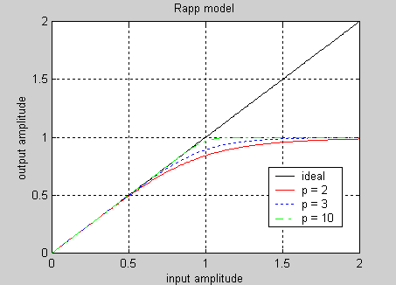
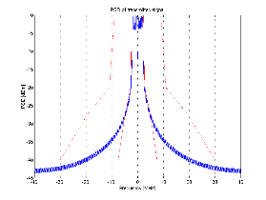
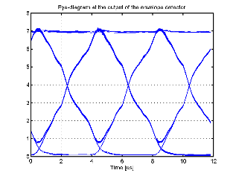
Modulation accuracy – test set-up
OOK
OFDM
Shaping
PA
+
CSF
Env. Det.
The receiver is expected to be based on an envelope detector since this has been agreed in the Simulation Scenario and Evaluation Methodology document
If the group would prefer to test the transmitter with a receiver based on an energy detector, it is proposed to change the Simulation Scenario and Evaluation Methodology document accordingly

Slide 9
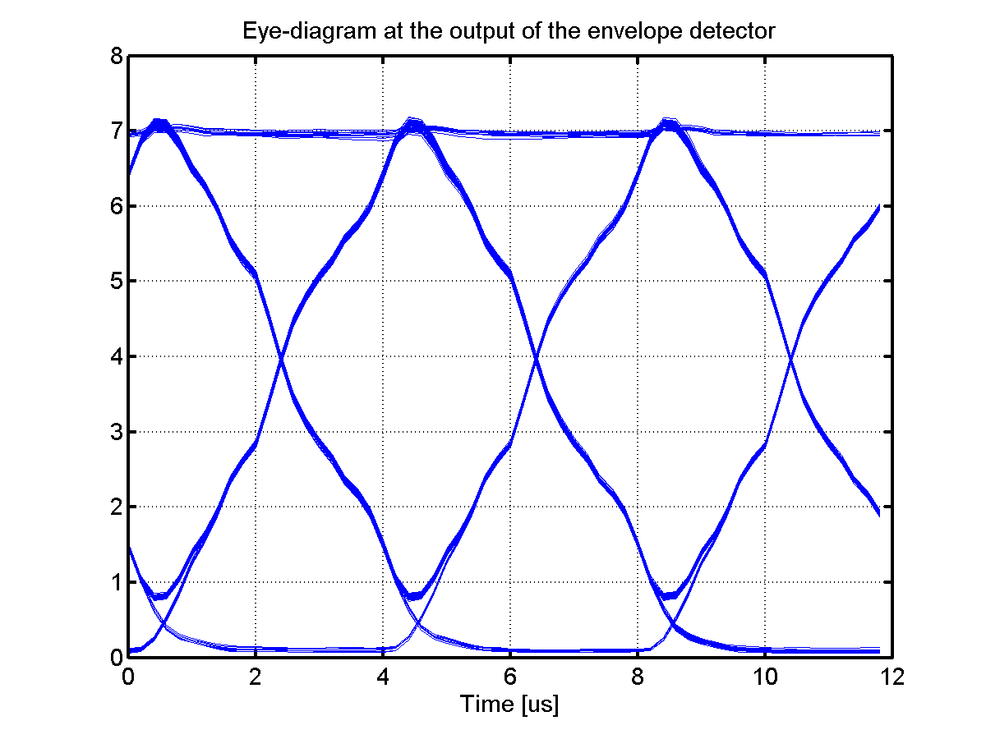
Modulation Accuracy - Metric
ON
OFF
The transmitted signal is a PN-data sequence to obtain all the different symbol transitions
The received signal used at the output of the envelope detector is used to generate an eye-diagram
The ON and OFF values are read our from the envelope detector ouput

Slide 10
32.3.10.4 Modulation accuracy – draft description
The transmit modulation accuracy test shall be performed by instrumentation capable of converting the transmitted signals into a stream of complex samples at sampling rate greater than or equal to the bandwidth of the signal being transmitted
The sampled signal shall be processed in a manner described in the Simulation Scenario and Evaluation Methodology document similar to an actual receiver, according to the following steps, or equivalent procedure:
Start of PPDU WUR frame shall be detected.
b) The received signal is sampled at Fs = TBD (20) MHz and processed as follows
c) For the WUR-HDR, a metric is obtained by a moving average (FIR) filter with N samples, where N = 2*Fs, Fs is the sampling rate. For WUR-LDR, N = 4*Fs.
d) For each transmitted ON and OFF symbol, the highest and lowest, respectively, metric value is found.
e) The ON metric to be used for calculating the modulation accuracy is the minimum of these ON metrics
f) The OFF metric to be used for calculating the modulation accuracy is the maximum of these OFF metrics
g) The modulation accuracy is calculated as 20log10(ON/OFF)
Note: The receiver does not explicitly find the sampling time, but effectively tries all possibilities and uses the best one. In this way errors due to non-ideal sampling is avoided. The idea is to describe what was seen in the eye-diagram

Slide 11
32.3.10.5 Time of Departure accuracy
Proposal: Just remove this heading

Slide 12
32.3.11.1 Receiver minimum input level sensitivity
Sensitivity for WUR-LDR decided to be -82dBm
From simulations WUR-HDR is about 4 dB worse
HRD may be more sensitive to imperfections not captured, add another 1 dB
Proposal:
Sensitivity for WUR-HDR: -77 dBm

Slide 13
32.3.11.2 Adjacent channel rejection
ACR for WUR-LDR decided to be 16 dB
From simulations WUR-HDR is about 4 dB in sensitivity
Leakage from adjacent channel the same
HRD may be more sensitive to imperfections not captured, add another 1 dB
Proposal:
ACR for WUR-HDR: 11 dB

Slide 14
32.3.11.3 Nonadjacent channel rejection
Since we have copied the requirements on sensitivity and ACR, it is proposed to do the same here. This is 32dB for the most robust MCS
Proposal:
Alternate ACR for WUR-LDR: 32 dB
Alternate ACR for WUR-HDR: 27 dB

Slide 15
32.3.11.5 CCA sensitivity
This requirement relates to that a receiver is used for carrier sensing in relation to CSMA/CA
The WUR is not intended to be used for this. If there is data to send the PCR is awake already…
Proposal: Just remove this heading

Slide 16
References
[1] S. Azizi et al. “A PAR Proposal for Wake-up Radio”, 11-16/1045r9
[2] S. Shellhammer and B. Tian, “Regulations and noise figure - Impact on SNR”, 11-17/0365r0
[3] S. Shellhammer and B. Tian, “WUR data rates”, 11-17/0990r2

Slide 17
Straw Poll 1a
Do you support that the PSD across the 4 MHz should be within +- TBD dB over the 4 MHz portion of the signal.
This the energy is measured using a 64 point FFT sampled at 20 MHz and the 6+6 bins around the DC sub-carrier should fulfill the requirement?
Y/N/A: 6/2/9

Slide 18
Straw Poll 1b
Do you support that to test this the energy is measured using a 64 point FFT and the 6+6 bins around the DC sub-carrier should fulfill the requirement?
Y/N/A:

Slide 19
Straw Poll 2 (Transmit center frequency and Symbol clock frequency tolerance)
Do you support that the transmitted center frequency tolerance shall be ±20 ppm maximum and that the transmit center frequency and the symbol clock frequency shall be derived from the same reference oscillator.
Y/N/A: 15/0/1

Slide 20
Straw Poll 3a (Modulation accuracy)
Do you support that the modulation accuracy should measured by a test equipment where
“The sampled signal shall be processed in a manner similar to an actual receiver” ?
Y/N/A:

Slide 21
Straw Poll 3b (Modulation accuracy)
Do you support that the modulation accuracy should measured by a test equipment where
The sampled signal shall be processed in a manner similar to an actual receiver, and where this actual receiver is as described in the Simulation Scenario and Evaluation Methodology document ?
Y/N/A: 10/0/5

Slide 22
Straw Poll 3c (Modulation accuracy)
Do you support that one requirement related to modulation accuracy is the ratio between the ON and OFF metric as obtained by the receiver according to the Simulation Scenario and Evaluation Methodology document? The ON/OFF metric ratio is TBD
Y/N/A: Y/N/A: 8/0/5

Slide 23
Straw Poll 3d (Modulation accuracy)
Do you support that the requirement on the previous slide is the only requirement that is needed for modulation accuracy?
Y/N/A: 1/2/12

Slide 24
Straw Poll 4 (Sensitivity WUR-HDR)
Do you support that the sensitivity for WUR-HDR is
-77 dBm?
Y/N/A: 10/0/4

Slide 25
Straw Poll 5 (ACR WUR-HDR)
Do you support that the adjacent channel rejection (ACR) is measured in the same way as for the PCR and the interfering signal is also the same as for the PCR. The adjacent channel rejection (ACR) requirement for WUR-HDR single channel is 11dB?
Y/N/A: 8/0/8

Slide 26
Straw Poll 6 (Nonadjacent CR WUR-HDR)
Do you support that the nonadjacent channel rejection (ACR) is measured in the same way as for the PCR and the interfering signal is also the same as for the PCR and that the requirements are:
Alternate ACR for WUR-LDR: 32 dB
Alternate ACR for WUR-HDR: 27 dB
Y/N/A: 4/0/9

