Slide 1
MU exclusive field for HBF
Date: 2018-05-07
Authors:

Slide 2
Introduction(1/2)
In 11ac, MU Exclusive Beamforming Report field is defined in addition to compressed beamforming report field to enhance MU-MIMO performance
Unlike SU-MIMO where feedback is sufficient, MU-MIMO precoding algorithms can get benefit from knowledge of the transmit correlation VS²VH with more accurate S per subcarrier.
However, in 11ay, the average SNR per stream within the Channel Measurement Feedback is only defined and there is no additional information for MU-MIMO

Slide 3
Introduction(2/2)
So, 11ay also need to define additional information for MU-MIMO transmission similar to 11ac
In this presentation, we propose to add MU-Exclusive beamforming report field in the Digital BF feedback element for 11ay

Slide 4
Observation Points(1/3)
: Per-tone-SNR Calculation
In 11ac, Delta SNR is used for MU Exclusive Beamforming Report
    where Vk,i is the ith column of the feedback beamforming matrix at subcarrier k, N is the noise plus interference power and is the average SNR of space-time stream i
  The difference at each per-tone-SNR relative to the average SNR per stream
    Average SNR has 0.5dB granularity, Delta-SNR has 1dB granularity
  Also, to reduce feedback overhead, 11ac reports Delta SNRs for tones spaced 2*Ng apart

Slide 5
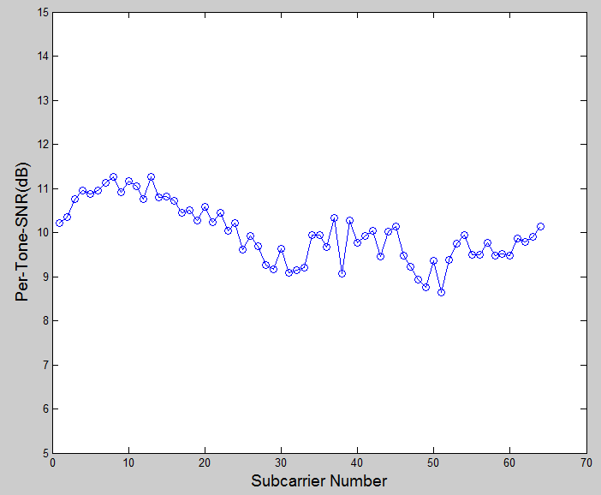
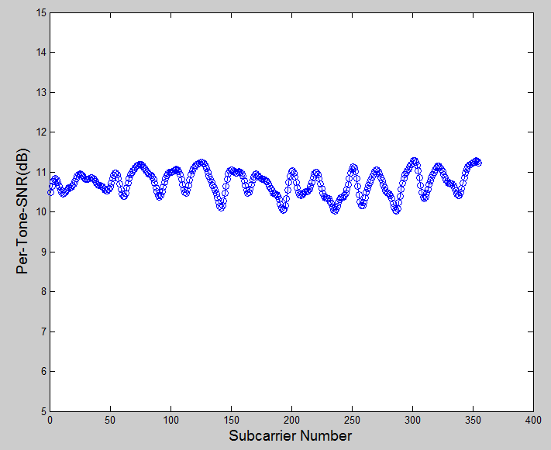
Observation Points(2/3)
: 11ac channel vs 11ay channel
11ay channel has lower selectivity than 11ac Channel TGnD
So, we can similarly introduce differential concept into 11ay
TGnD channel
11ay CR channel
Average SNR :10.0052
Max SNR : 11.2592
min SNR : 8.6318
Variance : 0.4359
Average SNR :10.7311
Max SNR : 11.2826
min SNR : 10.0171
Variance : 0.0909

Slide 6
Observation Points(3/3)
: Issue on conventional method
However, in 11ay, [1] shows that channel can have more frequency selectivity due to reflection
Moreover, the system design should cover a various of channel environments
So, we propose differential SNR method between adjacent tones spaced Ng apart not between average SNR and tones spaced 2*Ng apart in 11ac
  The range of feedback SNR value is increased

Slide 7
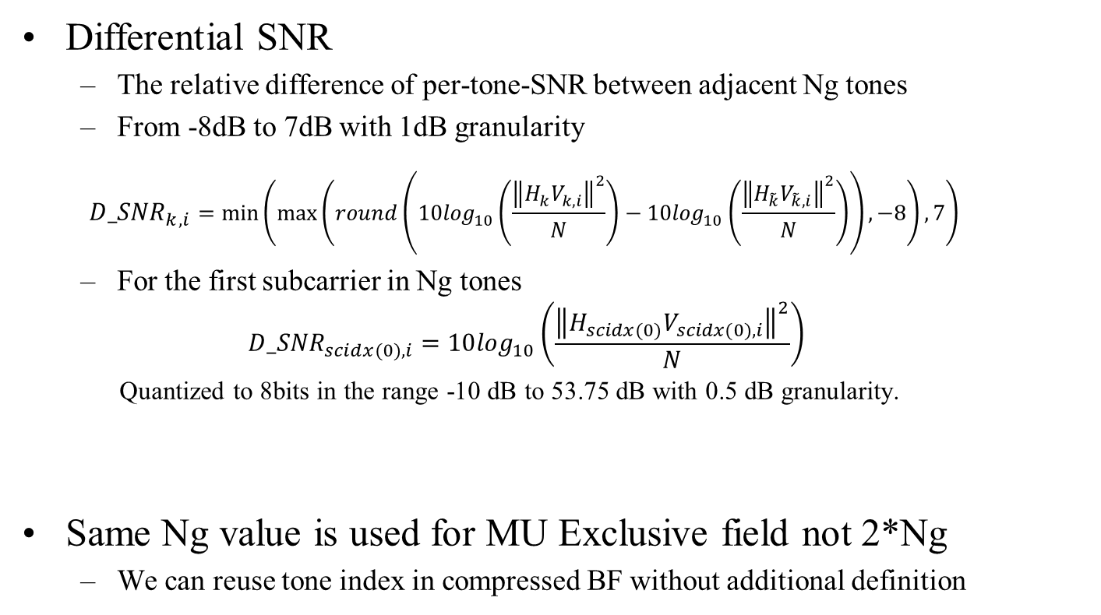
Proposed Method
: Differential SNR
Differential SNR
  The relative difference of per-tone-SNR between adjacent Ng tones
  From -8dB to 7dB with 1dB granularity
  $${D_SNR}_{k,i}=\min\left(\max\left(round\left(10\log_{10}\left(\frac{{\left\|H_{k}V_{k, i}\right\|}^{2}}{N}\right)−10\log_{10}\left(\frac{{\left\|H_{\tilde{k}}V_{\tilde{k}, i}\right\|}^{2}}{N}\right)\right), −8\right), 7\right)$$
  For the first subcarrier in Ng tones
  $${D_SNR}_{scidx(0),i}=10\log_{10}\left(\frac{{\left\|H_{scidx(0)}V_{scidx(0), i}\right\|}^{2}}{N}\right)$$
  Quantized to 8bits in the range -10 dB to 53.75 dB with 0.5 dB granularity.
Same Ng value is used for MU Exclusive field not 2*Ng
  We can reuse tone index in compressed BF without additional definition

Slide 8
Conclusion
We propose MU Exclusive Beamforming to enhance MU-MIMO performance similar to 11ac
Also, we propose differential-SNR method between adjacent tones spaced Ng apart to increase SNR range to feedback

Slide 9
Straw Poll #1
Do you agree
  to accept the text in11-18/0850r1 -Draft text for MU Exclusive Beamforming Report field?

Slide 10
References
[1] 11-18-0401-00-00ay-reflection-measurements
[2] 11-16-1388-00-00ay-implementation-of-channel-models-for-ieee-802-11ay

