Slide 1
16 Spatial Stream Support in
Next Generation WLAN
Date: 2018-05-07
Authors:
Notes:
September 2012

Slide 2
What’s Next
Trends
  Proliferation of high throughput demanding applications
    AR/VR, HD-gaming, 4k video, cloud computing, etc
  Availability of high speed backhaul: Fiber-to-home
  Adoption of 8 antenna Access Points
History
  11n: High Throughput (HT), 11ac: Very High Throughput (VHT), 11ax : High Efficiency (HE)
Mission of next generation: Increased throughput

Slide 3
16 Spatial Streams
Spatial multiplexing gain has been a key technology driver for 802.11 in the last few standards cycles
  Started with SU-MIMO in 802.11n
  Provides multiplicative gains within the same bandwidth by improving spectral efficiency
802.11ac and 802.11ax extended the benefits further by adding MU-MIMO
  DL MU-MIMO in 11ac and DL/UL MU-MIMO in 11ax
  Provides substantial spatial multiplexing gains even with STAs having a limited number of antennas
  Max number of spatial streams is 8
    APs with 8 antennas are getting adopted in market
Continuing the trend of better spectral efficiency, recommend increasing the maximum number of spatial streams to 16
  We show that significant throughput benefits are on offer by doing so

Slide 4
Fundamental Advantage of Predominantly Indoor WiFi Operation
Rich Scattering
Higher angular spreads
Lower spatial correlation at Tx and Rx
Good condition number of channels seen by 802.11
The result is a wireless channel capable of supporting a lot of spatial streams

Slide 5
MU-MIMO Performance Using Measured Channels
We analyzed MU-MIMO performance with 16x16 measured channels at 5GHz
  To validate the performance gains from >8 spatial streams
Measurements in a conference room setting
  8 clients with 2 antennas each
    λ/2 spaced dipoles
    Arranged around conference room table
  16 AP antennas – linear array, λ/2 spaced dipoles
    AP positioned in three LOS locations (same room as clients) and two NLOS locations (outside the conference room)
  Channel sounding system measures 20 MHz bandwidth channel

Slide 6
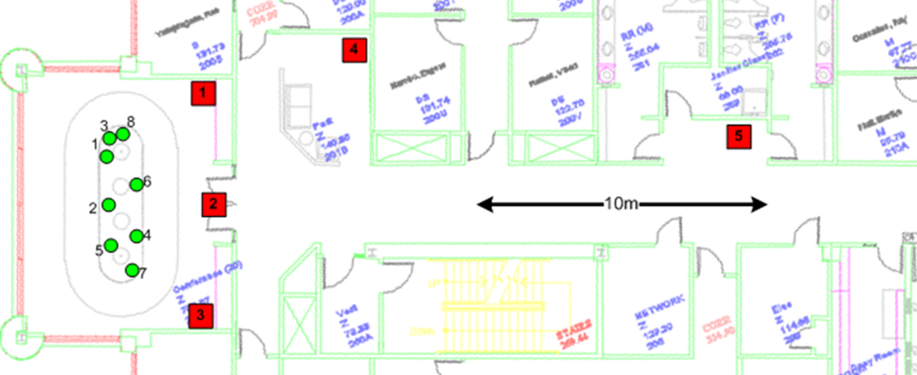
MU-MIMO Measurement Location
Green circles show 8 client locations (2 antennas per client)
Red squares show 5 tested AP locations
  Locations 1-3: LOS, AP in same room as clients
  Locations 4-5: NLOS
We show performance results for location 1
  All locations show similar trends

Slide 7
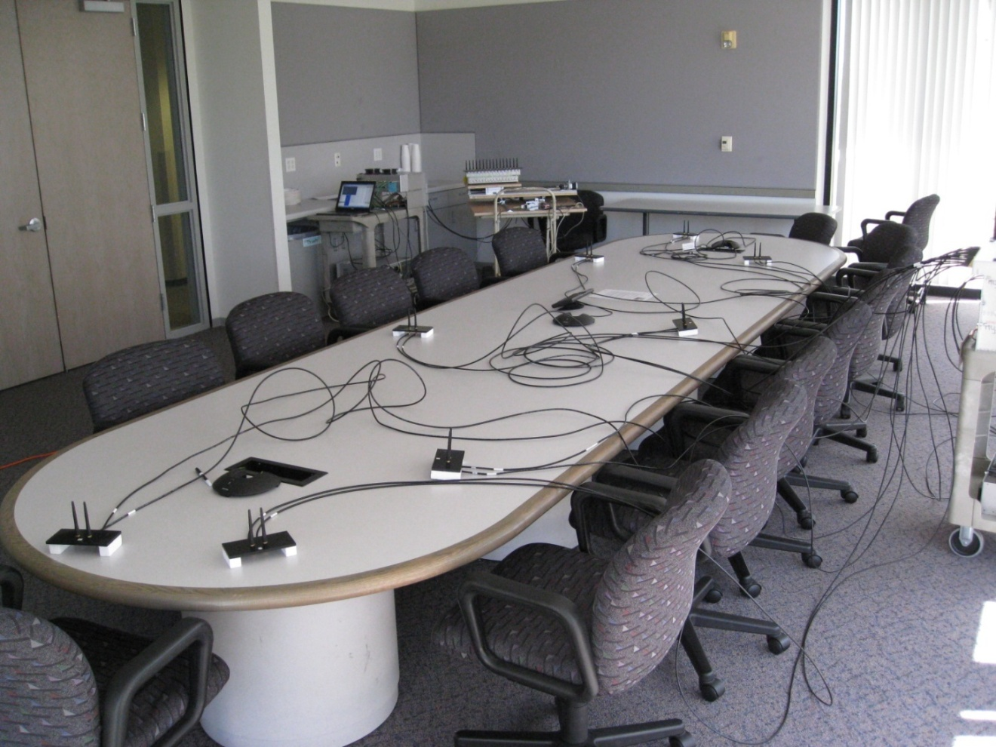
MU-MIMO Setup (AP in Location 3)

Slide 8
DL MU-MIMO Performance
Setup
  16Tx/8Tx AP to multiple 2 Rx STAs
  10th percentile of sum PHY throughput at the AP for 450 channel realizations
  MMSE precoding
  Perfect rate adaptation
  Effective SINR mapped to a throughput
Key observations
  By doing 16Tx MU-MIMO, we can get around 2x the throughput of 8Tx MU-MIMO
  Linear increase in throughput in going from 8 to 12 streams
Results for location 1

Slide 9
UL MU-MIMO Performance
Setup
  Multiple 2Tx STAs transmitting to a 16Rx/8Rx AP
  10th percentile of sum PHY throughput at the AP for 450 channel realizations
  MMSE receiver
  Perfect rate adaptation
  Effective SINR mapped to a throughput
Key observations
  Using 16Rx UL MU-MIMO, we can get around 2x the throughput of 8Rx UL MU-MIMO
  Linear increase in throughput in going from 8 to 12 streams
Results for location 1

Slide 10
Conclusions
Higher number of spatial streams has been an inevitable trend in WiFi for more than a decade
We recommend continuing along that path and supporting 16 streams in the next generation 802.11 standards
Preliminary results show that significant performance gains are on offer

