Slide 1
Discovery Assistance for 802.11ay
Date: 2018-05-08
Name | Affiliation | Address | Phone | Email
Mohamed Abouelseoud | Sony | 1730 N. First Street, San Jose CA 95112 | +1-408-352-4027 | Mohamed.Abouelseoud(at)sony.com
Kazuyuki Sakoda | Sony | 1730 N. First Street, San Jose CA 95112 | +1-408-352-4405 | kazuyuki.sakoda(at)sony.com

Slide 2
Overview
Robustness and latency are critical for consumer devices use cases
In [1], we proposed the use of the multi-band discovery assistance to:
  Reduce BHI overhead latency
  beacons are reduced to minimum and on-demand SLS is triggered
  Enable TDD for consumer devices without relying on human triggering
  Use multi-band to signal the request for beamforming
In [2], 3 options for discovery assistance implementation are proposed
  Option 1: new defined action frames
  Option 2: FST Setup Request and Response frames
  Option 3: OCT and Information Request and Response frames
This contribution presents details on Option 2 solution to use the FST setup frames to trigger discovery assistance

Slide 3
Multi-band Discovery Assistance (1)
Beacons/Probe Responses advertise the multi-band and discovery assistance capabilities on lower band
1-bit is needed in the Multi-band element to indicate that STA supports discovery assistance for the defined frequency band and channel
Propose to use 1 bit out of the 3 reserved bits in the Multi-band Control field
 | B0 B2 | B3 | B4 | B5 | B5B6 B7
 | STA Role | STA MAC Address Present | Pairwise Cipher Suite Present | Discovery Assistance Enabled | Reserved
Bits: | 3 | 1 | 1 | 1 | 32
Multi-band element

Slide 4
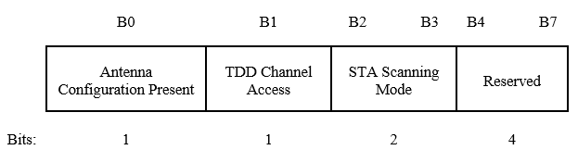
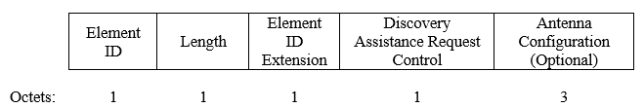
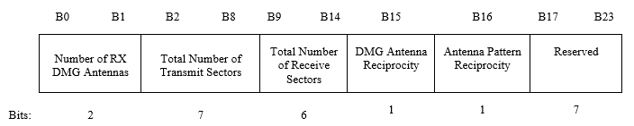
Multi-band Discovery Assistance (2)
New STA sends FST Setup Request on lower band with DMG Discovery Assistance Request element
Discovery assistance can happen in conjunction with FST
FST Setup Request frame

Slide 5
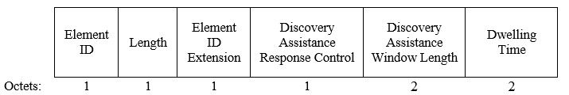
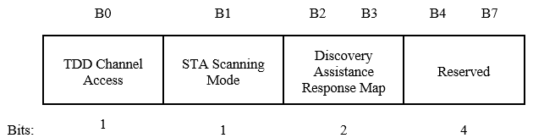
Multi-band Discovery Assistance (3)
Network STA responds with FST Setup Response frame on lower band with DMG Discovery Assistance Response element
FST Setup Response Frame

Slide 6
Multi-band Discovery Assistance (4)
Use MLME-BF-TRAINING primitives to trigger beacon sweeping for new STA or MLME-TDD-BF-TRAINING primitives to trigger TDD beamforming
Network STA starts sweeping beacons, sends the beamforming frames or listens for new STA beamforming frames/probes
STA is expecting discovery/beamforming frames from the network STA or start transmitting beamforming frames/probes

Slide 7
Multi-band Discovery Assistance Standard Requirements
Adding 1-bit to the multi-band element to indicate discovery assistance feature
2 new elements (DMG Discovery Assistance Request and DMG Discovery Assistance Response elements)
Enabling FST Setup Request and FST Setup Response frames to carry the DMG Discovery Assistance Request and DMG Discovery Assistance Response elements, respectively
Enabling triggering SLS or TDD beamforming when FST Setup Response frame with DMG Discovery Assistance Response element is received and diversity assistance is accepted

Slide 8
Straw poll (1)
Do you support the use of the FST setup protocol as described in 11-18/0817r0 to enable multi-band discovery assistance in multi-band capable devices?
  Yes
  No
  Abstain

Slide 9
mmW Discovery Assistance
Problem:
  New STA needs to discover more than one STA in the ESS or distribution network
  New STA does not have to associate through lower band to each STA in the network to request discovery signal
  Network devices are not necessary expected to all have multi-band capability
Solution:
  Network STAs can forward the DMG Discovery Assistance Request element to other STAs in the mmW ESS or Distribution Network to trigger other STAs to enable discovery for the new STA

Slide 10
mmW Discovery Assistance Example
STA 3
Network DMG device
New node ( STA 1) discovers one STA ( STA 2) through multi-band signal (beacon)
New STA (STA 1) sends discovery request through lower band to the discovered STA (STA 2)
Discovered STA (STA 2) sends Discovery Request to nearby mmW enabled STAs (STA 3, STA 4) to trigger discovery for the new STA
Other STAs ( STA 3, STA4) send discovery response to the discovered STA (STA 2) and start the discovery protocol if discovery assistance request is accepted
Discovered STA (STA 2) sends discovery response to the new STA (STA 1) and start the discovery protocol if discovery assistance request is accepted
STA 2
Network Multi-band capable device
STA 1
New Multi-band Capable device
STA4
Network DMG device
STA 1
STA 2
STA 3
STA 4

Slide 11
mmW Discovery Assistance Standards Implementation
STA 3
Network DMG device
STA 2
Network Multi-band capable device
STA 1
STA 2
STA 3
STA 4
STA 1
New Multi-band Capable device
STA4
Network DMG device

Slide 12
mmW Discovery Assistance Standard Requirements
Enable Information Request and Information Response frames to carry the DMG Discovery Assistance Request and DMG Discovery Assistance Response elements, respectively
Enable triggering SLS or TDD beamforming when Information Response frame with DMG Discovery Assistance Response element is received and discovery assistance is accepted

Slide 13
Straw poll (2)
Do you support the use of Information Request and Information Response frames to enable mmW Discovery Assistance?
  Yes
  No
  Abstain

Slide 14
References
[1] IEEE 802.11-18/486r0, “Multi-band Discovery Assistance”, Mohamed Abouelseoud, et.al.
[2] IEEE 802.11-18703r2, “Discussion the Multi-band Discovery Assistance Proposal”, Mohamed Abouelseoud, et.al.

Slide 15

Expected Latency Due to BHI (1)
BHI
TXTIME(µs) = T_{L-STF}+ T_{L-CE}+ ((Length +L_{L-Header})x 8 + N_{CW} x 168) x 32/1.76e3 + T_{TRN}
L_{L-Header}=5 Octets
 | Length (octets) | TX Time (µs)
SSW Frame | 26 | 14.91
SSW FB Frame | 28 | 18.25
Beacon Frame no TRN | 72 | 30.76
Beacon Frame with 31 TRN | 72 | 118.69
Frame Spacing | Time (µs)
MBIFS ( between BTI and ABFT) | 9
LBIF ( when switching DMG antennas) | 2
SBIF ( between sweeping frames) | 1

Slide 16
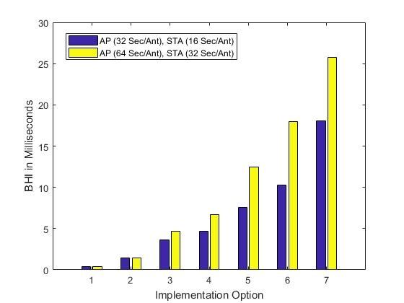
Expected Latency Due to BHI (2)
 | Beacons/BI | No of SSW slots | SSW frames/ slot | No of DMG Antennas | No of beacon TRNs
Option 1 | 1 | 2 | 8 | 1 | 0
Option 2 | 8 | 4 | 16 | 1 | 0
Option 3 | Full beacon sweep | 9 | 16 | 1 | 0
Option 4 | Full beacon sweep | 9 | 16 | 2 | 0
Option 5 | Full beacon sweep | 9 | 16 | 2 | 16
Option 6 | Full beacon sweep | 9 | 16 | 2 | 31
Option 7 | Full beacon sweep | 36 | 16 | 2 | 31

Slide 17
Discovery for TDD mode
On demand sweeping is a built-in feature in TDD mode
However, TDD mode as presented in [3] assumes manual triggering of the unicast beamforming frames.
A proper discovery trigger signaling is needed to enable the use of TDD mode for consumer devices

Slide 18
Discovery for non-TDD mode
Latency reduction can also be achieved through non-TDD mode
Tools already provided in the standard to reduce beacon transmission periodicity(partial sweeping), ABFT period optional, ATI optional
Reducing BHI to minimal affects discoverability
A discovery trigger signal is needed to enable the full beacon sweep only whenever it is needed and keep it minimum otherwise

Slide 19
Wi-Fi Agile Multi-band
Facilitates better management of Wi-Fi networks changing conditions and improved resource utilization
Uses several mechanisms
  Dynamic network monitoring: APs and client devices continually exchange information about the current Wi-Fi network environment
  Intelligent steering: APs suggest another AP, frequency band, or channel to client devices when the Wi-Fi environment becomes congested
  Fast network transitions: Once a client device decides to roam to a different AP, band, or channel, the association and connection happen quickly and seamlessly
WiFi Agile Multi-band does not consider network discovery and beacon/BF sweeping issues, it only exchanges information of prioritized available networks

