Slide 1
CID 1195
Date: 2018-07-09
Authors:

Slide 2
Abstract
This submission discusses CID 1195 of LB 232.

Slide 3
EDCA TXOPs
The Transmit Opportunity (TXOP) is one of the key modifications introduced by IEEE 802.11e-2005
A TXOP is a period of time during which the TXOP owner may use the wireless medium “at will”
  As long as the duration of all transmissions of the TXOP owner and any (expected) responses to its transmissions do not exceed the TXOP limit the TXOP owner may send one or more (aggregated) frames

Slide 4
TXOP limitations
The use of TXOPs is limited by various rules
  One such rules is the following
Frames queued at ACs other than the AC that gained access to the wireless medium must not be transmitted
  Clause 10.22.2.7, page 1385 of IEEE 802.11-2016: “Multiple frames may be transmitted in an EDCA TXOP […] if there is more than one frame pending in the primary AC for which the channel has been acquired. However, those frames that are pending in other ACs shall not be transmitted in this EDCA TXOP […].”
Why?

Slide 5
“Frames that are pending in other ACs shall not be transmitted in this EDCA TXOP”
Idea: An AC implements a virtual STA that resides within a physical STA
  A QoS STA (QSTA) consists of at most four (five) virtual STAs
Virtual STAs independently compete for TXOPs
Independence enables equal sharing among all virtual and physical STAs

Slide 6
Example
A physical QSTA has frames queued for AC_VO, AC_BE, and AC_VI
  The Voice packet has 160 B [3] length
  The BE packet has 1,500 B length
  The VI packet has 1,500 B length
AC_BE gains access to the wireless medium
The QBSS applies the default EDCA parameters according to table 9-137 of IEEE 802.11-2016
  Therefore, the duration of a AC_BE TXOP is limited to 2,528 µs

Slide 7
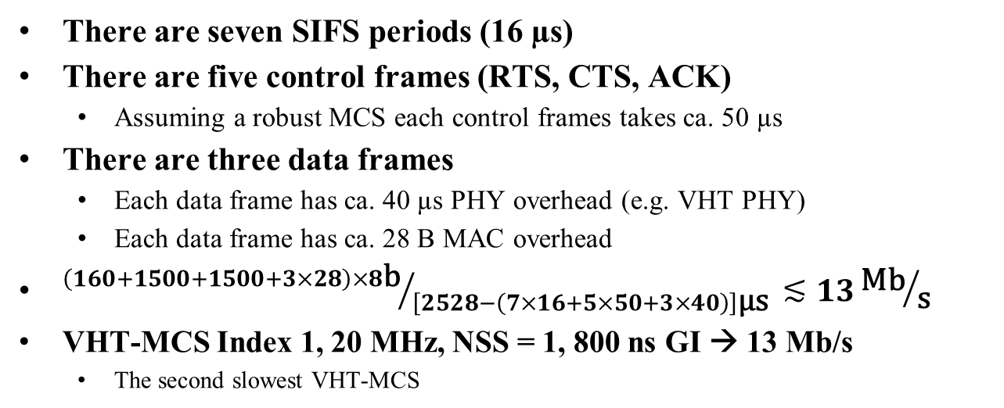
Which data rate is needed to transmit all three frames in a single TXOP?
There are seven SIFS periods (16 µs)
There are five control frames (RTS, CTS, ACK)
  Assuming a robust MCS each control frames takes ca. 50 µs
There are three data frames
  Each data frame has ca. 40 µs PHY overhead (e.g. VHT PHY)
  Each data frame has ca. 28 B MAC overhead
${\left(160+1500+1500+3×28\right)×8\text{b}}/{\left[2528−\left(7×16+5×50+3×40\right)\right]\text{µ}\text{s} }≲13{\text{Mb}}/{\text{s}}$
VHT-MCS Index 1, 20 MHz, NSS = 1, 800 ns GI → 13 Mb/s
  The second slowest VHT-MCS

Slide 8
Conclusion 1
Although we assumed RTS/CTS protection and no frame aggregation a AC_BE TXOP easily carries a payload of two frames of 1,500 B and one frame of 160 B

Slide 9
Backoff durations
Assuming initial transmission attempts succeed
  AIFS = AIFSN × 9 µs
  CW = [0 … CW_{min}], average CW = ½ × CW_{min}
Duration of three independent, successful backoffs
  AC_VO: 47.5 µs
  AC_VI: 65.5 µs
  AC_BE: 110.5 µs
  Total: 223.5 µs
Three independent backoff attempts double the backoff duration compared to a single AC_BE backoff attempt

Slide 10
Does it matter?
Enlarging the total backoff duration from 110.5 µs to 223.5 µs may not seem severe
However, we considered the best case
  All transmissions succeed on the first attempt
  With increasing load the probability for frame collisions increases too
  Then, larger CW values need to be considered

Slide 11
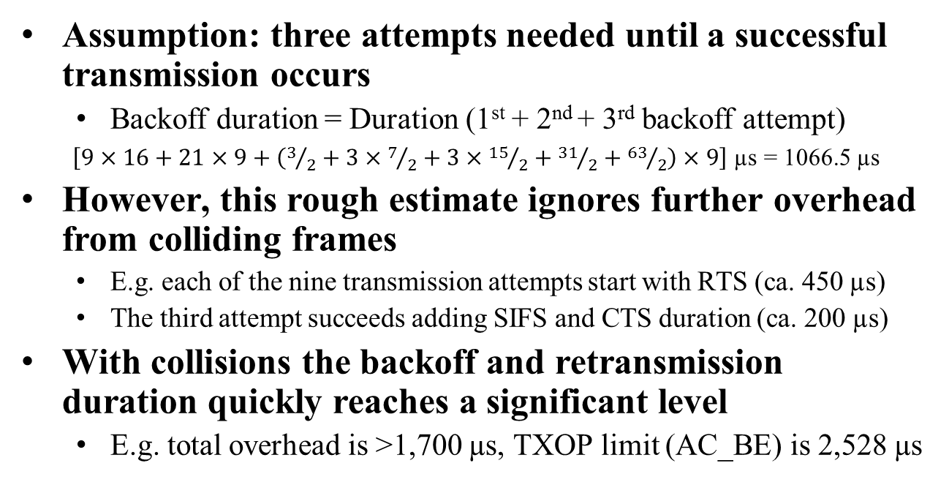
Retransmissions
Assumption: three attempts needed until a successful transmission occurs
  Backoff duration = Duration (1st + 2nd + 3rd backoff attempt)
$\left[9×16+21×9+\left(3/2+3×7/2+3×{15}/2+{31}/2+{63}/2\right)×9\right]$ µs = 1066.5 µs
However, this rough estimate ignores further overhead from colliding frames
  E.g. each of the nine transmission attempts start with RTS (ca. 450 µs)
  The third attempt succeeds adding SIFS and CTS duration (ca. 200 µs)
With collisions the backoff and retransmission duration quickly reaches a significant level
  E.g. total overhead is >1,700 µs, TXOP limit (AC_BE) is 2,528 µs

Slide 12
Conclusion 2
A successful TXOP is a precious resource
  In terms of overhead, receiving access to the wireless medium may be costly
  Collisions easily increase overhead to significant levels
Once a TXOP has been acquired it should be used to the full extent
  Under high load, the competition for TXOPs must be reduced since otherwise efficiency decreases

Slide 13
How to reduce collisions probability?
In principle, dynamic adjustment of EDCA parameters allows for converging to optimal CW_{min} values
  Optimal in terms of load and number competing entities
However, almost all QBSSs operate the 802.11 default EDCA parameter set
  Difficult to decide what is “best” EDCA parameter set now and for the a “foreseeable” future
  Selfish behavior prevents adjustments
    Compared to competing non-adjusting QAPs, an adjusting QAP makes its QBSS only worse
Many non-AP QSTA implementations are known to ignore EDCA parameter set updates
Consequently, dynamic EDCA parameter adjustments seem infeasible for collision probability reduction

Slide 14
How to reduce the collision rate?
The collision rate can be reduced by performing fewer backoffs
  Once a QSTA has gained access to the wireless medium the QSTA should use its TXOP for the total permissible duration
Overcome the limitations from granting a TXOP to virtual STAs only
  Once a virtual STA received a TXOP the virtual STA should be permitted sharing its TXOP with other virtual STAs collocated at the same physical QSTA

Slide 15
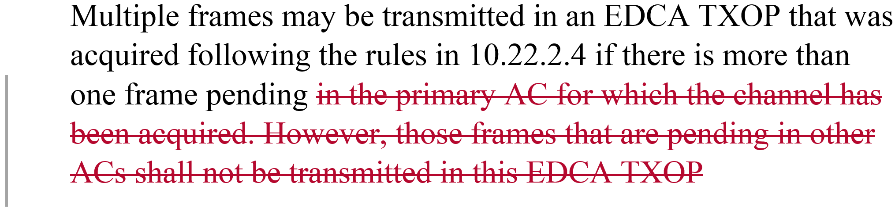
Proposal
Remove restriction on use of a primary AC’s TXOP
  IEEE 802.11-2016, Clause 10.22.2.7 (Multiple frame transmission in an EDCA TXOP), page 1385
Additional rules are needed describing that sharing is permissible only, if the queue of the primary AC has been emptied

Slide 16
A fundamental change?
No, because virtual STAs (different ACs) still independently compete on access to the wireless medium
  However, newer devices will make more efficient use of the wireless medium
Since newer devices may combine traffic of different ACs into a single TXOP, they need fewer backoffs leaving more opportunities for legacy devices
  Once a TXOP is acquired it is used more efficiently
    This efficiency gain may be substantial, outweighing potential concerns of latency increase because of TXOP usage increasing
When comparing with legacy behavior, the cost of collisions needs to be considered
  Collisions do not only decrease efficiency they also increase medium access latency

Slide 17
QoS in 802.11
[1, 2] explain that the current IEEE 802.11-2016 UP to AC mapping does not fit with common practices in the industry
The authors know of products that deliberately violate the IEEE 802.11-2016 mapping to achieve performance gains over competing products
  Furthermore, many products do not comply with the advertised TXOP limit
  Transmission duration may be much longer than permitted
[1] provides references to reports about issues with 802.11 QoS
In the Internet, various devices modify and rewrite fields of various protocols
  E.g. a large number of devices, which IETF denote as “middle boxes,” modify DSCP values in the IP header
Most traffic is not tagged at all
  Falls into AC_BE

Slide 18
Impact on equal sharing
Permitting a TXOP to be shared with non-primary ACs conflicts with the current paradigm of a TXOP to be exclusive for one AC
  Sole exception are 802.11ac DL MU-MIMO transmissions
A legacy implementation will perform more backoffs than a device permitting sharing
  Will it matter?

Slide 19
Legacy vs. new
All newer 802.11 devices impact operation of older devices
  E.g. 802.11e substantially changed the MAC behavior
    Instead of “one backoff, one packet” 802.11e allows for “one backoff, multiple packets”
    Frame aggregation (A-MPDU, A-MSDU) additionally increases the average transmission duration
There may be scenarios in which TXOP sharing may have no impact, other scenarios may see measurable impact
  The latter scenarios will be mostly artificial
As shown before, real-world usage of 802.11 QoS is severely impacted by implementation mistakes/deliberate modifications
  Compared to these issues the proposed modification is minor
Is the equal sharing paradigm as important as efficient operation in dense networks?
  802.11e was designed out of a context different than today
  The default EDCA parameter set was designed with a different background in mind
  802.11-2016 adjusted TXOP limits to reflect today’s realities

Slide 20
Efficiency
The authors believe that efficient use of the wireless medium is more important than precisely matching legacy behavior
  Any modification, improvement, and innovation will always impact currently deployed solutions
The authors believe that the proposed modification does not cause any disruption
  The MAC remains unmodified

Slide 21
How to implement?
A QSTA may share a TXOP with non-primary ACs after the primary AC queue is empty and the TXOP limit has not been reached
If shared, the remaining duration of the primary AC’s TXOP shall be filled with frames of non-primary ACs …
  … starting from top (higher) to bottom (lower) priorities
    E.g. this helps reducing latency for AC_VO
  … that fit “best” to the remaining TXOP duration
    Non-primary frames are selected such that TXOP usage is maximized
  … randomly selected from non-primary ACs
    Averages the performance improvement among all queues
  … without further restrictions
    Implementers select their own strategy

Slide 22
References
G. R. Hiertz, “UP mapping,” IEEE 802.11 submission 11-17/1445r0, Sep. 2017.
J. Henry and A. Myles, “QoS mapping comment for 802.11md Letter Ballot,” IEEE 802.11 submission, 11-18/354r1, Feb. 2018.
Cisco, “Voice Over IP - Per Call Bandwidth Consumption,” Apr. 2016. [Online]. Available: https://www.cisco.com/c/en/us/support/docs/voice/voice-quality/7934-bwidth-consume.html

