Slide 1
FDMA WUR Generation
Date: 2018-05-08
Authors:
Name | Affiliation | Address | Phone | Email
Junghoon Suh | Huawei |  |  | junghoon.suh@huawei.com
Jia Jia |  |  |  | justin.jia@huawei.com

Slide 2
Background
FDMA WUR PPDU [1]
We propose how to generate Manchester coded FDMA WUR waveform and its Spec text

Slide 3
FDMA WUR PPDU
20
MHz
Legacy
Spoof
WUR PPDU for Channel 0
Preamble
Symbol
Legacy
20
MHz
Legacy
Spoof
WUR PPDU for Channel 1
20
MHz
Preamble
Spoof
WUR PPDU for Channel 0
Preamble
Symbol
Symbol
20
MHz
Legacy
Spoof
WUR PPDU for Channel 2
Preamble
Symbol
20
MHz
Legacy
Spoof
WUR PPDU for Channel 1
Preamble
Symbol
Legacy
Spoof
20
MHz
Preamble
Symbol
WUR PPDU for Channel 3
.
40 MHz FDMA WUR PPDU
80 MHz FDMA WUR PPDU
Multicarrier based OOK ‘On’ symbol for 80 MHz FDMA WUR PPDU can be constructed with 256-point IFFT,
sampling at 80 MHz for the following,
  For Channel 0 waveform generation, thirteen subcarriers (-103 ~ -91) of subcarrier spacing of 312.5 KHz for 80 MHz OFDM symbol can be occupied with a certain sequence, but subcarrier -97 can be Null.
  For Channel 1 waveform generation, thirteen subcarriers (-39 ~ -27) of subcarrier spacing of 312.5 KHz for 80 MHz OFDM symbol
  can be occupied with a certain sequence, but subcarrier -33 can be Null.
  For Channel 2 waveform generation, thirteen subcarriers (26 ~ 38) of subcarrier spacing of 312.5 KHz for 80 MHz OFDM symbol
  can be occupied with a certain sequence, but subcarrier 32 can be Null.
  For Channel 3 waveform generation, thirteen subcarriers (90 ~ 102) of subcarrier spacing of 312.5 KHz for 80 MHz OFDM symbol
  can be occupied with a certain sequence, but subcarrier 96 can be Null.
For 2 usec ‘On’ OOK, the first 128 samples of the 256-IFFT outputs are selected, the last 32 samples of those 128
samples are prepended to the 128 samples and ends up generating 160 samples, representing the MC-OOK 2 usec ‘On’
symbol
For 4 usec ‘On’ OOK, the last 64 samples of the 256-IFFT outputs are prepended to the 256 samples and ends up
generating 320 samples, representing the MC-OOK 4 usec ‘On’ symbol

Slide 4
Block diagram and Construction of
80 MHz FDMA WUR Signal Generator
Channel 0
Manchester
-
based encoder
Channel 0
On
-
i_{TX}
WG
T
Sym
…..
Window
Analog
and RF
Channel 3
Manchester
-
Off
based encoder
-
WG
Channel 3
On
-
i_{TX}
WG
T
Sym
Determine the WUR_DATARATE for each 20 MHz Channel from the WUR_TXVECTOR of each corresponding STA
Manchester based encoder for each 20 MHz Channel: Pulse combination is determined according to the input bits as described in 32.3.9
The output of Manchester based encoder determines which samples to take either from On-WG i_{TX} of each 20 MHz Channel or from Off-WG. The On-WG i_{TX} or Off-WG is a type of buffer which stores corresponding waveform samples. The waveform samples stored in On-WG i_{TX} of each 20 MHz Channel are generated as in the previous slide, depending on the WUR_DATARATE. The samples in Off-WG have zero energy. Each symbol duration, T_{Sym} is 2 usec for high data rate (T_{SYM-HDR}) and 4 usec for low data rate (T_{SYM-LDR}).
The outputs of the waveform generator for each 20 MHz Channel are added with the outputs of the other 20 MHz Channels, sample by sample.
Apply windowing, Analog and RF

Slide 5
Simulation Parameters
SNR is based on 80 MHz Sampling
RX Filter design
  8 Tap FIR, 80 MHz sampling rate, Band Pass Filter
  with 4 MHz Bandwidth
  Detail design in the following slides
RX sampling rate, 4 MHz (Decimation of the received
signal)
TX sampling rate, 80 MHz
AWGN

Slide 6
Receiver for the Baseband Simulation
BPF
@ -30 MHz
Energy Detection
Band 0 Source
Recovered
BPF
@ -10 MHz
Energy Detection
Band 1 Source
Recovered
Channel
BPF
@ 10 MHz
Energy Detection
Band 2 Source
Recovered
BPF
@ 30 MHz
Energy Detection
Band 3 Source
Recovered
The following slides describe how to design the BPF for the baseband simulation

Slide 7
Digital Filter Design
F
t
f
-W
0
W
-T_{max}
T_{max}
T_{s} = 1/f_{s} , sampling time in second, f_{s} is the sampling rate
T_{max} = (in second)
W is one sided BW in Hz , where {(the number of actually occupied subcarriers + 2) / 2 }times the sub-carrier spacing which is 312.5 KHz.
  E.g.) in case of 14 occupied tones, W becomes (16 /2) * 312.5 KHz, that is, 2,500,000 Hz
  We give one extra tone to each side of 14 occupied tones to make 16 tones
Intermediate filter tap (h)
t = - T_{max} : T_{s} : T_{max}

Slide 8
Band Pass Filter Design
Windowing Mask has smooth transition to zero on its both ends so that it avoids abrupt jumps at the beginning and end of the truncated filter, and hence avoids the freq spillover in the truncated filter. Moreover, the windowing provides a reasonable time-localization in the truncated filter’s impulse response, and thus, keeps the induced ISI within an acceptable limit [2]
Hanning window (h_{w}) of duration T_{w} is given by
where
The final filter coefficient ( ) for LPF is
  sample by sample multiplication between and
If we denote the central freq to be
  Then the final filter coefficient ( ) for the center freq is

Slide 9
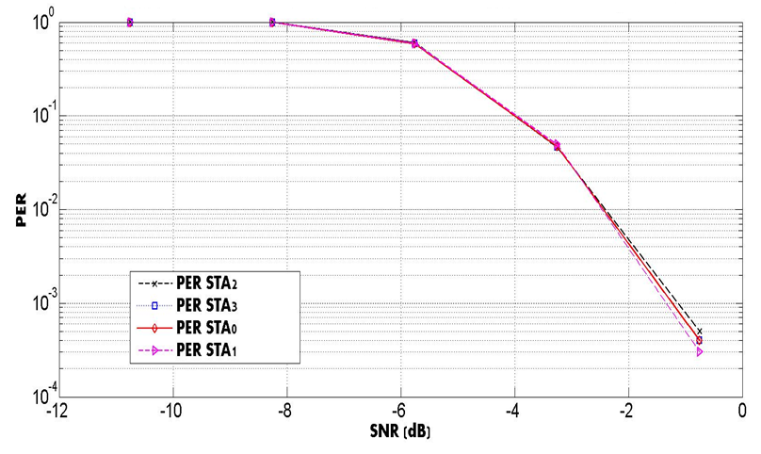
PER of WUR 80 MHz FDMA Scheduling over AWGN with 4 MHz RX sampling rate

Slide 10
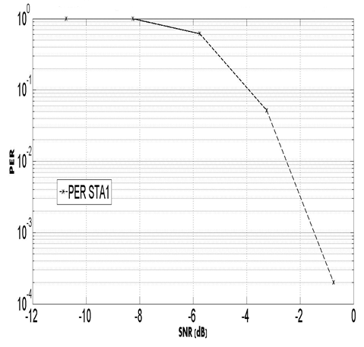
Performance of a single WUR frame when it is transmitted in 80 MHz WUR PPDU
20
MHz
Legacy
Spoof
Preamble
Symbol
20
MHz
Legacy
Spoof
WUR PPDU for Channel 1
Preamble
Symbol
20
MHz
Legacy
Spoof
Preamble
Symbol
20
MHz
Legacy
Spoof
Preamble
Symbol
TX power is not boosted for a single WUR frame, that is,
the same TX power applied to each 20 MHz Channel in the previous slide is kept for this single WUR frame

Slide 11
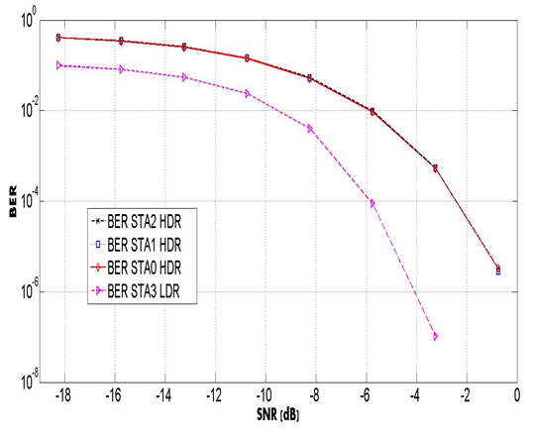
Performance of 80 MHz Mixed Rate based FDMA WUR PPDU over AWGN with 4 MHz RX sampling rate
Data portion, 96 bits for HDR and 24 bits for LDR
in order to align the packet length
20
MHz
Legacy
Spoof
HDR WUR PPDU for Channel 0
Preamble
Symbol
20
MHz
Legacy
Spoof
HDR WUR PPDU for Channel 1
Preamble
Symbol
20
MHz
Legacy
Spoof
HDR WUR PPDU for Channel 2
Preamble
Symbol
20
MHz
Legacy
Spoof
LDR WUR PPDU for Channel 3
Preamble
Symbol

Slide 12
Conclusions
FDMA PPDU Waveform Generation is described
  Each waveform of 4 MHz WUR frame in an 80 MHz PPDU is generated by occupying its corresponding tones with certain sequences
  Each sample of each 4 MHz WUR signal is added with the
  corresponding sample of other 4 MHz WUR signals
  Different data rate of each 4 MHz WUR frame in an 80 MHz PPDU can be mixed
Receiving STA tunes its RX filter according to the corresponding 20 MHz
Channel
Chan D is more hostile to a certain 20 MHz Channel than the others, and it is required to apply a careful schedule

Slide 13
References
[1] Mediatek “17/1625r6 Efficient FDMA Transmission Schemes for WUR WLAN”, IEEE 802.11 TGba, Mar 2018, Chicago IL, USA
[2] J. Abdoli, et. al., “Filtered OFDM: A New Waveform for Future Wireless Systems”, 2015 IEEE 16th International Workshop on Signal Processing Advances in Wireless Communications (SPAWC)

Slide 14
SP
Would you agree to add the WUR-PPDU waveform generation for FDMA transmission as in spec text proposal 11-18/0785r0 to the Spec text?
Y/N/Abs

