Slide 1
PAPR Reduction in WUR FDMA Mode
Date: 2018-05-07
Authors:

Slide 2
Introduction
In previous meeting, frequency domain multiple access (FDMA) mode is allowed in 802.11ba [1]
WUR transmitter can wake up multiple STAs using different 20MHz channels within 40MHz or 80MHz bandwidth
Due to the OOK nature of the WUR waveform, peak-to-average-power ratio will be much higher for FDMA
In this contribution, we study the design of channel phase rotation to reduce PAPR

Slide 3
Recap: WUR FDMA Transmission [1]
Each 20MHz only contain one 4MHz sub-channel for wake-up signal transmission.
Similar to 11ax’s 20MHz only operation, one wake-up receiver can stay in one of the sub-channel in wide bandwidth.
TBD item: same data rate for all 20MHz channels or mixed rate?

Slide 4
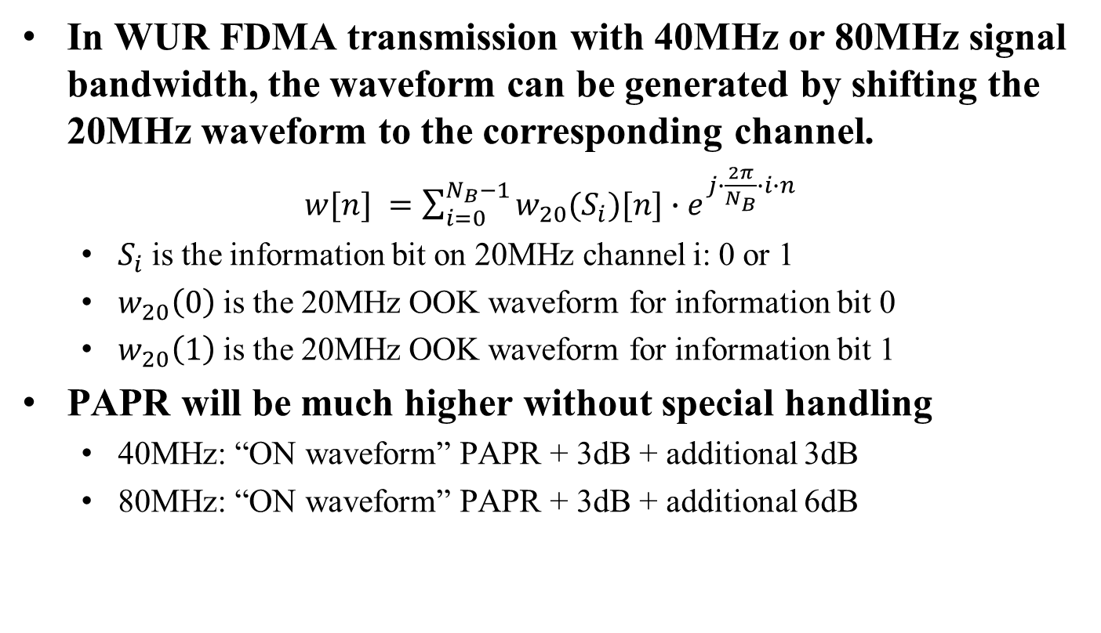
PAPR of FDMA Waveform
In WUR FDMA transmission with 40MHz or 80MHz signal bandwidth, the waveform can be generated by shifting the 20MHz waveform to the corresponding channel.
$w[n] =\sum_{i=0}^{N_{B}−1}{w_{20}(S_{i})[n]{∙e}^{j∙\frac{2π}{N_{B}}∙i∙n}}$
  $S_{i}$ is the information bit on 20MHz channel i: 0 or 1
  $w_{20}\left(0\right)$ is the 20MHz OOK waveform for information bit 0
  $w_{20}\left(1\right)$ is the 20MHz OOK waveform for information bit 1
PAPR will be much higher without special handling
  40MHz: “ON waveform” PAPR + 3dB + additional 3dB
  80MHz: “ON waveform” PAPR + 3dB + additional 6dB

Slide 5
PAPR Reduction for FDMA
High PAPR may require the transmitter to have larger power backoff, and affect the communication range.
  Especially if the WUR PAPR is higher than Legacy PAPR
For Legacy portion, the same “tone rotation” technique as in 802.11n/ac/ax needs to be applied.
For WUR portion, the PAPR can be reduced by either optimizing the waveform, “tone rotation”, or both.
  For waveform optimization, with the constraint of good 40/80MHz PAPR, the resultant 20MHz waveform may not have good PAPR property, so each receiver will see larger PAPR, and affect the performance.
  Optimizing “tone rotation” can be independent to the waveform design.

Slide 6
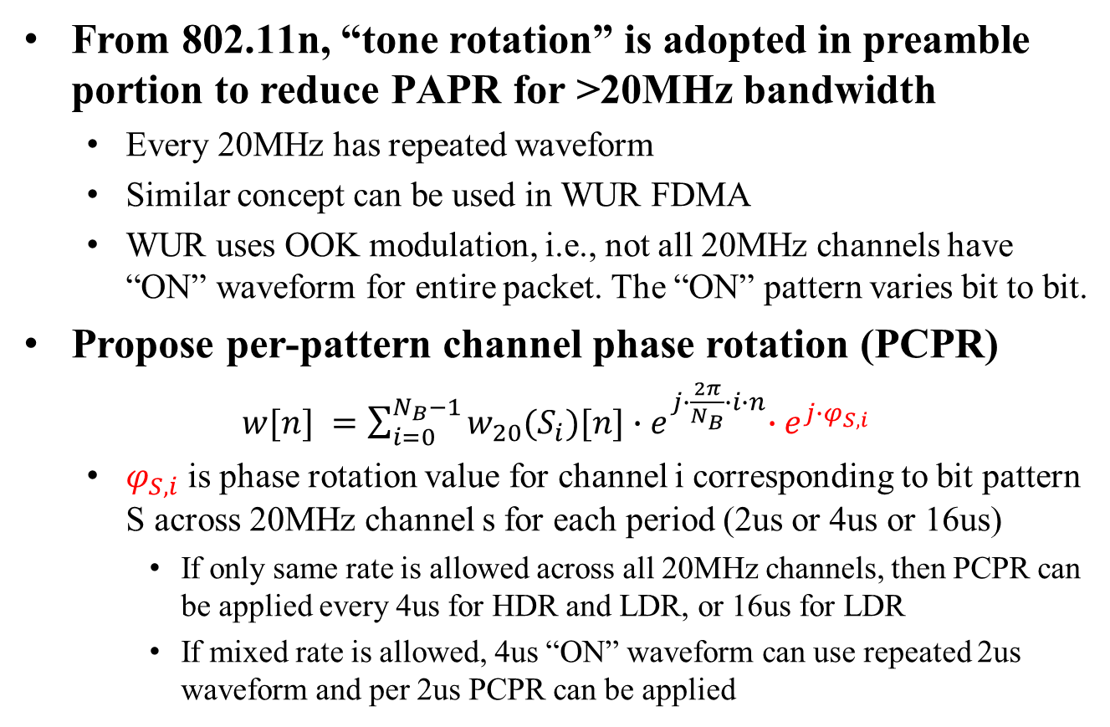
20MHz Channel Phase Rotation
From 802.11n, “tone rotation” is adopted in preamble portion to reduce PAPR for >20MHz bandwidth
  Every 20MHz has repeated waveform
  Similar concept can be used in WUR FDMA
  WUR uses OOK modulation, i.e., not all 20MHz channels have “ON” waveform for entire packet. The “ON” pattern varies bit to bit.
Propose per-pattern channel phase rotation (PCPR)
$w[n] =\sum_{i=0}^{N_{B}−1}{w_{20}(S_{i})[n]{∙e}^{j∙\frac{2π}{N_{B}}∙i∙n}{∙e}^{j∙φ_{S,i}}}$
  $φ_{S,i}$ is phase rotation value for channel i corresponding to bit pattern S across 20MHz channel s for each period (2us or 4us or 16us)
    If only same rate is allowed across all 20MHz channels, then PCPR can be applied every 4us for HDR and LDR, or 16us for LDR
    If mixed rate is allowed, 4us “ON” waveform can use repeated 2us waveform and per 2us PCPR can be applied

Slide 7







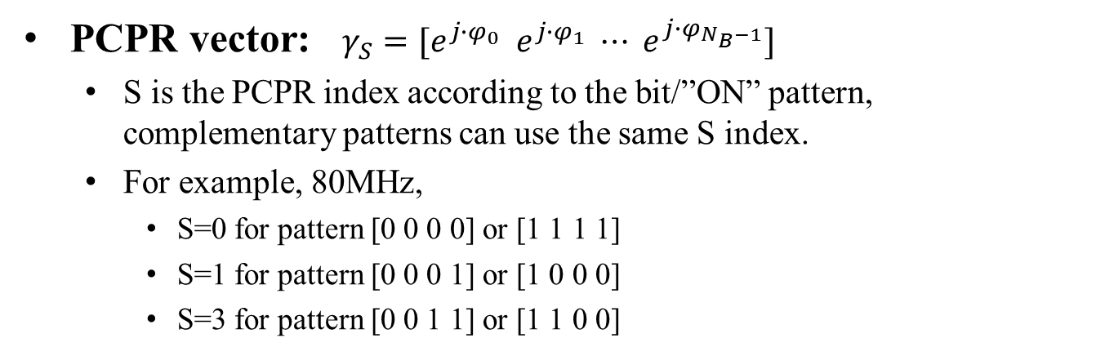









PCPR Illustration
20MHz channel 3
$γ_{0}$(3)
$γ_{1}$(3)
$γ_{3}$(3)
$γ_{5}$(3)
20MHz channel 2
$γ_{0}$(2)
$γ_{1}$(2)
$γ_{3}$(2)
$γ_{5}$(2)
20MHz
channel 1
$γ_{0}$(1)
$γ_{1}$(1)
$γ_{3}$(1)
$γ_{5}$(1)
20MHz channel 0
$γ_{0}$(0)
$γ_{1}$(0)
$γ_{3}$(0)
$γ_{5}$(0)
PCPR vector: $γ_{S}=[e^{j∙φ_{0}} e^{j∙φ_{1}} ⋯ e^{j∙φ_{N_{B}−1}}]$
  S is the PCPR index according to the bit/”ON” pattern, complementary patterns can use the same S index.
  For example, 80MHz,
    S=0 for pattern [0 0 0 0] or [1 1 1 1]
    S=1 for pattern [0 0 0 1] or [1 0 0 0]
    S=3 for pattern [0 0 1 1] or [1 1 0 0]

Slide 8
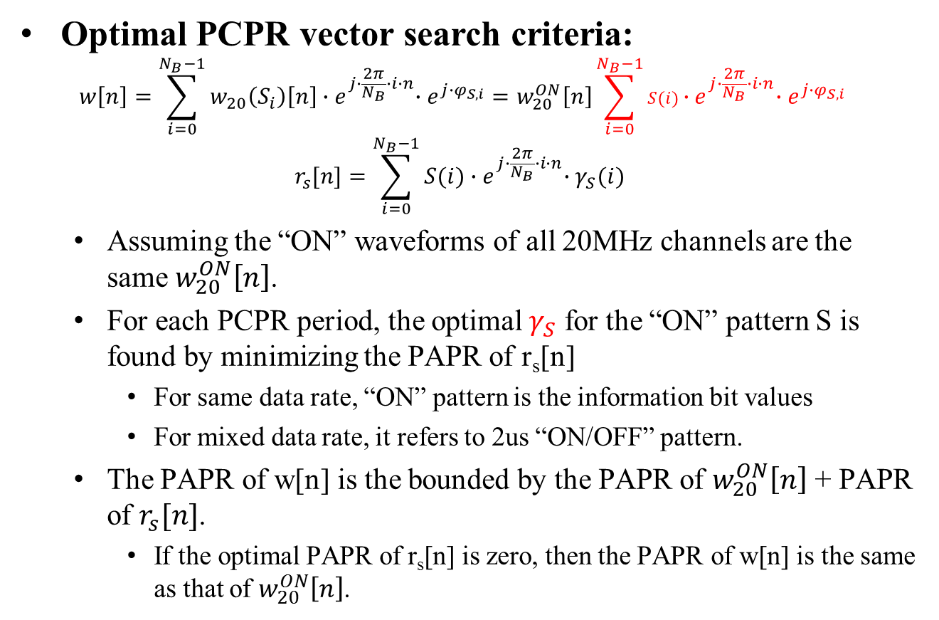
PCPR Values
Optimal PCPR vector search criteria:
$$r_{s}[n]=\sum_{i=0}^{N_{B}−1}{S(i){∙e}^{j∙\frac{2π}{N_{B}}∙i∙n}∙γ_{S}(i) }$$
  Assuming the “ON” waveforms of all 20MHz channels are the same $w_{20}^{ON}\left[n\right]$.
  For each PCPR period, the optimal $γ_{S}$ for the “ON” pattern S is found by minimizing the PAPR of r_{s}[n]
    For same data rate, “ON” pattern is the information bit values
    For mixed data rate, it refers to 2us “ON/OFF” pattern.
  The PAPR of w[n] is the bounded by the PAPR of $w_{20}^{ON}\left[n\right]$ + PAPR of $r_{s}[n]$.
    If the optimal PAPR of r_{s}[n] is zero, then the PAPR of w[n] is the same as that of $w_{20}^{ON}\left[n\right]$.

Slide 9
Advantage of PCPR Design
Previous contributions show that different waveform can be beneficial for different channel types [2, 3, 4].
PCPR vectors can be independent of waveform design.
  Transmitter can still choose the 20MHz waveform optimal for the receiver(s).
  The PCPR vectors can be applied to any 20MHz-channel waveform design, either time-domain or frequency-domain, with known PAPR bound.
  The transmitter sees smaller PAPR, while the receiver(s) can still observe the good PAPR property of the 20MHz waveform.

Slide 10
Numerical Results: 40MHz
S Index | Pattern | 40MHz BPR
0 | [1 1] or [0 0] | [1 j]
1 | [1 0] or [0 1] | [1 1]
  Achieves additional PAPR = 0
  S = 0, same as 11n/ac tone rotation
  S = 1, no rotation is needed.
    can use the same vector as S=0 for simplicity
S Index | Pattern | 40MHz BPR
0 | [1 1] or [0 0] or [1 0] or [0 1] | [1 j]

Slide 11
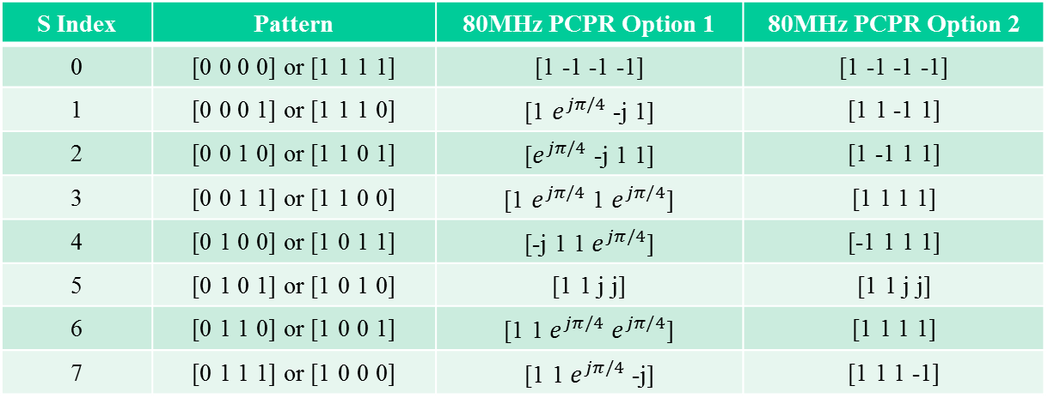
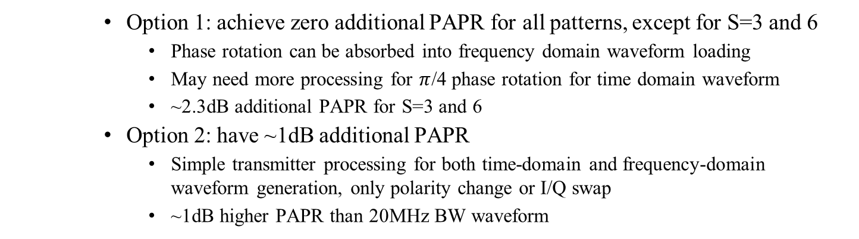
Numerical Results: 80MHz
S Index | Pattern | 80MHz PCPR Option 1 | 80MHz PCPR Option 2
0 | [0 0 0 0] or [1 1 1 1] | [1 -1 -1 -1] | [1 -1 -1 -1]
1 | [0 0 0 1] or [1 1 1 0] | [1 $e^{jπ/4}$ -j 1] | [1 1 -1 1]
2 | [0 0 1 0] or [1 1 0 1] | [$e^{jπ/4}$ -j 1 1] | [1 -1 1 1]
3 | [0 0 1 1] or [1 1 0 0] | [1 $e^{jπ/4}$ 1 $e^{jπ/4}$] | [1 1 1 1]
4 | [0 1 0 0] or [1 0 1 1] | [-j 1 1 $e^{jπ/4}$] | [-1 1 1 1]
5 | [0 1 0 1] or [1 0 1 0] | [1 1 j j] | [1 1 j j]
6 | [0 1 1 0] or [1 0 0 1] | [1 1 $e^{jπ/4}$ $e^{jπ/4}$] | [1 1 1 1]
7 | [0 1 1 1] or [1 0 0 0] | [1 1 $e^{jπ/4}$ -j] | [1 1 1 -1]
    Option 1: achieve zero additional PAPR for all patterns, except for S=3 and 6
      Phase rotation can be absorbed into frequency domain waveform loading
      May need more processing for $π$/4 phase rotation for time domain waveform
      ~2.3dB additional PAPR for S=3 and 6
    Option 2: have ~1dB additional PAPR
      Simple transmitter processing for both time-domain and frequency-domain waveform generation, only polarity change or I/Q swap
      ~1dB higher PAPR than 20MHz BW waveform

Slide 12
Simulations of PAPR
PAPR is computed based a WUR packet of length 48 bits
PAPR of the WUR portion is simulated
  10000 realizations are simulated
  The PAPR values have very low variance, so only average PAPR is listed in the result table
Waveform with no DC in [2] is used as an example
For 80MHz, consider three channel occupancy cases:
  Case 1: all four 20MHz channels are occupied [x x x x]
  Case 2: only three 20MHz channels are occupied [x x x o]
    The location of the unoccupied channel does not affect PAPR
  Case 3: only two consecutive channels are occupied [x x o o]
    Non consecutive two channels is the same as 40MHz
    The location of the unoccupied channels does not affect PAPR

Slide 13
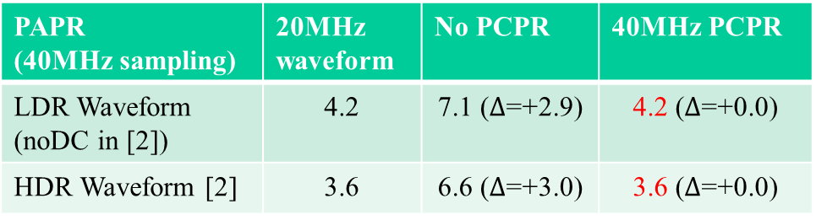
PAPR: 40MHz
40MHz: both two 20MHz channels are used
  20MHz waveform: only load one 20MHz channel of larger BW
    PAPR considers OFF periods (3dB higher than “ON” waveform PAPR).
    PAPR=1.2dB for 4us LDR “ON” waveform (0.2dB higher than [2] due to 40MHz sampling)
    PAPR=0.6dB for 2us HDR “ON” waveform (same as [2])
  No PAPR addition when PCPR is applied
PAPR (40MHz sampling) | 20MHz waveform | No PCPR | 40MHz PCPR
LDR Waveform (noDC in [2]) | 4.2 | 7.1 ($∆$=+2.9) | 4.2 ($∆$=+0.0)
HDR Waveform [2] | 3.6 | 6.6 ($∆$=+3.0) | 3.6 ($∆$=+0.0)

Slide 14
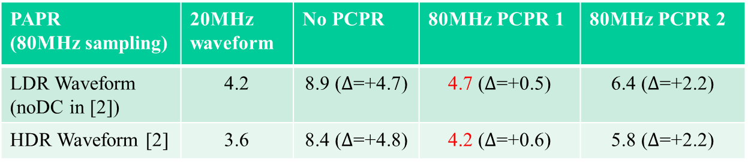
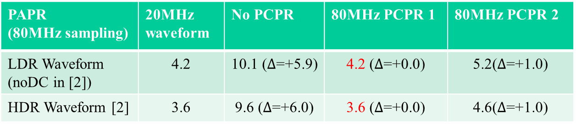
PAPR: 80MHz
Case 1: 20MHz channel occupancy [x x x x]
Case 2: 20MHz channel occupancy [x x x o]
PAPR (80MHz sampling) | 20MHz waveform | No PCPR | 80MHz PCPR 1 | 80MHz PCPR 2
LDR Waveform (noDC in [2]) | 4.2 | 10.1 ($∆$=+5.9) | 4.2 ($∆$=+0.0) | 5.2($∆$=+1.0)
HDR Waveform [2] | 3.6 | 9.6 ($∆$=+6.0) | 3.6 ($∆$=+0.0) | 4.6($∆$=+1.0)
PAPR (80MHz sampling) | 20MHz waveform | No PCPR | 80MHz PCPR 1 | 80MHz PCPR 2
LDR Waveform (noDC in [2]) | 4.2 | 8.9 ($∆$=+4.7) | 4.7 ($∆$=+0.5) | 6.4 ($∆$=+2.2)
HDR Waveform [2] | 3.6 | 8.4 ($∆$=+4.8) | 4.2 ($∆$=+0.6) | 5.8 ($∆$=+2.2)

Slide 15
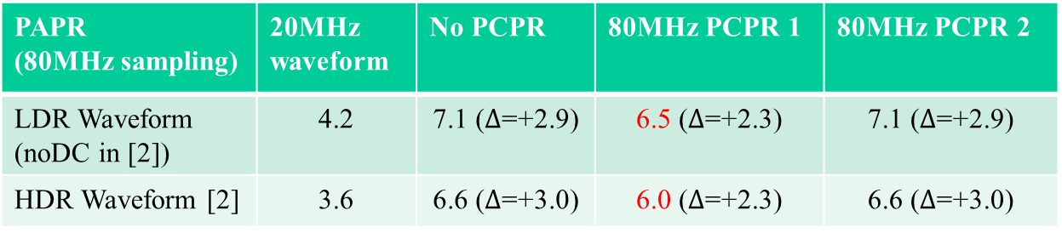
PAPR: 80MHz (Cont.)
Case 3: 20MHz channel occupancy [x x o o]
PAPR (80MHz sampling) | 20MHz waveform | No PCPR | 80MHz PCPR 1 | 80MHz PCPR 2
LDR Waveform (noDC in [2]) | 4.2 | 7.1 ($∆$=+2.9) | 6.5 ($∆$=+2.3) | 7.1 ($∆$=+2.9)
HDR Waveform [2] | 3.6 | 6.6 ($∆$=+3.0) | 6.0 ($∆$=+2.3) | 6.6 ($∆$=+3.0)

Slide 16
Summary
In WUR FDMA mode,
  WUR Legacy portion shall follow 11n/ac/ax tone rotation.
  WUR portion will have 3~6dB higher PAPR than 20MHz waveform if no phase rotation is applied.
Studied per-pattern channel phase rotation (PCPR) for WUR portion PAPR reduction in FDMA mode.
  Predefined PCPR values for different ON/OFF patterns.
  PCPR design is independent of waveform design.
  Numerical results show PCPR is effective to reduce PAPR.
PCPR can be a good option for FDMA mode
  WUR “ON” waveform design is NOT mandated.
  Transmitter side can perform joint waveform and phase rotation.

Slide 17
References
[1] Jianhan Liu and etc, 11-17-1625-06-00ba-efficient-fdma-transmission-schemes-for-wur-wlan
[2] Miguel Lopez and etc, 11-18-0479-02-00ba-mc-ook-symbol-design
[3] Vinod Kristem and etc, 11-18-0492-02-00ba-2us-ook-waveform-generation
[4] Eunsung Park and etc, 11-18-0421-01-00ba-ook-waveform-generation-follow-up

Slide 18
Straw Poll 1
Do you agree to add the following to SFD?
WUR FDMA transmitter shall apply per-20MHz “tone rotation” to the Legacy portion as in 802.11n/ac/ax for signal bandwidth larger than 20MHz?

Slide 19
Straw Poll 2
Do you agree to add the following to SFD?
WUR FDMA transmitter can apply per-pattern channel phase rotation (PCPR) to the WUR portion for signal bandwidth larger than 20MHz?

Slide 20
Straw Poll 3
Do you agree to add the following to SFD?
The per-pattern channel phase rotation (PCPR) for 40MHz can use values in the table below?
  Option 1:
  Option 2:
  PCPR Option 1:
  PCPR Option 2:
  N
  A
S Index | Pattern | 40MHz BPR
0 | [1 1] or [0 0] | [1 j]
1 | [1 0] or [0 1] | [1 1]
S Index | Pattern | 40MHz BPR
0 | [1 1] or [0 0] or [1 0] or [0 1] | [1 j]

Slide 21
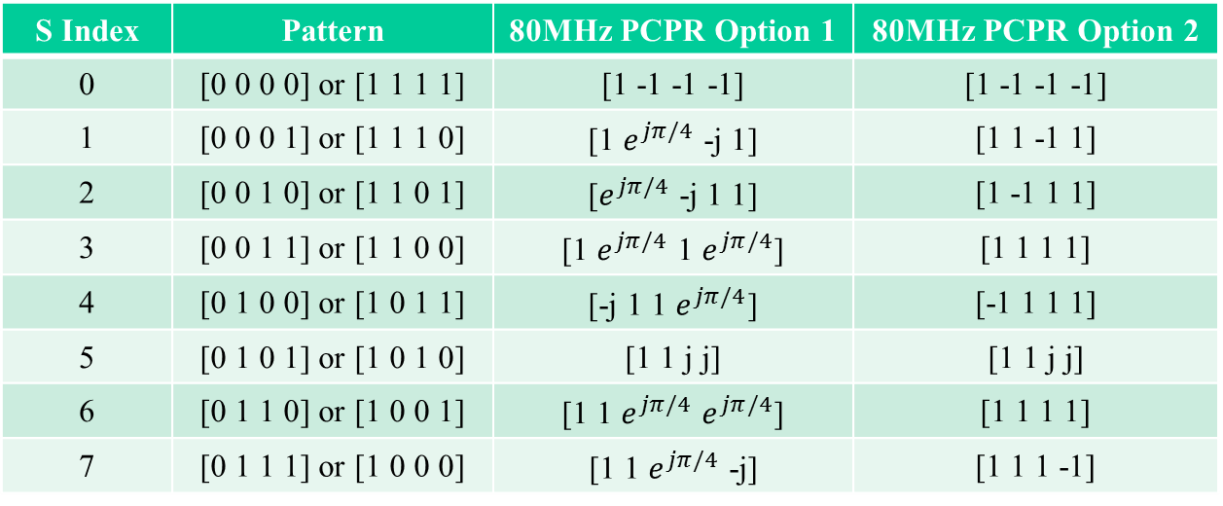
Straw Poll 4
Do you agree to add the following to SFD?
The per-pattern channel phase rotation (PCPR) for 80MHz can use the values in the table below?
  PCPR Option 1:
  PCPR Option 2:
  N
  A
S Index | Pattern | 80MHz PCPR Option 1 | 80MHz PCPR Option 2
0 | [0 0 0 0] or [1 1 1 1] | [1 -1 -1 -1] | [1 -1 -1 -1]
1 | [0 0 0 1] or [1 1 1 0] | [1 $e^{jπ/4}$ -j 1] | [1 1 -1 1]
2 | [0 0 1 0] or [1 1 0 1] | [$e^{jπ/4}$ -j 1 1] | [1 -1 1 1]
3 | [0 0 1 1] or [1 1 0 0] | [1 $e^{jπ/4}$ 1 $e^{jπ/4}$] | [1 1 1 1]
4 | [0 1 0 0] or [1 0 1 1] | [-j 1 1 $e^{jπ/4}$] | [-1 1 1 1]
5 | [0 1 0 1] or [1 0 1 0] | [1 1 j j] | [1 1 j j]
6 | [0 1 1 0] or [1 0 0 1] | [1 1 $e^{jπ/4}$ $e^{jπ/4}$] | [1 1 1 1]
7 | [0 1 1 1] or [1 0 0 0] | [1 1 $e^{jπ/4}$ -j] | [1 1 1 -1]

