Slide 1
OOK Waveform for FDMA
Date: 2018-05-07
Authors:

Slide 2
Introduction
In the previous meeting, FDMA transmission is proposed [1]:
  Each 20 MHz channel only contains one 4 MHz sub-channel for wake-up signal transmission
In this contribution, we propose a method based on existing QPSK Golay sequences to remedy the significant PAPR increase when WUSs are FDMed
[1]: IEEE 802.11-17/1625r6

Slide 3
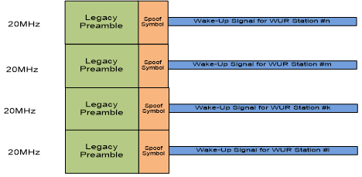

Problem Statement
Overlapping in time
HDR
CP
CP
CP
CP
Time
HDR
CP
CP
CP
CP
Time
LDR
CP
CP
Time
HDR
CP
CP
CP
CP
2$μ$s
Time
The PAPR can be significantly high since the ON signals on different channels overlap in time in case of FDMA
Intractable problem because
  There may be 1, 2, 3, or 4 active channels
  The active channel locations in frequency could be different
  LDR and HDR waveforms can also be different (e.g., CP size etc.)
many combinations for a given time period

Slide 4




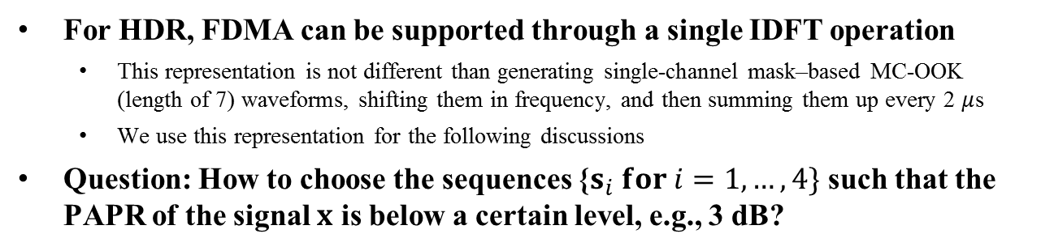






Transmitter Block Diagram (HDR)
Manchester-coded bit (0)
$$s_{1}$$
7
Channel 1
IDFT
$$0$$
CP
0
CP
CP
CP
$$0$$
Time
Manchester-coded bit (1)
1
$$s_{2}$$
7
Channel 2
CP
CP
CP
CP
$$0$$
$$0$$
Time
Manchester-coded bit (1)
CP+
$$x$$
1
7
CP
CP
CP
CP
$$s_{3}$$
Channel 3
Time
$$0$$
$$0$$
Manchester-coded bit (0)
CP
0
CP
CP
CP
$$s_{4}$$
7
Channel 4
2$μ$s
Time
$$0$$
$$0$$
For HDR, FDMA can be supported through a single IDFT operation
  This representation is not different than generating single-channel mask–based MC-OOK (length of 7) waveforms, shifting them in frequency, and then summing them up every 2 $μ$s
  We use this representation for the following discussions
Question: How to choose the sequences {$s_{i} for i=1,…, 4\}$ such that the PAPR of the signal $x$ is below a certain level, e.g., 3 dB?

Slide 5
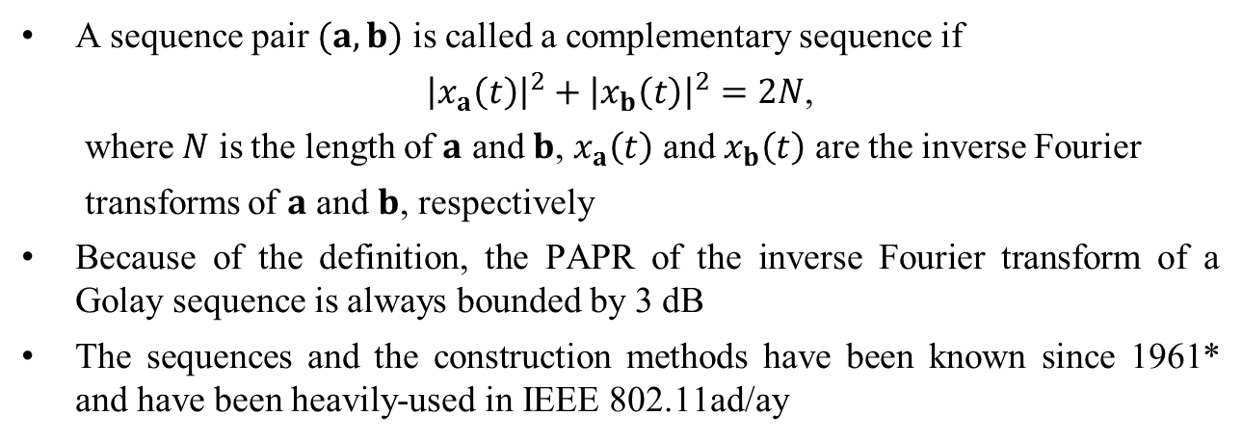



Golay Complementary Sequences
A sequence pair $(a,b)$ is called a complementary sequence if
${\left|x_{a}\left(t\right)\right|}^{2}+{\left|x_{b}\left(t\right)\right|}^{2}=2N$,
where $N$ is the length of $a$ and $b$, $x_{a}\left(t\right)$ and $x_{b}\left(t\right)$ are the inverse Fourier
transforms of $a$ and $b$, respectively
Because of the definition, the PAPR of the inverse Fourier transform of a Golay sequence is always bounded by 3 dB
The sequences and the construction methods have been known since 1961* and have been heavily-used in IEEE 802.11ad/ay
IDFT
$$a$$
$$x$$
$PAPR\left\{x\right\}≤3dB$**
*Golay, M. (April 1961). "Complementary series". IEEE Transactions on Information Theory. 7 (2): 82–8
*https://en.wikipedia.org/wiki/Complementary_sequences
**Matthew G. Parker, Kenneth G. Paterson, Chintha Tellambura, “Golay Complementary Sequences”, 2004

Slide 6

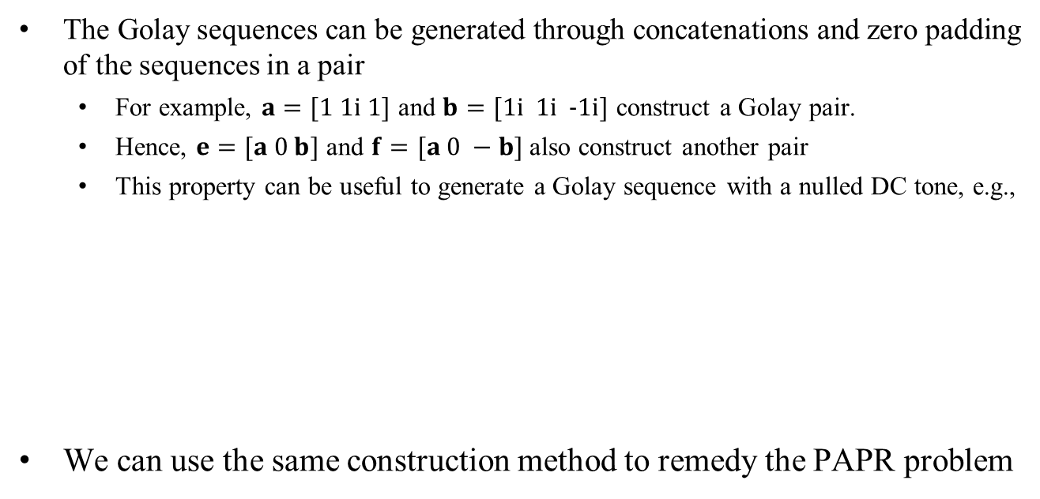



Generating a Length 7 Sequence with nulled DC tone (Single Channel)
The Golay sequences can be generated through concatenations and zero padding of the sequences in a pair
  For example, $a=[1 1i 1]$ and $b=[1i 1i \text{−}1i]$ construct a Golay pair.
  Hence, $e=[a 0 b]$ and $f=[a 0 −b]$ also construct another pair
  This property can be useful to generate a Golay sequence with a nulled DC tone, e.g.,
We can use the same construction method to remedy the PAPR problem
$$e$$
$$a$$
$$b$$
$$PAPR\left\{IDFT\left\{e\right\}\right\}≤3 dB$$
3
1
3
Frequency

Slide 7












Concatenating Golay Sequences
(Multiple Channels) 1/2
Channel 1
Channel 2
Channel 3
Channel 4
A Golay sequence
$$a$$
$$b$$
$$a$$
$$−b$$
Frequency
$$e$$
$$f$$
A Golay sequence
$$a$$
$$b$$
$$a$$
$$−b$$
Frequency
$$e$$
$$f$$
A Golay sequence
$$a$$
$$b$$
$$a$$
$$−b$$
Frequency
$$e$$
$$f$$
The figure above shows some examples of several channelization
  The PAPR is always less than or equal to 3 dB even if there is a non-contiguous mapping

Slide 8










Concatenating Golay Sequences
(Multiple Channels) 2/2
Channel 1
Channel 2
Channel 3
Channel 4
A Golay sequence
$$a$$
$$b$$
$$ia$$
$$b$$
$$a$$
$$−b$$
Frequency
$$e$$
$$f$$
A Golay sequence
$$a$$
$$b$$
$$a$$
$$−b$$
$$a$$
$$b$$
$$−a$$
$$b$$
Frequency
$$e$$
$$f$$
$$e$$
$$−f$$
Other cases can also be generated with several Golay construction methods*
*Matthew G. Parker, Kenneth G. Paterson, Chintha Tellambura, “Golay Complementary Sequences”, 2004

Slide 9



Handling FDMed LDR and HDR WUSs
Option 1 for LDR:
CP
CP
4$μ$s
Time
Option 2 for LDR:
CP
CP
CP
CP
2$μ$s
Time
If we use Option 2, the design for LDR and HDR can be unified and the IDFT durations are aligned
HDR
CP
CP
CP
CP
LDR
Time
CP
CP
CP
CP
Time
2$μ$s

Slide 10








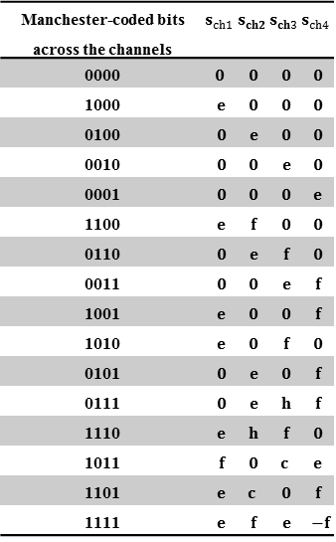
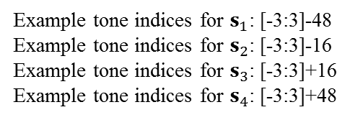











TX Diagram for FDMed LDR and HDR WUSs
Manchester-coded bits across the channels | $$s_{ch1}$$ | $$s_{ch2}$$ | $$s_{ch3}$$ | $$s_{ch4}$$
0000 | $$0$$ | $$0$$ | $$0$$ | $$0$$
1000 | $$e$$ | $$0$$ | $$0$$ | $$0$$
0100 | $$0$$ | $$e$$ | $$0$$ | $$0$$
0010 | $$0$$ | $$0$$ | $$e$$ | $$0$$
0001 | $$0$$ | $$0$$ | $$0$$ | $$e$$
1100 | $$e$$ | $$f$$ | $$0$$ | $$0$$
0110 | $$0$$ | $$e$$ | $$f$$ | $$0$$
0011 | $$0$$ | $$0$$ | $$e$$ | $$f$$
1001 | $$e$$ | $$0$$ | $$0$$ | $$f$$
1010 | $$e$$ | $$0$$ | $$f$$ | $$0$$
0101 | $$0$$ | $$e$$ | $$0$$ | $$f$$
0111 | $$0$$ | $$e$$ | $$h$$ | $$f$$
1110 | $$e$$ | $$h$$ | $$f$$ | $$0$$
1011 | $$f$$ | $$0$$ | $$c$$ | $$e$$
1101 | $$e$$ | $$c$$ | $$0$$ | $$f$$
1111 | $$e$$ | $$f$$ | $$e$$ | $$−f$$
Ch #1 (HDR)
0
CP
CP
CP
CP
1
Time
Ch #2 (HDR)
CP
CP
CP
CP
1
Time
Ch #3 (LDR)
CP
CP
CP
CP
Manchester-coded bit: 0
Time
$$s_{1}$$
7
Channel 1
IDFT
Ch #4 (HDR)
0
$$0$$
$$s_{ch1}$$
CP
CP
CP
CP
$$0$$
2$μ$s
Time
Manchester-coded bit: 1
$$s_{2}$$
7
Channel 2
$$0$$
$$s_{ch2}$$
Rate: 1 symbol/2$μ$s
Not Golay sequences but low PAPR
$$0$$
CP+
Manchester-coded bit: 1
$$s_{3}$$
7
Channel 3
$$0$$
$$s_{ch3}$$
$$0$$
Example tone indices for $s_{1}$: [-3:3]-48
Example tone indices for $s_{2}$: [-3:3]-16
Example tone indices for $s_{3}$: [-3:3]+16
Example tone indices for $s_{4}$: [-3:3]+48
$$e=\left[\begin{matrix}1 & 1i & 1 & 0 & 1i & 1i & −1i\end{matrix}\right]$$
Manchester-coded bit: 0
$$f=\left[\begin{matrix}1 & 1i & 1 & 0 & −1i & −1i & 1i\end{matrix}\right]$$
$$s_{4}$$
7
Channel 4
$$h=\left[\begin{matrix}1i & −1 & 1i & 0 & 1i & 1i & −1i\end{matrix}\right]$$
$$0$$
$$s_{ch4}$$
$$c=\left[\begin{matrix}−1i & −1 & 1i & 0 & 1i & −1 & −1i\end{matrix}\right]$$
$$0$$
$$s_{i}∈\{e,±f,h,c,\}$$

Slide 11
Simulation Assumptions
We simulate 5 different cases considering various FDMed WUSs with HDR and LDR (the results for different cases are given in appendix)
AP: 80 MHz sample rate
  PA: Rapp model with the smoothness factor of 3, 4x oversampling
WURx:
  Envelope detector (i.e., samples the accumulated the sum of absolutes of I- and Q- branches), 5th order Butterworth filter, ideal synchronization
We compare the MC-OOK proposals in the following contributions for HDR and LDR with the Golay sequences are given in Slide 10
  Option 1: Golay-based (QPSK)
  Option 2: LDR/HDR: IEEE 802.11-18/0479r2 (256 QAM)
  Option 3: LDR: IEEE 802.11-18/0421r0/HDR: IEEE 802.11-18/0492r0 (BPSK)
  Option 4: LDR/HDR: IEEE 802.11-18/0421r0 (BPSK)
We apply phase rotations for the channels as described in IEEE 802.11ac for 492, 479, and 421
  Extra phase rotations for different channels are not needed for Golay sequences

Slide 12
Numerical Analysis (2 HDRs, 2LDRs)
Legacy
SYNC
HDR
HDR
LDR
HDR
Time domain signal

Slide 13
Numerical Analysis (2 HDRs, 2LDRs)
Legacy
SYNC
HDR
HDR
LDR
HDR
Time domain signal

Slide 14
Numerical Analysis (2 HDRs, 2LDRs)
Legacy
SYNC
HDR
HDR
LDR
HDR
Time domain signal

Slide 15
PAPR Results (2 HDRs, 2LDRs)
Rates: | L L H H
Probability: | .5 | .8 | .99
Option 1 (Golay) | 6.61 | 6.61 | 6.67
Option 2 (256QAM) | 7.37 | 9.55 | 9.80
Option 3 (BPSK) | 8.99 | 11.08 | 11.13
Option 4 (BPSK) | 8.22 | 10.60 | 10.67

Slide 16
PAPR Results for Different Cases
The probability of sample power being 9.55 dB, 12.39 dB, and 10.77 dB higher than the average is 0.2 for Option 2, 3, and 4, respectively, in some cases (see appendix for details)
The instantaneous power is less than 6.67 dB above the average for Option 1 (Golay sequences) for all cases with .99 probability
 | Case 1 |  |  | Case 2 |  |  | Case 3 |  |  | Case 4 |  |  | Case 5
Rates: | _ _ H H |  |  | H H H H |  |  | L L H H |  |  | L L L H |  |  | H H L H
Probability: | .5 | .8 | .99 | .5 | .8 | .99 | .5 | .8 | .99 | .5 | .8 | .99 | .5 | .8 | .99 | Worst @ 0.8
Option 1 (Golay) | 6.02 | 6.02 | 6.02 | 6.01 | 6.67 | 6.67 | 6.61 | 6.61 | 6.67 | 6.62 | 6.67 | 6.67 | 6.01 | 6.62 | 6.67 | 6.67
Option 2 (256QAM) | 6.60 | 6.60 | 6.60 | 7.12 | 7.12 | 7.12 | 7.37 | 9.55 | 9.80 | 7.37 | 7.46 | 9.91 | 7.24 | 9.29 | 9.71 | 9.55
Option 3 (BPSK) | 9.38 | 9.38 | 9.38 | 9.89 | 12.39 | 12.39 | 8.99 | 11.08 | 11.13 | 8.39 | 8.59 | 10.63 | 9.72 | 11.36 | 11.41 | 12.39
Option 4 (BPSK) | 8.25 | 8.25 | 8.25 | 8.77 | 8.77 | 8.77 | 8.22 | 10.60 | 10.67 | 8.18 | 8.18 | 10.69 | 8.77 | 10.77 | 10.86 | 10.77

Slide 17
Spectral Growth under PA Impairment
Option 1 (Golay) causes less spectral growth for OBO = 5 dB as compared to other options

Slide 18
BER Results
Similar performance
w/o PA
Golay-based WUS is robust
When the samples are clipped heavily because of PA, the sum of absolute values can decrease and WUSs can interfere with each other
  Saturation can degrade the BER performance at WURx (e.g., Option 3)
  Golay-based WUS provides robustness against PA non-linearity by minimizing the fluctuation in time for FDMed OOK symbols

Slide 19
Conclusion
The PAPR can be significantly large when WUSs are FDMed
  Without taking any precautions, it can reach 10-13 dB or higher, which limits the coverage range of 802.11ba in some regions
The PAPR minimization for FDMed WUSs is an intractable problem due to the large number cases possible in an FDM scenario
  The phase rotations in IEEE 802.11ac cannot address all cases and they are a function of the sequence
  A scalable solution is needed
Existing Golay sequences can address the PAPR issue as the corresponding signals are always bounded by 3 dB
  We show that the PAPR gain can reach more than 3 dB in some cases
  Golay sequences are publicly available
    Known since 1960s
    Heavily-used in 802.11ad/ay
    Used for PAPR minimization, coding, etc. in academic studies

Slide 20
Appendix

Slide 21
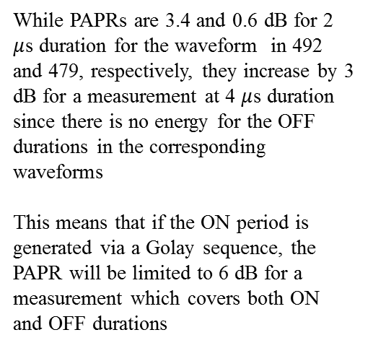
PAPR
6.4 dB [1]
3.6 dB [2]
Mean power
While PAPRs are 3.4 and 0.6 dB for 2 $μ$s duration for the waveform in 492 and 479, respectively, they increase by 3 dB for a measurement at 4 $μ$s duration since there is no energy for the OFF durations in the corresponding waveforms
This means that if the ON period is generated via a Golay sequence, the PAPR will be limited to 6 dB for a measurement which covers both ON and OFF durations
[1]: IEEE 802.11-18/0492r0
[2]: IEEE 802.11-18/0479r2

Slide 22
PAPR Results – Case 1
 | Case 1
Rates: | _ _ H H
Probability: | .5 | .8 | .99
Option 1 (Golay) | 6.02 | 6.02 | 6.02
Option 2 (256QAM) | 6.60 | 6.60 | 6.60
Option 3 (BPSK) | 9.38 | 9.38 | 9.38
Option 4 (BPSK) | 8.25 | 8.25 | 8.25

Slide 23
PAPR Results – Case 2
 | Case 2
Rates: | H H H H
Probability: | .5 | .8 | .99
Option 1 (Golay) | 6.01 | 6.67 | 6.67
Option 2 (256QAM) | 7.12 | 7.12 | 7.12
Option 3 (BPSK) | 9.89 | 12.39 | 12.39
Option 4 (BPSK) | 8.77 | 8.77 | 8.77

Slide 24
PAPR Results – Case 3
 | Case 3
Rates: | L L H H
Probability: | .5 | .8 | .99
Option 1 (Golay) | 6.61 | 6.61 | 6.67
Option 2 (256QAM) | 7.37 | 9.55 | 9.80
Option 3 (BPSK) | 8.99 | 11.08 | 11.13
Option 4 (BPSK) | 8.22 | 10.60 | 10.67

Slide 25
PAPR Results – Case 4
 | Case 4
Rates: | L L L H
Probability: | .5 | .8 | .99
Option 1 (Golay) | 6.62 | 6.67 | 6.67
Option 2 (256QAM) | 7.37 | 7.46 | 9.91
Option 3 (BPSK) | 8.39 | 8.59 | 10.63
Option 4 (BPSK) | 8.18 | 8.18 | 10.69

Slide 26
PAPR Results – Case 5
 | Case 5
Rates: | H H L H
Probability: | .5 | .8 | .99
Option 1 (Golay) | 6.01 | 6.62 | 6.67
Option 2 (256QAM) | 7.24 | 9.29 | 9.71
Option 3 (BPSK) | 9.72 | 11.36 | 11.41
Option 4 (BPSK) | 8.77 | 10.77 | 10.86

Slide 27
BER (Case 3)
Golay-based WUS is robust
Golay-based WUS is robust

Slide 28
SP
Do you agree that the method of OOK waveform generation based on Golay sequences described in the Slide 10 can be included in the 802.11ba spec as an example for implementing the frequency domain multiplexed WUS?
Y
N
A

