Slide 1
OOK Waveform for FDMA
Date: 2018-04-12
Authors:

Slide 2
Introduction
In the previous meeting, FDMA transmission is proposed [1]:
  Each 20 MHz channel only contains one 4 MHz sub-channel for wake-up signal transmission
In this contribution, we propose a method based on existing QPSK Golay sequences to remedy the significant PAPR increase when WUSs are FDMed
[1]: IEEE 802.11-17/1625r6

Slide 3
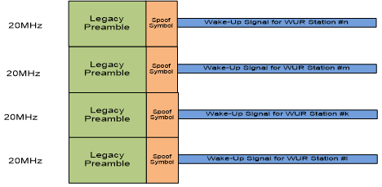

Problem Statement
Overlapping in time
HDR
CP
CP
CP
CP
Time
HDR
CP
CP
CP
CP
Time
LDR
CP
CP
Time
HDR
CP
CP
CP
CP
2$μ$s
Time
The PAPR can be significantly high since the ON signals on different channels overlap in time in case of FDMA
Intractable problem because
  There may be 1, 2, 3, or 4 active channels
  The active channel locations in frequency could be different
  LDR and HDR waveforms can also be different (e.g., CP size etc.)
many combinations for a given time period

Slide 4




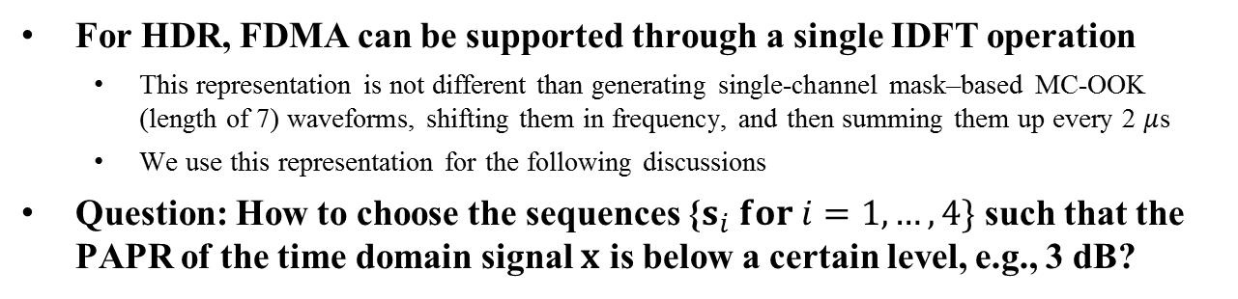






Transmitter Block Diagram (HDR)
Manchester-coded bit (0)
$$s_{1}$$
7
Channel 1
IDFT
$$0$$
CP
0
CP
CP
CP
$$0$$
Time
Manchester-coded bit (1)
1
$$s_{2}$$
7
Channel 2
CP
CP
CP
CP
$$0$$
$$0$$
Time
Manchester-coded bit (1)
CP+
$$x$$
1
7
CP
CP
CP
CP
$$s_{3}$$
Channel 3
Time
$$0$$
$$0$$
Manchester-coded bit (0)
CP
0
CP
CP
CP
$$s_{4}$$
7
Channel 4
2$μ$s
Time
$$0$$
$$0$$
For HDR, FDMA can be supported through a single IDFT operation
  This representation is not different than generating single-channel mask–based MC-OOK (length of 7) waveforms, shifting them in frequency, and then summing them up every 2 $μ$s
  We use this representation for the following discussions
Question: How to choose the sequences {$s_{i} for i=1,…, 4\}$ such that the PAPR of the time domain signal $x$ is below a certain level, e.g., 3 dB?

Slide 5
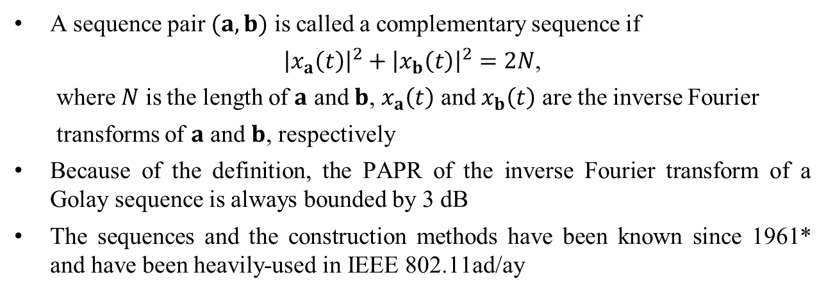



Golay Complementary Sequences
A sequence pair $(a,b)$ is called a complementary sequence if
${\left|x_{a}\left(t\right)\right|}^{2}+{\left|x_{b}\left(t\right)\right|}^{2}=2N$,
where $N$ is the length of $a$ and $b$, $x_{a}\left(t\right)$ and $x_{b}\left(t\right)$ are the inverse Fourier
transforms of $a$ and $b$, respectively
Because of the definition, the PAPR of the inverse Fourier transform of a Golay sequence is always bounded by 3 dB
The sequences and the construction methods have been known since 1961* and have been heavily-used in IEEE 802.11ad/ay
IDFT
$$a$$
$$x$$
$PAPR\left\{x\right\}≤3dB$**
*Golay, M. (April 1961). "Complementary series". IEEE Transactions on Information Theory. 7 (2): 82–8
*https://en.wikipedia.org/wiki/Complementary_sequences
**Matthew G. Parker, Kenneth G. Paterson, Chintha Tellambura, “Golay Complementary Sequences”, 2004

Slide 6

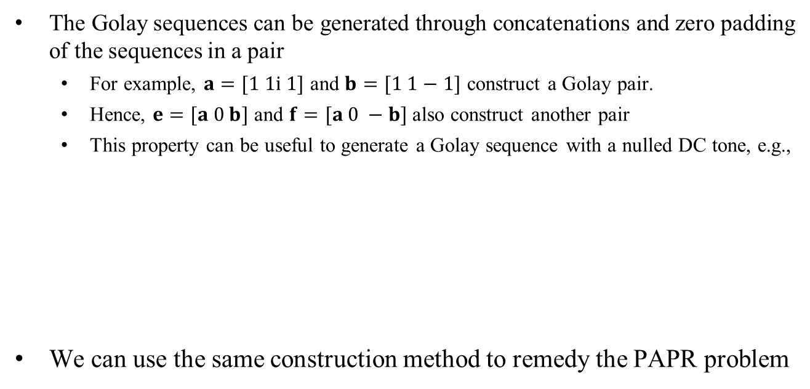



Generating a Length 7 Sequence with nulled DC tone (Single Channel)
The Golay sequences can be generated through concatenations and zero padding of the sequences in a pair
  For example, $a=[1 1i 1]$ and $b=[1 1−1]$ construct a Golay pair.
  Hence, $e=[a 0 b]$ and $f=[a 0 −b]$ also construct another pair
  This property can be useful to generate a Golay sequence with a nulled DC tone, e.g.,
We can use the same construction method to remedy the PAPR problem
$$e$$
$$a$$
$$b$$
$$PAPR\left\{IDFT\left\{e\right\}\right\}≤3 dB$$
3
1
3
Frequency

Slide 7










Concatenating Golay Sequences
(Multiple Channels) 1/2
Channel 1
Channel 2
Channel 3
Channel 4
A Golay sequence
$$a$$
$$b$$
$$a$$
$$−b$$
Frequency
$$e$$
$$f$$
A Golay sequence
$$a$$
$$b$$
$$a$$
$$−b$$
Frequency
A Golay sequence
$$a$$
$$b$$
$$a$$
$$−b$$
Frequency
The figure above shows some examples of several channelization
  The PAPR is always less than or equal to 3 dB even if there is a non-contiguous mapping

Slide 8




Concatenating Golay Sequences
(Multiple Channels) 2/2
Channel 1
Channel 2
Channel 3
Channel 4
A Golay sequence
$$a$$
$$b$$
$$ia$$
$$b$$
$$a$$
$$−b$$
Frequency
A Golay sequence
$$a$$
$$b$$
$$a$$
$$−b$$
$$a$$
$$b$$
$$−a$$
$$b$$
Frequency
Other cases can also be generated with other Golay construction methods*
*Matthew G. Parker, Kenneth G. Paterson, Chintha Tellambura, “Golay Complementary Sequences”, 2004

Slide 9



Handling FDMed LDR and HDR WUSs
Option 1 for LDR:
CP
CP
4$μ$s
Time
Option 2 for LDR:
CP
CP
CP
CP
2$μ$s
Time
If we use Option 2, the design for LDR and HDR can be unified and the IDFT durations are aligned
HDR
CP
CP
CP
CP
LDR
Time
CP
CP
CP
CP
Time
2$μ$s

Slide 10








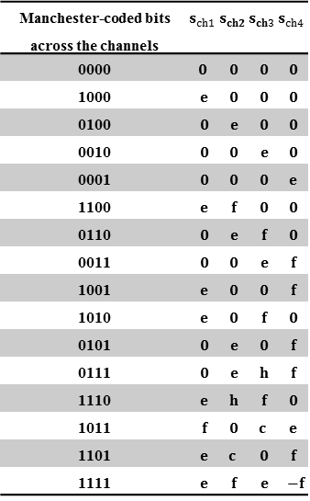
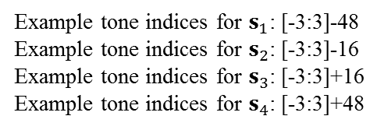











FDMed HDR and LDR WUSs with Golay-based Sequences
Manchester-coded bits across the channels | $$s_{ch1}$$ | $$s_{ch2}$$ | $$s_{ch3}$$ | $$s_{ch4}$$
0000 | $$0$$ | $$0$$ | $$0$$ | $$0$$
1000 | $$e$$ | $$0$$ | $$0$$ | $$0$$
0100 | $$0$$ | $$e$$ | $$0$$ | $$0$$
0010 | $$0$$ | $$0$$ | $$e$$ | $$0$$
0001 | $$0$$ | $$0$$ | $$0$$ | $$e$$
1100 | $$e$$ | $$f$$ | $$0$$ | $$0$$
0110 | $$0$$ | $$e$$ | $$f$$ | $$0$$
0011 | $$0$$ | $$0$$ | $$e$$ | $$f$$
1001 | $$e$$ | $$0$$ | $$0$$ | $$f$$
1010 | $$e$$ | $$0$$ | $$f$$ | $$0$$
0101 | $$0$$ | $$e$$ | $$0$$ | $$f$$
0111 | $$0$$ | $$e$$ | $$h$$ | $$f$$
1110 | $$e$$ | $$h$$ | $$f$$ | $$0$$
1011 | $$f$$ | $$0$$ | $$c$$ | $$e$$
1101 | $$e$$ | $$c$$ | $$0$$ | $$f$$
1111 | $$e$$ | $$f$$ | $$e$$ | $$−f$$
Ch #1 (HDR)
0
CP
CP
CP
CP
1
Time
Ch #2 (HDR)
CP
CP
CP
CP
1
Time
Ch #3 (LDR)
CP
CP
CP
CP
Manchester-coded bit: 0
Time
$$s_{1}$$
7
Channel 1
IDFT
Ch #4 (HDR)
0
$$0$$
$$s_{ch1}$$
CP
CP
CP
CP
$$0$$
2$μ$s
Time
Manchester-coded bit: 1
$$s_{2}$$
7
Channel 2
Not Golay sequences ( because of asymmetricity) but low PAPR
$$0$$
$$s_{ch2}$$
Rate: 1 symbol/2$μ$s
$$0$$
CP+
Manchester-coded bit: 1
$$s_{3}$$
7
Channel 3
$$0$$
$$s_{ch3}$$
$$0$$
Example tone indices for $s_{1}$: [-3:3]-48
Example tone indices for $s_{2}$: [-3:3]-16
Example tone indices for $s_{3}$: [-3:3]+16
Example tone indices for $s_{4}$: [-3:3]+48
$$e=\left[\begin{matrix}1 & 1i & 1 & 0 & 1 & 1 & −1\end{matrix}\right]$$
Manchester-coded bit: 0
$$f=\left[\begin{matrix}1 & 1i & 1 & 0 & −1 & −1 & 1\end{matrix}\right]$$
$$s_{4}$$
7
Channel 4
$$h=\left[\begin{matrix}1i & −1 & 1i & 0 & 1 & 1 & −1\end{matrix}\right]$$
$$0$$
$$s_{ch4}$$
$$c=\left[\begin{matrix}1 & −1i & 1 & 0 & 1 & 1 & −1\end{matrix}\right]$$
$$0$$
$$s_{i}∈\{e,±f,h,c,\}$$

Slide 11
Simulation Assumptions
We simulate 5 different cases considering various FDMed WUSs with HDR and LDR
The Golay sequences are given in Slide 10
We compare the MC-OOK proposals in the following contributions for HDR and LDR
  IEEE 802.11-18/0492r0
  IEEE 802.11-18/0479r2
  IEEE 802.11-18/0421r0
We apply phase rotations for the channels as described in IEEE 802.11ac for 492, 479, and 421
  Extra phase rotations for different channels are not needed for Golay sequences

Slide 12
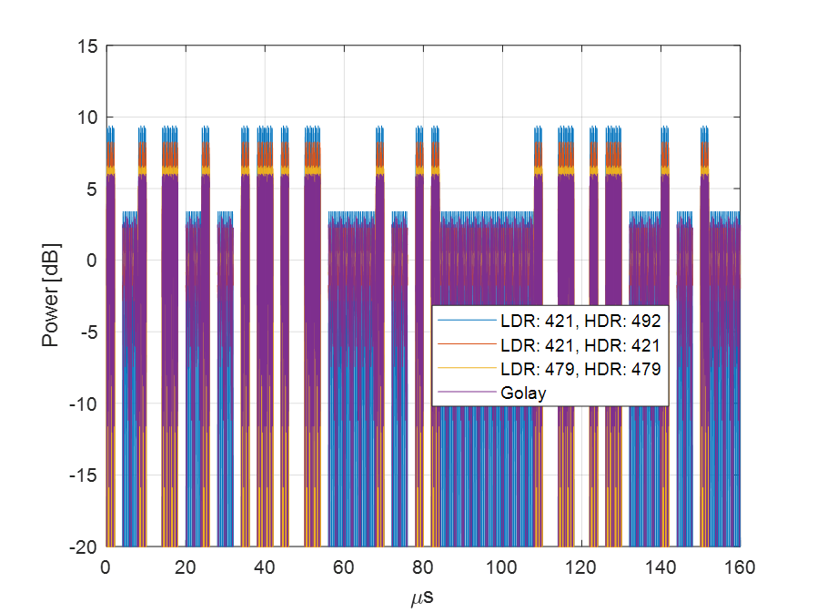
Numerical Analysis – Case 1
(2 HDRs)
HDR
HDR
x
x
Time domain signal:

Slide 13
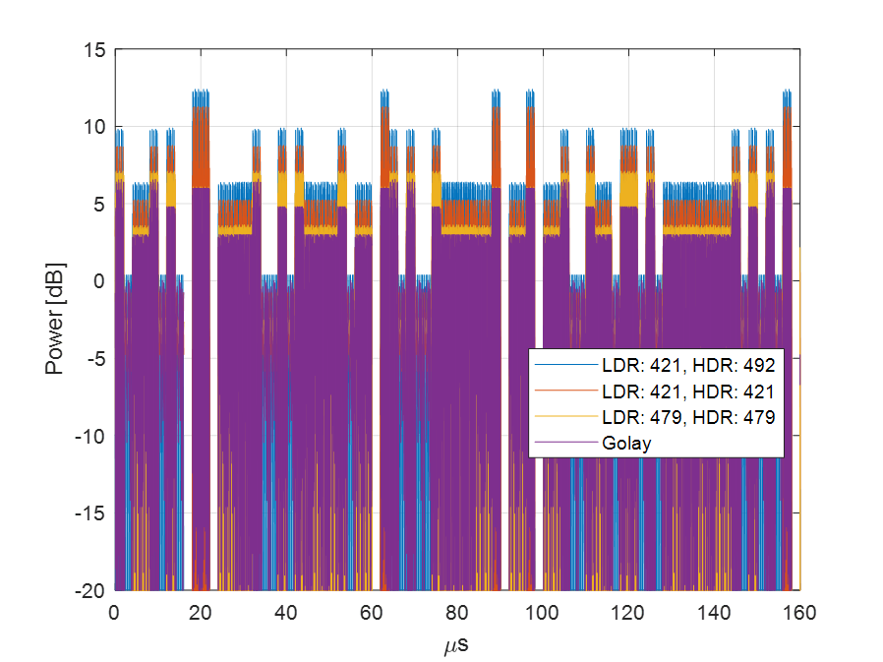
Numerical Analysis – Case 2
(4 HDRs)
HDR
HDR
HDR
HDR
Time domain signal:

Slide 14
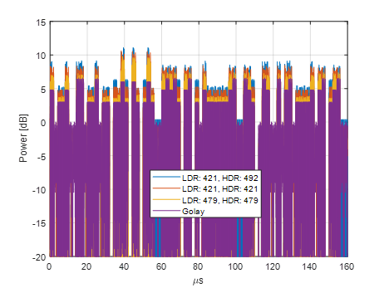
Numerical Analysis – Case 3
(2 HDRs, 2LDRs)
HDR
HDR
LDR
LDR
Time domain signal:

Slide 15
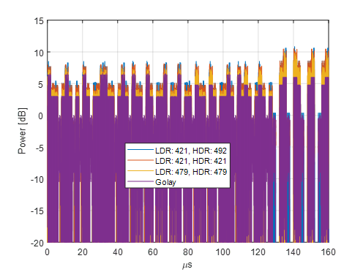
Numerical Analysis – Case 4
(1 HDR, 3 LDRs)
HDR
LDR
LDR
LDR
Time domain signal:

Slide 16
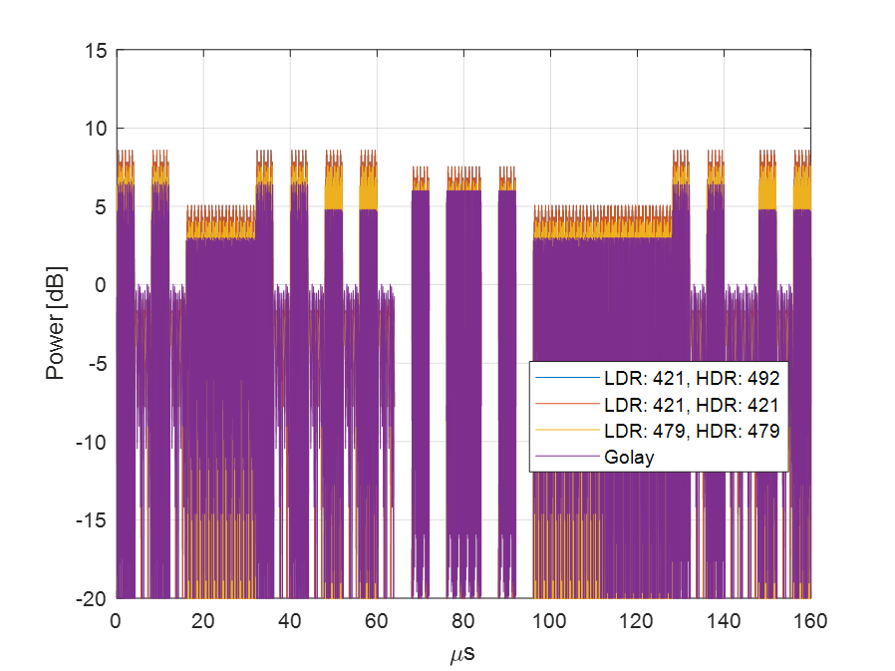
Numerical Analysis – Case 5
(4 LDRs)
LDR
LDR
LDR
LDR
Time domain signal:

Slide 17
Conclusion
The PAPR can be significantly large when WUSs are FDMed
  Without taking any precautions, it can reach 10-13 dB or higher, which limits the coverage range of 802.11ba in some regions
The PAPR minimization for FDMed WUSs is an intractable problem due to the large number cases possible in an FDM scenario
  The phase rotations in IEEE 802.11ac cannot address all cases and they are a function of the sequence
  A scalable solution is needed
Existing Golay sequences can address the PAPR issue as the corresponding signals are always bounded by 3 dB
  We show that the gain can reach more than 3 dB in some cases
  Golay sequences are publicly available
    Known since 1960s
    Heavily-used in 802.11ad/ay
    Used for PAPR minimization, coding, etc. in academic studies

Slide 18
Appendix

Slide 19
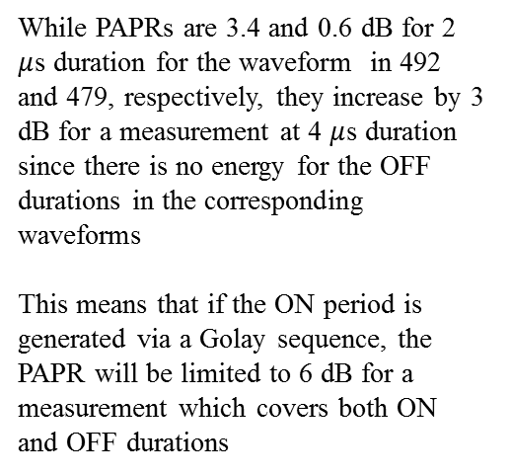
PAPR
6.4 dB [1]
3.6 dB [2]
Mean power
While PAPRs are 3.4 and 0.6 dB for 2 $μ$s duration for the waveform in 492 and 479, respectively, they increase by 3 dB for a measurement at 4 $μ$s duration since there is no energy for the OFF durations in the corresponding waveforms
This means that if the ON period is generated via a Golay sequence, the PAPR will be limited to 6 dB for a measurement which covers both ON and OFF durations
[1]: IEEE 802.11-18/0492r0
[2]: IEEE 802.11-18/0479r2

