Slide 1
Some Use Cases for Broadcast Services over WLAN
Date: 2018-03-08
Authors:

Slide 2
Abstract
This submission discusses some use cases of broadcast services over WLAN.

Slide 3
Broadcast Service
Broadcast:
One of the best ways to utilize characteristics of wireless media!
Efficiently provide information to many people simultaneously!
However
Currently, broadcast function of WLAN is mainly used for distributing management information such as Beacon and Probe Request/Response.
Why don’t we use this nice feature to distribute general information?

Slide 4
How can we utilize broadcast function over WLAN?
Possible broadcast services:
Distribution of local/area specific information
Floor information of a shopping mall
Menu in a restaurant
Flight information at an airport
Traffic information for vehicles
Emergency Services
Weather information
Earthquake, etc

Slide 5
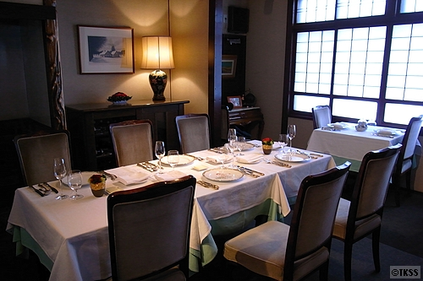
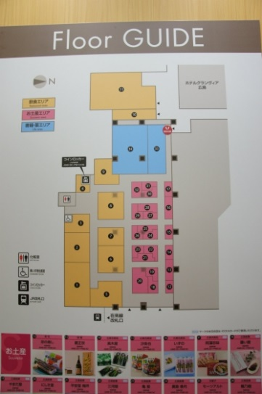
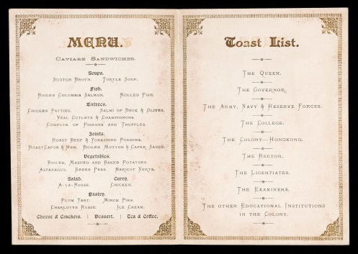
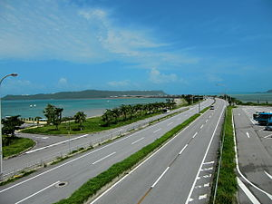
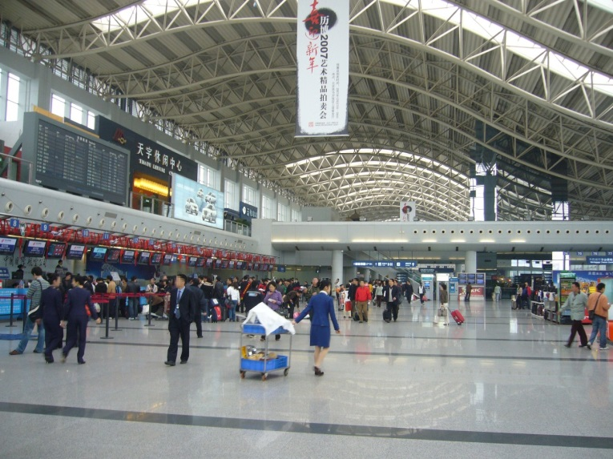
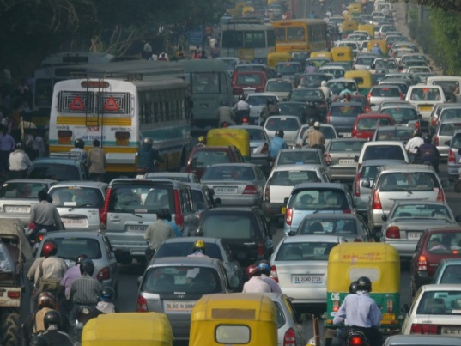
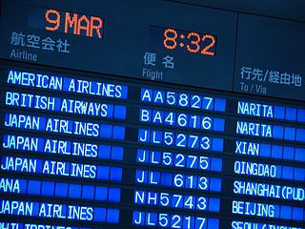
Examples of use cases – Local/Area specific information
Floor Guide
Traffic Information
Flight Information

Slide 6
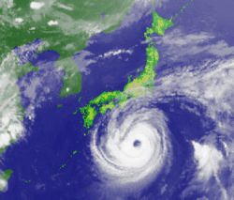
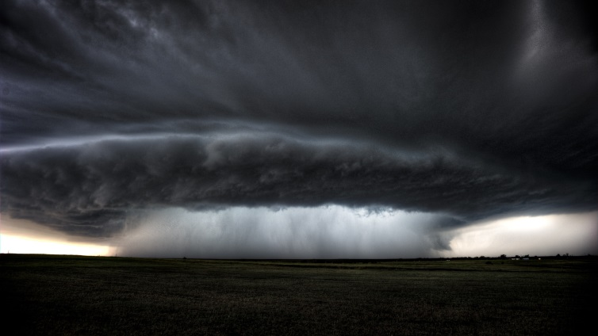
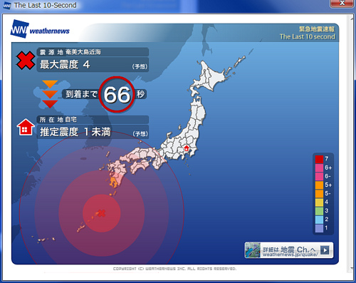
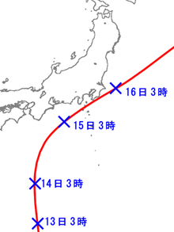
Examples of use cases – Emergency Information

Slide 7
Thoughts on Broadcast Services over WLAN
Some discussion items:
It will be good if information can be provided not only to the associated STAs but also to the unassociated STAs.
For the STAs, it is indispensable to have means to confirm the validity of the information source.
Management of the bandwidth used for broadcast services will be necessary.

Slide 8
Conclusion
There will be many use cases of the broadcast services over WLAN which will be useful to derive the technical requirements.
Open issues:
Security
Reliability
Power consumption, etc.
Let’s continue discussions of use cases, requirements to have better image of the broadcast services over WLAN in the study group.
Let’s demonstrate this feature in Tokyo Olympics/Paralympics games in 2020!

Slide 9
References
[1] Hitoshi Morioka, “Broadcast Service on WLAN,” 11-17-1736-04-0wng

