Slide 1
Modulation schemes for optical wireless communications
Date: 2018-03-08
Authors:

Slide 2
Abstract
In this document we first introduce the basic principle of optical wireless communication (OWC), then differences between radio frequency communications and LED based OWCs are listed, next we present the principle of some popular modulation schemes in OWC systems.

Slide 3
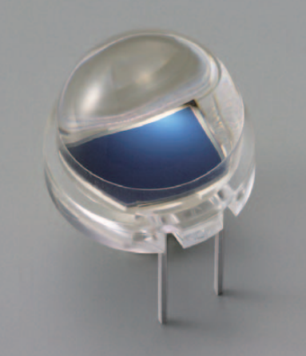
Basic principle of OWC
Input Current
Radiant Power
LED
380
780
λ (nm)
Photodetector
≈1000×λ
Spectral sensitivity
Photocurrent
350
1100
λ (nm)

Slide 4
Intensity-Modulation Direct-Detection
(IM-DD)
Background
  LED - Incoherent light
  PD - Wideband reception (e.g., 200 - 1100 nm), optical power (Watt) to photocurrent (ampere) converter
What is IM-DD?
  IM is a form of modulation scheme in which the optical power output of a source is varied in accordance with some characteristic of the modulating signal.
  DD means that demodulation is achieved through direct detection of the optical power and conversion using a photo-detector.

Slide 5
RF vs. LED-based OWC
 | RF | LED-based OWC
Carrier | Radio wave (e.g., < 3THz) | Optical wave (e.g., visible, infrared light)
Modulation category | Band-pass modulation | Baseband modulation
Signal propagation | Line-of-Sight (LOS) and Non-LOS (NLOS) | Mainly LOS
Data density /frequency re-use | Co-channel interference high density deployment may not lead to linearly increased data capacity | Interference is bounded and hence frequency reuse efficiency is higher
Operation method | Coherent detection | IM/DD
Signal space | Complex signal | Real signal
Signal polar | Bipolar | Unipolar (non-negative)

Slide 6
Modulation schemes
Pulse based modulation schemes
  On-Off Keying (OOK)
  Pulse-Amplitude Modulation (PAM)
  Pulse-Position Modulation (PPM)
Multi-carrier modulation schemes
  Direct Current-biased Optical Orthogonal Frequency Division Multiplexing (DCO-OFDM)
  Asymmetrically Clipped Optical Orthogonal Frequency Division Multiplexing (ACO-OFDM)

Slide 7
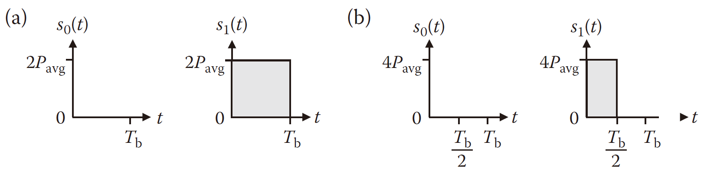
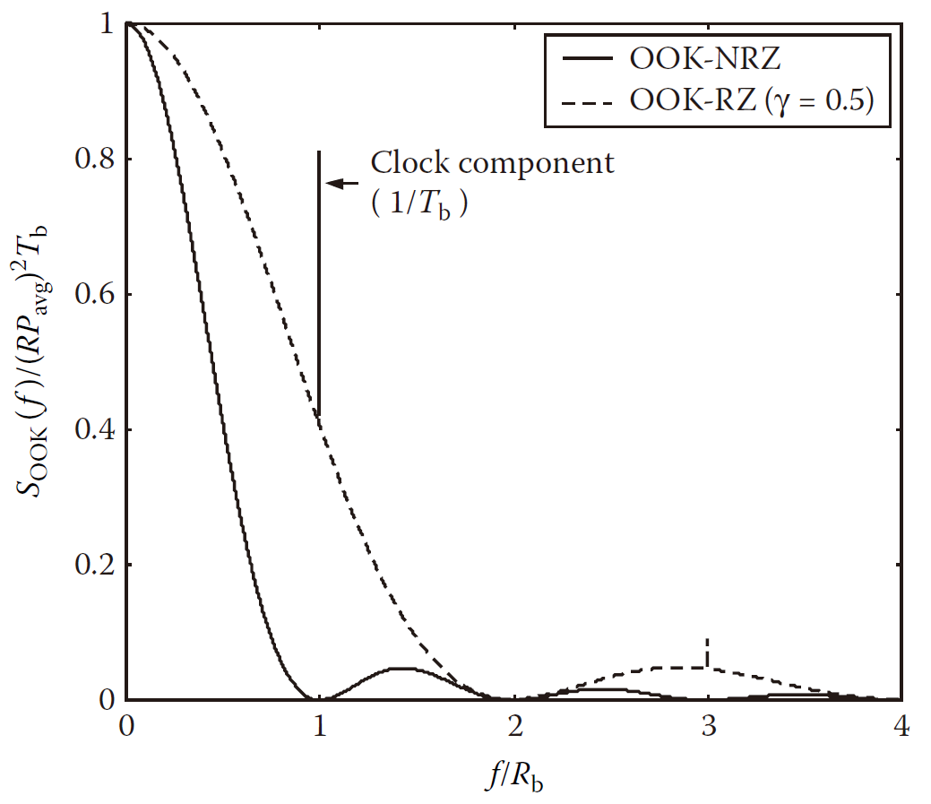
Pulse based modulation schemes
--On-Off Keying (OOK)
Time domain waveform
Power spectral density curve

Slide 8
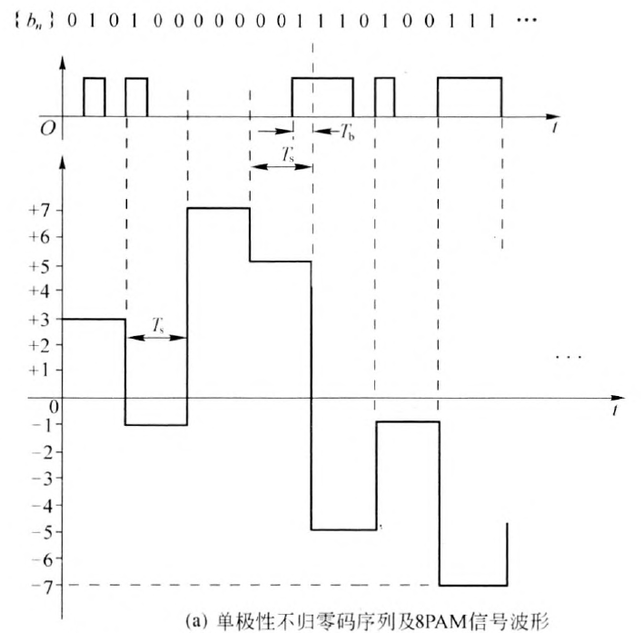
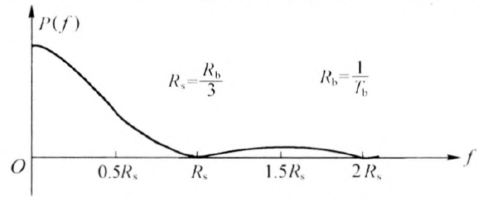
March 2018
Pulse based modulation schemes
--Pulse-Amplitude Modulation (PAM)
Definition
  Message information is encoded in the amplitude of a series of signal pulse.
Time domain waveform
Power spectral density curve
OOK | 8-PAM (AC)
000 | -7
001 | -5
010 | -3
011 | -1
100 | 1
101 | 3
110 | 5
111 | 7

Slide 9
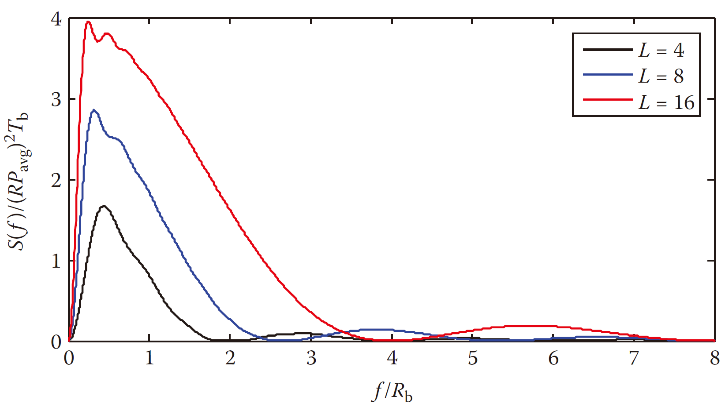
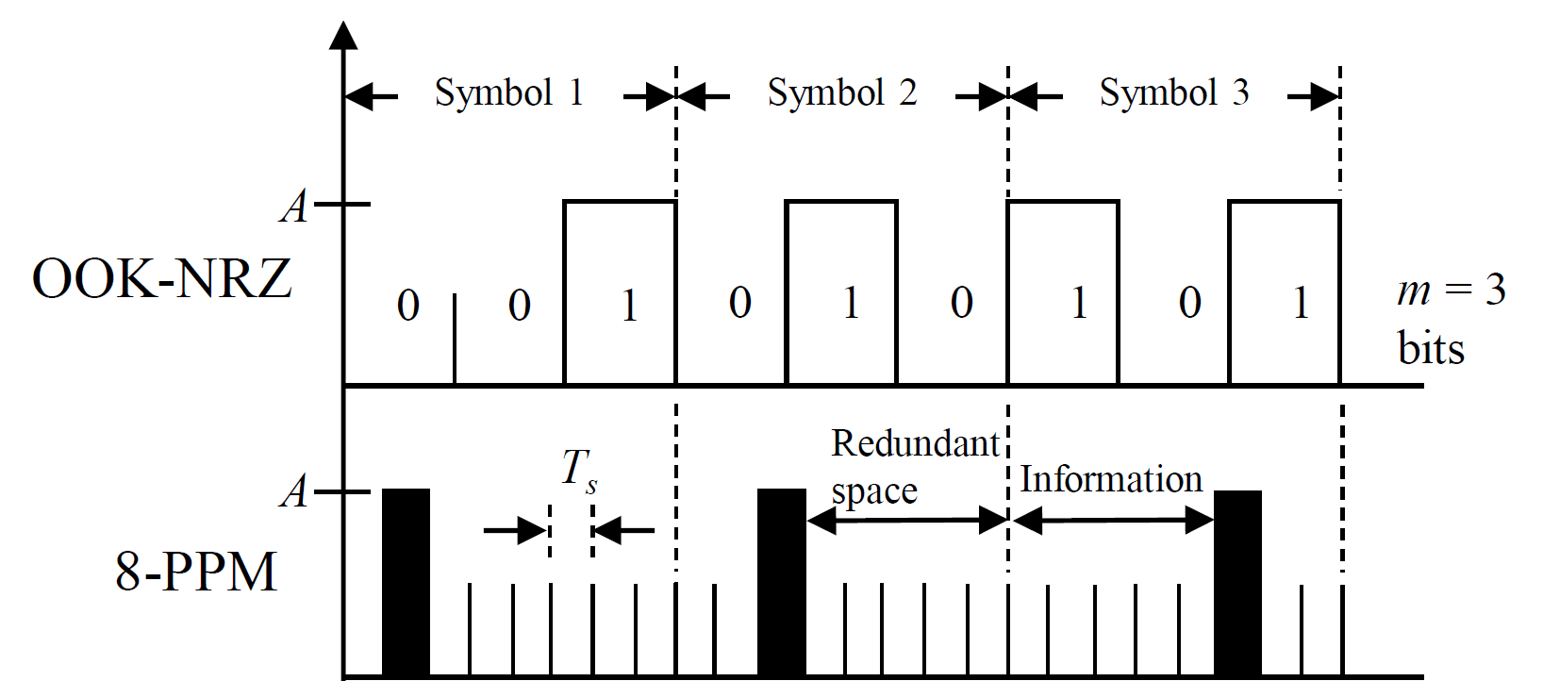
Pulse based modulation schemes
--Pulse-Position Modulation (PPM)
Definition
  m message bits are encoded by transmitting a single pulse in one of 2^{m} possible required time shifts.
Time domain waveform (8-PPM)
Power spectral density curve
OOK | 8-PPM
000 | 10000000
001 | 01000000
010 | 00100000
011 | 00010000
100 | 00001000
101 | 00000100
110 | 00000010
111 | 00000001

Slide 10
Multi-carrier modulation schemes
--OFDM
 | RF | OWC
Signal polar | Bipolar | Unipolar
Signal space | Complex signal | Real signal
Reception method | Coherent Reception | Direct Detection

Slide 11
Multi-carrier modulation schemes
--OFDM

Slide 12
Multi-carrier modulation schemes
--Direct Current-biased Optical-OFDM
Hermitian symmetry
IFFT
Add a bias

Slide 13
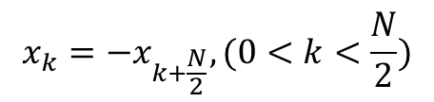


Multi-carrier modulation schemes
--Asymmetrically Clipped Optical-OFDM
$$x_{k}={−x}_{k+N/2},(0<k<N/2)$$
$$x_{k}={−x}_{k+N/2},(0<k<N/2)$$
DCO-OFDM | ACO-OFDM
IFFT
$$x_{k}={−x}_{k+\frac{N}{2}},(0<k<\frac{N}{2})$$
clipping

Slide 14
Multi-carrier modulation schemes
--ACO-OFDM
ACO-OFDM
FFT
X_{m}= 0
m:even integer

Slide 15
Summary
The basic principle of OWC
Differences between RF and OWC
Popular modulation schemes
  Pulse based modulation schemes
  Multi carrier based modulation schemes

Slide 16
References
[1] J. M. Kahn and J. R. Barry, "Wireless infrared communications," Proceedings of the IEEE, vol. 85, no. Compendex, pp. 265-298, 1997.
[2] pureVLC, "Differences Between Radio & Visible Light Communications A technical guide," 2012.
[3] RF Wireless World. (2018). VLC vs Wifi | Difference between VLC and Wifi. Available: http://www.rfwireless-world.com/Terminology/Difference-between-VLC-vs-Wifi.html
[4] P. Gopal, V. K. Jain, and S. Kar, "Modulation techniques used in earth-to-satellite and inter-satellite free space optical links," in SPIE Security + Defence, 2014, vol. 9248, p. 10: SPIE.
[5] S. D. Dissanayake and J. Armstrong, "Comparison of ACO-OFDM, DCO-OFDM and ADO-OFDM in IM/DD Systems," Lightwave Technology, Journal of, vol. 31, no. 7, pp. 1063-1072, 2013.
[6] J. Armstrong and A. J. Lowery, "Power efficient optical OFDM," Electronics Letters, vol. 42, no. 6, pp. 370-372, 2006.
[7] Z. Ghassemlooy, W. Popoola, and S. Rajbhandari, Optical wireless communications: system and channel modelling with Matlab®. CRC Press, 2012.
[8] R. Meslehz, H. Elgalaz, and H. Haas, "An overview of indoor OFDM/DMT optical wireless communication systems," in CSNDSP, 2010, pp. 566-570: IEEE Computer Society.
[9] Z. Zhan, M. Zhang, D. Han, P. Luo, X. Tang et al., "1.2 Gbps non-imaging MIMO-OFDM scheme based VLC over indoor lighting LED arrangments," in OECC, 2015, pp. 1-3.
[10] Y. Yuan, M. Zhang, P. Luo, Z. Ghassemlooy, D. Wang et al., "SVM detection for superposed pulse amplitude modulation in visible light communications," in CSNDSP, 2016, pp. 1-5.
[11] Y. Yuan, M. Zhang, P. Luo, Z. Ghassemlooy, L. Lang et al., "SVM-based detection in visible light communications," Optik - International Journal for Light and Electron Optics, vol. 151, pp. 55-64, 12// 2017.

