Slide 1
Existence Indication of Attacker or Jammer in LMR
Date: 2018-03-06

Slide 2
Introduction
In 11az PHY security mode, methods are proposed for interference detection
  The repeated LTF symbols for consistency check
  Energy detector for detecting replay attacker
Attacker or jammer significantly degrade the ToA estimation accuracy, and the polluted ToA estimations should be discarded. For security protection, the wireless ranging may be disabled.
When initiator or responder detects the attacker or jammer, it’s necessary for the other side to be notified, such that both sides can behave properly.
In this submission, we propose to define a parameter field in the LMR frame to indicate the existence of the attacker or jammer.

Slide 3
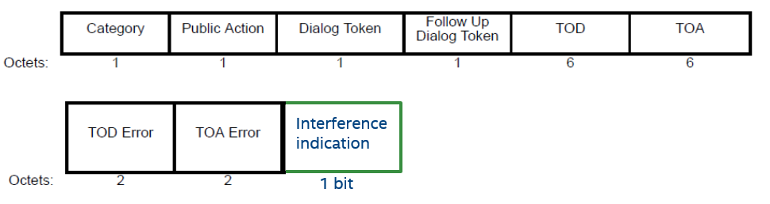
Definition of the New Indication Field in LMR
Option 1: Add a new information field in the LMR
Option 2: Use reserved bits in the ToA error field
      The Bit B5 can be used for interference indication
      Only valid for the security mode

Slide 4
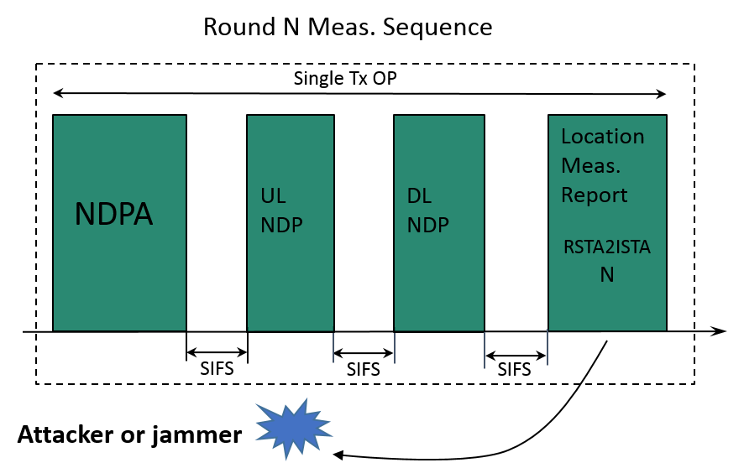
Usage Example for Immediate LMR
When attacker or jammer is detected, the responder sets the existence indication field in the immediate LMR to notify the initiator.
Similar rule applied to bidirectional LMR and MU measurement sequence.

Slide 5
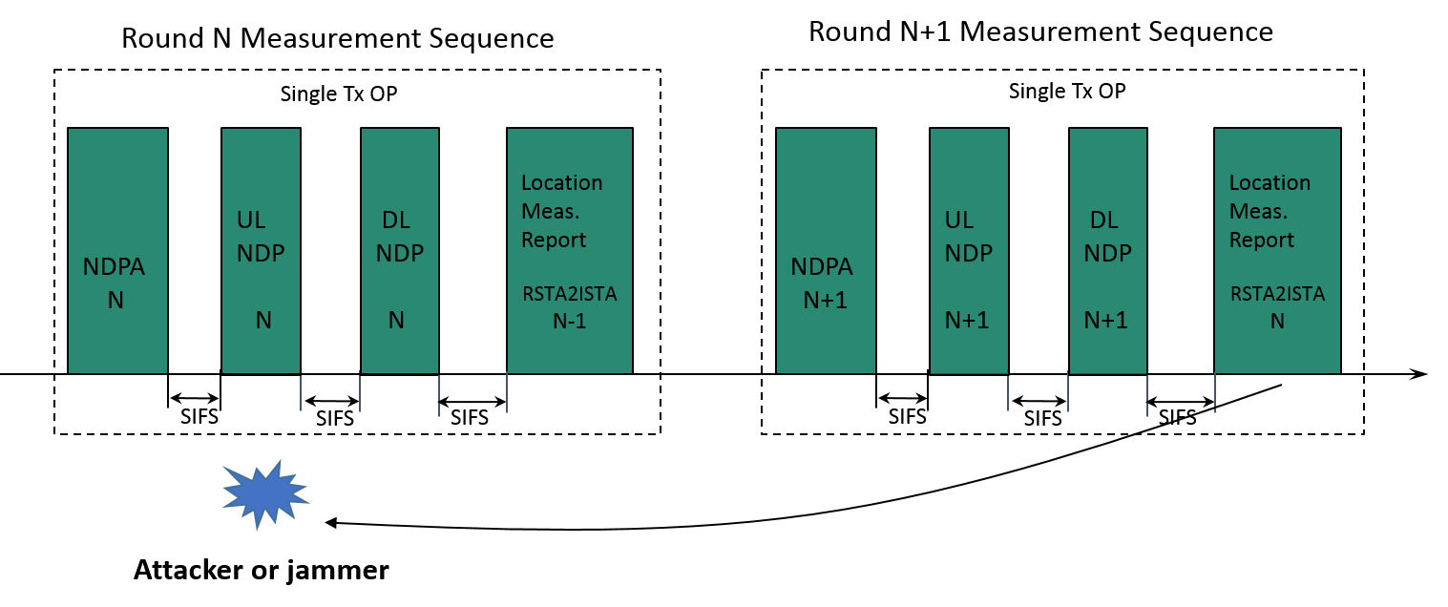
Usage Example for Delayed LMR
For delayed LMR, if attacker or jammer is detected, the responder will set the existence indication of attacker or jammer for the previous round measurement.
Similar rule applied to bidirectional LMR and MU measurement sequence.

Slide 6
80+80 and 160MHz Bandwidths
Support of 80+80 and 160MHz bandwidths
  Optional feature in11ax and 11ac
  CBW160 or CBW80+80 may be generated using two separate RF LOs
  VHT- or HE-LTF sequence is only defined for 80MHz band
    Upper and lower 80MHz bands use the same LTF sequence (11ac)
    Or with sign flip for some segments of the sequence (11ax)
  The upper and lower 80MHz bands can be processed separately in digital domain

Slide 7
80+80 and 160MHz Bandwidths in 11az
11az uses random HEz-LTF sequence for security protection
  Option 1: Using different random HEz-LTF sequence for upper and lower 80MHz bands provides more security protection
    More difficult for attacker to guess both of LTF sequences correctly
    SAC code indicates LTF for upper and lower 80MHz band separately
  Option 2: Using same HEz-LTF sequence for upper and lower 80MHz bands
    Aligns with legacy design
    Simplify the SAC code design and implementation
    Same security protection level as single 80MHz band
    A sign flip may be applied to the LTF sequences on upper and lower 80MHz segments for PAPR reduction

Slide 8
LMR for 80+80 and 160MHz Bandwidths
Diversity gain across upper and lower 80MHz segments
  If measurement in one 80MHz segment is invalid, the measurement on the other 80MHz segment can still be used for RTT calculation
  If measurements on both 80MHz bands are valid, the RTT results can be averaged for improving accuracy
To exploit the diversity gain, for 80+80 and 160MHz bands
  LMR includes single ToA and ToD field for both 80MHz segments
  The ToD on the upper and lower 80MHz segments should be the same
  Invalid bit indicates whether the ToA and ToD are valid or not

Slide 9
Straw Poll #1
For secured ranging on 80+80 and 160MHz bandwidths, do you support
  Using same LTF sequence for upper and lower 80MHz segments
Y: N: Abstain :

Slide 10
Motion #1
For secured ranging on 80+80 and 160MHz bandwidths, we agree
  Using same LTF sequence for upper and lower 80MHz segments
Y: N: Abstain :

