Slide 1
CTS_DTS Control Trailer for SU-MIMO Channel Access
Date: 2018-03-03
Authors:

Slide 2
Introduction
The current specification for the RTS/CTS method for SU-MIMO channel access (10.36.11.4.3 SU-MIMO channel access procedure), allows the recipient EDMG STA to set up an SU-MIMO configuration with the DMG CTS field using a control trailer.
However, the current CTS_DTS control trailer does not support signaling the configuration needed to the transmitter.
We highlight the problem and discuss a suitable solution.

Slide 3
Current Specification
If an EDMG STA that receives an RTS frame with a control trailer indicating a SU-MIMO transmission or hybrid beamforming to itself is able to perform the SU-MIMO receiving, it shall configure its DMG antennas according to the settings included in the control trailer of the received RTS frame.
It shall also transmit a DMG CTS frame with a control trailer in response of the received RTS frame. For this transmitted DMG CTS frame, the TXVECTOR parameter SCRAMBLER_INIT_SETTING shall be set to CONTROL_TRAILER and the parameter CT_TYPE shall be set to CTS_DTS.
If it uses SU-MIMO for the transmission in the reverse direction, the SISO/MIMO field shall be set to 1 and the SU/MU MIMO field shall be set to 0. The DMG CTS frame should be transmitted using all SU-MIMO sectors, with a small delay between each sector. The control trailer also indicates the corresponding DMG antenna configuration for the upcoming SU-MIMO transmission in the reverse direction.

Slide 4
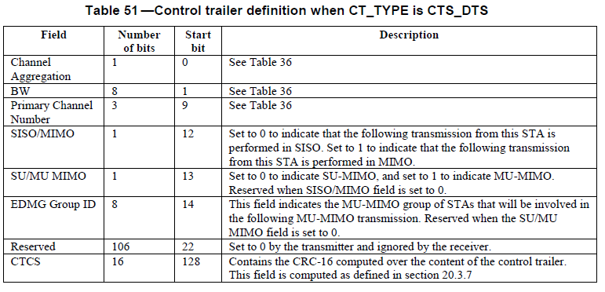
Current CT_Type is CTS_DTS

Slide 5
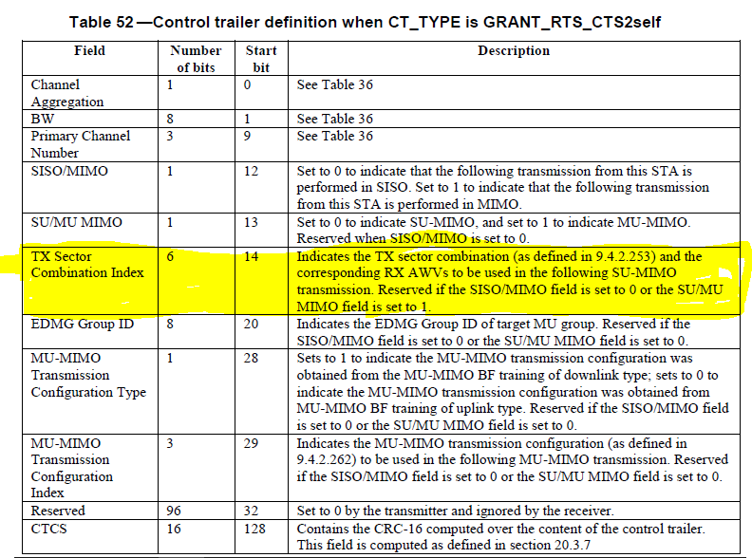
CT_Type is GRANT_RTS_CTS2Self

Slide 6
Updated CTS_DTS CT Field
“The control trailer also indicates the corresponding DMG antenna configuration for the upcoming SU-MIMO transmission in the reverse direction” : The current CT for CTS_DTS does not contain any configuration information.
Solution: Add field similar to “TX Sector Combination Index” found in the GRANT_RTS_CTS2Self control trailer to the CTS_DTS control trailer

Slide 7
Additional Issues
“If it uses SU-MIMO for the transmission in the reverse direction”: Use of the term “Reverse Direction” may be problematic e.g. may be confused with “Reverse Direction Protocol”
Change reverse direction as the OPPOSITE direction and define this explicitly
“If it uses SU-MIMO for the transmission in the reverse opposite direction, i.e. from the EDMG STA that received the Grant frame to the EDMG STA that transmitted the Grant frame,”
“If it uses SU-MIMO for the transmission in the reverse opposite direction, i.e. from the EDMG STA that received the RTS frame to the EDMG STA that transmitted the RTS frame,

Slide 8
Conclusion
In this contribution, we have discussed some issues with the current RTS CTS procedure in 10.36.11.4.3 (SU-MIMO channel access procedure) in D1.0 and presented a solution.
We have also presented a modification to the term reverse direction due to a possible confusion with the Reverse Direction Protocol.

Slide 9
References
IEEE P802.11ay™/D1.0

Slide 10
Straw Poll 1
Do you agree to the following?
Do you agree to the Draft Text in 11-18/0502r0
Y/N/A

