Slide 1
Home use case addition proposal
Date: 2018-03-08
Name | Affiliation | Address | Phone | Email
Kazuyuki Sakoda | Sony | 1730 N. First Street, San Jose CA 95112 | +1-408-352-4405 | kazuyuki.sakoda(at)sony.com
Mohamed Abouelseoud | Sony | 1730 N. First Street, San Jose CA 95112 | +1-408-352-4027 | Mohamed.Abouelseoud(at)sony.com

Slide 2
Agenda
Motivation
Recap on consumer device use cases
Proposed addition to the 802.11ay use case document

Slide 3
Motivation
11-18/194r1 (distribution network use case for consumer devices) introduces additional considerations for home use case
11-15/625r7 (802.11 TGay usage scenarios) summarizes comprehensive potential use cases of 802.11ay.
It might be useful to complement 11-15/625r7 with additional considerations in 11-18/194r1.
This presentation includes proposal to the addition to 11-15/625r7

Slide 4
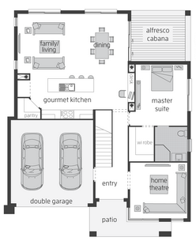
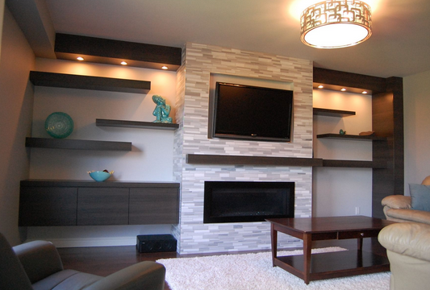
Recap on consumer device use cases from 11-18/194r1
Use case | Application | Venue | Range | Bandwidth | Latency
UHD transfer | Video streaming | Indoor | 5-10m (~20m) | >Gbps | <5msec
VR headset | Video streaming | Indoor | 5-10m (~20m) | >Gbps | <5msec
Camera video transfer | Video streaming | Indoor/ outdoor | 10-50m | <Gpbs | <20msec
Source
(STB)
Sink
(Display)
Sink
(Display)
Source
(Console)
Sink
(Headset)
Blockers
move

Slide 5
Key attribute
Highlights from
11-18/194

Slide 6
Usage Model 2: 8K UHD Wireless Transfer at Smart Home
Pre-Conditions:
11ay is interfaced between a source device (e.g. set-top box, blu-ray player, tablet, smart phone) and a sink device (e.g. smart TV, thin display) to stream 8K UHD contents at home.
Environment:
Devices are operating in close proximity at home. Typical distance between devices are < 5m.
When it comes to the link between a set-top box and a thin display (or smart TV), the set-top box can be inside a table which may provide some SNR loss.
Source device and sink device might be located at places where LOS signal cannot reach
Source device and sink device might be located at far side of the room and the link may experience human blockage
Some users may try to install source device and sink device to different rooms
Application:
At least 28 Gbps data rate is required for a link to stream uncompressed 8K UHD streaming (60 frames per second, 24 bits per pixel, 4:2:2 Chroma sampling at minimum).
Jitter <5ms, delay<5ms.
Traffic Conditions
Only a single link may exist at a time.
There is typically minimum interference from other mm-wave links at home.
Traffic is mostly unidirectional.
Robustness is essential. Video streaming needs to be maintained continuously even when the link is obstructed or the D2D link between source device and sink device is weak due to lack of link budget
Use Case
Split TV: TV is on the wall as a thin display and set-top box works as a controller, wirelessly interfaced by 11ay to replace wired interfaces.
Smart display (Mirroring): Uncompressed 8K UHD streaming is through smart TV. 8K UHD video can be real-time transferred from Smartphone/tablet to smart TV. When user enters home, the video which the user is watching in his/her smart phone is seamlessly played in the smart TV.
Proposed addition
Capture from 11-15/625r7

Slide 7
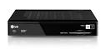
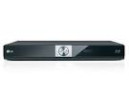
Usage Model 2: 8K UHD Wireless Transfer at Smart Home
Requirements
- Provides full rate >28 Gbps
- High QoS/QoE (latency < 5ms, jitter<5ms)
- P2P
Source
(STB)
Sink
(Display)
8K UHD
Service
Replacement
of wired interface
Set-top box
(TV controller)
Wireless Transfer
from fixed device
Blu-ray player
Source
(STB)
TV or Display
Wireless Transfer
from mobile device
Smart phone/Tablet
Sink
(Display)
Proposed addition
Sink
(Display)
Capture from 11-15/625r7

Slide 8
Usage Model 3: Augmented Reality/Virtual Reality Headsets and Other High-End Wearables
Pre-Conditions:
The high-end wearable (e.g. augmented reality/virtual reality headsets, high-def glasses, etc.) and its managing device (e.g. gaming console, smartphone, etc.) are equipped with 11ay interfaces and form a PBSS. All desired media content, processing power, and control needed by the high-end wearable resides on the managing device (i.e. internet connectivity not required).
Application:
User plays a game, watches a movie, etc. using his high-end wearable, which is communicating with the managing device (e.g. gaming console, smartphone). Both devices must be able to tolerate moderate user movement.
Data rate at ~20 Gbps, latency < 5 ms, jitter <5 ms, PER<10E-2.
Environment:
The high-end wearable may be used at home or in public.
At home, there are less than 4 interferers. In public (e.g. commuter train) there can be up to 120 interferers. Interferers have varying QoS requirements.
Transmissions (both desired signal and interference) can be LOS or NLOS. The D2D link between the high-end wearable and its managing device < 5 m.
Traffic Conditions:
The D2D link may be obstructed (i.e. NLOS) and there may be significant interference from other 11ay users (e.g. other wearables, access points, etc.).
Devices may be stationary or moving (pedestrian speed) while in use.
Robustness is essential. Video streaming needs to be maintained continuously even when the link is obstructed.
Use Case:
Public use case:
A passenger on a crowded commuter train is playing a game using his AR/VR headset and smartphone.
Some percentage of his fellow passengers are also playing a game using their AR/VR headsets and smartphones.
All passengers are semi-stationary, i.e. they shift and move in response to the game.
The QoS/QoE requirements of the gaming application are met.
Home use case:
User installed game console to a room and enjoy game with VR headsets. The link might experience human blockage. There might be multiple VR headsets in a room.
Capture from 11-15/625r7

Slide 9
Usage Model 3: Augmented Reality/Virtual Reality Headsets and Other High-End Wearables
High-end wearables can be used at home and in public
High-end wearable and its managing device may both be subject to low level movement
Operating environment is usually indoor < 5 m
AR/VR headsets touting close-to-reality user experience with 3D video and 7.1 audio
Video quality can support up to 3D 4K
Current products include Sony HMZ-T3 goggles and Oculus VR headsets
Features | Requirements | Notes
Distance | 5 m
Video Quality | 3D 4K [1] | HDMI 2.0
Range of Motion for head-worn wearable | Neck Roll [2] | 0.17 (s/60deg)
 | Neck Pitch[2] | 0.14(s/60deg)
 | Neck Yaw[2] | 0.13 (s/60deg)
Device mobility | Pedestrian speeds | < 4km/hr
No need to add here.
Capture from 11-15/625r7

Slide 10
Straw polls
Do you think it is beneficial to include additional consideration in slide 6-8 to IEEE 802.11-15/625r7 “IEEE 802.11 TGay Use Cases”?
Yes:
No:
Don’t care

Slide 11
References
[1] IEEE 802.11-15/625r7 “IEEE 802.11 TGay Use Cases”, Rob Sun, et.al.
[2] IEEE 802.11-18/194r0, “Distribution network use cases for consumer devices”, Kazuyuki Sakoda, et.al.

