Slide 1
WUR performance study with multiple TX antennas
Date: 2018-03-03
Authors:

Slide 2
Introduction
Studies so far looked at WUR performance with single Tx antenna
AP will Transmit with multiple antennas, to be compatible with legacy WLAN devices (Example: .11ax, .11ac)
How to best make use of multiple Tx antennas for the WUR transmission?
  Legacy preamble uses CSD for multi antenna transmission, with CSD of 200 ns for second Tx antenna (Table 19-9 in the Spec)
  Should we do CSD for WUR as well?
    What CSD values to use?
    Should the CSD be same for Legacy portion and WUR?

Slide 3
Impact of CSD on WUR performance
Not using any CSD can create undesired nulls at some of the STA locations
  The RF signals from the multiple antennas can add up destructively at the receiver, depending on the location of the receiver
Impact of CSD
  CSD can increase the delay spread of the effective channel.
    Might result in increased ISI
  CSD can create increased frequency selectivity of channel
    How much more frequency selectivity can we observe in 4 MHz bandwidth

Slide 4
WUR packet structure
24 µs
Legacy+WUR mark
Wake-up preamble
MAC header
Payload
FCS
Low Rate
S
S
128 µs
Higher Rate
S Complement
64 µs
S: 32 bit sequence, with bit duration of 2 usec

Slide 5
Implementation 1: WUR multi antenna transmission with delay
Tx1
WUR packet
H1
Delay
H2
Rx
Tx2
WUR packet
  Signal from second Tx antenna was delayed
  The overall Tx power was equally divided among the Tx antennas
  MISO channel with correlated small scale fading across the TX antennas
  The RF signal from Tx1 and Tx2 are combined at the Rx

Slide 6
Implementation 2: WUR multi antenna transmission with CSD per OFDM symbol
WUR Packet
OFDM Symbol 1
OFDM Symbol 2
--------
OFDM Symbol N
Tx1
H1
CSD
CSD
CSD
WUR Packet
OFDM Symbol 1
OFDM Symbol 2
--------
OFDM Symbol N
H2
Rx
Tx2
  For Tx2, the WUR packet is constructed by applying cyclic shift to each OFDM symbol in the STF/LTF/Preamble/Data fields
  The overall Tx power was equally divided among the Tx antennas
  MISO channel with correlated small scale fading across the TX antennas
  The RF signal from Tx1 and Tx2 are combined at the Rx

Slide 7
Receiver Processing
The RF signals from multiple Tx are combined at the Rx
The combined RF signal correlated with 32-bit sequence 2S-1, to determine rate and timing
  In theory, the preamble template used for sync detection needs to be modified for multiple Tx case, accounting for the delay
    But the Rx is not aware of the number of Tx antennas
  For two Tx case, the delay = 200ns = 0.8 sample (@ 4 MHz sampling).
    This does not seem significant enough?
OOK decoding based on the estimated timing

Slide 8
Simulation parameters
TX Parameters
  2 Transmit antennas, with CSD = 200 ns
  4 Transmit antennas, with CSD = [50 100 150] ns
  For low rate, we use 13 L-STF coefficients to generate 4 us OOK pulse
  For high rate, we use optimized 7 IFFT coefficients (with 32 pt. FFT approach) to generate 2 us OOK pulse [1]
RX Parameters
  4 MHz LPF (IIR) – generated using MATLAB
    Third order Butterworth filter
    Cutoff freq. = 2.5 MHz, Sampling freq. =160 MHz
  Processed both I and Q component of received signal
  Channels: AWGN and Channel D
  No phase noise and No ACI
  2.4 GHz band operation
  SNR is measured at 20 MHz bandwidth

Slide 9
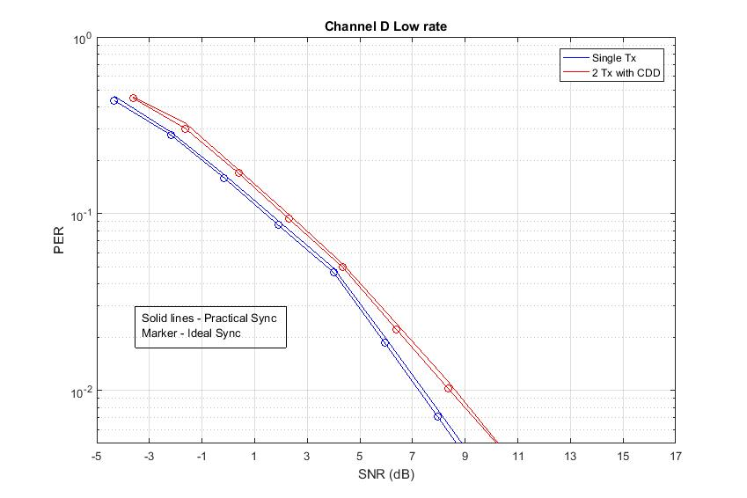
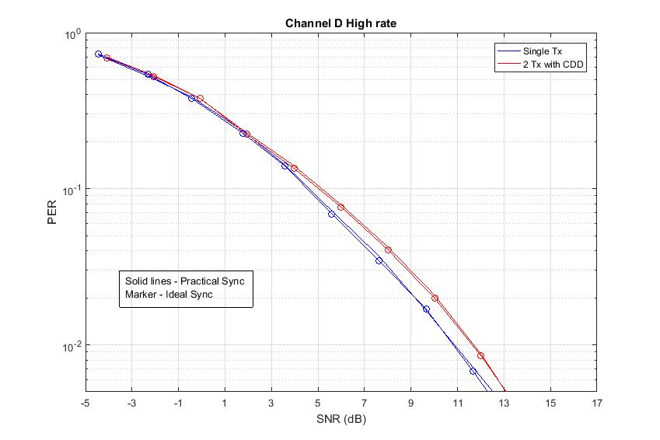
Performance in Channel D (Implementation 1)
200 ns CDD seems to degrade the WUR performance by 0.5 dB – 1 dB
  Interestingly, it is more noticeable for low rate case
  Performance degradation not because of timing, but due to OOK decoding
  Low rate: spilling of energy in OFF period due to CDD happens twice and hence more degradation

Slide 10
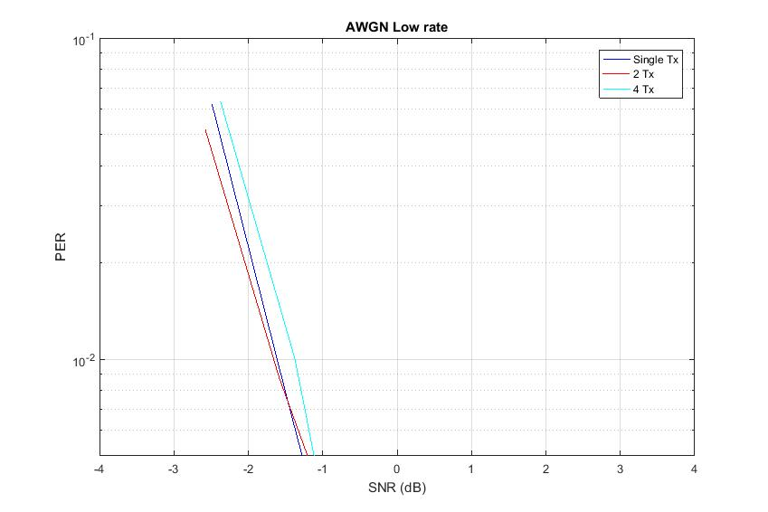
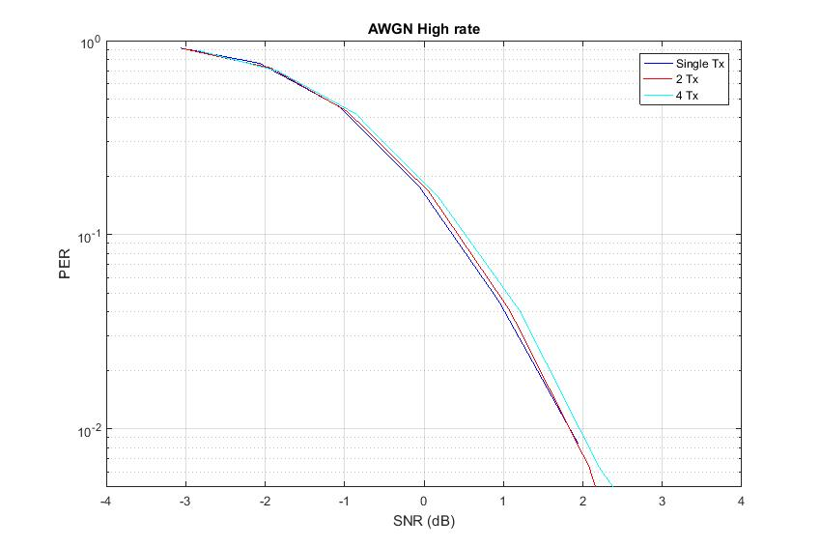
Performance in AWGN (Implementation 2)
Performance degradation of around 0.25 dB due to multi antenna transmission

Slide 11
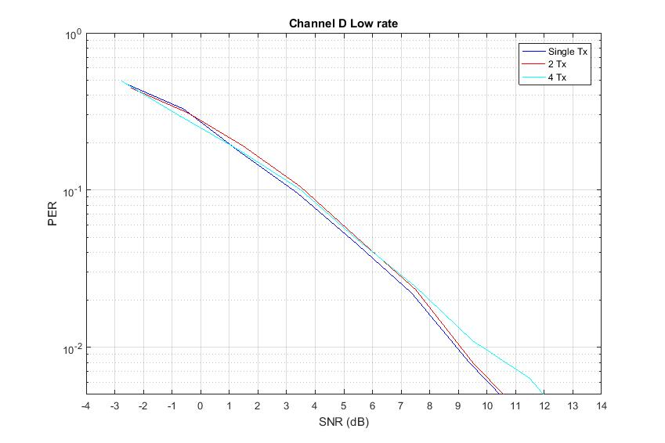
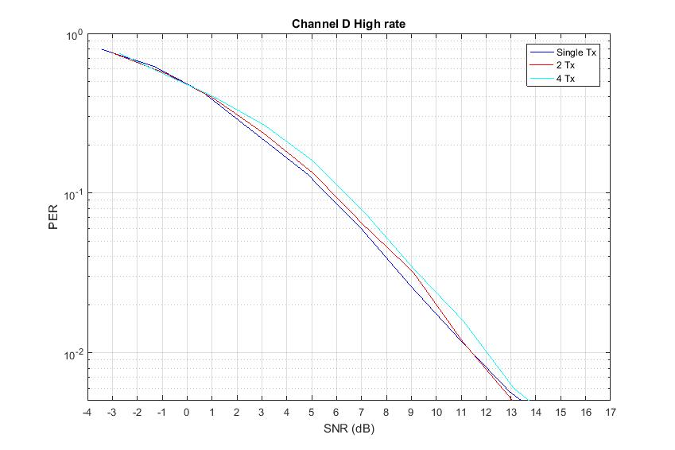
Performance in Channel D (Implementation 2)
Performance degradation of 0.4 dB (with 2 Tx) and 0.6 dB (with 4 Tx) due to multi antenna transmission
  Note that applying CSD is equivalent to transmitting a different 4 us/2 us OOK pulse on air.

Slide 12
Summary
Preliminary studies on impact of multiple antennas on WUR performance
Considered two implementations of multi antenna transmission
  Implementation 1: A Delay was applied to the whole packet
  Implementation 2: CSD was applied to each OFDM symbol in the packet
For implementation 1, the performance degraded by 0.5-1 dB with multi antenna transmission
  Due to spilling of energy into OFF period
For implementation 2, performance degradation of 0.4 dB and 0.2 dB were observed in Channel D and AWGN respectively
  Applying CSD is equivalent to transmission of different OOK pulse on the air.
  Pulse optimized for single TX antenna might not be the best for multi antenna case

Slide 13
References
[1] Vinod Kristem, Shahrnaz Azizi, Thomas Kenney, “2 us OOK pulse
for high rate, IEEE 802.11-18/97r0,” January 2018

Slide 14
Appendix

Slide 15
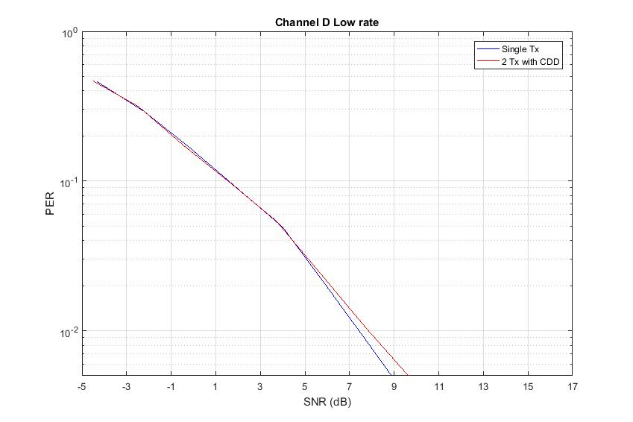
Performance in Channel D (Zero delay in Implementation 1)
With zero CDD values, the gap seems to be negligible.
  Not sure if the channel model can capture the spatial nulls as this requires random drops of STA locations?

