Slide 1
2 us OOK waveform generation
Date: 2018-03-03
Authors:

Slide 2
Introduction
Last IEEE meeting, we presented a contribution on 2 us OOK waveform generation [1]
We would like to run straw polls to collect IEEE TGba community opinion on this

Slide 3
2us OOK Pulse Design Options
Time-Masking approach
Generate 4us OOK pulse by populating center 13 subcarriers, with subcarrier spacing of 312.5 KHz.
Transmit either first or second half of the 4us pulse
32 pt. FFT based approach
Increase the subcarrier spacing to 625 KHz
32 pt. FFT in 20 MHz Bandwidth
WUR pulse occupying the center 7 subcarriers (including DC)

Slide 4
Comparison of time-masking and 32 pt. FFT
Did exhaustive search to find best pulse shape in terms of performance and PAPR
Study done for both time-masking and FFT based approaches
Identified the ‘optimal’ pulse shape for 32 pt. FFT approach that provides good tradeoff between PER performance and PAPR

Slide 5
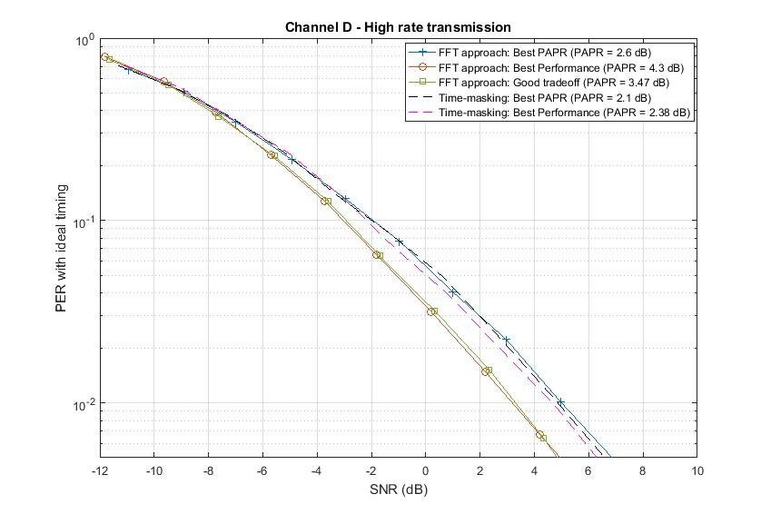
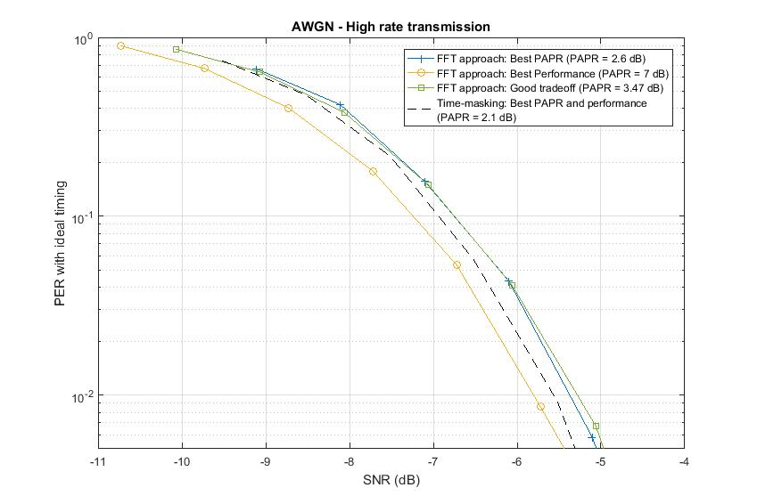
Performance comparison of time-masking and 32 pt. FFT
Performance comparison: best time-masking pulse vs optimum 32 pt. FFT based pulse
Channel D: Optimum FFT pulse is better by 1 dB @10% PER and 1.5 dB @1% PER
AWGN: best time-masking pulse is better by 0.2 dB @10% PER and 0.2 dB @1% PER
PAPR comparison: 32 pt. FFT pulse PAPR = 3.47 dB, best time-masking pulse PAPR = 2.38 dB
Slightly higher PAPR might not be an issue and the legacy LTF and SIG fields have higher PAPR

Slide 6
References
[1] Vinod Kristem, Shahrnaz Azizi, Thomas Kenney, “2 us OOK pulse
for high rate, IEEE 802.11-18/97r0,” January 2018

Slide 7
Straw Poll 1
Which of the following two options do you support for generating the 2 us OOK pulse for the high rate transmission
Option 1: Time-masking approach
Option 2: 32 pt. FFT Approach

Slide 8
Straw Poll 2
Do you support the use of following 7 IFFT coefficients for generating the 2 us OOK pulse with 32 pt. FFT approach?
S = (1+1j)*[0 0 0 … 0 1 1 -1 0 -1 -1 1 0 0 0 … 0]
Yes/No/Abstain:

