Slide 1
Field Measurement Results for Distribution Networks and Short Range Devices Coexistence
Date: 2018-03-08
Name | Affiliation | Address | Phone | Email
Sam Alex | Facebook | 1 Hacker Way Menlo Park, CA 94025 USA |  | sampalex@fb.com
Nabeel Ahmed |  |  |  | nabeel@fb.com
Payam Torab |  |  |  | ptorab@fb.com
Djordje Tujkovic |  |  |  | djordjet@fb.com
Michael Grigat | Deutsche Telekom | Deutsche-Telekom-Allee 7, 64372 Darmstadt, Germany |  | m.grigat@telekom.de
Nikolas Olaziregi | Nokia | Copernicuslaan 50, 2018 Antwerp, Belgium |  | Nikolas.Olaziregi@nokia.com

Slide 2
Outline
Motivation
Ray tracing simulation
Measurement scenarios and results
Comparison between measurements and simulations
Conclusion

Slide 3
Motivation
To study coexistence between 802.11ad based Short Range Devices (SRD) and distribution network for Fixed Wireless Access (FWA) [1]
Early simulations in [2] indicated that FWA system can coexist with indoor SRD devices
In this presentation we concentrate on
  Ray tracing simulation performance for impact of FWA on outdoor SRDs
  Real world measurement for both indoor and outdoor scenarios
  Comparison of simulations and measurements for both indoor and outdoor scenarios
Preliminary investigation shows that with transmit power control on FWA devices, coexistence between SRD and FWA is possible

Slide 4
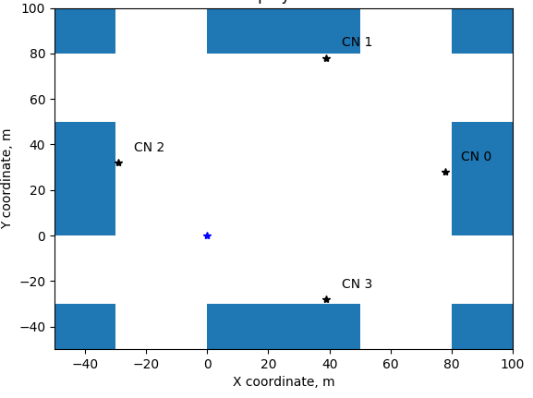
Ray tracing simulation: City square scenario
Question
  How does FWA deployment in a typical city square with lot of building reflections impacts performance of SRDs located outside
Ray tracing simulation is used to determine the received signal power level at each point within the city square
Distribution node (DN) and serving client nodes (CN) assumed to be 2m above the SRD location in this simulation
Simulation tools were calibrated between Intel and Facebook
  Results similar between the two companies
DN

Slide 5
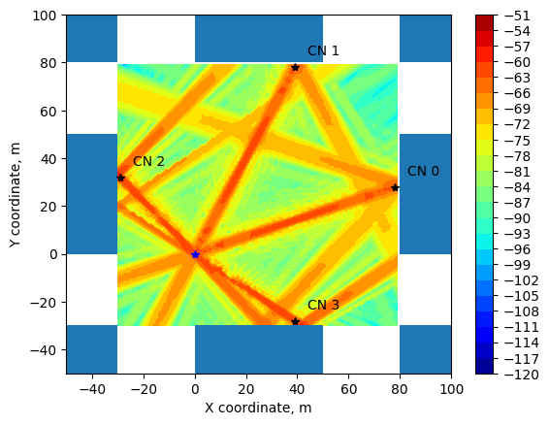
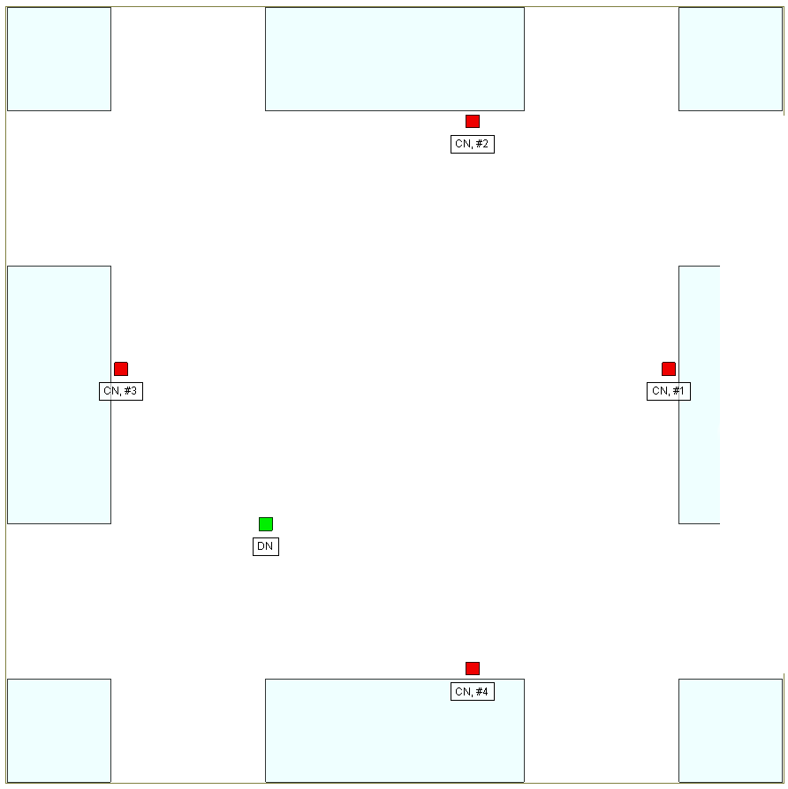
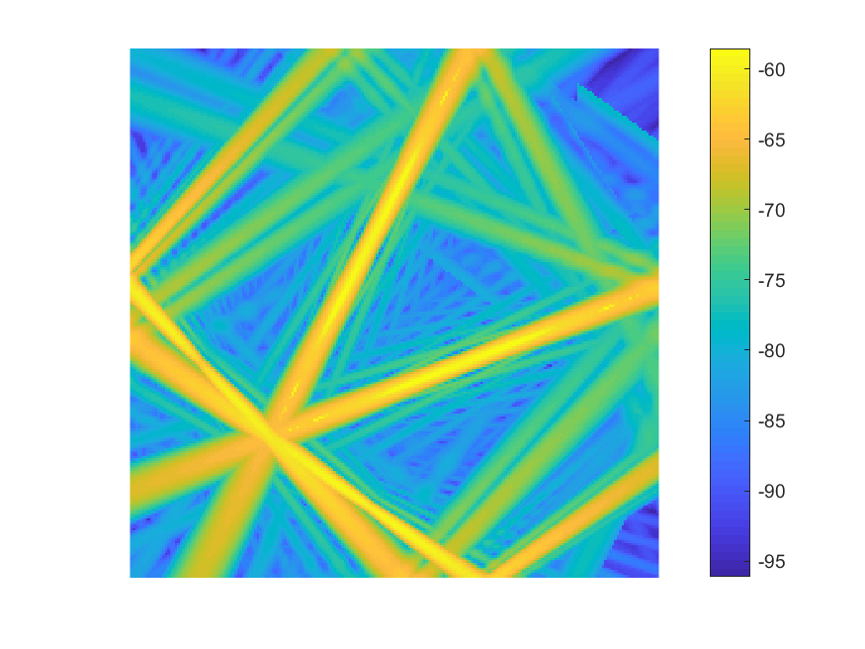
Signal Power of Received Signal
Power received (P_{RX} in dBm) by an Omni directional antenna (0dBi reference) on the SRD when FWAs transmit at maximum allowed EIRP (=40dBm) is shown below
Facebook simulation
Intel simulation
150m
150m

Slide 6
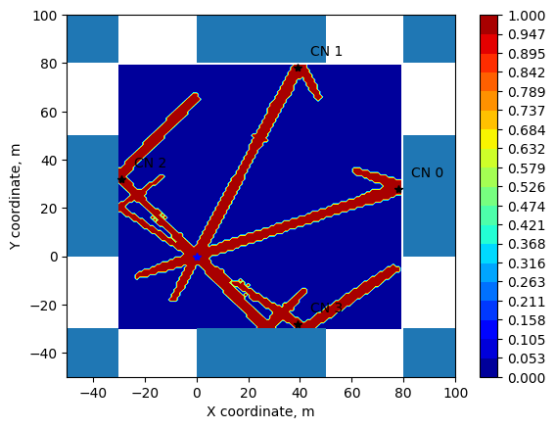
CCA trigger
When transmit power is not controlled on FWA nodes, the SRDs on the FWA link paths can have their CCA flag triggered, i.e. when P_{RX} exceed the CCA threshold of -68dBm
Roughly 10% of the areas will have CCA triggered assuming omni directional CCA
  Directional CCA towards the intended RX will reduce probability of blockage
Facebook
Intel

Slide 7
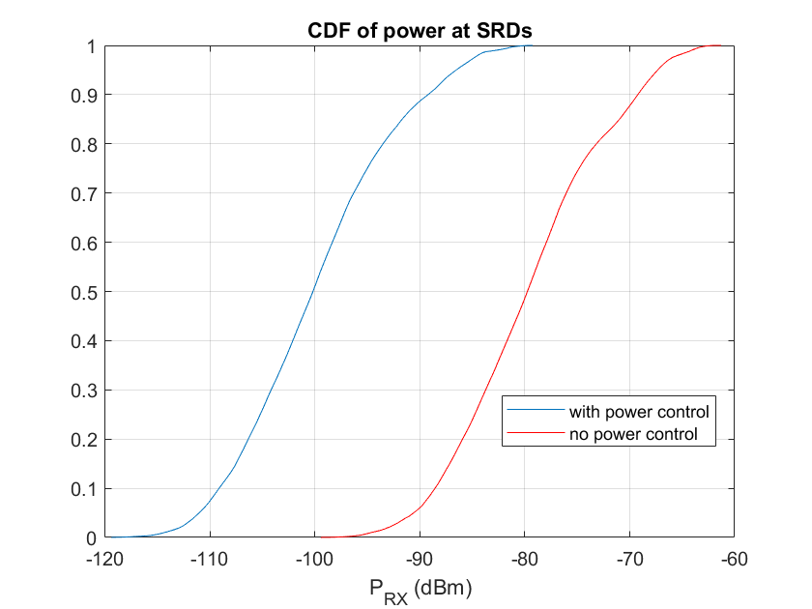
Transmit Power Controlled scenario
In the transmit power controlled scenario, DN and CN target SNR of 18dB (MCS12) at their respective receivers
Received power levels are well below CCA thresholds (-68dBm), i.e. no CCA triggering anywhere within the assumed city square
CCA_thresh

Slide 8
Field Measurement: Test cases
Standalone baseline reference
  FWA without external interference
  SRD devices without interference
Coex performance
  Impact of FWA to SRD with max Tx EIRP
  Impact of FWA to SRD with Tx power control
  Impact of SRD to FWA
  Coexistence on adjacent channel
Deployment scenario
  Outdoor Inline (Collinear links)
  Outdoor Perpendicular
  Outdoor to Indoor (SRD behind the window)
cochannel scenario

Slide 9
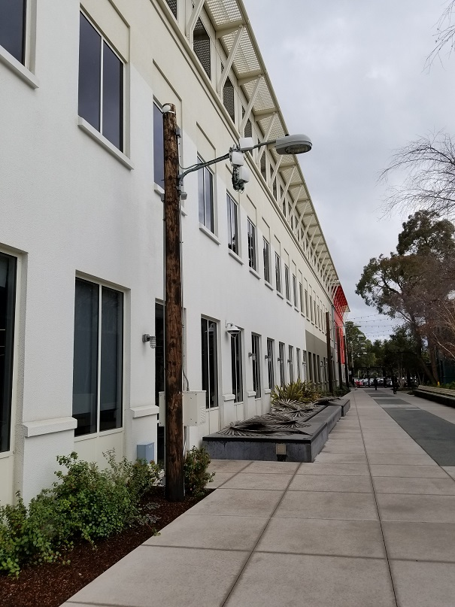
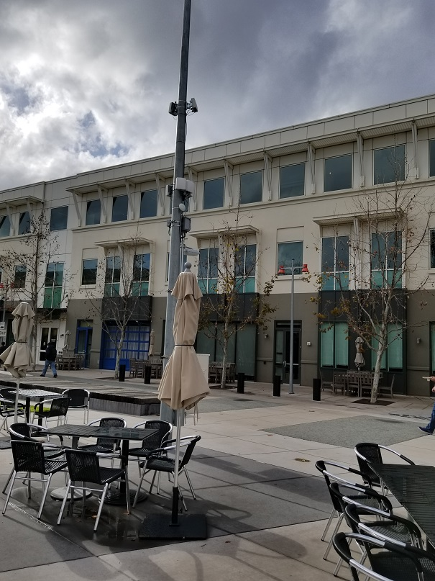
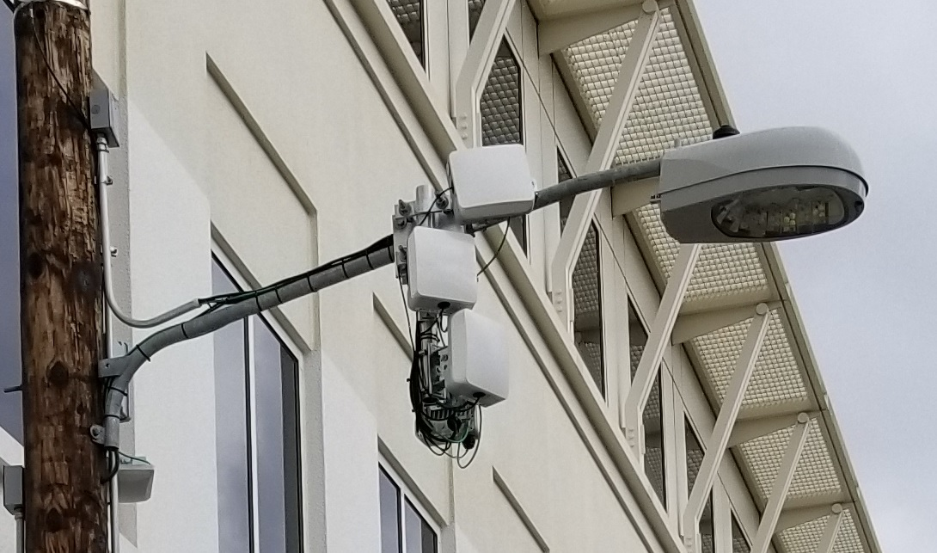
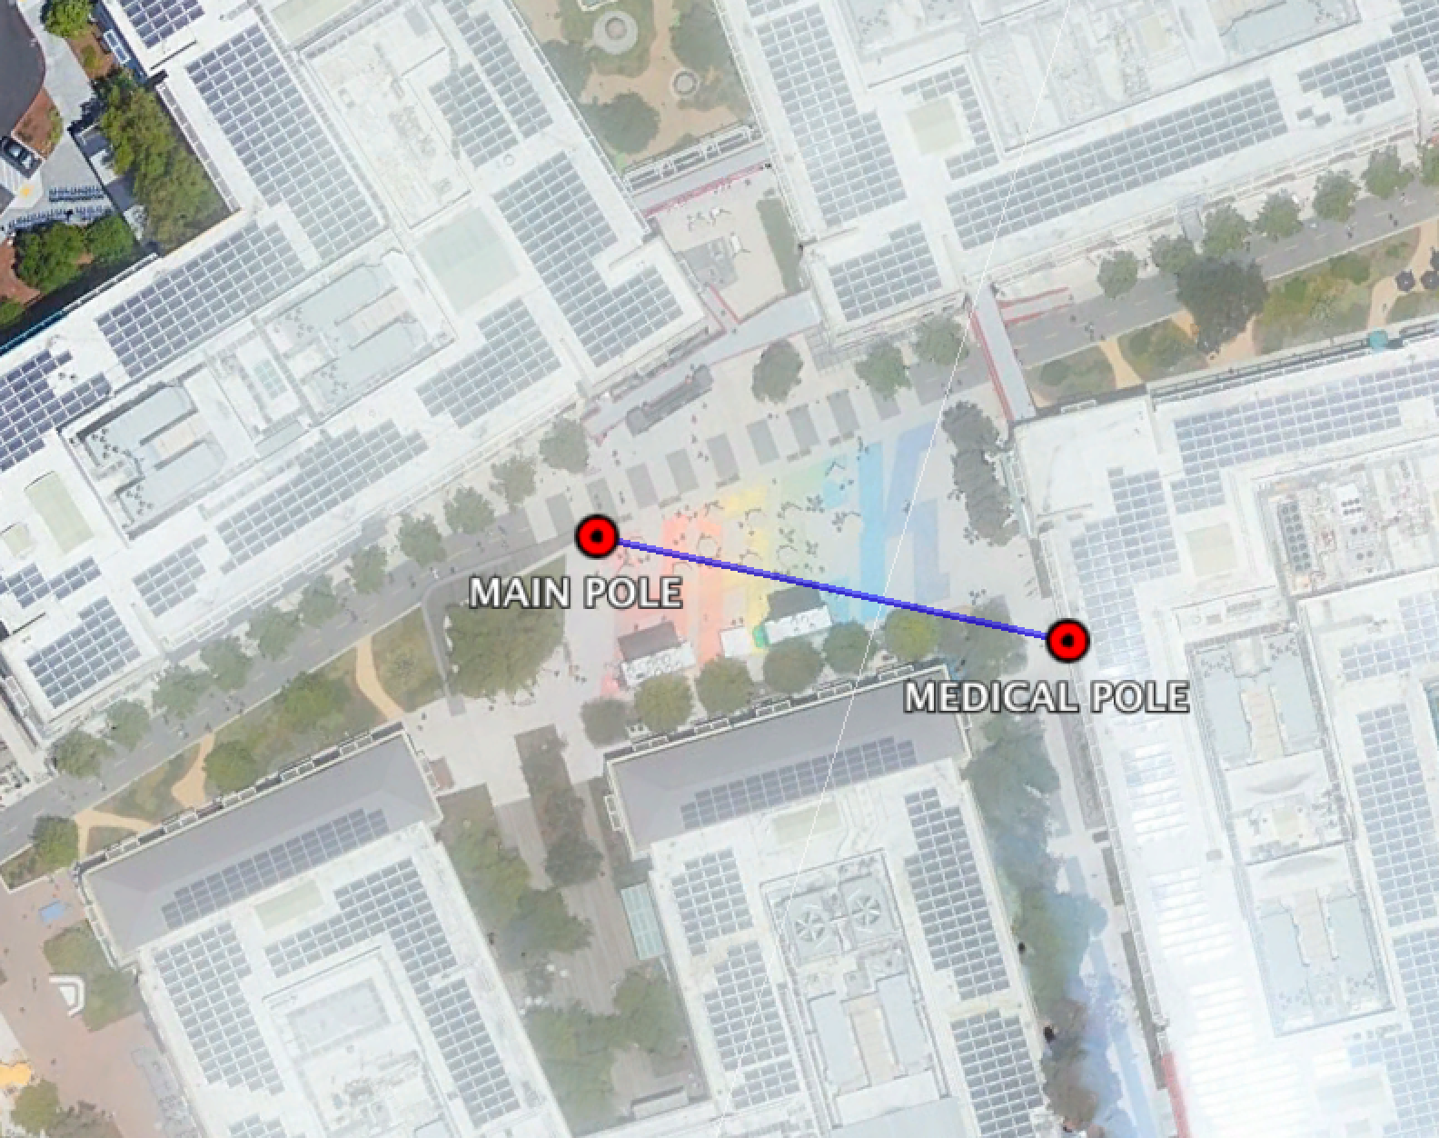
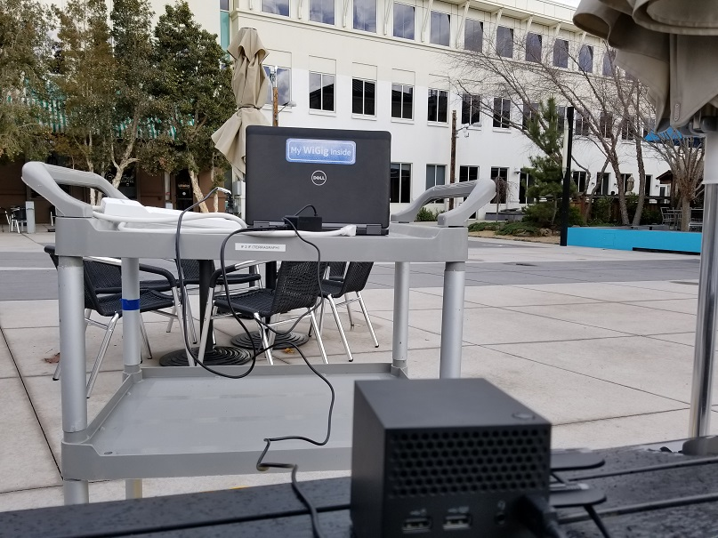
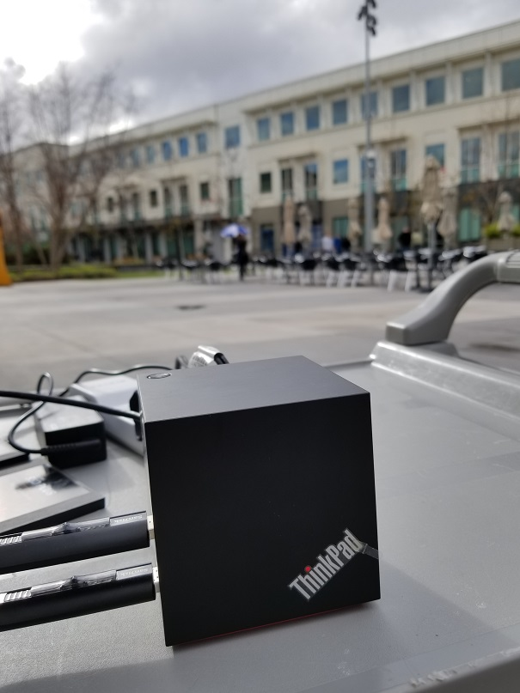
Test setup and equipment
Measurements performed at Facebook campus in Menlo Park, CA (Hacker square comparable in size to the simulated City square scenario)
FWA device: 60GHz 11ad based TDD/TDM prototype
SRD device: Intel’s 60GHz 11ad notebook and wireless docking station
DN1
DN2
WiGig enabled
Notebook
DN2
DN1
WiGig enabled
Docking station
SRD link

Slide 10
Equipment Specifications
SRD
  8x2 antenna elements, ~17dBi antenna gain
  EIRP ~ 25dBm
  1Gbps (unidirectional) offered traffic
  Automatic MCS selection
FWA
  36 horizontal x 8 vertical elements, ~30dBi antenna gain
  Automatic Tx power control (TPC) with maximum average EIRP = 40dBm
    Tested also with manual Tx power settings up to max ~45dBm
  TCP 1Gbps + 1Gbps bidirectional offered traffic
  Automatic MCS selection

Slide 11
Baseline FWA
(TPC/max 45dBm)
(TPC/max 45dBm)
6m
50m
Distribution node 1 (DN1)
Distribution node 2 (DN2)
A single 50m DN-DN link from a small mesh network located at Hacker square is considered. The nodes are positioned 6m above the ground with line of sight (LOS) between the nodes.
Baseline established by sweeping over different EIRP levels to observe the link performance (throughput, MCS and PER) in the absence of any external interference. Bidirectional TCP iPerf traffic of 1Gbps is offered in each direction on link
For the rest of experiment we choose a conservative power level in lieu of TPC in order to obtain consistent test results. The selected power should be able to achieve the highest MCS on the link.

Slide 12
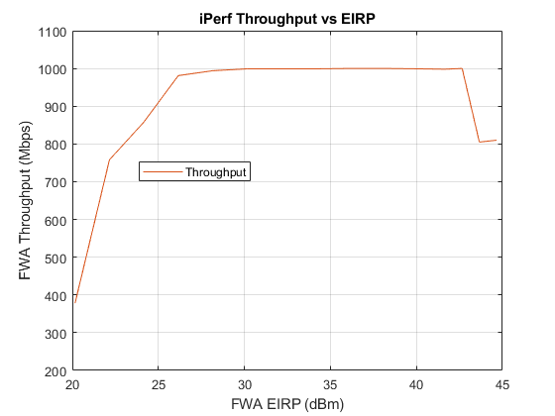
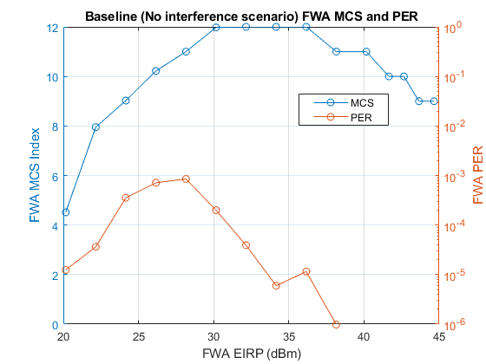
Baseline FWA performance
TPC selected power
(Minimum power required to achieve highest MCS)
For a 50m link, FWA supports MCS12 at 30dBm EIRP (would be chosen if TPC was enabled)
Instead we fix a conservatively EIRP of 34dBm to ensure stable MCS12 performance and also to provide consistent interference to the SRD during the experiment
Throughput of 1Gbps is achieved in each direction simultaneously (net 2Gbps)
Performance impact/degradation due to SRD interference is measured relative to this baseline
MCS backed off to
account for reduced
TX EVM at high EIRP

Slide 13
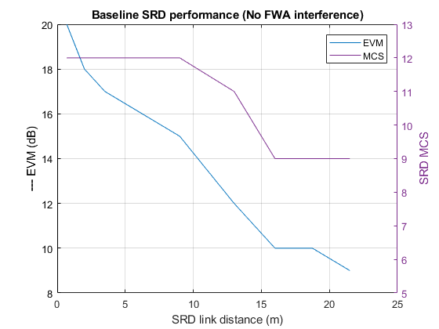
Baseline SRD
Baseline for SRD established by placing devices on the test site at various link distances, with FWA inactive
The link maintains a throughput of 1Gbps through the entire range of link distances (from 1m to 20m)
SRD Rx EVM as a function of SRD link distance. SRDs meet MCS 12 when link distance <7m, beyond that it gracefully degrades with increasing link distance.
Degradation of SRD performance against this baseline/reference is studied.

Slide 14
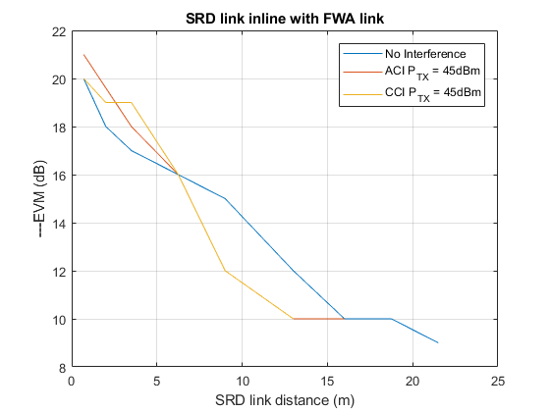

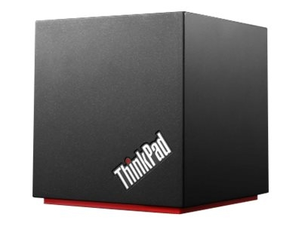
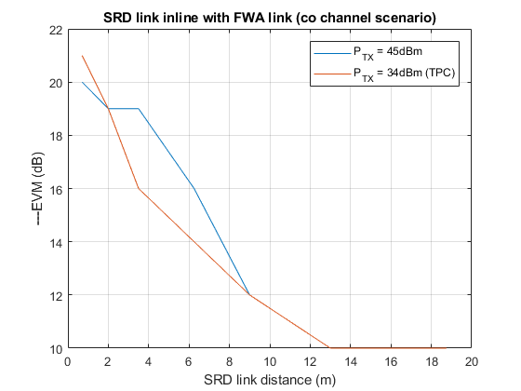
Scenario 1: Outdoor Inline
(TPC/max 45dBm)
(TPC/max 45dBm)
6m
15m
1m<link_dist<20m
1m
DN1
50m
DN2
Co channel interference (CCI) scenario: Some impact on performance seen at highest FWA powers when both links operate on the same channel (channel 2)
  At maximum FWA power (EIRP = 45dBm)
    MCS degrades gracefully from 12 to 9 when increasing link distance from 7 m to 10m
    SRD was able to maintain a stable connection only up to 10m link distance.
  With TPC on FWA
    SRD was able to have stable connection and was also able to support the throughput at distance > 10m.
Adjacent channel interference (ACI) scenario: When SRD link was moved to channel 1 or 3, both systems didn’t impact each others performance even at maximum FWA EIRP of 45dBm

Slide 15
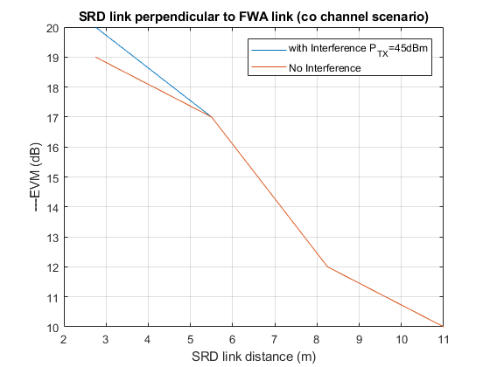
Scenario 2: Outdoor Perpendicular
(TPC/max 45dBm)
(TPC/max 45dBm)
10m
DN1
10m
DN2
50m
One SRD unit kept on the FWA link path (connecting two FWA nodes), while the other SRD is placed perpendicular to this link path
No throughput impact seen on SRD RX EVM, even with maximum FWA power
  Sufficient SINR for SRD

Slide 16

Scenario 3: Outdoor to Indoor
Window
(upto 12dB loss)
(TPC/max 45dBm)
(TPC/max 45dBm)
1m – 8m
2m
DN1
50m
DN2
SRDs placed within a room on the 2nd floor such that the nodes are directly positioned behind a FWA node, with only a window separating the FWA from the SRD node
No impact observed to SRD device when FWA operates at max Tx power (EIRP = 45dBm)
Room size limitations and obstacles limited the maximum SRD link distance to 8m
Window loss (safety glass can be up to 12dB loss) provides additional protection to the SRD
Earlier simulations in [2] similarly predicted no impact to indoor SRDs from outdoor FWA systems

Slide 17
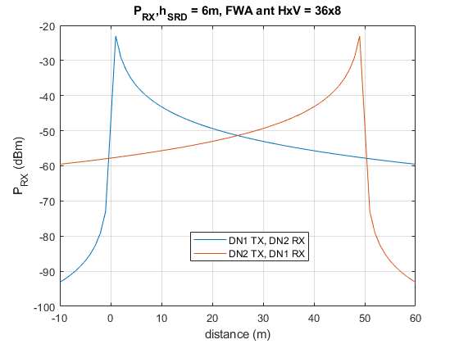
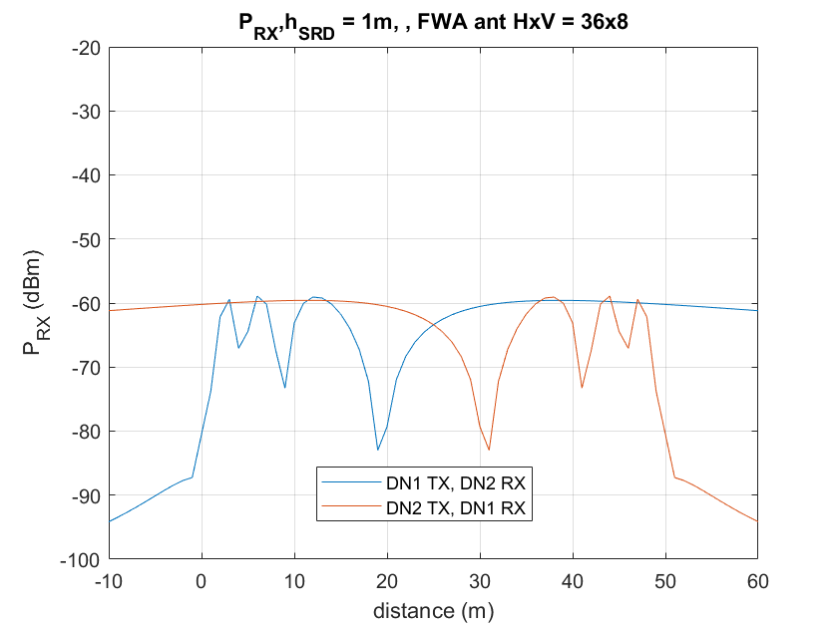
Justification of results: Comparison to Simulations
For FWA link of 50m, the power received from FWA by SRD (with 0dBi ref antenna) at a given height h_{SRD}, when FWA transmits at full power (EIRP = 45dBm) is as shown below
For SRD at 1m height, maximum interference observed is around -60dBm (8dB above CCA threshold) even when no power control is applied at the FWA node. The vertical antenna pattern provides the isolation required to achieve such low interference to SRDs.
When power control is applied (EIRP = 34dBm), the received power fall off by 11dB, i.e. below the CCA threshold.
For indoor SRD scenario with FWA mounted close to windows: Front to Back Ratio (FBR) for FWA provides additional 50dB isolation minimizing impact to indoor SRDs, i.e, P_{RX}<-68dBm.
CCA_thresh
CCA_thresh
From side-lobes in vertical domain
DN1
DN2
DN1
DN2

Slide 18
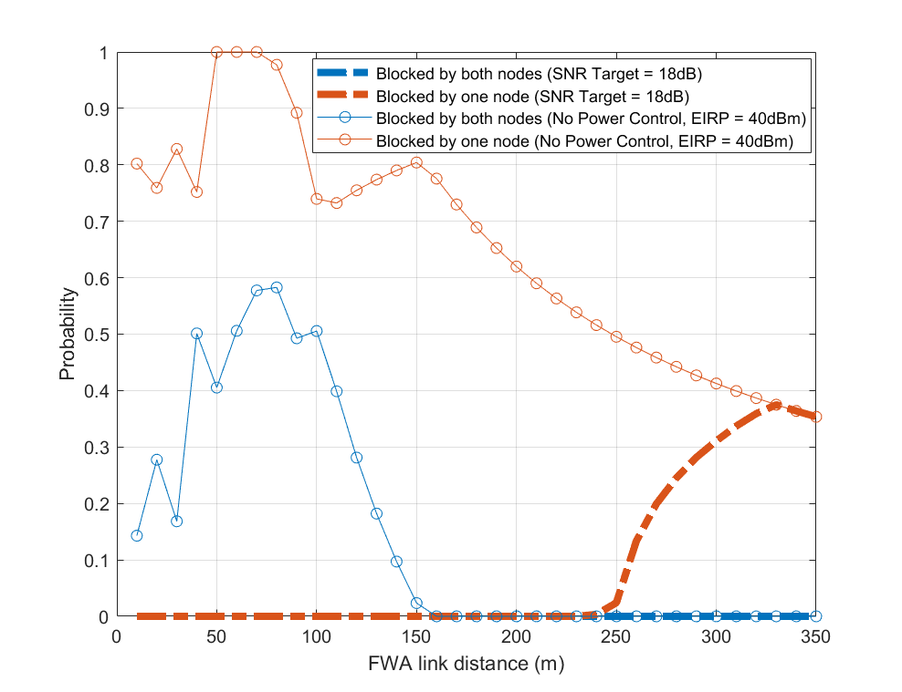
Probability of blocking
Depending on the location of SRD on the FWA link path, we can calculate if its CCA would be triggered by either one or both sides of FWA link
  If only one of the FWAs can trigger the SRD CCA then, there is at most 50% chance of the SRD TX being blocked (due to FWAs TDD/TDM protocol)
  If both FWAs can trigger the CCA of the SRD, then the SRD TX would be 100% blocked unless its CCA is directional
For SRD placed inline the FWA link path, the probability of being blocked depends on the FWA link distance, target SNR for power control and maximum EIRP allowed (=40dBm)
For target TPC SNR of 18dB, SRD is never blocked by both sides of FWA link, irrespective of the link distance
Again the chart assumes omni (0 dBi) channel sense by SRD; for an SRD pair and sensing the channel directionally results should improve

Slide 19
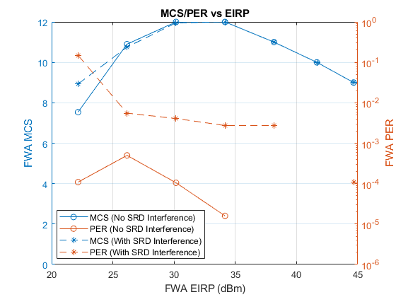
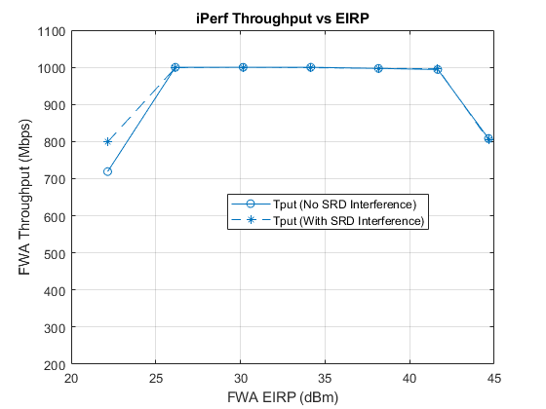
Impact of SRD devices to FWA
From measurements, no significant impact observed to FWA throughput or MCS from active SRD
Slight impact on PER was seen due to occasional increase in packet failure, this was not significant to cause impact to MCS selection or throughput

Slide 20
Conclusion
Number of outdoor and outdoor to indoor FWA vs SRD coexistence scenarios analyzed via simulation and field measurements
No impact observed to SRD for co-channel perpendicular and adjacent channel collinear test cases, irrespective of FWA power control strategy
When SRD link is collinear with FWA on the same channel, transmit power control is required at FWA to mitigate impact to the SRD link
For outdoor to indoor scenario, no impact to SRD device observed

Slide 21
Acknowledgment
The authors would like to thank Intel, for providing ray tracing analysis for calibrating the simulations and for providing their SRD equipment, tools and support for successfully performing the coexistence studies and measurements presented herewith

Slide 22
References
[1] IEEE 802.11-17/1019r0, mmWave Mesh Network Usage Model
[2] IEEE 802.11-18/0131r0, Distribution Networks and Short Range Devices Coexistence

