Slide 1
Punctured NDP
Date: 2018-07-06
Authors:

Slide 2
Discussion
This contribution provides partial resolution to CID 16723
Preamble puncture enables transmitter to zero out one or more non-primary 20MHz channels in an HE MU PPDU [1]
  No pre-HE modulated fields transmitted in punctured channels
  RUs that overlap a punctured 20MHz channel are not allocated
However, HE sounding procedure [1] does not describe sounding over BW that includes 20MHz channel puncture(s)
Need to define preamble punctured sounding procedure including
  NDPA modification to indicate puncture pattern [2]
  NDP puncture and transmission
  Beamforming feedback modification and transmission
This slide-deck describes (2) and (3)

Slide 3
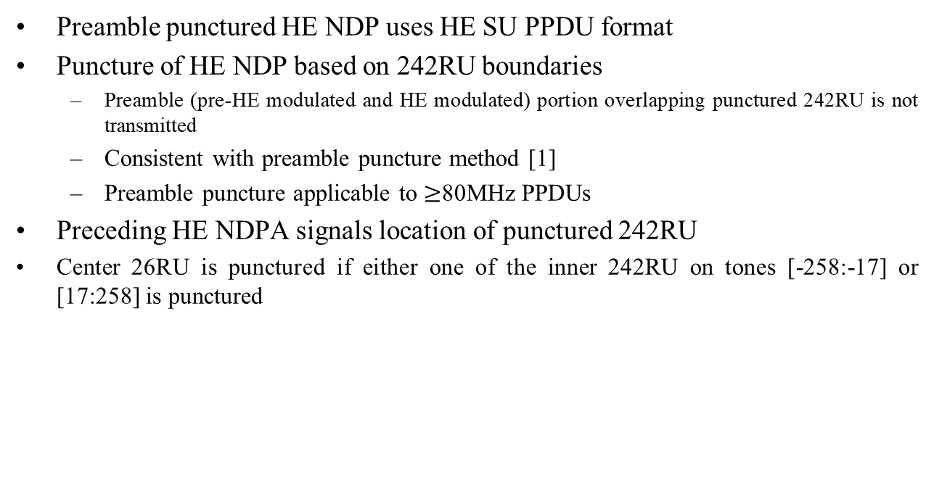
Preamble Punctured HE NDP
Preamble punctured HE NDP uses HE SU PPDU format
Puncture of HE NDP based on 242RU boundaries
  Preamble (pre-HE modulated and HE modulated) portion overlapping punctured 242RU is not transmitted
  Consistent with preamble puncture method [1]
  Preamble puncture applicable to $≥$80MHz PPDUs
Preceding HE NDPA signals location of punctured 242RU
Center 26RU is punctured if either one of the inner 242RU on tones [-258:-17] or [17:258] is punctured
80 MHz HE PPDU
242RU: [-500:-259] [-258:-17] [17:258] [259:500]
Center 26RU & DC

Slide 4
Preamble Punctured BF Feedback
Computation of average SNR excludes all tones that overlap with punctured 242RU
BF feedback frame not transmitted over 242RUs indicated as punctured in preceding HE NDPA
  In non-TB Sounding: BF feedback frame transmitted over largest contiguous BW including primary 20MHz channel and excluding any punctured 242RU
  In TB-Sounding: BF feedback frame transmitted over RU assignment signaled in Trigger frame

Slide 5
Proposal (1)
Propose to add the following section ‘28.3.16.1 Punctured NDP’ on page 547 line 53 with the following text:
The HE NDP PPDU as defined in section 28.3.16 may be punctured over one or more 242 RUs.
The punctured tones exactly match the location of those 242 RU as defined in Table 28-8. The preamble portion overlapping those 242RU is punctured as well.
If an HE NDP PPDU is punctured then the preceding NDPA shall signal the location of the punctured 242RU
The center 26RU is punctured if either one of the inner 242RU on tones [-258:-17] or [17:258] is punctured
The feedback report field (section 9.4.1.63) for a punctured NDP shall not be transmitted over 242RUs that were punctured in the preceding HE NDPA
  In non-TB Sounding: BF feedback frame transmitted over largest contiguous BW including primary 20MHz channel and excluding any punctured 242RU
  In TB-Sounding: BF feedback frame transmitted over RU assignment signaled in Trigger frame
The calculation of the average SNRs in Table 9-76b shall not include tones that fall within the punctured 242 RUs

Slide 6
Proposal (2)
Propose to add to table 28-1 TXVECTOR and RXVECTOR a new parameter called ‘Punctured Non-HT Modulation’ with the Value field description as follows:
  8 bit field indicating the punctured 20MHz subchannels in 80+80/160MHz in order of increasing frequency.
  Only the 4 MSB are applicable for 80MHz
  The field is not defined for 20MHz or 40MHz transmissions

Slide 7
Proposal (3)
Propose to add the following section ‘28.3.13.1 Punctured Non-HT duplicate transmission’ on page 543 line 28 with the following text:
For 80 MHz and 160 MHz punctured non-HT duplicate transmissions, the Data field shall be as described in section 21.3.10.12 Non-HT duplicate transmission with the exception that 20MHz subbands that are punctured in the TXVECTOR field ‘Punctured Non-HT Modulation’ are omited from the transmission
In a noncontiguous 80+80 MHz non-HT punctured duplicate transmission, data transmission in each frequency segment shall be as defined for an 80 MHz punctured non-HT duplicate transmission.

Slide 8
References
802.11ax D3.0
Disallowed subchannels 18/496

Slide 9
Straw poll #1
Do you support adding the text on slides 5-7?

