Slide 1
WUR Discovery Frame Format
Date: 2018-03-04
Authors:
Name | Affiliation | Address | Email
Guoqing Li | Apple |  | Guoqing_li@apple.com
Rojan Chitrakar | Panasonic
Kaiying Lv | ZTE
Po-Kai Huang | Intel
Taewon Song | LG Elecronics
Roger Marks | Huawei
Lily Lv | Huawei

Slide 2
Introduction
802.11ba has defined Smart Scanning use cases in the Usage Model document, and the concept and content of WUR Discovery frame are also agreed [1][2] [3][4]
This contribution discusses the field sizes in WUR Discovery frame format, i.e., how many bits are allocated to indicate compressed SSID, BSSID and PCR Channel

Slide 3
Considerations
Frame transmission duration
  Longer frame duration adds more medium usage, but can accommodate more information
Collision probability (i.e., the probability that more than one distinct input values generate the same output value)
  Larger field size usually leads to less collision probability, but results in longer medium usage
Other considerations such as implementation complexity and memory usage
  Re-using existing functions in baseline spec such as existing CRC may not result in optimal compression, but can minimize design and implementation complexity
Before we make decisions on each field, let us examine some data points on frame duration and collision probability

Slide 4
General WUR Discovery Frame Format
WUR Discovery frame format follows the general WUR Frame Format defined in D0.1
We assume that WUR Discovery frame can include a Frame Body field
  Whether we absolutely need Frame Body depends on how many bits are needed for each field and will be concluded in the end
Here, we assume 2-byte FCS
B0 B7 | B8 B19 | B20 B31
Frame Control | Address | TD Control | Frame Body | FCS
8 | 12 | 12 | optional | TBD
Compressed BSSID
Compressed SSID
PCR Channel
Notes:
PCR advertise SSID
Short SSID

Slide 5
WUR Discovery Frame Tx Duration
Frame Tx Duration=24us + Sync +WUR Discovery Frame content
SSID+APID+PCR Channel (octets) | Total Frame Size (octets) | Low Rate (ms) | High Rate (ms)
5 | 8 | 1.176 | 0.344
6 | 9 | 1.304 | 0.376
7 | 10 | 1.432 | 0.408
8 | 11 | 1.56 | 0.440
9 | 12 | 1.688 | 0.472
10 | 13 | 1.816 | 0.504
Target duration:
~1.5ms

Slide 6
Collision Probability of Using Hashed SSID
According to the probability theory. Given a perfect hashing algorithm
the Probability of collision after the generation of the hashing results:
Where the m stands for the hashing output bits, n stands for the # of input entries (Note, not the length of input bits), H is the total output space, H=2^m
Column1 | n=2 | n=4 | n=8 | n=16 | n=32 | n=64
m=3 | 25.00%
m=4 | 12.50% | 50.00%
m=5 | 6.25% | 25.00%
m=6 | 3.13% | 12.50% | 50.00%
m=7 | 1.56% | 6.25% | 25.00%
m=8 | 0.78% | 3.13% | 12.50% | 50.00%
m=9 | 0.39% | 1.56% | 6.25% | 25.00%
m=10 | 0.20% | 0.78% | 3.13% | 12.50% | 50.00%
m=11 | 0.10% | 0.39% | 1.56% | 6.25% | 25.00%
m=12 | 0.05% | 0.20% | 0.78% | 3.13% | 12.50% | 50.00%
m=13 | 0.02% | 0.10% | 0.39% | 1.56% | 6.25% | 25.00%
m=14 | 0.01% | 0.05% | 0.20% | 0.78% | 3.13% | 12.50%
m=15 | 0.01% | 0.02% | 0.10% | 0.39% | 1.56% | 6.25%
m=16 | 0.00% | 0.01% | 0.05% | 0.20% | 0.78% | 3.13%
Suggested Hashed output bits

Slide 7
Discussions on Compressed SSID
Further expanding the table and zoom in to the reasonable size, we have the following collision probability
For example, if we use 16 bit s compressed SSID size, then in an environment with 64 different original SSIDs, the probability that more than one original SSIDs generate same compressed SSID is 3.12%
  i.e., the probability that these 64 different SSIDs generate 64 different compressed SSID is 1-3.12%
Compressed SSID size (octets) | 32 SSIDs | 64 SSIDs | 128 SSIDs
14 | 3.13% | 12.5% | 50%
15 | 1.56% | 6.25% | 25%
16 | 0.78% | 3.12% | 12.5%
24 | 0.03% | 0.012% | 0.048%
32 | 0. 0.0000119% | 0.000047% | 0.0001907%

Slide 8
Proposed Compressed SSID Size
Based on the collision probability calculation, we suggest 16 bits to indicate compressed SSID

Slide 9
Discussion on Compressed BSSID
In high density environment, there can be hundreds of APs detected by a single STA [6]
Using 16 bit compressed BSSID, the collision probability is 50% for 300 BSSIDs and 30% for 200 BSSIDs
16 bit compressed BSSID
Collision Prob
Num of APs

Slide 10
Discussion on Compressed BSSID (cont.)
Using 24 or 32 bit compressed BSSID, the collision probability is considered very low
24 bit compressed BSSID
32 bit compressed BSSID
Collision Prob
Collision Prob
Num of APs
Num of APs

Slide 11
Proposed Compressed BSSID Size
Based on the collision probability calculation, we propose to use 24 bits as compressed BSSID
  For example, the 24 bits can be truncated from the CRC32 used in 11ai for compression information

Slide 12
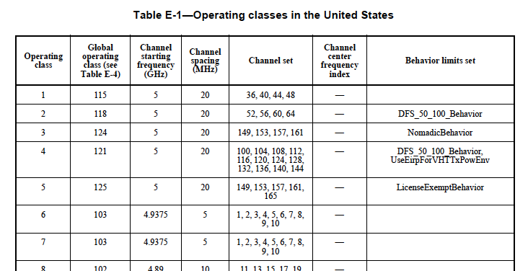
PCR Channel
PCR Channel defined in baseline spec includes
  Operation class: 8 bits
  Channel number: 8 bits
The Operating Class indicates radio operation in a regulatory domain as well as behaviors and signal detection limits
The Channel Number indicates the channel index in the Channel Set
For example

Slide 13
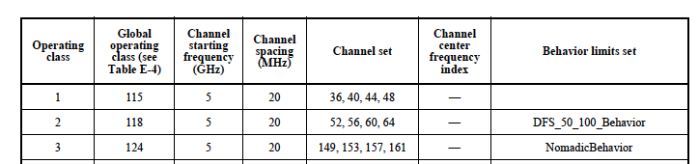
PCR Channel (cont.)
Operating Class defines a STA’s operating requirement in the regulatory domain; the STA can use such info in choosing an AP to scan
If 8 bit PCR channel field size is preferred, then we suggest include the 8 bit Operating Class
Once operating class is known to the device, the search for primary 20 can be limited to a few choices
However, 16 bits is recommended to minimize the search time

Slide 14
Proposed Size for Each Field
Compressed SSID: 16 bits
Compressed BSSID: 24 bits
PCR Channel: 16 bit (Operating Class + Channel)

Slide 15
Proposed WUR Discovery Frame Format
B0 B7 | B8 B19 | B20 B31
Frame Control | Address | TD Control | Frame Body | FCS
8 | 12 | 12 | 32 | 2
AP Identifier/compressed BSSID
(24 bits)
Compressed SSID
(16 bits)
PCR Channel
(16 bits)
The transmission duration of a WUR Discovery frame including 20MHz preamble and SYNC field is 1.432ms@ low rate

Slide 16
Compression Method Discussion
Compressed SSID can be based on Short SSID calculation and truncate it to 16 bits, or use CRC16
Compressed BSSID can be based on the same polynomial used for Short SSID and truncate it to 24

Slide 17
References
17-1386r7 Examining 802.11ba usage models for mainstream devices
17-29r7 WUR Usage Model Document
17-1608r7 WUR Discovery Frame for smart scanning
18-160r7 WUR Discovery Frame content
11-xx-PHY Layer AP Discovery Hashed SSID
11-xx-Ruckus measurement of high density environment

Slide 18
SP1
Do you agree to add the following to SFD?
  Adopt the following sizes for WUR Discovery frame:
    Compressed SSID: 16 bit
    Compressed BSSID: 24 bits

Slide 19
SP2
Do you agree to add the following text to SFD:
  PCR Channel information in WUR Discovery frame is 16 bits

Slide 20
SP3
  Do you agree to the following method to generate compressed BSSID?
    Reuse CRC 32 polynomial in 802.11 and truncate it to 24 bits, i.e. not design a new hash function for compressed BSSID

Slide 21
SP 4
Do you agree to use CRC (A specific polynomial is TBD) to generate compressed SSID?
  • Y
  • N
  • A
Note: please refer to 11-18-0356-02-00ba-compressed-ssid-for-wur-discovery-frame for details (R0 was presented by Taewon in 11ba Teleconf call)

Slide 22
SP5
Do you support advertisement of WUR Discovery Frame transmission parameters of APs by PCR?
  Y
  N
  A
Note: please refer to #244r1 (presented by Kaiying Lv in 11ba Teleconf call) for more details

Slide 23
SP6
Do you agree to add to SFD:
Following information about APs’ WUR Discovery frames should be advertised by the PCR :
  WUR Discovery Channel (Should be selected from a fixed subset of all possible WUR channels)
  Compressed SSID (computation of compressed SSID is TBD)
  Other information TBD,
    Y
    N
    A
Note: please refer to #244r1 (presented by Kaiying Lv in 11ba Teleconf call) for more details

